Slide 1
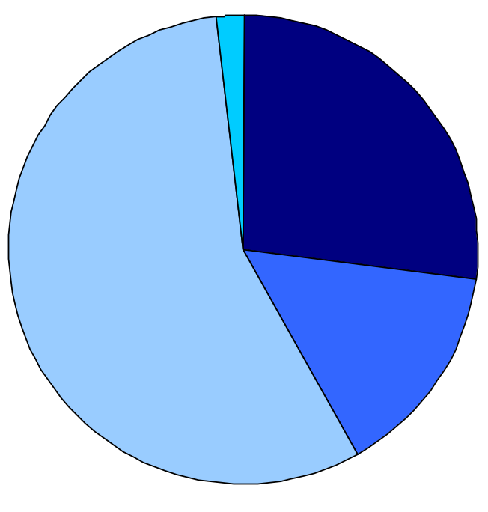
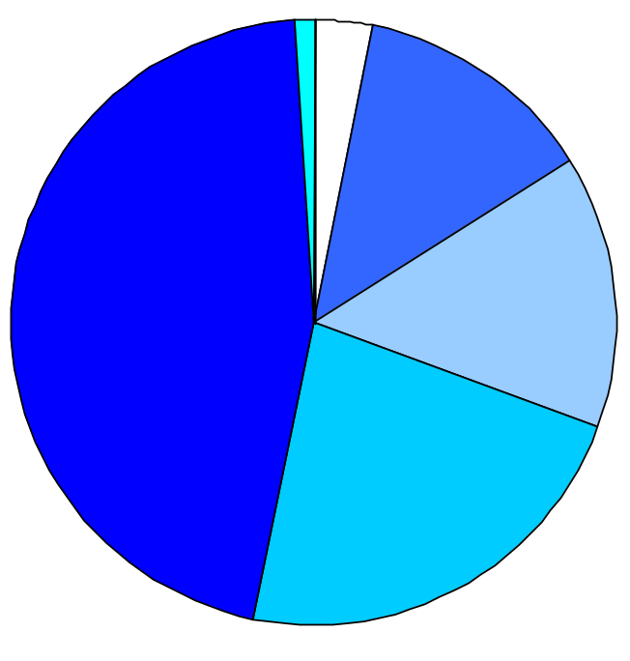
Four of 10 Young Adults Ages 19–29 Who Had Insurance
Through Their Parent’s Employer While in High School
Lost or Had to Switch Insurance After High School;
Almost Half Went Without Insurance for Two Years or More
What happened to health insurance when graduated from or left high school
Length of time without insurance*
Don’t know/ refused
2%
Don’t know/ refused
1%
<1 month
3%
>1 month to <6 months
13%
Lost insurance
27%
2 years or more
46%
6 months to <1 year
15%
Continued to get insurance through
same source
56%
Switched to a new source
15%
1 year to
<2 years
23%
* Among those who had a gap between losing and gaining new insurance, or who went without insurance after
graduating from or leaving high school, or who did not have insurance when they graduated from or left high school.
Note: Numbers may not sum to 100% because of rounding.
Source: The Commonwealth Fund Survey of Young Adults (2009).
THE COMMONWEALTH
FUND

