Slide 1
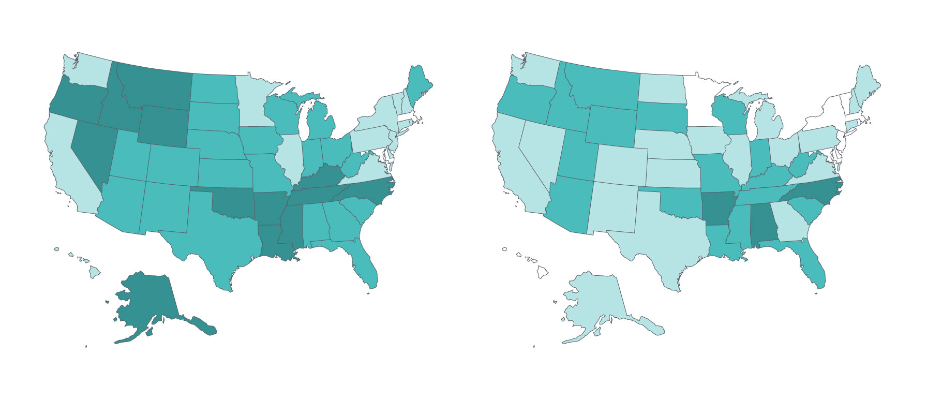
Reduction Across States in Percentage of People Under Age 65 Who Spent a Large Share of Income on Medical Care Relative to Income
2013–14
2015–16
10%–11% of people (2 states and D.C.)
9%–11% of people (9 states and D.C.)
12%–14% of people (14 states)
12%–14% of people (20 states)
15%–17% of people (21 states)
15%–17% of people (18 states)
18%–22% of people (13 states)
18%–19% of people (3 states)
Notes: For the purposes of this exhibit, we count the District of Columbia as a state. Includes both uninsured and insured individuals under age 65 living in households that spent 10 percent or more of annual income on medical expenses (excluding premiums, if insured); and people who spent 5 percent or more, if the household’s annual income was below 200 percent of the federal poverty level. Two years of data are combined to ensure adequate sample size for state-level estimation.
Data source: Ougni Chakraborty, Wagner School of Public Service, New York University, analysis of 2014, 2015, 2016, and 2017 Current Population Survey, Annual Social and Economic Supplement.

