Slide 1
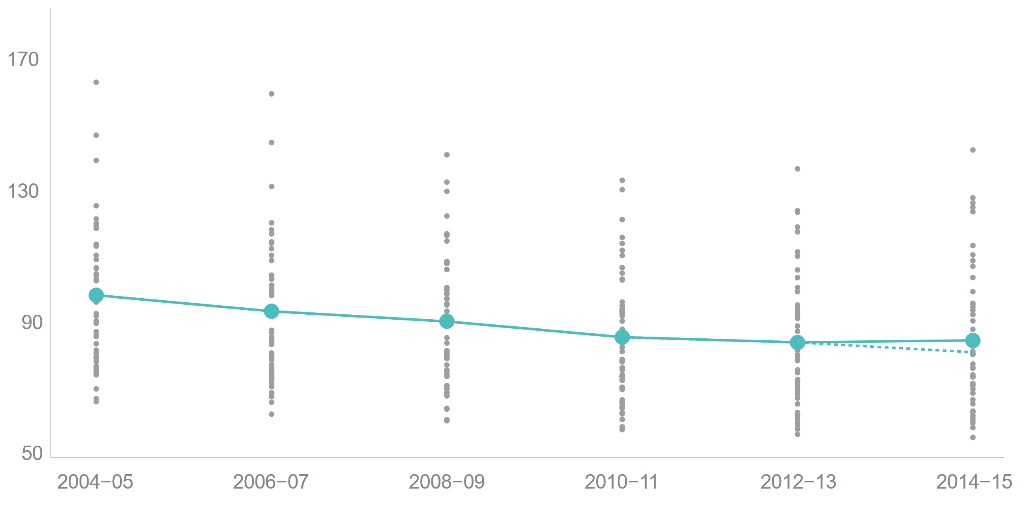
Premature death rates from treatable medical conditions rose slightly following decade-long decline
Mortality amenable to health care: deaths per 100,000 population
U.S. average
State rates
U.S. average if historical trend had continued
Notes: Y-axis starts at 50 deaths per 100,000. Dashed line represents the expected premature death rate if the historical trend from 2004–05 to 2012–13 had continued in 2014–15. Premature deaths reported here do not include deaths from suicide, alcohol, or drug use; see Appendix H for a complete list of health care–amenable deaths.
Data: 2004–2015 National Vital Statistics System (NVSS) Mortality All-County Micro Data Files.

