Slide 1
The Commonwealth Fund 2012 International Health Policy Survey On the Front Line: Primary Care Doctors’ Experiences in Eleven Countries
Robin Osborn, Moderator
The Commonwealth Fund
February 5, 2013

Slide 2
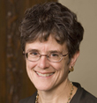
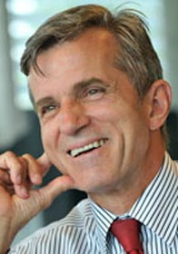
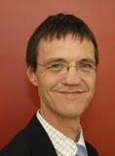
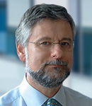
Today’s Webinar Presenters
Robin Osborn
Vice President and Director
International Program in Health Policy and Innovation,
The Commonwealth Fund
(Moderator)
Cathy Schoen
Senior Vice President for Policy, Research, and Evaluation,
The Commonwealth Fund
Thomas Björn Zeltner, M.D.
President, Swiss Foundation Science et Cité
Former Secretary of State for Health and
Director-General of the Swiss Federal Office of Public Health (1991-2009)
Jako Burgers, M.D., Ph.D.
Head of Guideline Development and Research,
Dutch College of General Practitioners (NHG)
Martin Roland CBE, D.M., M.B. B. Ch.
Professor of Health Services Research, University of Cambridge
Special Advisor, RAND Europe

