Slide 1
Health system performance in the Netherlands
Philip van der Wees
Joost Wammes
Gert Westert
IQ healthcare
May 18, 2017

Slide 2
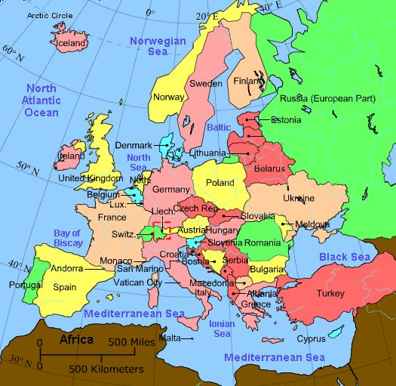
The Netherlands
17 Million citizens
Size similar to Massachusetts
GDP/c: $48.000
Life expectancy: 79.7 (m); 83.1 (f)

Slide 3
The Dutch Health Care System ”Solidarity with regulated competition”
Regulated via four legislative systems: curative care, long term care, social support, care for children and adolescents
Mix of public (90%) & private (10%) financing
Total health care costs around €95 Billion (11% GDP)
Primary care
Primary care with ~10,000 primary care physicians in ~5,000 practices
Primary care physicians mainly self employed, reimbursed via capitation and (limited) bundled payment
Hospital care
Hospital care in ~90 hospitals (8 academic) and ~250 independent treatment centers with ~22,000 medical specialists
Specialists either in group practice (54%) or employed by hospital (46%)
Hospitals reimbursed via diagnosis-related groups

Slide 4
Curative care
Reform in 2006: establishing a regulated market system.
Objective: increase efficiency and quality with regulated competition and individual choice of citizens/patients
Characteristics:
Health insurance mandate for Essential Health Benefits (99.9%)
Additional coverage (84%)
Paid via premiums/deductibles (50%) and income dependent taxes (50%)
Average annual premium around €1200
Annual mandatory deductible €385

Slide 5
Long term care
Reform in 2015: major shift from residential to non-residential care
Objective: to limit expenditure growth in safeguarding fiscal sustainability and stimulate client-centeredness
Characteristics
Largely publicly funded (€20 Billion)
Individual/social responsibility via informal care
Shift from residential to non-residential care (living longer at home)
Decentralization of non-residential care through municipalities

Slide 6
International Health Policy Survey 2016

Slide 7
How easy was it for you to receive care in the evening or in the weekend? (% easy/very easy)
Access to health care is excellent

Slide 8
Your primary care physician…(% full agreement)
Important role of primary care physician

Slide 9
Did the hospital provide aftercare or ensured you would receive aftercare from a health care professional? (% yes)
Coordination between hospital and primary care should be better

Slide 10
Conclusions
Strong performance:
Strong primary care system with a primary care physician for (almost) all citizens
Weekend and after hours care organized by primary care physicians
Points for improvement:
Organization and coordination of aftercare after hospital discharge is limited
Implementation and evaluation of long term care reform is still underway

