Slide 1
How Would the American Health Care Act Change Medicaid?
Sara Collins, Ph.D.
Vice President, Health Care Coverage and Access
How Would the American Health Care Act Change Medicaid and Impact States’ Economies?
June 20, 2017
Notes:
There has always been uncertainty WRT

Slide 2
States That Expanded Medicaid Saw Greatest Reductions in Rates of Uninsured Working-Age Adults
EXHIBIT 1
Percent
2013
2015
States that expanded Medicaid as of January 1, 2015
States that had not expanded Medicaid as of January 1, 2015
Notes: States are arranged in rank order based on their uninsured rate in 2013. Alaska, Indiana, Louisiana, and Montana expanded their Medicaid programs after Jan. 1, 2015.
Data: U.S. Census Bureau, 2013 and 2015 One-Year American Community Surveys. Public Use Micro Sample (ACS PUMS).

Slide 3
Low-Income Adults in Arkansas and Kentucky Experienced Marked Improvements in Health Care Access and Affordability Following Medicaid Expansion Compared to Adults in Texas, Which Did Not Expand Medicaid, 2016
EXHIBIT 2
Percentage point change since baseline (2013) compared to non-expansion states (Texas)
p < .10. ** p < .05. *** p < .01.
Adapted from B. D. Sommers, B. Maylone, R. J. Blendon et al., “Three-Year Impacts of the Affordable Care Act: Improved Medical Care and Health Among Low-Income Adults,” Health Affairs Web First, published online May 17, 2017.

Slide 4
AHCA Makes Sweeping Changes to the Medicaid Program
EXHIBIT 3
 | Affordable Care Act | American Health Care Act
Medicaid Expansion | For adults up to 138% poverty, enhanced federal match of 100% phasing down to 90% by 2020. | Phases out the Medicaid expansion.
Existing Medicaid Program | Federal match ranges from 50% - 76% across states. | Caps the federal contribution to Medicaid.

Slide 5
States Would Lose an Estimated $834 Billion in Federal Funds for Their Medicaid Programs Under the AHCA
EXHIBIT 4
Congressional Budget Office, Cost Estimate for H.R. 1628, the American Health Care Act of 2017 (May 24, 2017), https://www.cbo.gov/system/files/115th-congress-2017-2018/costestimate/hr1628aspassed.pdf, Table 3.

Slide 6
Impact of the AHCA on Medicaid
June 20, 2017

Slide 7
Enrollment and Spending Trends in Medicaid
Children are the largest group of enrollees, but
aged and disabled enrollees account for more than half of total program spending
Medicaid Enrollment vs. Spending by Eligibility Category, FY 2014 (millions)
Medicaid Spending by Service, FY 2016 (billions)
Includes acute and long-term care
Note: http://www.kff.org/medicaid/state-indicator/distribution-of-medicaid-enrollees-by-enrollment-group/?currentTimeframe=0&sortModel=%7B%22colId%22:%22Location%22,%22sort%22:%22asc%22%7D
http://www.kff.org/medicaid/state-indicator/medicaid-spending-by-enrollment-group/?currentTimeframe=0&sortModel=%7B%22colId%22:%22Location%22,%22sort%22:%22asc%22%7D
http://www.kff.org/medicaid/state-indicator/distribution-of-medicaid-spending-by-service/?currentTimeframe=0&sortModel=%7B%22colId%22:%22Location%22,%22sort%22:%22asc%22%7D

Slide 8
AHCA: Significant Losses in Coverage
The AHCA estimated to result in 23 million fewer covered individuals by 2026
Effects of AHCA on Health Insurance Coverage, 2020-2026 (millions)
Sources: https://www.cbo.gov/system/files/115th-congress-2017-2018/costestimate/hr1628aspassed.pdf

Slide 9
Implications for Trigger States under AHCA
Key Implications
Trigger States
Trigger States: At least seven expansion states have legislative provisions that require the state to reduce or eliminate Medicaid eligibility and/or benefits for the expansion population if enhanced funding is reduced
Arkansas: Expansion will be terminated within 120 days after FMAP reduction
Illinois: If FMAP is reduced below 90%, the expansion will be terminated no later than the end of the third month following the month in which the reduction in FMAP takes effect
Indiana: Requires the state to terminate the expansion program if FMAP rates are reduced
Michigan: Expansion will be terminated if the FMAP is reduced and annual state savings and other nonfederal net savings associated with the implementation of the expansion are not sufficient to cover the reduction
New Hampshire: Expansion will be terminated within 180 days if the FMAP rate falls below 95 percent in 2017 and 94 percent in 2018
New Mexico: The state will “reduce or rescind eligibility” for the new adult category if FMAP rates are reduced
Washington: If FMAP is reduced, the WA Healthcare Authority must take steps to ensure that the state does not incur any additional costs beyond what would have been incurred had the enhanced FMAP remained in effect
Arkansas
Michigan
Illinois
New Hampshire
Indiana
New Mexico
Washington
Sources: Arkansas HB 1143; Illinois SB 26; Indiana SB 165; Michigan HB 4714; New Hampshire HB 1696; New Mexico HB 2; Washington SB 5034

Slide 10
Medicaid’s Financing Structure Today
States receive federal funding for all allowable program costs
Since 1965, federal legal guarantee to share all costs with states
State share determine by federal matching rate which vary by population and service
For most beneficiary groups and services, matching rate in FY 2017 = 50%- 74%
Matching rate for expansion adults = 95% in 2017; 90% in 2020 and beyond
All costs- including unanticipated costs- are shared by states/federal government:
Higher than expected enrollment; economic downturn
Rising drug costs
Public health epidemics (e.g., opioid epidemic)
Breakthrough treatments or medications
New initiatives related to delivery system reform or access
Source: Federal Medical Assistance Percentage (FMAP), http://kff.org/medicaid/state-indicator/federal-matching-rate-and-multiplier/

Slide 11
AHCA: Ends the Shared Committment by Capping Federal Funding
Aggregate cap on Medicaid funding is built up from per capita caps for five different eligibility groups
Base Year
Spending
Actual
Enrollment
X
Trend Rate*
X
Aged
M-CPI + 1
x
Aged
Blind & Disabled
M-CPI + 1
x
Blind/ Disabled
Aggregate Spending Cap
Children
M-CPI
x
Children
Expansion
Adults
M-CPI
x
Expansion Adults
Other Adults
M-CPI
x
Other
Adults
Certain enrollees are excluded from the cap calculation, such as those receiving any Medicaid-funded services through an Indian Health Service or Tribal facility, CHIP-financed children, and partial benefit enrollees. The cap also excludes certain types of payments, including administrative funds and disproportionate share hospital (DSH) payments.
*To calculate a state’s starting caps in 2020, 2016 spending is trended by M-CPI; starting in 2020, M-CPI+1 is used to trend and calculate the aged and disabled spending caps, while M-CPI continues to apply to children, expansion adults, and other adults

Slide 12
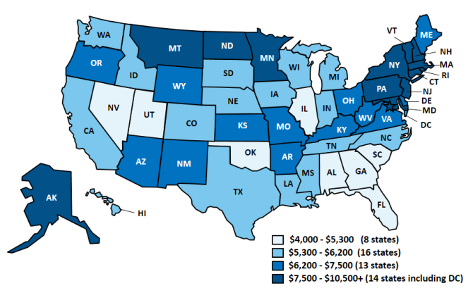
Capped Funding: Locks in Disparities Across States
Capped funding freezes in historic differences in spending
Spending Per Full Medicaid Enrollee, FY 2011
Source: Rudowitz, R., Garfield, R., and Young, K., Overview of Medicaid Per Capita Cap Proposals, Kaiser Family Foundation, June 2016. Available at: http://kff.org/report-section/overview-of-medicaid-per-capita-cap-proposals-issue-brief/.

Slide 13
AHCA: Per Capita Cap Trend Rate
Proposed national growth trends varied across eligibility groups.
Average Annual Growth in Medicaid Spending per Full-Benefit Enrollee Relative to National Benchmarks (FYs 2000 – 2011)
Per Capita Caps
Optional Block Grants
American Health Care Act Proposed Benchmarks:
Per capita caps
CPI-Med (adults and children)
CPI-Med +1% (aged and disabled)
Optional block grants (children and adults only)
CPI-U
Sources: RWJ Foundation, Manatt analysis, “Data Points to Consider When Assessing Proposals to Cap Federal Medicaid Funding: A Toolkit for States,” accessed at: http://statenetwork.org/resource/data-points-to-consider-when-assessing-proposals-to-cap-federal-medicaid-funding-a-toolkit-for-states/

Slide 14
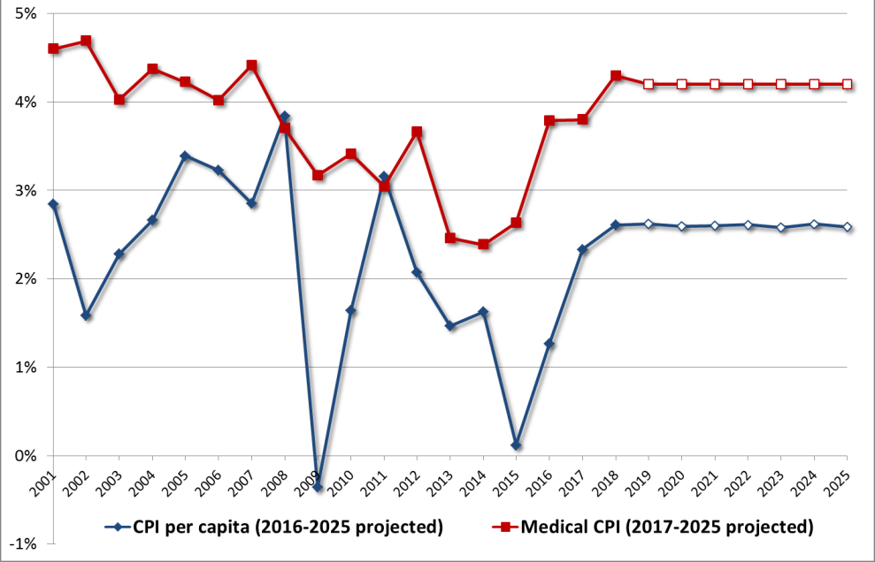
The Particular Trend Rate Matters But All Unpredictable
Considerations
Annual Growth in the Consumer Price Index and
Medical Consumer Price Index , CY 2000-25
Medical CPI measures how much consumers are spending out-of-pocket on a representative “basket” of medical goods and services over time.
Projected
Risks
MCPI is not designed to monitor how much is spent on behalf of Medicaid beneficiaries and does not reflect local price growth variation
MCPI growth rates vary considerably.
Source: Manatt analysis of Bureau of Labor Statistics, CPI Databases, https://www.bls.gov/cpi/data.htm; HHS, CMS, Office of the Acutary, 2016 Actuarial Report on the Financial Outlook for Medicaid, https://www.medicaid.gov/medicaid/financing-and-reimbursement/downloads/medicaid-actuarial-report-2016.pdf

Slide 15
Impact of Per Capita Cap Highly Sensitive to M-CPI
If medical CPI is 3.7%...
If medical CPI is 3.2%...
State must cut $477.4 million to stay below cap
Contribution to the impact of the cap, 2026 (millions)
Total spending prior to per capita cap cuts, 2026 = $7.9 billion
Source: Manatt Medicaid financing model
Note: Assumes CMS baseline spending per enrollee growth rates. Includes federal and state spending for example state.

Slide 16
Contribution to Impact of Per Capita Cap Varies by Group, Distribution of Cuts May Differ
Room under cap (+) or excess spending (-)
by eligibility group
State must cut spending by $477.4 million to stay below cap, or it faces clawback
Contribution to impact of cap, 2026 (millions)
Spending prior to cuts = $7.9 billion
Source: Manatt Medicaid model
Note: Includes federal and state spending.

Slide 17
The American Health Care Act: Economic & Employment Consequences for States
Leighton Ku, PhD, MPH
Professor of Health Policy & Management & Director, Center
for Health Policy Research
June 2017

Slide 18
Purpose and Methods
CBO and others have examined effects of American Health Care Act (AHCA) on insurance coverage and costs.
23 million more uninsured
14 million fewer covered by Medicaid due to phase down of Medicaid expansions, per capita caps and other changes.
We assess potential effects on economies and employment in all 50 states and DC from 2018-26.
Begin by using CBO estimates of changes in federal funding.
Examine combined effects of changes in Medicaid, premium tax subsidies, tax repeals and other changes.
Then model effects on state employment and economies using a regional economic model, PI+ from REMI.
18

Slide 19
The Rise and Fall in Employment If AHCA Enacted
# of Jobs
864,000
Total Employment
Baseline
Health Care
Employment
-924,000
19

Slide 20
Key National Findings: Total Changes
 | 2018 | 2026
CHANGES IN FEDERAL FUNDING:
Tax Repeal | $45 bil. | $102 bil.
Coverage-Related Spending (bil $) | -$6 bil. | -$160 bil.
Net Change in Federal Deficit (bil $) | $39 bil. | -$58 bil
CHANGES IN ECONOMIC OUTPUTS:
Total Employment | 864,000 | -924,000
Health Care | -24,000 | -725,000
All Other | 888,000 | -199,000
Gross State Product (bil $) | $91 bil. | -$93 bil.
Business Output (bil $) | $160 bil. | -$148 bil.
20

Slide 21
Effects of Coverage vs. Tax Changes
 | 2018 | 2026
Coverage Related Changes
Federal Funds | -$6 bil. | -$160 bil.
Total Employment | 24,000 | -1,940,000
Health Care | -100,000 | -829,000
Gross State Product | $5 bil. | -$235 bil.
Tax Repeal Changes
Federal Funds | $45 bil. | $102 bil.
Total Employment | 837,000 | 1,018,000
Health Care | 76,000 | 104,000
Gross State Product | $86 bil. | $142 bil.
Major factor leading to job loss is the large cuts
to Medicaid. Followed by changes in premium tax credits.
Tax changes are less effective in stimulating growth.
21

Slide 22
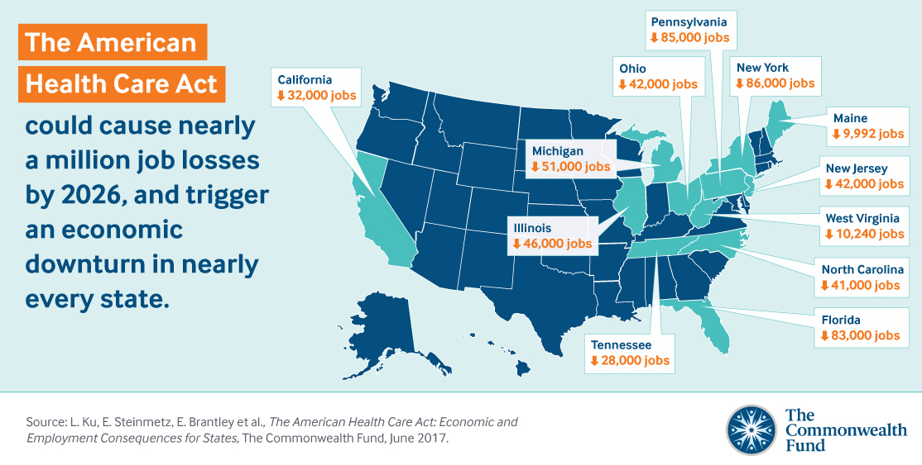
Top Ten State Losses
22

Slide 23
Financial Impact of AHCA Medicaid Provisions on Safety-Net Hospitals
PREPARED FOR:
The Commonwealth Fund
PRESENTED BY:
Al Dobson, Ph.D.
June 20, 2017

Slide 24
Purpose
To examine how the AHCA Medicaid provisions, which are estimated to reduce federal Medicaid spending by $834 billion over ten years, will impact the financial stability of safety-net hospitals
Safety-net hospitals were defined as acute care hospitals meeting the “Deemed DSH Hospital” criteria
Dobson | DaVanzo Hospital Financial Simulation Model (HFSM) used to estimate the financial impact on these hospitals due to the AHCA Medicaid provisions

Slide 25
AHCA Medicaid Provisions will Negatively Impact Safety-Net Hospital Net Income
Five key Medicaid provisions under the AHCA were modeled and their impact on safety-net hospital net income was measured relative to current law
Change in Net Income for Safety-Net Hospitals
Due to AHCA Medicaid Provisions (2017 – 2026)
AHCA Medicaid Provision | Excess Income/(Loss) (millions)
Current Law | $74,064
Eliminating Individual Mandate and Medicaid Expansion | ($19,444)
Eliminating Medicaid DSH Reductions | $13,711
Eliminating 3-Month Retroactive Eligibility | ($13,263)
Imposing Per-Capita Spending Limits | ($3,646)
Safety-Net Funds to Hospitals in Non-Expansion States | $4,365
Total Effect of All AHCA Medicaid Provisions Modeled | ($18,277)
Source: Dobson | DaVanzo analysis of Medicare Hospital Cost Report Data for 2015

Slide 26
AHCA Medicaid Provisions will Negatively Impact Safety-Net Hospital Margins
By 2026, we project total margins for safety-net hospitals to be near zero as well as a substantial decline in operating margins
Projected Total and Operating Margins for
Safety-Net Hospitals 2015 - 2026
Total Margins
Operating Margins
Source: Dobson | DaVanzo analysis of Medicare Hospital Cost Report Data for 2015

Slide 27
Safety-Net Hospitals in Expansion States will Experience Largest Impact
Projected Total and Operating Margins for Safety-Net Hospitals in Expansion and non-Expansion States 2015 – 2026
Medicaid Expansion States
Non-Expansion States
Total Margins
Total Margins
Operating Margins
Operating Margins
Source: Dobson | DaVanzo analysis of Medicare Hospital Cost Report Data for 2015

Slide 28
Safety-net hospitals with highest proportion of vulnerable patients will be hit hardest
Safety-net hospitals ranked highest to lowest based on hospital’s proportion of low-income patients treated
Those in highest tercile have the lowest operating and total margins under current law, and will experience the greatest negative impact from the AHCA, regardless of whether they are located in a Medicaid expansion or non-expansion state.
 | Total Margin in 2026 |  |  | Operating Margin in 2026
Proportion of Low-income Patients | (1) Current Law | (2) After AHCA | (3) Percentage Point Change | (4) Current Law | (5) After AHCA | (6) Percentage Point Change
Safety-Net Hospitals in Medicaid Expansion States
Total | 2.7% | -0.5% | -3.2% | -4.6% | -8.5% | -3.9%
Lowest Tercile | 5.5% | 3.6% | -1.9% | 0.7% | -1.6% | -2.2%
Middle Tercile | 0.7% | -3.5% | -4.1% | -5.6% | -10.4% | -4.9%
Highest Tercile | 0.0% | -4.7% | -4.7% | -12.3% | -18.6% | -6.3%
Safety-Net Hospitals in Non-Expansion States
Total | 3.2% | 2.2% | -1.0% | -2.0% | -3.1% | -1.2%
Lowest Tercile | 5.4% | 4.8% | -0.6% | 1.9% | 1.2% | -0.7%
Middle Tercile | 2.3% | 1.1% | -1.1% | -3.2% | -4.5% | -1.3%
Highest Tercile | 2.0% | 0.5% | -1.5% | -4.8% | -6.6% | -1.8%
Total | 2.9% | 0.5% | -2.4% | -3.6% | -6.4% | -2.8%
Source: Dobson | DaVanzo analysis of Medicare Hospital Cost Report Data for 2015

Slide 29
Key Findings
We estimate that by 2026 total margins would drop to 0.5 percent compared to current law estimates of 2.9 percent (83% reduction).
Safety-net hospitals in Medicaid expansion states would experience the largest negative impact on margins under the AHCA - particularly, small rural hospitals as well as small and mid-size urban hospitals.
Safety-net hospitals in states that expanded Medicaid may see uncompensated care costs more than double compared current law by 2026.
Safety-net hospitals that have the highest commitment to serving low-income and Medicaid patients tend to have the lowest operating and total margins under current law and will be negatively impacted the most by the AHCA.
The diminished financial stability of safety-net hospitals under the AHCA not only affect the institutions and Medicaid patients, but affect the entire community served by these hospitals.

