Slide 1

Results from the 2018 Scorecard on State Health System Performance
www.commonwealthfund.org
Media teleconference: May 2, 2018
Embargoed
until 12:01 am,
Thursday,
May 3, 2018

Slide 2

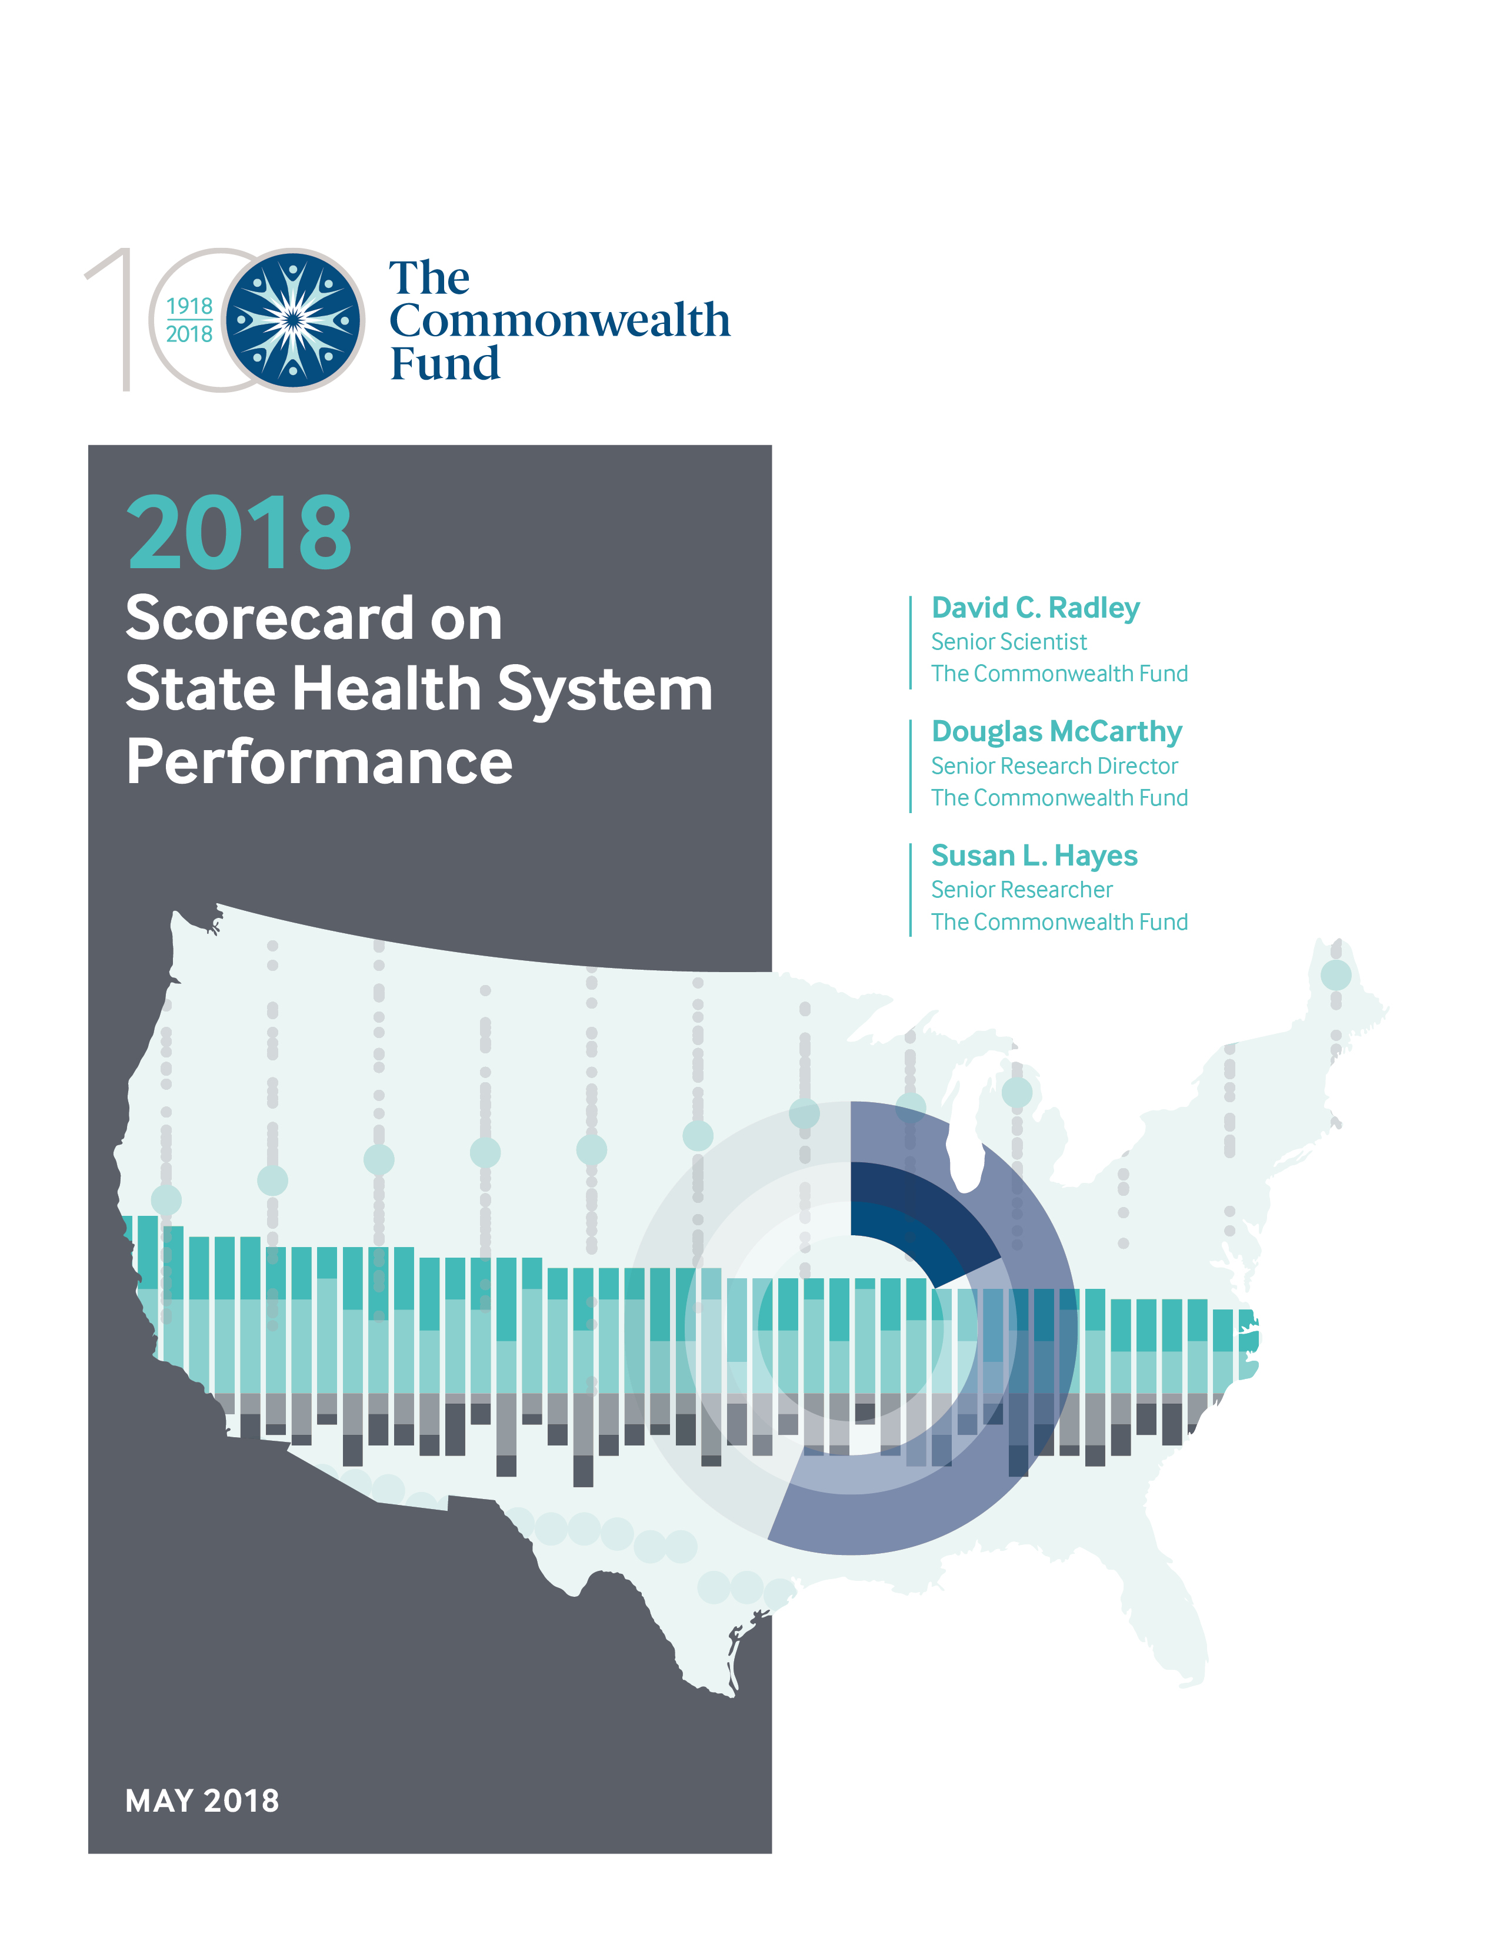
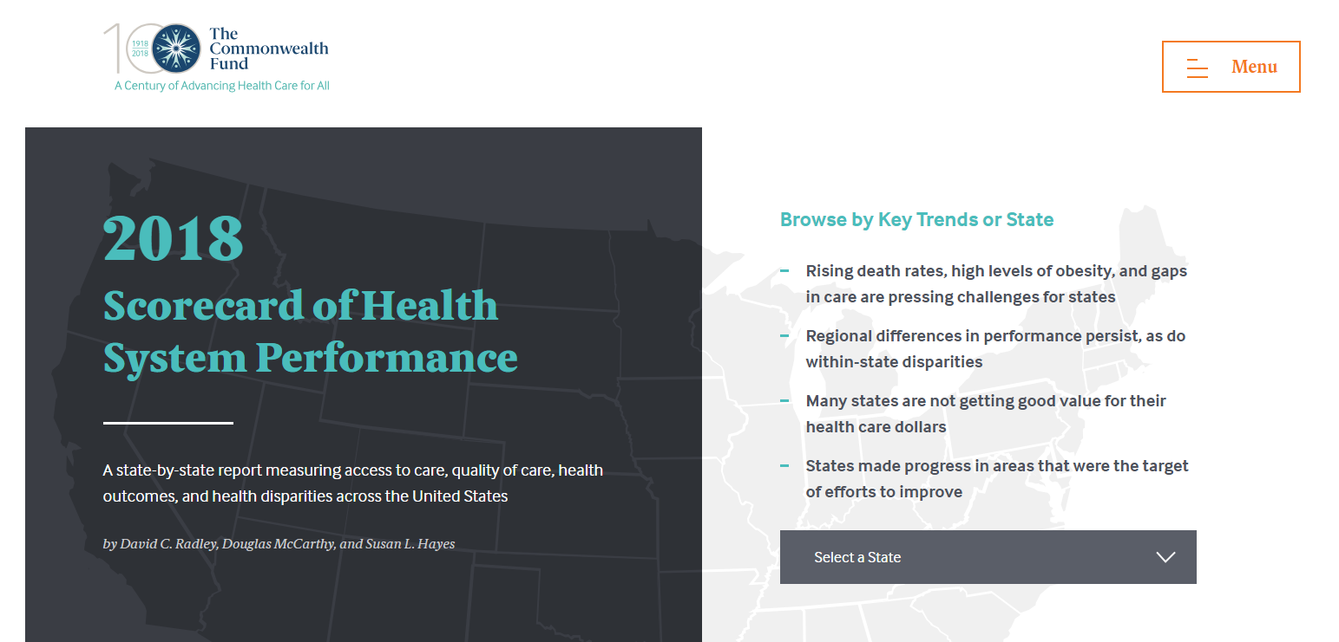
Exhibit 2
Results from the 2018 Scorecard on State Health System Performance
Online interactive report
Printable version

Slide 3
Exhibit 3
Key Findings from the Scorecard
Premature deaths are on the rise in states across the country
  ‘Deaths of despair’ surge
  Premature deaths from treatable conditions increase
Many states are not getting good value for their health care dollars
  Gaps in mental health care are pervasive
  Shortfalls in quality – high rates of ineffective care and opportunities to improve use of preventive care
States experience widespread gains in health care access
  These improvements may be at risk

Slide 4
Leading states offer targets for aiming higher
Exhibit 4
Better Performance
U.S. Average
Worse Performance
States are arranged in rank order from left (best) to right (worst), based on their overall 2018 State Scorecard rank.

Slide 5
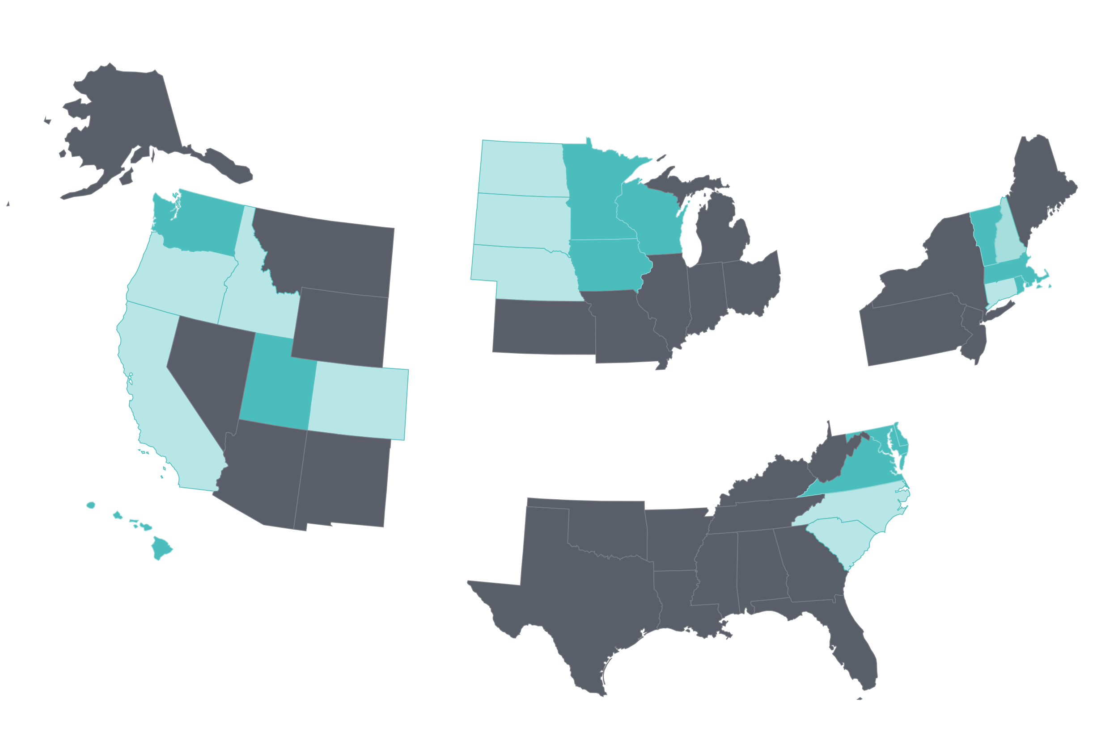
State health system performance varies within regions
Exhibit 5
Northeast
West
Midwest
South
Top 3 states in each region
Better-than-average states in each region
Worse-than-average states in each region
Note: Regions are U.S. Census regions. Regional shading is based on performance among states within the region only. See Scorecard Methods for additional detail.

Slide 6
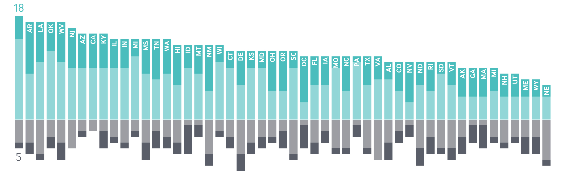
More improvement than decline
Exhibit 6
New York
MOST IMPROVED
Greatly improved
Improved
Worsened
Greatly worsened
INDICATORS IMPROVED
INDICATORS WORSENED
Notes: Based on trends for 37 of 43 total indicators (Disparity dimension not included); trend data are not available for all indicators. Bar length equals the total number of indicators with any improvement or worsening with an absolute value greater than 0.5 standard deviations (StDev) of the state distribution. Lighter portion of bars represents the number of indicators with a change of 0.5–0.9 StDevs between baseline and current time periods, darker portions represent indicators with 1.0 or greater StDev change.

Slide 7
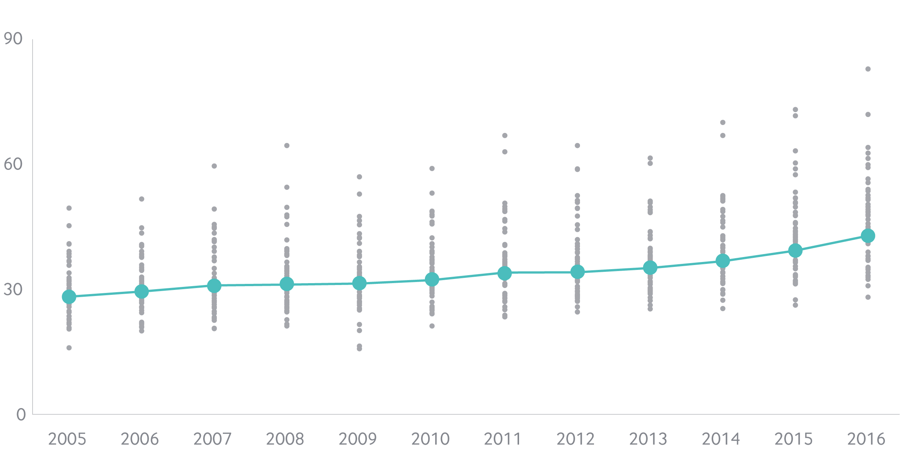
Deaths from suicide, alcohol, and drug overdose are on the rise and differences between are states widening
Exhibit 7
Deaths per 100,000 population
U.S. average
State rates
Data: 2004–2016 National Vital Statistics System (NVSS), via CDC WONDER

Slide 8
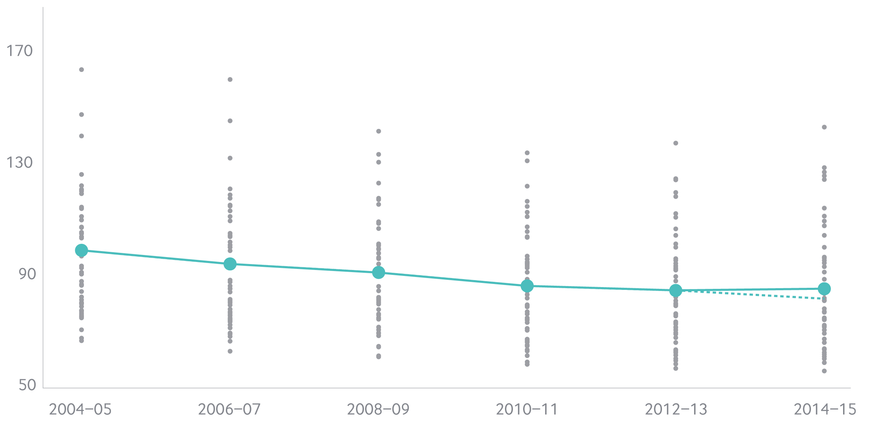
Premature death rates from treatable medical conditions rose slightly following decade-long decline
Exhibit 8
Mortality amenable to health care: deaths per 100,000 population
U.S. average
State rates
U.S. average
if historical trend had continued
Note: Y-axis starts at 50 deaths per 100,000. Dashed line represents the expected premature death rate if the historical trend from 2004-05 to 2012-13 had continued in 2014-15. Premature deaths reported here do not include deaths from suicide, alcohol, or drug use; see appendix for complete list of health care amenable deaths.
Data: 2004–2015 National Vital Statistics System (NVSS) Mortality All-County Micro Data Files.

Slide 9
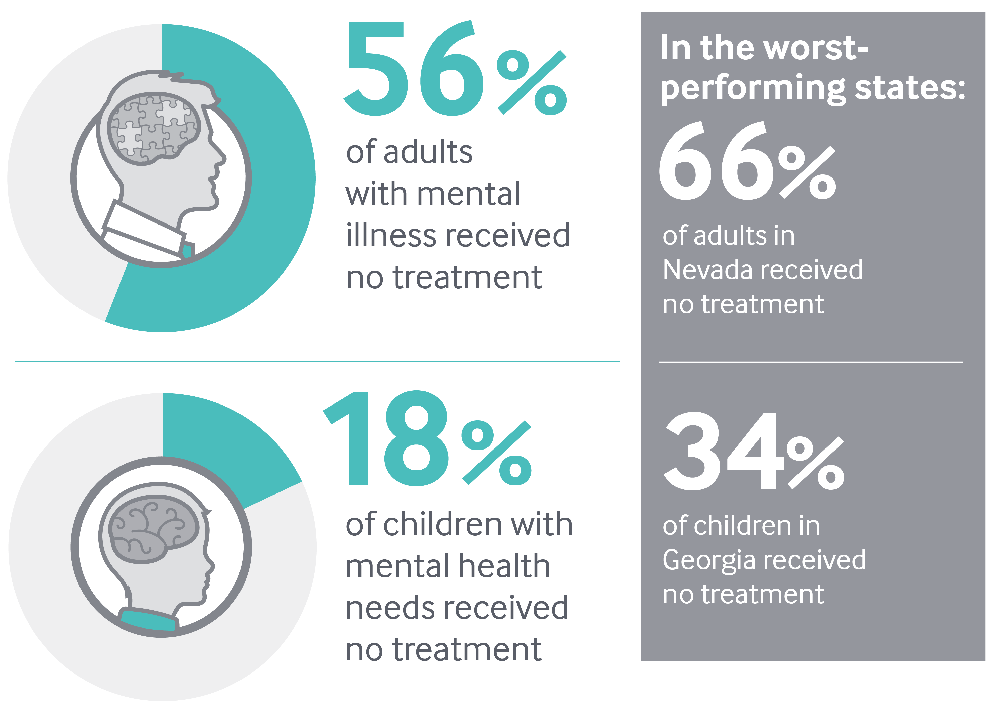
Exhibit 9
Gaps in mental health care are pervasive
U.S. Average
Data Sources: 2013-15 National Survey of Drug Use and Health, as reported in The State of Mental Health Care America, 2017.
2016 National Survey of Children’s Health, as reported by the Child and Adolescent Health Measurement Initiative.

Slide 10
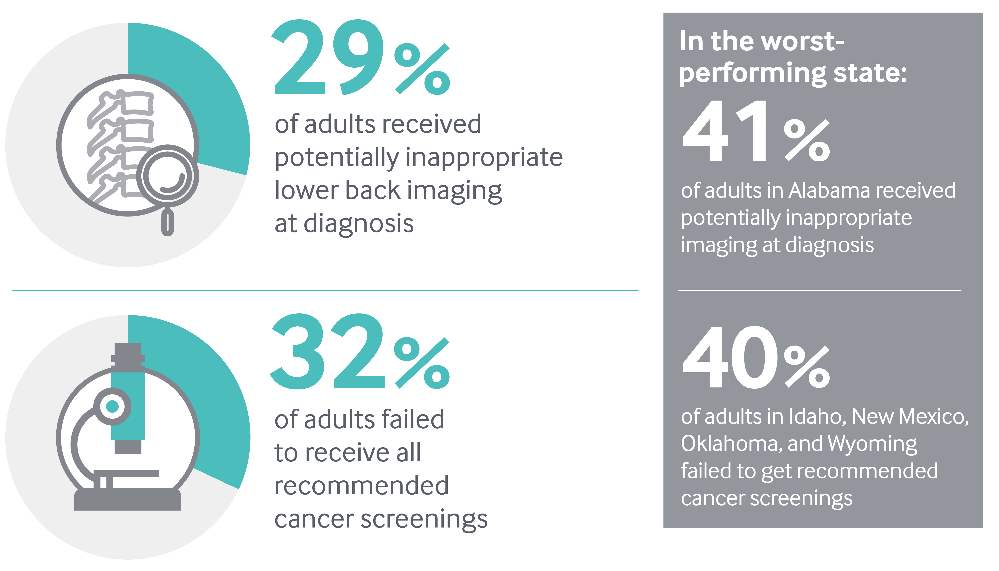
Exhibit 10
Shortfalls in quality of care are seen across states
U.S. Average
Note: Lower back pain imaging is measured among newly diagnosed patients ages 18-50 with employer-sponsored insurance.
Data: Lower back imaging, 2015 Truven MarketScan Database, analysis by M.Chernew, Harvard University; Cancer screenings, 2016 Behavioral Risk Factor Surveillance System (BRFSS).

Slide 11
Income-related disparities in health care access differ across states
Exhibit 11
Alabama
Pennsylvania
Less than 200%
federal poverty level
400% federal poverty level or higher
Data: Uninsured (ages 19-64): U.S. Census Bureau, 2016 One-Year American Community Surveys. Public Use Micro Sample (ACS PUMS). Cost Barriers (ages 18 and older): 2016 Behavioral Risk Factor Surveillance System (BRFSS).

Slide 12
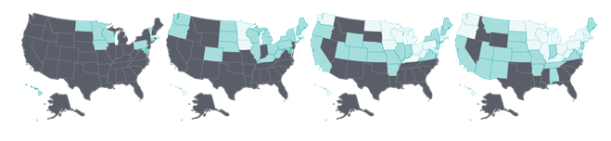
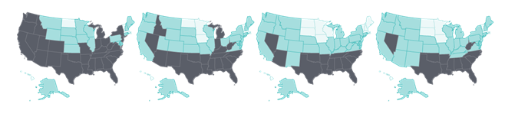
Cost barriers to receiving care fell as uninsured rates fell following ACA coverage expansions
Exhibit 12
Uninsured adults
Less than 10%
10%-14%
15+ %
Adults who went without care because of costs
2013
2014
2015
2016
Notes:
Data: Uninsured (ages 19-64): U.S. Census Bureau, 2013-2016 One-Year American Community Surveys. Public Use Micro Sample (ACS PUMS). Cost Barriers (ages 18 and older): 2013-2016 Behavioral Risk Factor Surveillance System (BRFSS).

Slide 13
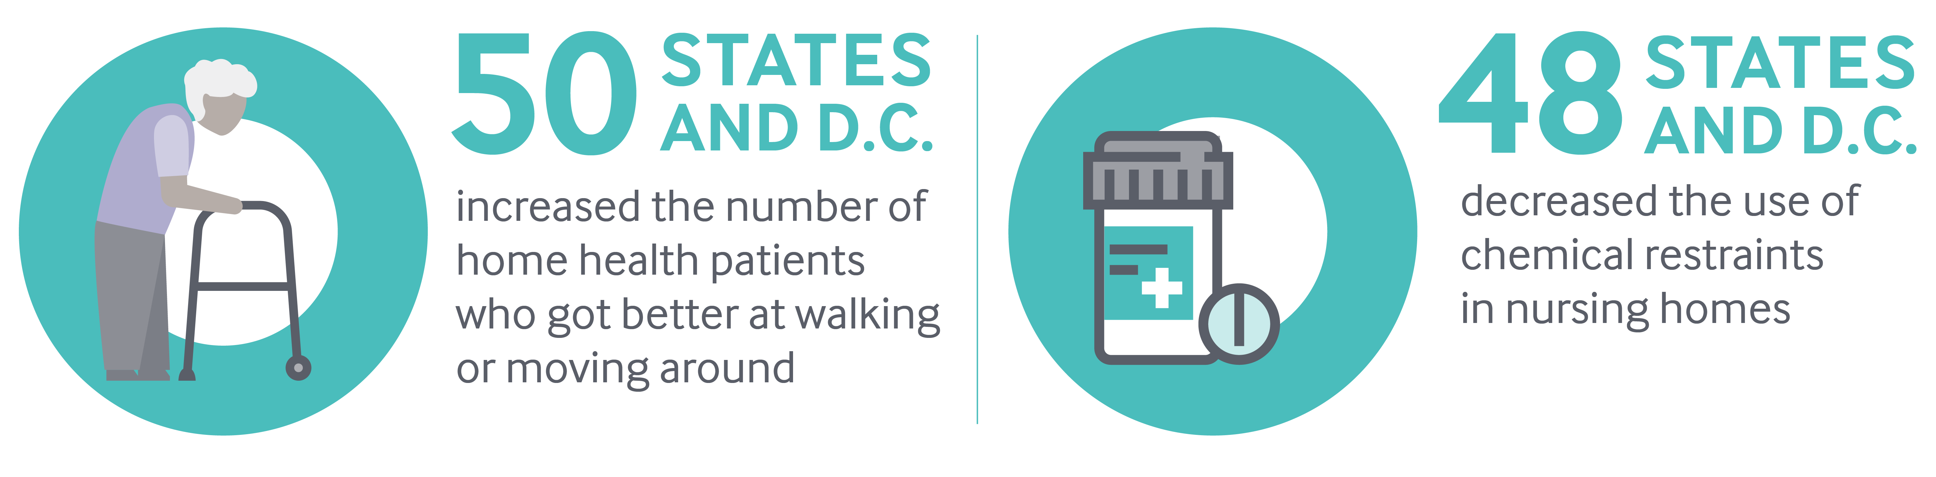
Exhibit 13
Home health patients have gained better mobility and nursing home care has improved across the U.S.
Notes: D.C. stands for District of Columbia. Chemical restraints means use of antipsychotic medication.
Data: OASIS (via CMS Home Health Compare); MDS (via CMS Nursing Home Compare).

Slide 14
National Gains If All States Achieved Top Rates* of Performance
Exhibit 14
18 million | more adults and children insured, beyond those who already gained coverage through the ACA
14 million | fewer adults skipping care because of its cost
26 million | more adults with a usual source of care
11 million | more adults receiving recommended cancer screenings
837,000 | more young children receiving all recommended vaccines
1 million | fewer Medicare beneficiaries receiving a high-risk prescription drug
440,000ª | fewer hospital readmissions
5.7 millionª | fewer emergency room visits for nonemergency care or conditions treatable with primary care
89,000 | fewer deaths before age 75 from treatable diseases
Note: *Performance benchmarks set at the level achieved by the top-performing state with available data for this indicator. (a) Estimate based on working age population, ages 18-64, with employer-sponsored insurance and Medicare beneficiaries age 65 and older.

Slide 15
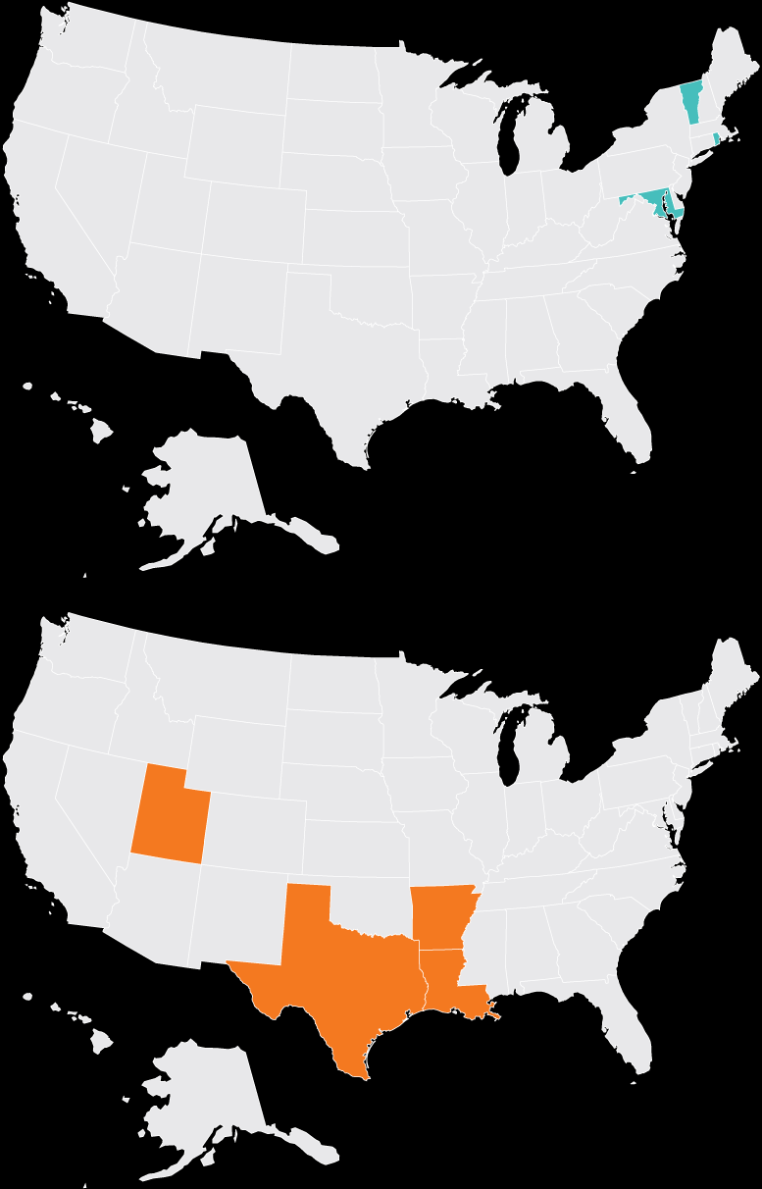
Examples of State Action to Address Challenges
Exhibit 15
Vermont
Maryland, Vermont, and Rhode Island
implemented the ACA’s optional Medicaid health home model to deliver integrated substance use disorder treatment, medical and behavioral health care and social services, to people with opioid use disorders
Rhode Island
Maryland
Utah
Arkansas, Louisiana, Texas, and Utah
had the greatest reductions in the
use of “chemical restraints” in nursing homes, a key goal of the National Partnership to Improve Dementia Care in Nursing Homes
Arkansas
Louisiana
Texas

Slide 16
Summary and Implications
Exhibit 16
Rising mortality overshadows recent gains in healthcare access & targeted improvements in quality
Important role for the federal government to help equalize opportunity among states
Need for comprehensive and coordinated national and state efforts to deal with opioid epidemic and rising rates of obesity
Gains in access to care associated with the ACA’s coverage expansions may be at risk
States likely to assume greater responsibility for the direction of health policy in coming years, creating opportunities for leadership and collaboration to promote health system improvement

Slide 17
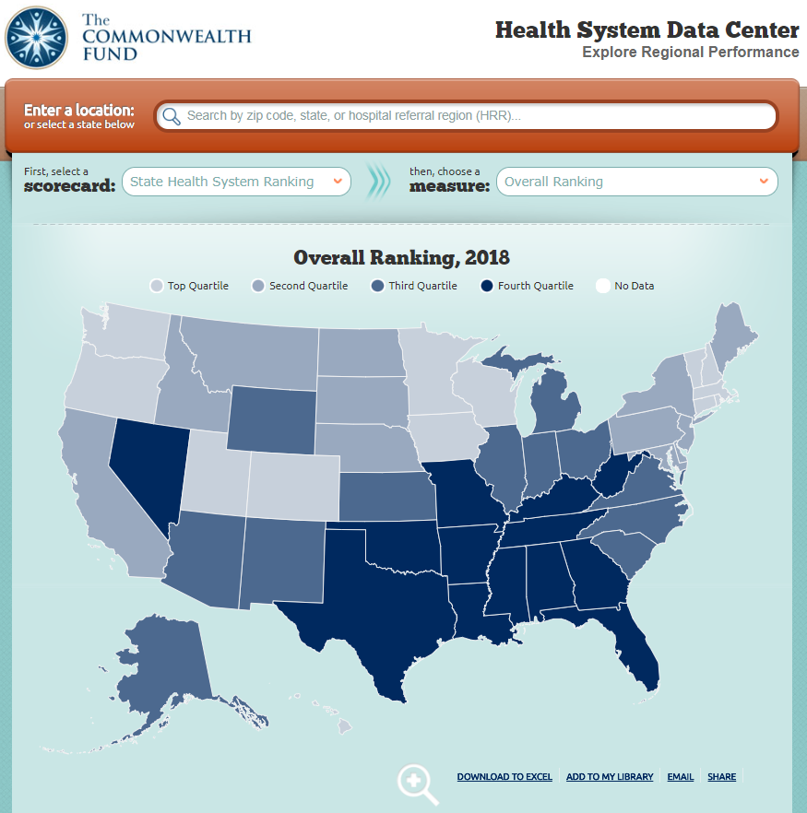
For More Information, Visit the Fund’s Health System Data Center: http://datacenter.commonwealthfund.org/

Slide 18
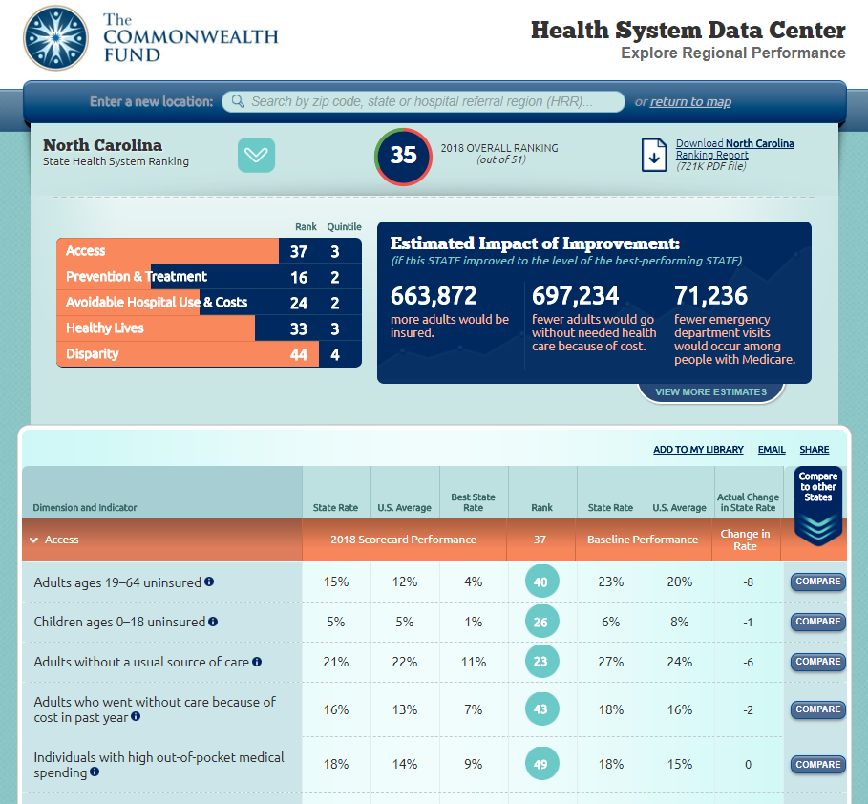
http://datacenter.commonwealthfund.org
Downloadable Profile
Benchmarking tools
Customizable Benchmarking tools and comparisons

Slide 19
Exhibit 19
State Health System Scorecard Methods
Goal: to provide benchmarks and trends to inform national, state and local action to improve health care system performance
Health System Focus: Builds on previous Scorecards
  43 indicators organized into 4 dimensions: Access/affordability; Prevention/treatment; Avoidable hospital use and costs; and Healthy lives
  Disparity dimension assesses a subset of indicators by income within states
  National data sources including administrative claims, national surveys, and vital statistics available for states
2- to 3-year trend data available for 37 indicators
  Generally from 2013 to 2016, but varies by indicator
Scoring:
  Each indicator is ranked
  Dimension rank is based on average of indicator ranks
  Overall rank based on average of five dimension ranks
Estimated gains are based on rates of performance in the top performing state

