Slide 1
Exhibit 1. More Than 16 Million More People Under Age 65 Purchased Coverage on Their Own or Enrolled in Medicaid, 2013–2014
Millions, under age 65
Among 270 million people under age 65
Source: U.S. Census Bureau, 2013 and 2014 Current Population Survey Reports

Slide 2
Exhibit 2. Uninsured Rate Among Working Age Adults Working Less Than Full Time Fell More Than 6 Percentage Points, 2013–2014
Percent under age 65 who were uninsured all year
Percent ages 18-64 who were uninsured all year
Age
Work Experience
Source: U.S. Census Bureau, 2013 and 2014 Current Population Survey Reports

Slide 3
Exhibit 3. African-Americans and Latinos Made Significant Coverage Gains, 2013–2014
Percent under age 65 who were uninsured all year
Race/Ethnicity
Income
Source: U.S. Census Bureau, 2013 and 2014 Current Population Survey Reports and from CPS’s table creator at http://www.census.gov/cps/data/cpstablecreator.html

Slide 4
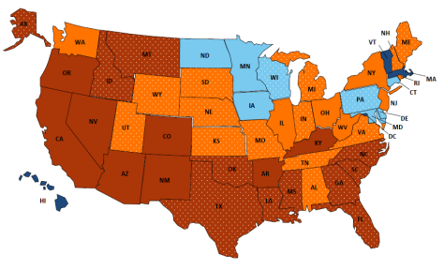
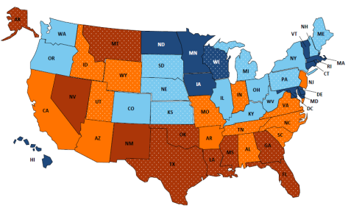
Exhibit 4. Uninsured Rates Declined in Every State, 2013–2014
2013
2014
3%–<8% uninsured
>14% uninsured
8%–<10.5% uninsured
Not expanding Medicaid*
10.5%–<14% uninsured
*Medicaid expansion status as of January 1, 2014.
Source: U.S. Census Bureau, 2013 and 2014 1-Year American Community Surveys.

