Slide 1
More than 24 Million More People Under Age 65 Purchased Coverage on Their Own Or Enrolled in Medicaid, 2013-2015
Exhibit 1
Millions, under age 65
Among 271 million people under age 65
Source: U.S. Census Bureau, 2013, 2014, and 2015 Current Population Survey Reports and from CPS’s table creator at http://www.census.gov/cps/data/cpstablecreator.html

Slide 2
Young Adults Have Made the Greatest Gains in Coverage: Uninsured Rate Fell More than 7 Percentage Points, 2013-2015
Exhibit 2
Percent under age 65 who were uninsured all year
Age
Source: U.S. Census Bureau, 2013, 2014, and 2015 Current Population Survey Reports

Slide 3
African-Americans and Latinos Made Significant Coverage Gains, 2013-2015
Exhibit 3
Percent under age 65 who were uninsured all year
Race/Ethnicity
Note: White and African Americans only includes those who are White or African American alone.
Source: U.S. Census Bureau, 2013, 2014, and 2015 Current Population Survey Reports and from CPS’s table creator at http://www.census.gov/cps/data/cpstablecreator.html

Slide 4
People with Low and Moderate Incomes Continue to Make Strong Coverage Gains
Exhibit 4
Percent under age 65 who were uninsured all year
Income
Source: U.S. Census Bureau, 2013, 2014, and 2015 Current Population Survey Reports and from CPS’s table creator at http://www.census.gov/cps/data/cpstablecreator.html

Slide 5
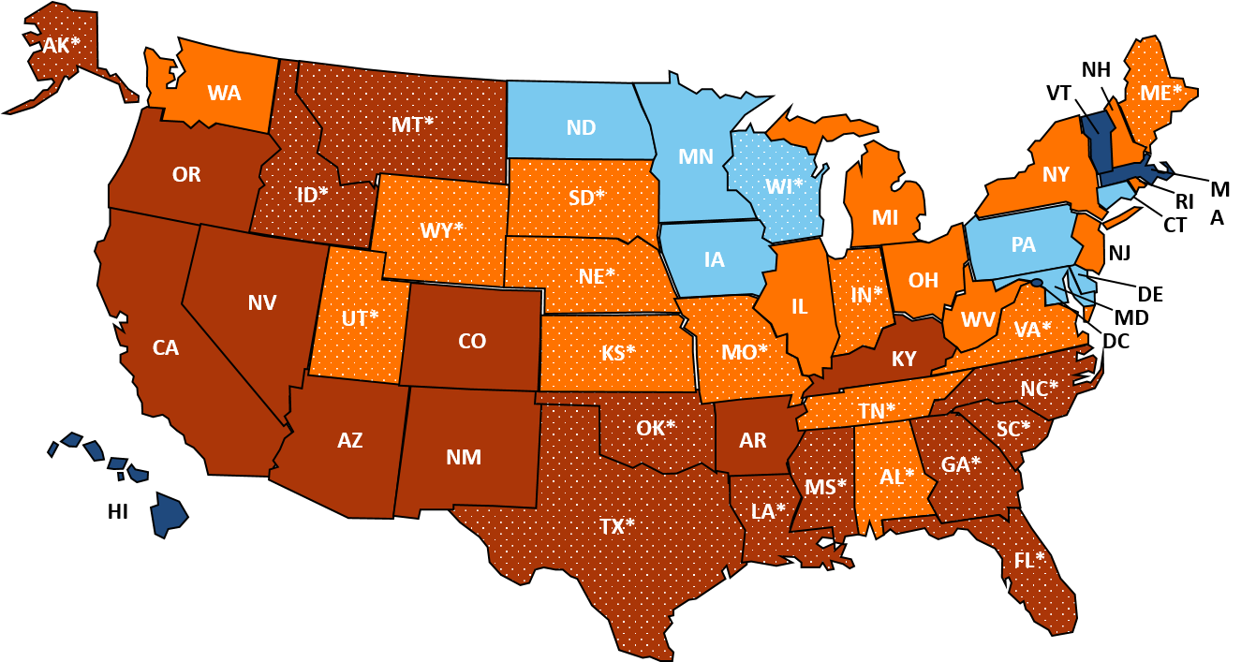
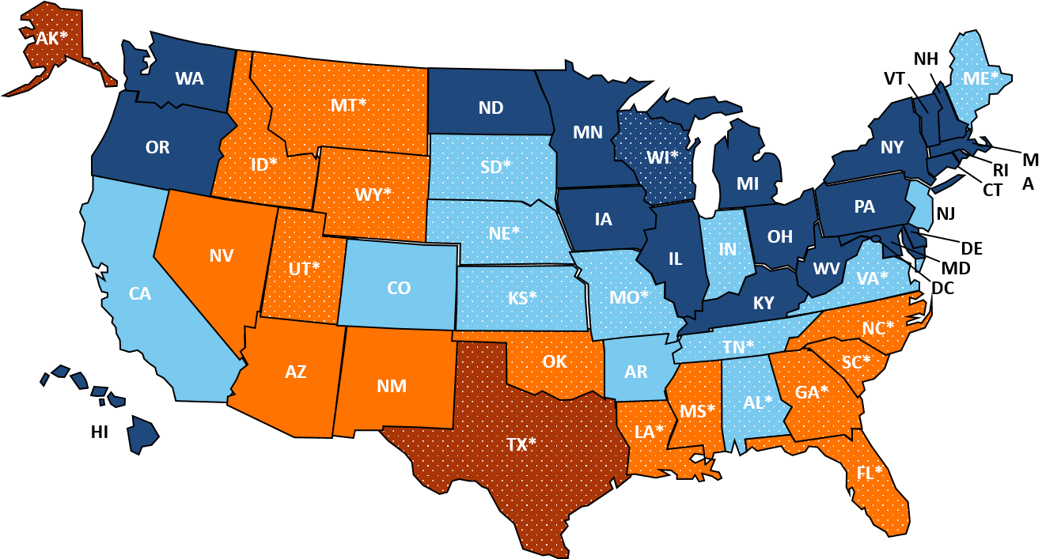
Uninsured Rates Declined Nationwide from 2013 to 2015
2013
2015
3%–<8% uninsured
>14% uninsured
8%–<10.5% uninsured
*Not expanding Medicaid (as of January 1, 2015)
10.5%–<14% uninsured
Source: Health Insurance Coverage in the United States: 2015. U.S. Census Bureau, 2013 and 2015 American Community Surveys.

