Slide 1
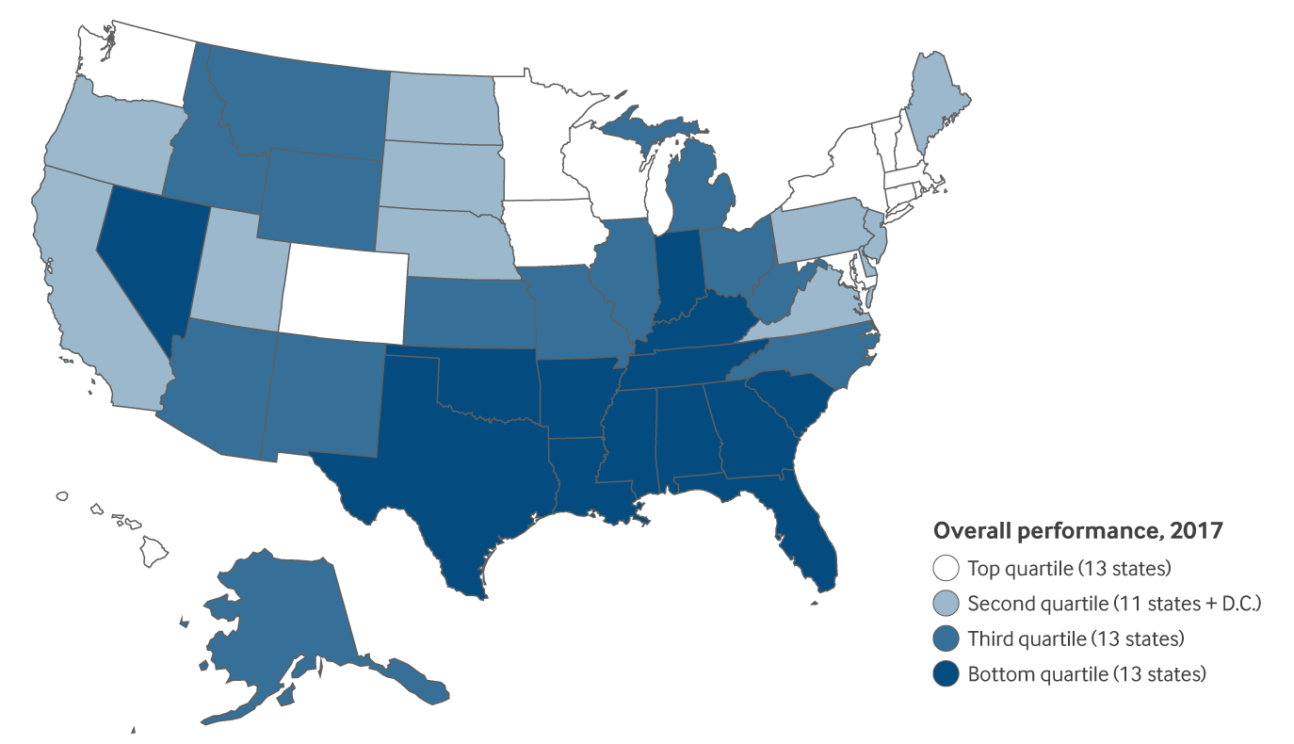
Overall State Health System Performance: Scorecard Ranking, 2017

