Slide 1
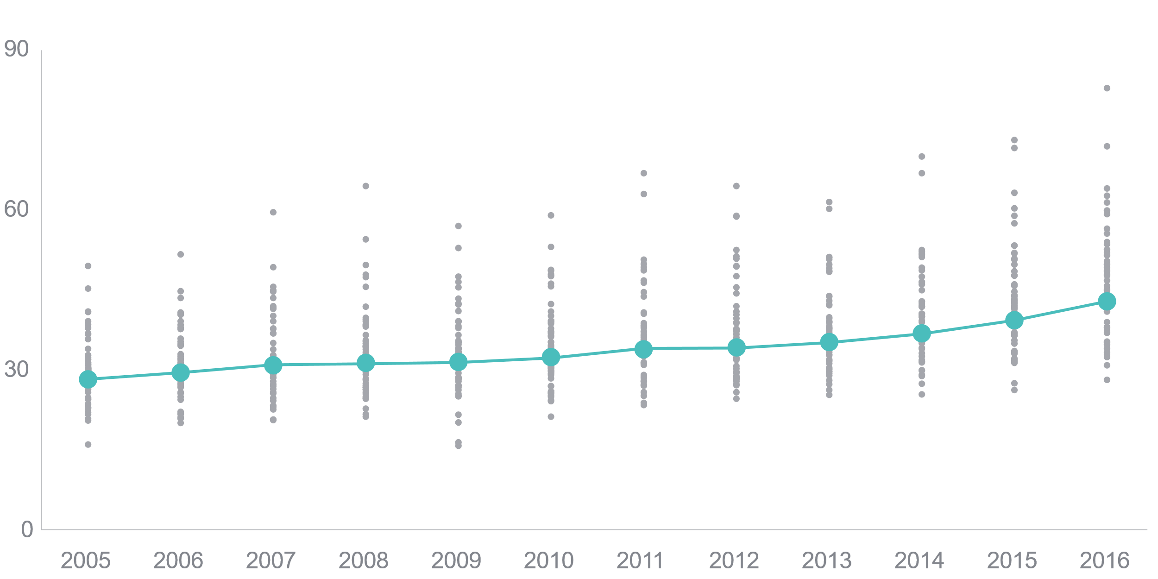
Deaths from suicide, alcohol, and drug overdose on the rise and differences between states widening
Deaths per 100,000 population
U.S. average
State rates
Data: 2004–2016 National Vital Statistics System (NVSS), via CDC WONDER.

