Slide 1
State Health Insurance Marketplaces: Implementation Status and Key Issues
Sara R. Collins, Ph.D.
Vice President, Affordable Health Insurance
Health Insurance Marketplaces Webinar
Progressive States Network and The Commonwealth Fund
May 13, 2013

Slide 2
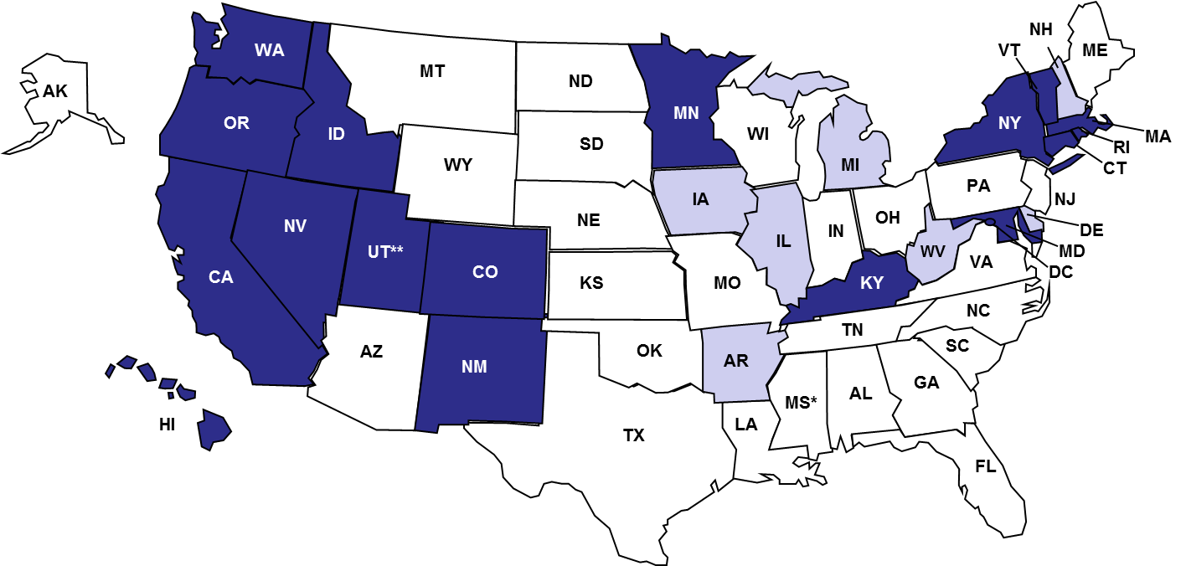
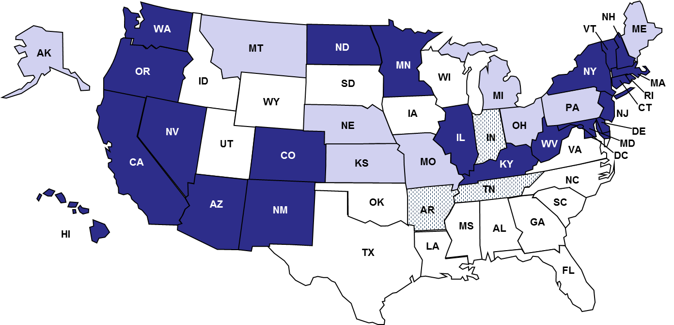
Exhibit 1. State Action on Establishing Health Insurance Marketplaces and Participation in Medicaid Expansion, As of May 2013
Health Insurance Marketplaces
Medicaid Expansion
Pursuing state-run exchange (17 + DC)
Expanding (22 + DC)
Pursuing state-federal partnership exchange (7)
Expanding with variation (3)
Unclear/undecided (9)
Pursuing federally facilitated exchange (26)
Not expanding (16)
Source: National Conference of State Legislatures, Federal Health Reform: State Legislative Tracking Database. http://www.ncsl.org/default.aspx?TabId=22122; Avalere State Reform Insights; Center of Budget and Policy Priorities
Politico.com; Commonwealth Fund Analysis.
Notes:
These two maps give you a sense of where implementation stands on what are essentially the two pillars of the law’s coverage expansion : the state insurance marketplaces and the Medicaid expansion. In the map on the left, you can see in dark blue the 17 states and DC that have received conditional approval from HHS to operate their own marketplaces next year. Preparedness, however, across the 17 states varies substantially – it is unlikely that all will gain final approval, and that HHS will operate marketplaces in some of these states. 7 states have received conditional approval to operate their marketplaces in partnership with HHS – [they will manage health plans and consumer outreach and enrollment assistance]. But more than half the states will have a federal exchange next year.
State participation in the Medicaid expansion is more problematic. The law of course assumed full state participation. For a couple reasons, the law provided that people earning above the poverty level would be eligible for either Medicaid or private plans with tax credits, but those with incomes below poverty are not eligible for the tax credits. A state that does not expand will leave its lowest income residents without health insurance. So far, 23 states and DC are expanding, a handful of states are considering expanding but using funds for private plans. About 22 states are undecided or are not going to expand.
On the plus side the use of Medicaid funds for private plans:
Would help ensure that the poorest residents in those states (people with incomes under 100 percent of poverty are not eligible for premium tax credits in states that do not expand)would benefit from the expansion, rather than continue without coverage
The approach would reduce the problem of “churning” in insurance coverage starting next year. There is concern that when people’s income changes year to year, either above or below the 133% of poverty threshold, thus changing eligibility from Medicaid to premium tax credits for private plans, or to Medicaid from tax credits, that they will experience a gap in coverage until the adjustment is made. In addition, a change in coverage might force people to change plans and providers, creating a break in care, which could be particularly problematic for people with chronic health problems. If everyone is in private plans, income fluctuations are much less problematic for continuity of coverage and care.
Would have the effect of “mainstreaming” Medicaid by granting more people access to private plans, increasing equity of access to providers across the income spectrum.
Increases size of the risk pool in the exchange, spreading costs over a broader pool, rather than segmenting risk between Medicaid and exchange
Economies of scale in administration, lower cost to government and families in moving people between coverage programs.
On the downside, this alternative strategy would:
Likely increase costs to federal and state governments (over time) because of higher provider rates. This will increase costs of implementation, and reduce the viability of the expansion, and support for it, over time.
Potentially increase costs to enrollees and lessen participation. We do not know the details yet of the AR negotiation, but it is critical that states not be allowed to increase what people in this income range would pay for their premiums or out of pocket expenses, or receive in covered benefits. Poorer, less affordable coverage, would lessen the protection of this income group, as well as reduce the likelihood that people will join, lowering the numbers of people with coverage.

Slide 3
Exhibit 2. Source of Insurance Coverage Pre-Reform and Under Affordable Care Act, Assuming Partial Expansion of Medicaid, 2016
31 M
(11%)
Uninsured
24 M (9%)
Exchanges
(Private
Plans)
57 M (21%)
Uninsured
160M (58%)
ESI
154 M (56%)
ESI
26 M (9%)
Nongroup/Other
23 M (8%)
Nongroup/Other
34 M (12%)
Medicaid/CHIP
45 M (16%)
Medicaid/CHIP
Under Prior Law
Affordable Care Act
Among 277 million people under age 65
* Employees whose employers provide coverage through the exchange are shown as covered by their employers.
Note: ESI is employer-sponsored insurance; “Other” includes Medicare. Implementation of Affordable Care Act assume not all states implement Medicaid expansion.
Source: Congressional Budget Office, February 2013 Estimate of the Affordable Care Act on Health Insurance Coverage, February 2013. http://www.cbo.gov/sites/default/files/cbofiles/attachments/43900_ACAInsuranceCoverageEffects.pdf

Slide 4
Exhibit 3. 7 Million People Estimated to Enroll in Plans Through the Health Insurance Marketplaces in 2014
Millions of people, ages 0-64
Source: Congressional Budget Office, February 2013 Estimate of the Affordable Care Act on Health Insurance Coverage, February 2013. http://www.cbo.gov/sites/default/files/cbofiles/attachments/43900_ACAInsuranceCoverageEffects.pdf

Slide 5
Exhibit 4. Change in Uninsured Under the Affordable Care Act and Medicaid Expansion Among Selected States, 2022
States | Current uninsured (thousands) | Reduction in uninsured with Medicaid expansion (thousands) | Reduction in uninsured without Medicaid expansion (thousands)
Alabama | 711 | 457 | 217
Alaska | 137 | 72 | 45
Florida | 4,181 | 2,116 | 1,247
Georgia | 2,107 | 1,082 | 592
Idaho | 251 | 125 | 69
Iowa | 299 | 74 | 54
Kansas | 383 | 182 | 80
Louisiana | 877 | 527 | 256
Maine | 146 | 74 | 45
Michigan | 1,372 | 632 | 415
Mississippi | 562 | 327 | 158
Missouri | 805 | 494 | 235
Source: John Holahan, Matthew Buettgens, Caitlin Carroll, Stan Dorn, The Cost and Coverage Implications of the ACA Medicaid Expansion: National and State-by-State Analysis, Kaiser Family Foundation, November 2012. Available: http://kaiserfamilyfoundation.files.wordpress.com/2013/01/8384.pdf

Slide 6
Exhibit 5. Change in Uninsured Under the Affordable Care Act and Medicaid Expansion Among Selected States, 2022 (continued)
States | Current uninsured (thousands) | Reduction in uninsured with Medicaid expansion (thousands) | Reduction in uninsured without Medicaid expansion (thousands)
Montana | 184 | 98 | 60
Nebraska | 238 | 113 | 65
North Carolina | 1,651 | 795 | 408
Ohio | 1,627 | 991 | 534
Oklahoma | 647 | 352 | 226
Pennsylvania | 1,357 | 705 | 393
South Carolina | 775 | 440 | 237
South Dakota | 116 | 58 | 32
Texas | 7,355 | 3,792 | 2,554
Utah | 442 | 239 | 163
Virginia | 1,071 | 554 | 339
Wisconsin | 581 | 300 | 177
Wyoming | 89 | 46 | 30
Source: John Holahan, Matthew Buettgens, Caitlin Carroll, Stan Dorn, The Cost and Coverage Implications of the ACA Medicaid Expansion: National and State-by-State Analysis, Kaiser Family Foundation, November 2012. Available: http://kaiserfamilyfoundation.files.wordpress.com/2013/01/8384.pdf

Slide 7
Exhibit 6. Affordable Care Act: Key Implementation Issues, 2013-2014
Readiness of insurance marketplaces for October 1, 2013 open enrollment
IT systems in place for state, federal, partnership?
Are plans certified to be sold, do they have sufficient network capacity to enroll large numbers of people over a large geographic area?
What are plan premiums? Deductibles? Are they viewed as “affordable”?
Do state and federal governments have sufficiently aggressive outreach strategy so that people eligible come to the marketplaces?
Is there sufficient public awareness of the marketplaces and eligibility for Medicaid, subsidized private plans?
What will be the experience of people choosing plans, gaining access to tax credits? Do they enroll, why or why not?
Coordination of Medicaid programs and marketplaces, or will these operate like separate markets?
State Medicaid participation and alternate “private plan” approaches
Coverage of people with incomes under poverty who are excluded from tax credit eligibility .
Effects on enrollment and out of pocket cost exposure.

