Slide 1
SABEW ACA Webinar January 22, 2014
Michael marchand
Director of Communications

Slide 2
Washington Healthplanfinder
Created by legislation in 2011, additional legislation in 2012 and 2013
Governed by 11 member, bipartisan Board
Federally funded through 2014 (pending additional request)
Entry point for Medicaid, Qualified Health Plans
Deloitte is system integrator
17 critical system interfaces (carriers, state agencies, HUB)
2013 legislation appropriates spending authority in 2015
Open enrollment ends March 31, 2014

Slide 3
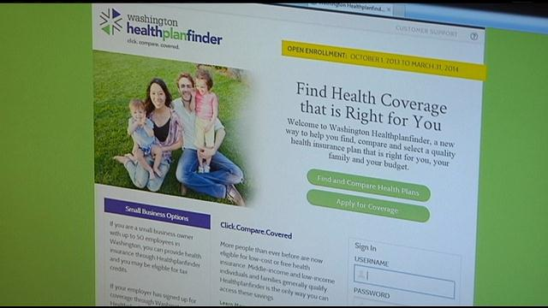
Most Recent Key Metrics (through January 9th)
Website traffic and call center:
Unique visitors: 1,237,129
Accounts created: 336,858
Call center volume (Jan to date): 39,373
Average initial call center wait time (Jan to date): 3 min
Average wait time after menu selection (Jan to date): 39 min
Enrollments and applications:
QHP enrollments: 73,098
Total new enrollments
(including Medicaid): 270,868
QHP applicants (need to pay): 76,058

Slide 4
Enrollment Summary
Through December enrollments (Dec. 31):
About 23% of QHP enrollments are not receiving any tax credits
20% of enrollments ages 18-34
35% of enrollments age 55-64
56% of enrollees choosing silver plans
Recent trends:
QHP enrollments increasing
Today, QHP enrollments 18% of total. We had started out at ~10%
In December QHP enrollment increased by ~400%, and
Medicaid newly eligible and immediate coverage enrollment doubled
Notes:
Oct. 1 through Nov. 28 – From press release
18,131 in QHP
91,853 Newly Eligible
66,484 Medicaid, Immediate Coverage
176,468

Slide 5
Successes and Challenges
Successes
Enrollment
Stabilizing system performance
Marketing and Outreach campaign
Stakeholder support
Challenges
Call center volume and wait times
Medicaid renewals and pending applications
Reconciling back end financial and enrollment reports
Improving system performance and enhancing the user experience

Slide 6
Lessons Learned
Managing scope and governance is critical
Testing the system: limited time, real world environment
Understanding Call Center volume
Activating the IPAs, Producers, Partners, etc.
Frequency of updates and communications
We didn’t know what we didn’t know
What does steady state look like?
Infrastructure development, clean financial audit
Preparing for upcoming key deadlines

Slide 7
Moving Forward – Operational Excellence
Going from a development to operational environment.
Technical & Operational
Addressing immediate site fixes
Ongoing website augmentation
Future enhancements, (e.g. Medicaid shopping and adult dental)
Optimizing the customer experience
Healthplanfinder Business
Policy & Governance
Onboarding new board members
Financial sustainability
Additional level 1 grant request
Board strategic planning

Slide 8
Resources
www.wahealthplanfinder.org
www.wahbexchange.org
1-855-WAFINDER (1-855-923-4633)
TTY/TTD for Deaf : 1-855-627-9604
info@wahbexchange.org
WAHealthplanfinder
@waplanfinder
waplanfinder

