Slide 2
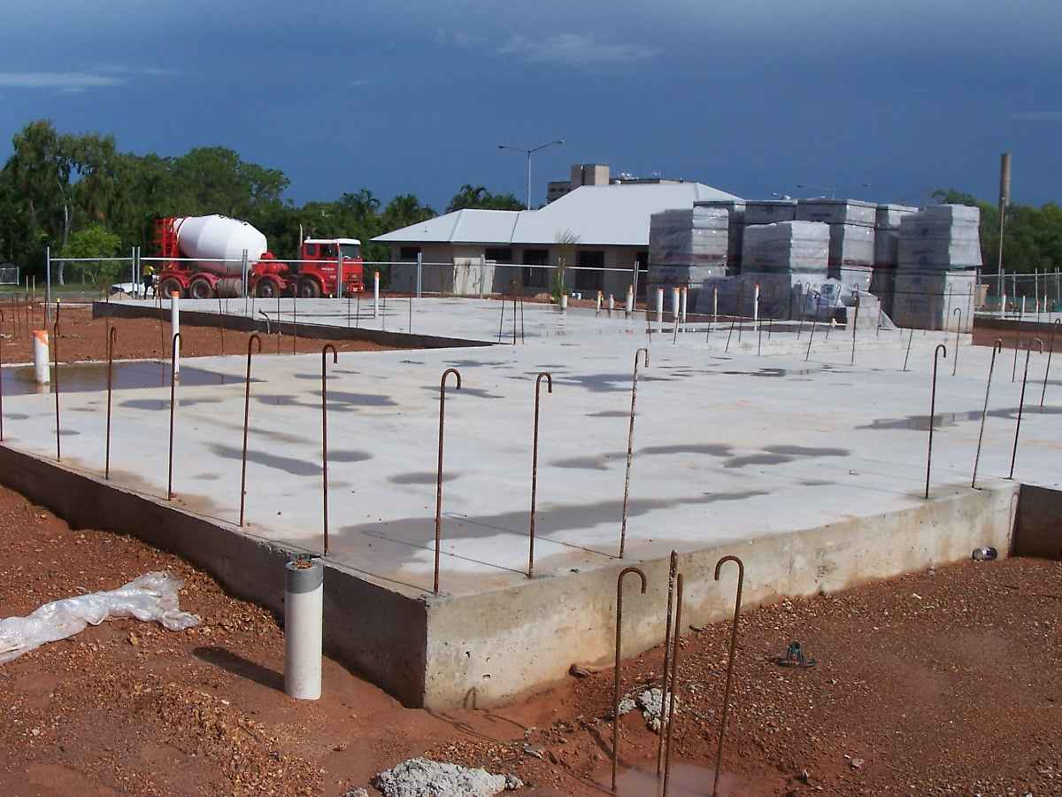
Horizons
Metrics
Methodically Identify & Remove Friction
Decision Process
Methods

Slide 3
Methods Framework

Slide 4
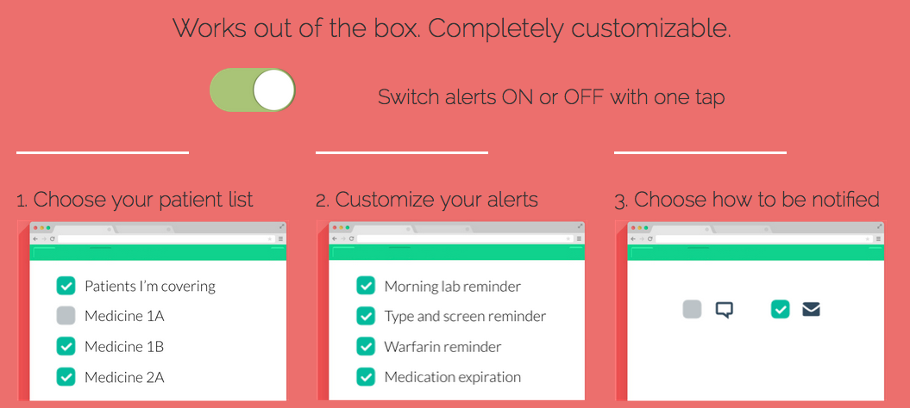
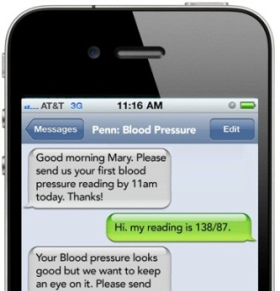
Innovation Center Impact
Rampant experiments
Platforms add speed & lower cost
New approaches
New relationships & new interactions
Notes:
Examples of benefits of CInO role to innovation at Penn
Rampant experimentation, new solutions and platforms reducing marginal cost of that experimentation
New behaviors, from contextual inquiry to reframing problems, paper prototyping to get it right faster or fake-back ends
Oncology sprint
Same day scheduling
Postpartum hypertension
Agent (as platform) and MICU recipe
More cutting edge technology evaluated in proper way via NTR
New relationships with primary payer partner
Partnering on more and more novel research (eg, Towerview for medication adherence)
Investigating payment models for telehealth (derm, etc.)
Companies solving important needs – from antibiotic stewardship to heart failure readmissions and medication adherence
Attracting innovative faculty
Top of mind with VC leaders and innovative new companies

