Slide 1
Implementing New York’s DSRIP Program:
Implications for Medicaid Payment and Delivery System Reform
May 12, 2016

Slide 2
Foundation Support
The research reflected in this presentation was supported by:

Slide 3
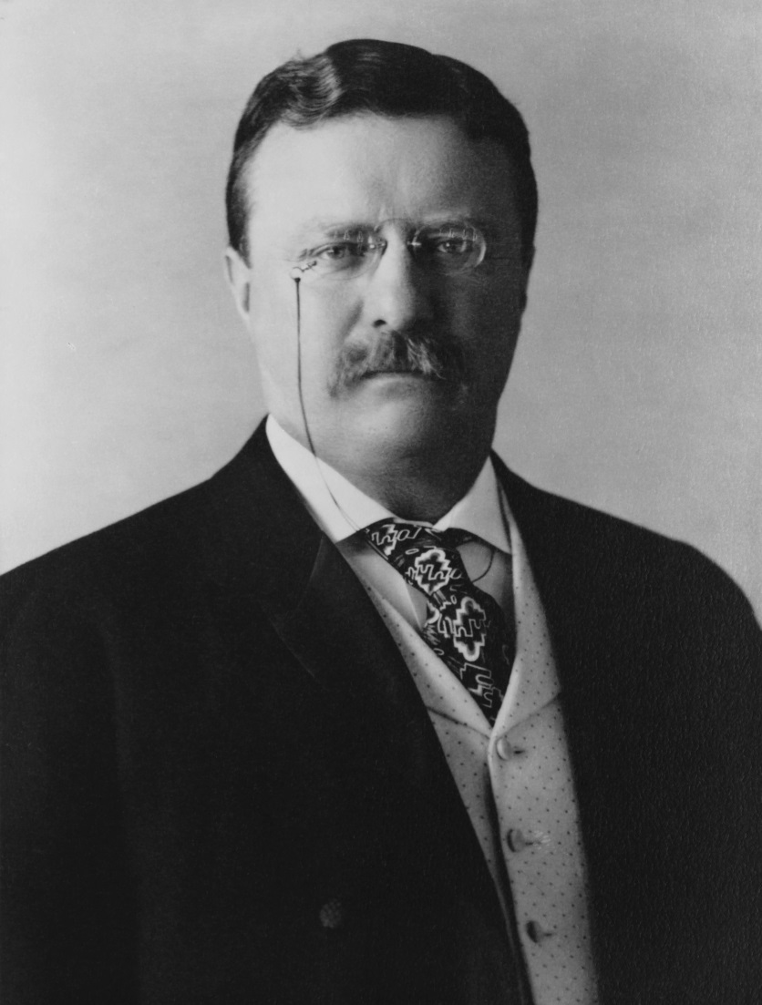
The Triumph of High Achievement
“
It is not the critic who counts; not the man who points out how the strong man stumbles, or where the doer of deeds could have done them better. The credit belongs to the man who is actually in the arena, whose face is marred by dust and sweat and blood…who spends himself in a worthy cause; who at the best knows in the end the triumph of high achievement, and who at the worst, if he fails, at least fails while daring greatly, so that his place shall never be with those cold and timid souls who neither know victory nor defeat.
President Theodore Roosevelt

Slide 4
Ten States Implementing DSRIP or DSRIP-Like Programs
Oregon Approved in 2014 for $300m
Kansas
Approved in 2013 for $60m
New Hampshire
Approved in 2016 for $150m
New York
Approved in 2014 for $8.25b*
California
Approved in 2010 for $6.67b; renewed in 2015 for $7.46b
Massachusetts
Approved in 2011 for $630m; extended through 2017 for $690m
New Jersey
Approved in 2012 for $583m
New Mexico
Approved in 2012 for $29m
Alabama
Approved in 2016 for $328m
Texas
Approved 2011 for $11.4b
DSRIP Program
DSRIP-Like Program
*See slide 5 for details
Sources: Kaiser Family Foundation, 2015. Key Themes from Delivery System Reform Incentive Payment Waivers in 4 States. kff.org/medicaid/issue-brief/key-themes-from-delivery-system-reform-incentive-payment-dsrip-waivers-in-4-states/; Department of Health and Human Services, 2015. www.medicaid.gov/Medicaid-CHIP-Program-Information/By-Topics/Waivers/1115/downloads/ca/medi-cal-2020/ca-medi-cal-2020-ca.pdf; New York State Department of Health, 2016. www.health.ny.gov/health_care/medicaid/redesign/dsrip/; Office of the Alabama Governor, 2016. governor.alabama.gov/newsroom/2016/02/alabama-medicaid-transformation-rco-program-approved-1115-waiver; NASHP, 2015. State Experiences Designing and Implementing Medicaid DSRIP Pools. www.macpac.gov/wp-content/uploads/2015/06/State-Experiences-Designing-DSRIP-Pools.pdf; New Hampshire Department of Health and Human Services, 2016. http://www.dhhs.nh.gov/section-1115-waiver/documents/pr-2016-01-05-transformation-waiver-terms.pdf.

Slide 5
New York’s Transformation Vision and Investments
Statewide DSRIP Goals for 2020
$8.25 billion
$1.5 billion
$1.08 billion
New York Transformation Investments: $11.33 Billion
25% reduction in avoidable hospital use
At least 80% managed care payments to providers via value-based payment methods
Transform the New York State health care system into a “financially viable, high performing system”
$500 million
DSRIP program funding
DSRIP funding via waiver and additional federal/state funding
Capital Restructuring Financing Program funding
State funding for capital and infrastructure improvements
Medicaid Redesign funding
Health home development, long-term care services, home- and community-based services funding via waiver
Interim Access Assurance Fund
Time-limited funding for safety-net providers via waiver
Sources: Centers for Medicare and Medicaid Services, New York Partnership Plan Special Terms and Conditions, March 31, 2016; New York State Department of Health, Final DSRIP Valuation Overview, June 2015; New York State Department of Health, DSRIP Program Project Toolkit, October 2014; and New York State Department of Health, Capital Restructuring Financing Program, April 2015.
Notes:
Additionally: SIM Grant

Slide 6
Year 0
April 2014
March 2015
Year 1
April 2015
March 2016
Year 2
April 2016
March 2017
DSRIP Timeline and Organizing Structure
Year 3
April 2017
March 2018
Year 4
April 2018
March 2019
PPSs Drive DSRIP Implementation
Public hospitals and safety-net providers applied to lead integrated delivery networks called Performing Provider Systems (PPSs)
25 PPSs approved: 23 hospital-led, one physician-led, one FQHC-led
PPSs required to select 5-11 clinical projects addressing system transformation, clinical improvement, and population health
Funding allocation based on scope and complexity of PPSs’ undertakings and size of attributed populations
Year 5
April 2019
March 2020

Slide 7
DSRIP Funding Architecture
In early years, DSRIP funding supports PPS development and project implementation. In later years, funding rewards PPSs for meeting outcome goals.
DSRIP Funding Allocation by Year
Project Progress Milestones
Process metrics assessing adherence to DSRIP requirements
Pay-For-Reporting
Reporting of process and outcome metrics
Pay-For Performance
Performance on specified outcome measures
Note: As part of a December 2015 waiver amendment request to the federal Centers for Medicare and Medicaid Services, New York is seeking to slightly modify these percentages.
Source: New York State Department of Health, Attachment I—NY DSRIP Program Funding and Mechanics Protocol, April 2014.

Slide 8
DSRIP is Catalyzing Change in New York’s Health Landscape
“
DSRIP has galvanized the industry to think about advancing a population health infrastructure and accelerating the shift from fee-for-service to population health management. It is making the investment necessary to make this transition effective. It has served as both a catalyst and an accelerant.
PPS Leader

Slide 9
Organization, Governance, and Market Transformation
Long-Term Role of PPSs Uncertain
PPS Governance Will Evolve
Hospital Network Strategies Key to Evolving Market

Slide 10
Care Model and Social Determinants of Health
New investment in community-based care initiatives
(e.g., PCMH)
Lack of focus on social determinants of health
Sustainability of investments in new care models unclear
“
DSRIP is local. It’s about identifying and meeting local needs and investing in infrastructure to meet those needs.
PPS Leader

Slide 11
Data-Sharing and Analytics
Providers require clinical, administrative, and financial data to successfully implement new care models and value-based payment structures.
State and PPSs investing heavily in analytics platforms
Availability of accurate, detailed and timely claims data limited
Providers concerned about data availability to identify at-risk patients and improve coordination of care

Slide 12
Measurement and Accountability
Complex reporting requirements may hamper implementation efforts.
PPSs set reporting requirements (e.g., proof of performance) for participating organizations
PPSs accountable for 100-330 process and outcome metrics, depending on project selection
State required to report to CMS quarterly on delivery system improvement, achievement towards project and population goals, Medicaid spending, and value-based payment arrangements; failure to achieve milestones will result in federal reduction of state funding, which in turn will result in state reduction of PPS funding
“
[DSRIP is] not about launching 10 or 11 projects, not about ticking boxes to hit particular requirements, not about moving the needle on performance measures. It’s about a fundamental restructuring towards a system that really rewards value.
State Government Official

Slide 13
Value-Based Payment Arrangements and Sustainability
“We’re in a race to get to value-based reimbursement before other funding streams run out.”
-PPS Leader
Ultimate Relationship between PPSs and MCOs is Unclear
VBP Requirements May Incentivize Provider Consolidation
Will Social Services Be Supported in VBP Relationships?
Payment Levels Matter

Slide 14
Thank You!
Deborah Bachrach, Partner
dbachrach@manatt.com
William Bernstein, Partner
wbernstein@manatt.com

