Slide 1
2015 Commonwealth Fund
International Health Policy Survey of Primary Care Physicians:
Practice Preparedness to Manage Care for Patients with Complex Needs
Eric Schneider
Senior Vice President for Policy and Research
The Commonwealth Fund

Slide 2
Health Care Spending as a Percentage of GDP 1985 to 2013
Percent
*2012
Notes: GDP refers to gross domestic product. Dutch and Swiss data current spending only exclude spending on capital formation of health care providers. Source: OECD Health Data 2015.

Slide 3
5 Percent of People Account for 50 Percent of Spending on Health Care
Distribution of health expenditures for the U.S. population, by magnitude of expenditure, 2012
Share of Health Spending
Population
1%
5%
10%
23%
50%
50%
66%
97%
Source: Agency for Healthcare Research and Quality analysis of 2012 Medical Expenditure Panel Survey.

Slide 4
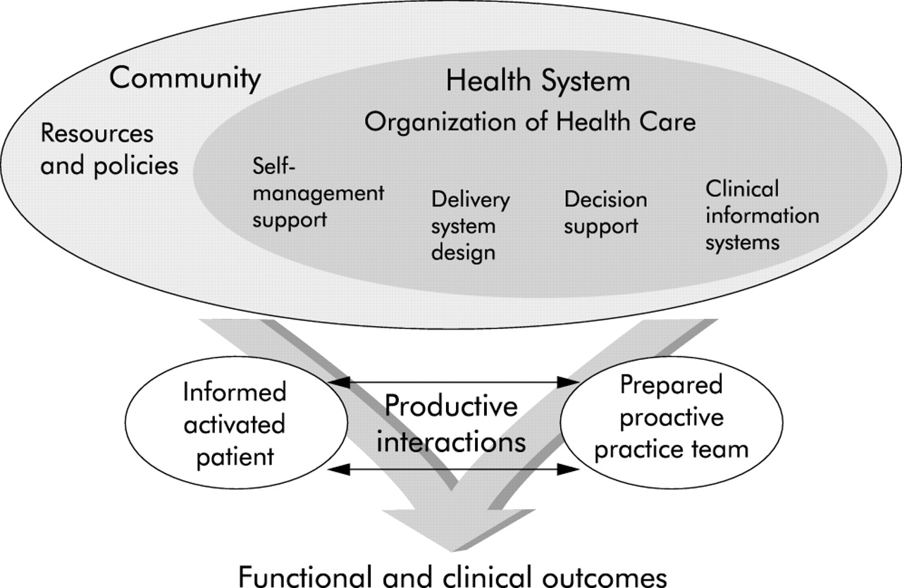
Chronic Care Model

Slide 5
2015 Commonwealth Fund International Health Policy Survey
Views and experiences of primary care doctors in 11 countries (18th annual survey)
Topics:
Practice preparedness to manage patients with complex needs
Capacity to provide access and care management
Communication and care coordination
Health information technology
Physician satisfaction and views of the system

Slide 6
Doctors’ Views of Practice Preparedness to Manage Care for Patients with Complex Needs

Slide 7
Doctors’ Views of Practice Preparedness to Manage Patients with Complex Needs
 | Multiple Chronic Conditions | Palliative Care | Dementia | Long-Term Home Care Services | Social Services in the Community | Severe Mental Health Problems | Substance Use-Related Issues
AUS
CAN
FR
GER
NETH
NZ
NOR
SWE
SWIZ
UK
US
>75% of doctors reporting “well-prepared”
>25% and ≤ 75% of doctors reporting “well-prepared”
≤ 25% of doctors reporting “well-prepared”
Top 2 countries in each category
Base: Excludes doctors who report that they "never“ see these patients. Source: 2015 Commonwealth Fund International Health Policy Survey of Primary Care Physicians.

Slide 8
Doctors’ Views of Practice Preparedness to Manage Patients with Complex Needs
 | Multiple Chronic Conditions | Palliative Care | Dementia | Long-Term Home Care Services | Social Services in the Community | Severe Mental Health Problems | Substance Use-Related Issues
AUS
CAN
FR
GER
NETH
NZ
NOR
SWE
SWIZ
UK
US
>75% of doctors reporting “well-prepared”
>25% and ≤ 75% of doctors reporting “well-prepared”
≤ 25% of doctors reporting “well-prepared”
Top 2 countries in each category
Base: Excludes doctors who report that they "never“ see these patients. Source: 2015 Commonwealth Fund International Health Policy Survey of Primary Care Physicians.

Slide 9
Doctors’ Views of Practice Preparedness to Manage Patients with Complex Needs
 | Multiple Chronic Conditions | Palliative Care | Dementia | Long-Term Home Care Services | Social Services in the Community | Severe Mental Health Problems | Substance Use-Related Issues
AUS
CAN
FR
GER
NETH
NZ
NOR
SWE
SWIZ
UK
US
>75% of doctors reporting “well-prepared”
>25% and ≤ 75% of doctors reporting “well-prepared”
≤ 25% of doctors reporting “well-prepared”
Top 2 countries in each category
Base: Excludes doctors who report that they "never“ see these patients. Source: 2015 Commonwealth Fund International Health Policy Survey of Primary Care Physicians.

Slide 10
Doctors’ Views of Practice Preparedness to Manage Patients with Complex Needs
 | Multiple Chronic Conditions | Palliative Care | Dementia | Long-Term Home Care Services | Social Services in the Community | Severe Mental Health Problems | Substance Use-Related Issues
AUS
CAN
FR
GER
NETH
NZ
NOR
SWE
SWIZ
UK
US
>75% of doctors reporting “well-prepared”
>25% and ≤ 75% of doctors reporting “well-prepared”
≤ 25% of doctors reporting “well-prepared”
Top 2 countries in each category
Base: Excludes doctors who report that they "never“ see these patients. Source: 2015 Commonwealth Fund International Health Policy Survey of Primary Care Physicians.

Slide 11
Primary Care Practice Capacity to Provide Enhanced Access and Care Management

Slide 12
Availability of Doctor or Nurse for After-Hours Care
Percent
* In Norway, respondents were asked whether there practice has arrangements or if there are regional arrangements. Source: 2015 Commonwealth Fund International Health Policy Survey of Primary Care Physicians.
12

Slide 13
Use Nurses or Case Managers to Monitor & Manage Chronic Care Patients
Percent
Source: 2015 Commonwealth Fund International Health Policy Survey of Primary Care Physicians.
11

Slide 14
Staff Frequently Make Home Visits
Percent
Source: 2015 Commonwealth Fund International Health Policy Survey of Primary Care Physicians.
13

Slide 15
Primary Care Doctors’ Experiences with Communication and Care Coordination

Slide 16
Always receive notification when
patient is seen in the ED and
when discharged from the hospital:
Percent Reporting
Source: 2015 Commonwealth Fund International Health Policy Survey of Primary Care Physicians.
15

Slide 17
Frequently Coordinates Care with Social Services or Other Community Providers
Percent
Source: 2015 Commonwealth Fund International Health Policy Survey of Primary Care Physicians.
17

Slide 18
Health Information Technology

Slide 19
Use of Electronic Medical Records, 2006-2015
Percent
Source: 2006-2015 Commonwealth Fund International Health Policy Survey of Primary Care Physicians.

Slide 20
Provides Patient with Electronic Access
% reporting offer patients the option to: | AUS | CAN | FR | GER | NETH | NZ | NOR | SWE | SWIZ | UK | US
E-mail about medical question or concern | 30 | 15 | 54 | 50 | 57 | 53 | 32 | 61 | 80 | 38 | 57
View online, download, or transmit information from medical record | 11 | 7 | 18 | 8 | 13 | 24 | 3 | 20 | 11 | 28 | 60
Source: 2015 Commonwealth Fund International Health Policy Survey of Primary Care Physicians.

Slide 21
Can Electronically Exchange Patient Summaries with Doctors Outside their Practice
Percent
Source: 2015 Commonwealth Fund International Health Policy Survey of Primary Care Physicians.

Slide 22
Satisfaction with Electronic Medical Record
Percent reporting: very satisfied/satisfied with EMR
Base: Doctors reporting they use an electronic record
Source: 2015 Commonwealth Fund International Health Policy Survey of Primary Care Physicians.

Slide 23
Primary Care Doctors’ Views of the Health Care System and
Practice Issues

Slide 24
“System Works Well, Only Minor Changes Needed” 2012 and 2015
Percent of Physicians Reporting:
Source: 2012 & 2015 Commonwealth Fund International Health Policy Survey of Primary Care Physicians.

Slide 25
Time Practice Spends on Insurance Issues or Claiming Payments MAJOR problem
Percent reporting
Source: 2015 Commonwealth Fund International Health Policy Survey of Primary Care Physicians.

Slide 26
How Stressful is Your Job as Primary Care Physician?
Source: 2015 Commonwealth Fund International Health Policy Survey of Primary Care Physicians.

Slide 27
Take-Away Messages
Industrialized countries have many opportunities to improve primary care for patients with complex needs
Primary care could be a keystone to address spending
Multidisciplinary teams
Electronic access, after-hours care and home visits
More effective use of health information technology
Better integrating care within and outside of the health care system
Looking to other countries offers an opportunity for valuable cross-national lessons to be learned
As reforms unsettle or disrupt current health systems, managing the transition will be critical

