Slide 1
Housing as a Platform
How Supportive Housing Addresses Complex Needs
August 1, 2016

Slide 2
About CSH
Advancing housing solutions that:
Improve lives of vulnerable people
Maximize public resources
Build strong, healthy communities
Notes:
CSH is a national non-profit headquartered in New York with offices in 12 states and staff in 18 states.
At CSH, it is our mission to advance housing solutions that deliver three powerful outcomes:
improved lives for the most vulnerable people
maximized public resources
strong, healthy communities across the country.
CSH is working to solve some of the most complex and costly social problems our country faces--like those related to homelessness.

Slide 3
CSH Frequent User Initiative Timeline and Outcomes
4. “Integrating FQHC Health Care Services with PSH in Los Angeles” Report
7. CSH SIF subgrantees in Los Angeles, San Francisco, Ann Arbor, and CT begin targeting and housing frequent users of health services and integrating housing and health care
10. CSH T/TA Program:
Webinars, Direct TA, Training, Peer to Peers
1. CSH’s Frequent Users of Health Systems Initiative
in CA
5. CSH Awarded Federal Social Innovation Fund Grant
2. NYC
FUSE: Frequent users of shelter and jail
3. Criminal justice FUSE replication: Minneapolis, DC, RI, CT, Denver, Chicago
2004
2006
2007
2008
2009
2010
2011
2012
2013
2014
2015-2017
9. CSH Awarded HRSA National Cooperative Agreement
Program | Selected Outcomes
1. FUHSI | ED visits/charges, inpatient admits/days/charges all decrease by 60% or more after 2 years in program
2. NYC FUSE | 40% fewer jail days, 50% fewer psychiatric hospitalizations; $15k savings per tenant
6. San Diego Project 25 | Cost savings over $1.4 million in reduced emergency services (ER and ambulance trans.) after 12 months
7. LA County FUSE/10th Decile Project | 81% average decrease in costs per tenant; ER utilization down 71%; hospital readmits and inpatient stays down by more than 80%
8. CSH and PCDC conduct integrated healthcare and supportive housing market assessment and convening
Notes:
10 years ago, CSH piloted the Frequent Users of Health Services Initiative in California, which targeted services and some housing to frequent users of emergency departments in several CA cities. Even without a complete connection to housing, this initiative achieved a 60% reduction in ED and inpatient visits.
On the other side of the country, CSH was experimenting with a similar model for frequent users of jails and homeless shelters in NYC. With a much stronger housing component, evaluations findings noted not only 40% fewer jail days but, importantly, a 50% decrease in psychiatric hospitalizations for the FUSE treatment group, achieving health improvements along with reduced redivisim to jails. The early results from the FUSE model in NYC were so promising we quickly sought to replicate the model in several communities nationwide.
We didn’t forget about frequent users of healthcare though, and tirelessly worked with several communities on FUSE pilots for frequent users of emergency heatlh servicies. Beginning in 2011 we began to see success as pilots we helped in various ways launched in LA County, Detroit, Phoenix, and San Diego. Notably, the project in San Diego, Project 25, has deep connections with an FQHC, and in the first year achieved cost savings of over $1.4 million in reduced emergency services.
Through this work, CSH wanted to figure out a way for more communities to house frequent users, and to formally test our theory that a combination of data driven targeting, affordable housing with wraparound support services, and integration with primary and behavioral health care could legitimately save governments enough money that they just might be willing to pay for the program after the model was proven to work. So, we applied for and received a federal Social Innovation Fund grant through the Corporation for National and Community Service, an agency under the White House. In 2012, we sub-granted these funds to four communities to test our model - San Francisco, Washtenaw Co., MI, Connecticut, and several regional partnerships in Los Angeles County.
In every community CSH has had the opportunity to work with on a frequent user initiative, health centers have played a critical role in serving frequent users by establishing both a primary and preventive health care connection and working to coordinate care with housing providers. In 2014, we decided to bring this knowledge to the larger health center community by applying for and receiving a HRSA NCA T/TA award. Through this award, we hope to help health centers nationwide learn how to partner with hospitals, housing providers, and other systems to improve care for unstably housed frequent users of health services.

Slide 4
Promising Practices in Texas – Houston
1) Created INTEGRATED CARE TEAMS
Social Services
Behavioral
Healthcare
Primary Healthcare
Medical Services
Mental Health Counseling
Detox & Substance Abuse Treatment
Life Skills Training
Eviction Prevention Programs
Job Training & Employment Counseling
Nutrition Counseling
Recreational and Social Events
Literacy Training
Tenant Advocacy
2) Assigned TEAMS to SH

Slide 5
Promising Practices in Texas - Houston
Goal:
Maximize Use of Mainstream Resources like Medicaid
City HHS –
$6M 1115 Medicaid Waiver
Seeds Creation of Integrated Care Teams
FQHCs learn to bill Medicaid, Insurance and other sources
Use 1115 Medicaid Waiver funds to cover the funding gap
Repurpose public/private service funding to create permanent payer source to fill modest gap
Entice Managed Care to fund non-covered services

Slide 6
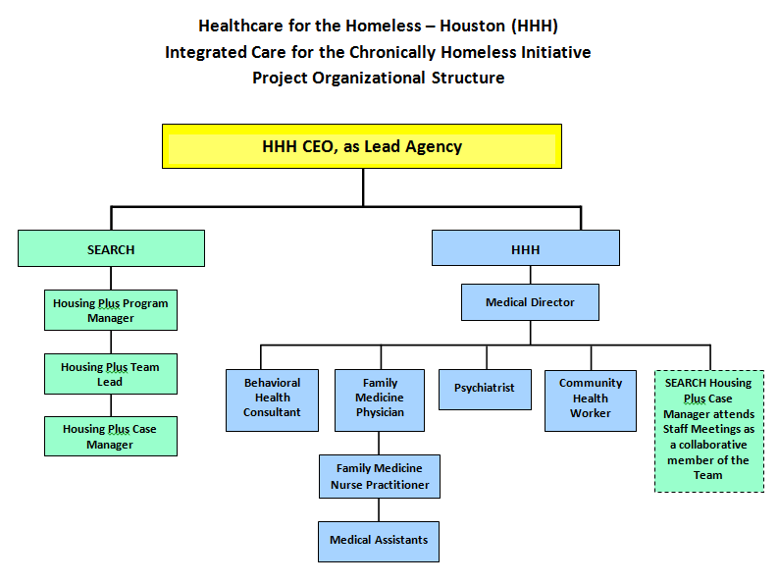
Staffing structure – Integrated Care Team

Slide 7
Delivery of Care
Initial Engagement
Ongoing Engagement
Housing Navigation
Meeting
Initiate Housing Process & Clinical Appointment
Obtain Security Deposit, Furnishings, Move In Items, Food
Clinical Case Manager
Meeting
Selection of a Health Home
Baseline ED Utilization & Administer SF36v2 Survey
Clinical Appointments
Medical Appointments
Behavioral Health Appointments
Specialty Care
Case Management Services
Informal Case Management
Clinical Case Management Sessions
LCDC Group & Individual Therapy
Community Health Sessions
6 Month SF36v2 Surveys

Slide 8
Integrated Care – Promising Early Outcomes
Top Diagnosis
SF 366
Scores of 50 reflect the norm
Statistically significant mean increase of 6 in MH from baseline to second assessment
PHQ 99
Composite baseline score: 15.2 (Depression 10+)
Baseline to first assessment – mean score of 10.68
ER Visits
Baseline 3 visits per year – included 126 participants
68 people with ER visits in year 1 (54% reduction)
Baseline Physical Summary score: 40.67 and Mental Summary score: 40.06
First to second assessment – mean score of 8.6
Average reduction in visits from 12.4 to 6.3
Participant with 144 visits in 2 years prior reduced to 20 since enrollment
Decreased scores in PH from baseline to first, moderate increase from first to second assessment
Substance Use Disorders (81%)
Chronic Pain/Pain-related disorders (73%)
Severe Mental Illness (64%)
Hypertension (44%)
Diabetes (22%)
Hepatitis C (24%)

Slide 9
Thank you
Kelly Sowards Opot: Kelly.opot@csh.org
Acting Associate Director, CSH
Texas Program

