Slide 1
The American Health Care Act: Economic & Employment Consequences for States
Leighton Ku, PhD, MPH
Professor of Health Policy & Management & Director, Center
for Health Policy Research
June 2017

Slide 2
Purpose and Methods
CBO and others have examined effects of American Health Care Act (AHCA) on insurance coverage and costs.
23 million more uninsured
14 million fewer covered by Medicaid due to phase down of Medicaid expansions, per capita caps and other changes.
We assess potential effects on economies and employment in all 50 states and DC from 2018-26.
Begin by using CBO estimates of changes in federal funding.
Examine combined effects of changes in Medicaid, premium tax subsidies, tax repeals and other changes.
Then model effects on state employment and economies using a regional economic model, PI+ from REMI.

Slide 3
The Rise and Fall in Employment If AHCA Enacted
# of Jobs
864,000
Total Employment
Baseline
Health Care
Employment
-924,000

Slide 4
Key National Findings: Total Changes
 | 2018 | 2026
CHANGES IN FEDERAL FUNDING:
Tax Repeal | $45 bil. | $102 bil.
Coverage-Related Spending (bil $) | -$6 bil. | -$160 bil.
Net Change in Federal Deficit (bil $) | $39 bil. | -$58 bil
CHANGES IN ECONOMIC OUTPUTS:
Total Employment | 864,000 | -924,000
Health Care | -24,000 | -725,000
All Other | 888,000 | -199,000
Gross State Product (bil $) | $91 bil. | -$93 bil.
Business Output (bil $) | $160 bil. | -$148 bil.

Slide 5
Effects of Coverage vs. Tax Changes
 | 2018 | 2026
Coverage Related Changes
Federal Funds | -$6 bil. | -$160 bil.
Total Employment | 24,000 | -1,940,000
Health Care | -100,000 | -829,000
Gross State Product | $5 bil. | -$235 bil.
Tax Repeal Changes
Federal Funds | $45 bil. | $102 bil.
Total Employment | 837,000 | 1,018,000
Health Care | 76,000 | 104,000
Gross State Product | $86 bil. | $142 bil.
Major factor leading to job loss is the large cuts
to Medicaid. Followed by changes in premium tax credits.
Tax changes are less effective in stimulating growth.

Slide 6
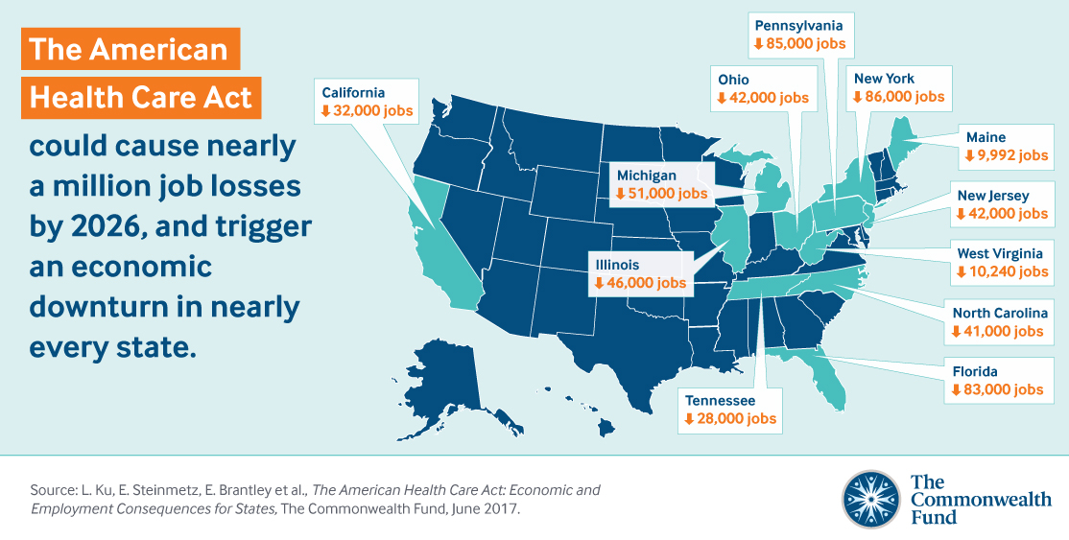
Top Ten State Losses

