Slide 1

What’s at Stake?
States’ Progress on Health Coverage and Access to Care, 2013-2016
Embargoed: Not for release before 12:01 ET
December 14, 2017
www.commonwealthfund.org
Media Teleconference: December 13, 2017

Slide 2

Overview of Key Findings
Exhibit 2
The Affordable Care Act has substantially improved access to health care in states nationwide.
More people have coverage. The uninsured rate among adults, children and people with lower incomes has fallen to record lows in most states.
Health care is more affordable. In many states, people are better able to get and afford the care they need, and fewer households are spending large shares of their incomes on health care.
Medicaid expansion has been central to states’ success.
The current policy environment poses risks to these gains.

Slide 3
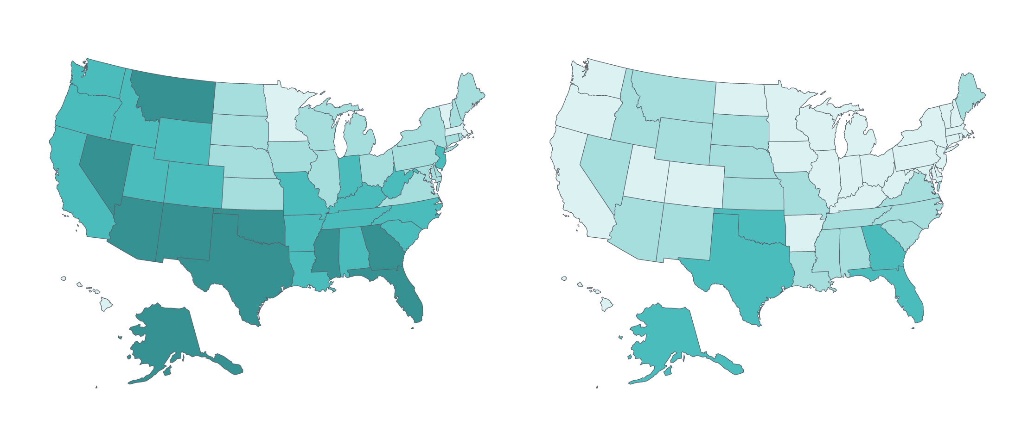
Exhibit 3
State uninsured rates improved dramatically during three first three years of ACA coverage expansions
Percent of Population Under Age 65 Uninsured, 2013−2016
2013
2016
<10% (4 states plus D.C.)
<10% (27 states plus D.C.)
10%–14% (18 states)
10%–14% (18 states)
15%–19% (18 states)
15%–19% (5 states)
≥20% (10 states)
Notes: “D.C.” stands for District of Columbia.
Data source: U.S. Census Bureau, 2013 and 2016 1-Year American Community Surveys, Public Use Micro Sample (ACS PUMS).

Slide 4
Thirteen states experienced double-digit declines in their adult uninsured rate
Exhibit 4
2013 adult (ages 19-64) uninsured rate
2016 adult (ages 19-64) uninsured rate
Notes: States are arranged in order of adult uninsured rate in 2013, highest to lowest. Numbers in red are percentage point (ppt) decline between 2013 and 2016 rates.
Data source: U.S. Census Bureau, 2013 and 2016 1-Year American Community Surveys, Public Use Micro Sample (ACS PUMS).

Slide 5
Uninsured rates for low-income adults declined in every state, with the greatest declines in Medicaid expansion states
Exhibit 5
Percent
2013
2016
Medicaid Expansion States
Notes: Low-income adults defined as adults ages 19-64 living in a household with income <200% of the federal poverty level. Medicaid expansion states are those states that expanded Medicaid by January 1, 2016. Louisiana expanded its Medicaid program in July 2016. States arranged in order of their 2016 rate.
Data source: U.S. Census Bureau, 2013 and 2016 1-Year American Community Surveys, Public Use Micro Sample (ACS PUMS).

Slide 6
Two-thirds of states (highlighted) reduced their uninsured rate among children by at least 2 percentage points
Exhibit 6
Percent
2013
2016
Notes: States are arranged in order of their 2016 rate. Data for 2016 not available for Rhode Island, and data for 2013 and 2016 not available for the District of Columbia and Vermont.
Data source: U.S. Census Bureau, 2013 and 2016 1-Year American Community Surveys. Public Use Micro Sample (ACS PUMS).

Slide 7
Exhibit 7
Nearly three-fourths of states saw a reduction in the share of adults who went without care because of costs
Percentage point decline between 2013 and 2016
Connecticut
D.C.
Hawaii
Idaho
Iowa
Kansas
Louisiana
Michigan
Maryland
New Hampshire
New Jersey
North Carolina
Oklahoma
Virginia
Wisconsin
Arizona
Colorado Georgia
Illinois
Indiana
Mississippi
Missouri
Montana
South Carolina
Utah
West Virginia
California New Mexico
Washington
Arkansas
Tennessee
Kentucky
Oregon
Note: Adults defined as age 18 and older. “D.C.” stands for District of Columbia.
Data: 2013 and 2016 Behavioral Risk Factor Surveillance System (BRFSS).

Slide 8
Exhibit 8
States that expanded Medicaid saw greater declines in the share of adults
who went without care because of costs
Average percentage-point change, 2013 to 2016*
Low-Income Adults
Hispanic Adults
Black Adults
Medicaid-expansion states, as of January 1, 2016
Nonexpansion states, as of January 1, 2016
Notes: *Average percentage point change is defined as the rate of adults 18 and older who reported going without needed care because of costs in 2013 less the rate in 2016. Rates were calculated in expansion and non-expansion states by summing the number of individuals who did and did not forego needed care. For the purposes of this exhibit we count the District of Columbia as a Medicaid expansion state, and Louisiana, which expanded its Medicaid program after Jan. 1, 2016, as a non-expansion state.
Data: 2013 and 2016 Behavioral Risk Factor Surveillance System (BRFSS).

Slide 9
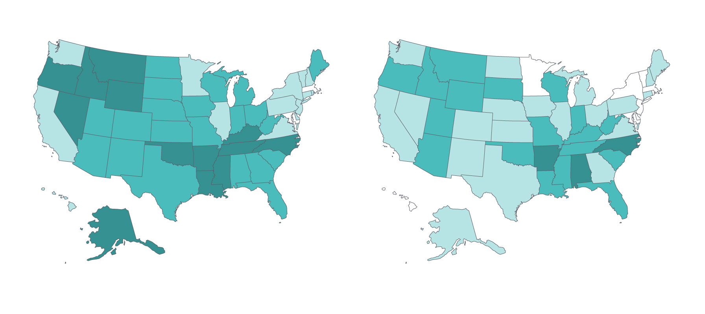
Exhibit 9
Fewer people under age 65 spent a high portion of income on medical care
2013-14
2015-16
10%–11% of people (2 states plus D.C.)
9%–11% of people (9 states plus D.C.)
12%–14% of people (14 states)
12%–14% of people (20 states)
15%–17% of people (21 states)
15%–17% of people (18 states)
18%–22% of people (13 states)
18%–19% of people (3 states)
Notes: “D.C.” stands for District of Columbia. This measure includes both insured and uninsured people and uses two thresholds to identify people under age 65 with high out-of-pocket spending: people living in households which spent 10 percent or more of their income on health care (excluding premiums if insured); or 5 percent or more, if their annual income was below 200 percent of the federal poverty level.
Data source: U.S. Census Bureau, 2014, 2015, 2017 and 2017 Current Population Surveys.

Slide 10
The share of at-risk adultsª without a routine doctor visit in the past two years improved in more than half of states
Exhibit 10
Improved (30 states plus D.C.)
Little or No Change (18 states)
Worsened (2 states)
ªAt-risk adults defined as all adults age 50 and older, and adults ages 18–49 who are in fair or poor health or who were ever told they have diabetes
or pre-diabetes, acute myocardial infarction, heart disease, stroke, or asthma. “D.C.” stands for District of Columbia.
Data source: 2013 and 2016 Behavioral Risk Factor Surveillance System (BRFSS).

Slide 11
Premiums for Individual Market Coverage Projected to Increase if Individual Mandate Repealed
Exhibit 11
Average additional spending in annual premiums for a 40-year-old purchasing unsubsidized individual market coverage would top $1,000 in these states
Notes: Using 2018 premium data as the baseline, Commonwealth Fund researchers examined the difference between CBO’s projection of what premiums would look like under current law for the 7 million people who buy their own, unsubsidized coverage and what premiums would look like if the ACA’s individual mandate penalties were repealed as part of the tax bill. The analysis is based on a 40-year-old’s premium for the lowest-cost silver plan in the 39 states that use the federally facilitated marketplace. For more on methods, see S. R. Collins, M. Z. Gunja, and H. K. Bhupal, "Senate Tax Bill Results in Premium Increases for Many Who Buy Their Own Coverage; Wealthiest to Benefit Most from Any Offsets from Tax Cuts," To the Point, The Commonwealth Fund, Nov. 21, 2017. Data: Data.Healthcare.gov Plan Year 2018 Individual Medical Coverage Landscape.

Slide 12
Summary and Implications
Exhibit 12
During the first three years of the ACA’s major coverage expansions, the number of uninsured Americans fell to a record low, and improvements in access to care were widespread across states.
Recent federal policy activity—including the likely repeal of the health insurance mandate penalty, the failure so far to renew federal funding for the Children’s Health Insurance Program, and shortened open enrollment period and deep cuts in outreach funding for ACA marketplace coverage—could jeopardize these gains.
It will be important to continue to monitor state health system performance on coverage and access to determine the effect of current and future policy changes.

Slide 13
Change in State Health System Performance by Access Indicator, 2013-2016
Appendix 1
Number of states that:
a
Notes: For the purposes of this exhibit we count the District of Columbia as a state, and the asterisk indicates which category D.C. falls in for each indicator. “Improved” or “Worsened” refers to a change of at least 0.5 standard deviations between the two time periods (2013 to 2016, except where noted). “Little or no change” category includes states with changes of less than 0.5 standard deviations as well as states with no change or without sufficient data to assess change over time. Individuals under age 65 with out-of-pocket medical costs relative to annual income, is a two-year average. ª At-risk adults defined as all adults age 50 or older, or adults ages 18 to 49 in fair or poor health, or ever told they have diabetes or pre-diabetes, acute myocardial infarction, heart disease, stroke, or asthma.

Slide 14
Methodology
Appendix 2
The six health care access and affordability indicators reported in this brief align with those reported in The Commonwealth Fund’s ongoing series of Health System Performance Scorecards.
Findings are based on the authors’ analysis of the most recent publicly available data from the U.S. Census Bureau and the Behavioral Risk Factor Surveillance System.
Measuring Change Over Time: We considered an indicator’s value to have changed if it was at least one-half (0.5) of a standard deviation larger than the difference in rates across all states over the two years being compared.
Scoring and Ranking: We averaged state rankings for the six indicators to determine a state’s access and affordability dimension rank.

Slide 15
Premiums for Individual Market Coverage Projected to Increase if Individual Mandate Repealed
Appendix 3
Average Additional Spending in Annual Premiums for a 40-year-old Purchasing Unsubsidized Individual Market Coverage in the 39 states that use the federally facilitated marketplace
Notes: Using 2018 premium data as the baseline, Commonwealth Fund researchers examined the difference between CBO’s projection of what premiums would look like under current law for the 7 million people who buy their own, unsubsidized coverage and what premiums would look like if the ACA’s individual mandate penalties were repealed as part of the tax bill. The analysis is based on a 40-year-old’s premium for the lowest-cost silver plan in the 39 states that use the federally facilitated marketplace. For more on methods, see S. R. Collins, M. Z. Gunja, and H. K. Bhupal, "Senate Tax Bill Results in Premium Increases for Many Who Buy Their Own Coverage; Wealthiest to Benefit Most from Any Offsets from Tax Cuts," To the Point, The Commonwealth Fund, Nov. 21, 2017. Data: Data.Healthcare.gov Plan Year 2018 Individual Medical Coverage Landscape.

