Slide 1
Overall Local Health System Performance: Scorecard Ranking, 2016
Overall performance, 2016
Top quintile (61 local areas)
Second quintile (61)
Third quintile (63)
Fourth quintile (61)
Bottom quintile (60)
Source: Commonwealth Fund Scorecard on Local Health System Performance, 2016 Edition.

Slide 2
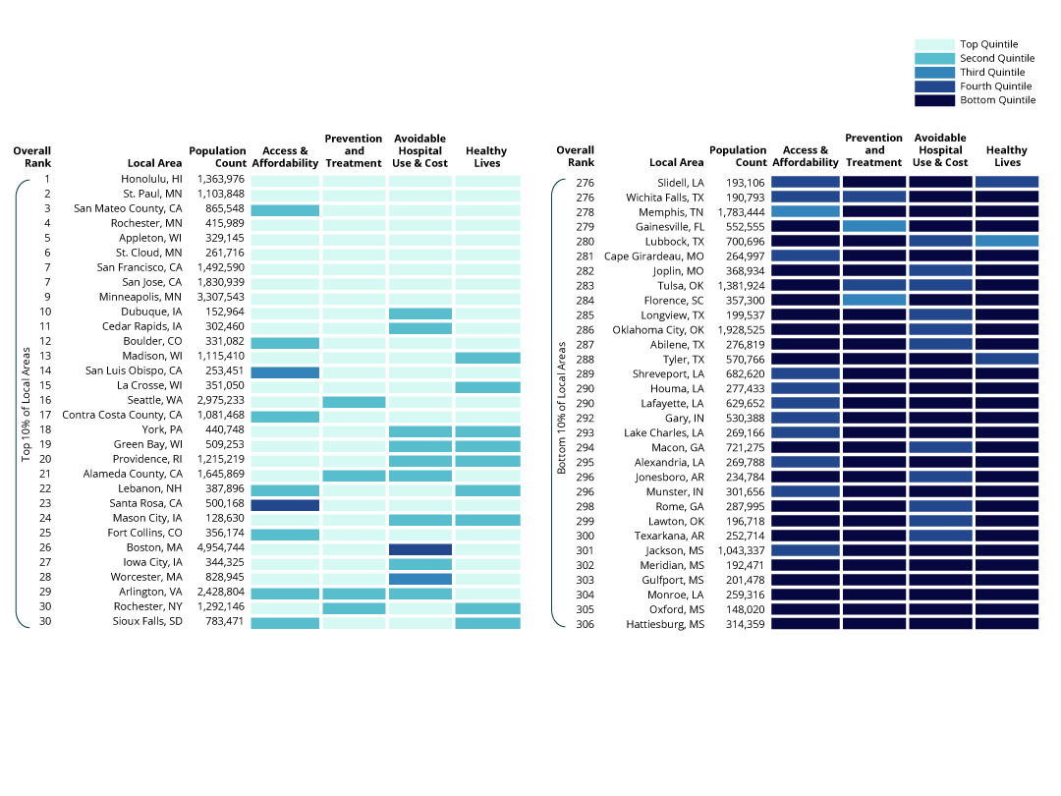
Performance by Dimension
Source: Commonwealth Fund Scorecard on Local Health System Performance, 2016 Edition.

Slide 3
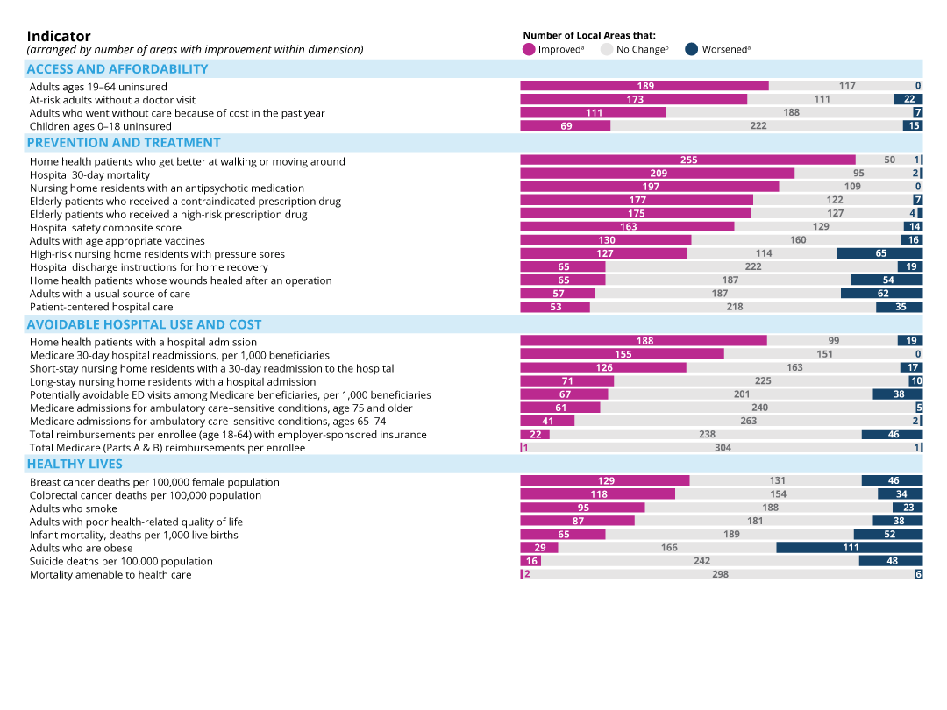
Overall Improvement by Indicator
Notes: Only Scorecard indicators with trends are shown. Trend data generally reflect the three-year period ending in 2014 or 2015—refer to Appendix for additional detail. ª Improvement or worsening refers to a change between the baseline and current time periods of at least 0.5 standard deviations. ^{b} Includes the number of local areas with little or no change or without sufficient data for this subpopulation to assess change over time.
Source: Commonwealth Fund Scorecard on Local Health System Performance, 2016 Edition.

Slide 4
Larger Reductions in Uninsured Adults in Low-Income Communities in States That Expanded Medicaid
Percentage-point reduction in uninsured adults between 2012 and 2014
Notes: States’ Medicaid expansion status as of January 1, 2014. Lower-income local areas are defined as those hospital referral regions (HRRs) where 40% or more of residents live in households with incomes below 200% of the Federal Poverty Level (FPL). Higher-income local areas are defined as those HRRs where fewer than 30% of residents live in households with incomes below 200% FPL.
Data: 2012 and 2014 American Community Survey Public Use Micro Sample (ACS PUMS).
Source: Commonwealth Fund Scorecard on Local Health System Performance, 2016 Edition.

Slide 5
Premature Death Rates Vary by Local Areas Within States
Mortality amenable to health care: deaths per 100,000, 2012–13
U.S. average, all races = 84 per 100,000
Notes: States are arranged in rank order based on the highest local mortality rate in the state.
Data: 2012 and 2013 National Vital Statistics System (NVSS) mortality all-county micro data files.
Source: Commonwealth Fund Scorecard on Local Health System Performance, 2016 Edition.

Slide 6
Employer-Sponsored Insurance and Medicare Spending per Enrollee, Relative to U.S Median Spending for Each Population, 2014
Per-Enrollee Spending: Employer-Sponsored Insurance
0.62–0.89 (76 HRRs)
Per-Beneficiary Spending: Medicare
0.64–0.89 (77 HRRs)
0.90–0.99 (75 HRRs)
0.90–0.99 (76 HRRs)
1.00–1.08 (75 HRRs)
1.00–1.08 (77 HRRs)
1.09–2.12 (75 HRRs)
1.09–1.52 (76 HRRs)
Notes: Ratio values lower than 1.0 indicate lower-than-median spending, ratio values higher than 1.0 indicate higher-than-median spending. Median spending is determined separately for the commercially insured and Medicare populations. Spending estimates exclude prescription drug costs; are adjusted for regional wage differences; and Medicare estimates reflect only the age 65+ Medicare fee-for-service population.
Data: Commercial—2014 Truven MarketScan Database, analysis by M. Chernew, Harvard Medical School. Medicare—2014 administrative claims via February 2016 CMS Geographic Variation Public Use File.
Source: Commonwealth Fund Scorecard on Local Health System Performance, 2016 Edition.

Slide 7
Scorecard Performance Among Lower- and Higher-Income Local Areas: Low-Income Communities Tend to Rank Lower
Overall Performance
Access & Affordability
Prevention & Treatment
Avoidable Use & Cost
Healthy
Lives
Top performance quintile
Middle performance quintile
Bottom performance quintile
Higher-income
Lower-income
Higher-income
Lower- income
Higher-income
Lower-income
Higher-income
Lower-income
Higher-income
Lower- income
Note: Lower-income local areas are defined as those hospital referral regions (HRRs) where 40% or more of residents live in households with incomes below 200% of the Federal Poverty Level (FPL). Higher-income local areas are defined as those HRRs where fewer than 30% of residents live in households with incomes below 200% FPL. Quintile delineations are are based on overall Scorecard performance.
Source: Commonwealth Fund Scorecard on Local Health System Performance, 2016 Edition.

Slide 8
Low-Income Local Areas Are Making Progress in Reducing 30-Day Readmissions to the Hospital
Median reduction of 7 per 1,000 in local areas where 40% or more of the population lives in households with low incomes
Median reduction of 5 per 1,000 in local areas where less than 30% of the population lives in households with low incomes
Reduction in 30-day hospital readmissions, per 1,000 Medicare beneficiaries, 2012–2014
Resident population below 200% FPL
Note: : Lower-income local areas are defined as those hospital referral regions (HRRs) where 40% or more of residents live in households with incomes below 200% of the Federal Poverty Level (FPL). Higher-income local areas are defined as those HRRs where fewer than 30% of residents live in households with incomes below 200% FPL.
Data: 2012 and 2014 administrative claims via February 2016 CMS Geographic Variation Public Use File.
Source: Commonwealth Fund Scorecard on Local Health System Performance, 2016 Edition.

