Slide 1

Results from the 2019 Scorecard on State Health System Performance
www.commonwealthfund.org
Media teleconference: June 11, 2019
Embargoed
until 12:01 am,
June 12, 2019

Slide 2
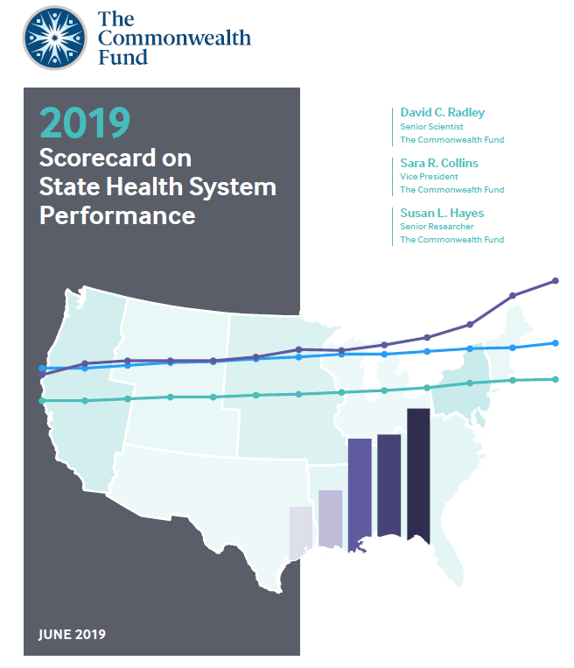
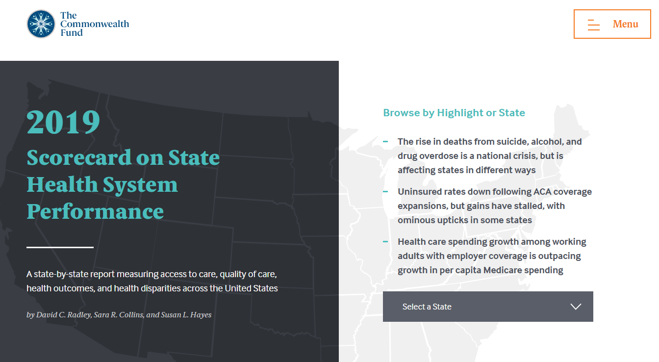
Results from the 2019 Scorecard on State Health System Performance
Exhibit 2
Online interactive report
Printable Version

Slide 3
Key Findings from the Scorecard
Exhibit 3
Deaths from suicide, alcohol, and drugs are a national crisis, but affect states in different ways
  States in New England, the Mid-Atlantic, and a number of Southeastern states have been hard-hit by the opioid epidemic
  Several western and plains states had higher rates of death from suicide and alcohol use than from drugs in 2017
States’ progress in expanding health care coverage and access since the Affordable Care Act (ACA) was enacted has stalled
  16 states experienced small upticks in their adult uninsured rate between 2016 and 2017
Health care costs are the primary driving force behind rising premiums, which are an increasing financial burden to working families in all states.
  per-enrollee spending growth in employer plans grew faster and was more variable across states than per beneficiary spending in Medicare

Slide 4
Hawaii, Massachusetts, and Minnesota lead the nation
Exhibit 4
Better performance
U.S. average
Worse performance
States are arranged in rank order from left (best) to right (worst), based on their overall 2019 Scorecard rank.

Slide 5
Eight states are leaders in their own regions
Exhibit 5
Great Lakes
Mid-Atlantic
New England
Rocky Mountains
Southeast
Plains
Southwest
West
Top state in each region
Better-than-average states in each region
Worse-than-average states in each region

Slide 6
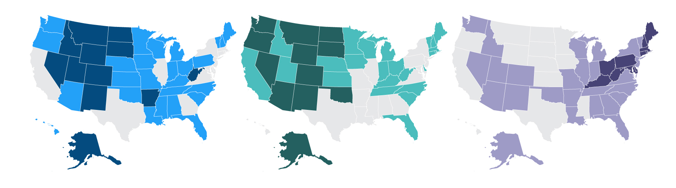
Deaths from suicide, alcohol, and drug overdose impact states differently (deaths per 100,000 in 2017)
Exhibit 6
Suicide
Alcohol
Drug overdose
Deaths per 100,000 in 2017
Deaths per 100,000 in 2017
Deaths per 100,000 in 2017
6.6–13.6 (12 states)
5.5–7.9 (14 states)
8.1–13.8 (13 states)
13.8–19.1 (26 states)
8.2–11.8 (24 states)
14.4–29.4 (26 states)
20.1–28.9 (12 states)
13.4–30.6 (12 states)
30.0–57.8 (11 states)
Note: D.C. not counted in state tallies.
Data: 2005–2017 National Vital Statistics System (NVSS), via CDC WONDER

Slide 7
Drug overdose deaths unequal across states, disproportionately impact Pennsylvania, Ohio and West Virginia
Exhibit 7
Deaths per 100,000
Low-rate states
West Virginia
Ohio
Pennsylvania
U.S.
Notes: ‘Low-rate’ refers to the median value among the group of states with rates below the U.S. average.
Data: 2017 National Vital Statistics System (NVSS), via CDC WONDER

Slide 8
Deaths from suicide, alcohol, and drug overdose on the rise, 2005-2017
Exhibit 8
Deaths per 100,000
Cumulative increase
2005–2017
Drug overdose
115%
Suicide
28%
Alcohol
37%
Data: 2005–2017 National Vital Statistics System (NVSS), via CDC WONDER

Slide 9
Drug overdose deaths up more than 300% in Ohio, Delaware and West Virginia
Exhibit 9
Percent change 2005 - 2017
Lower growth states
West Virginia
Delaware
Ohio
U.S.
Notes: ‘Lower growth’ refers to the median value among the group of states with growth rates below the U.S. average.
Data: 2005–2017 National Vital Statistics System (NVSS), via CDC WONDER

Slide 10
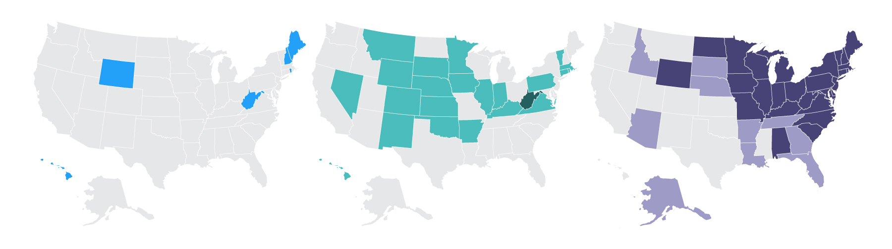
Growth in deaths from suicide, alcohol, and drug overdose differ across states
Exhibit 10
Suicide
Alcohol
Drug overdose
Percent change 2005–2017
Percent change 2005–2017
Percent change 2005–2017
3%–48% (44 states)
3%–48% (27 states)
16%–47% (13 states)
52%–87% (6 states)
51%–96% (22 states)
53%–86% (10 states)
100% or more (0 states)
119% (1 state)
107%–450% (26 states)
Note: Growth is measured as the percent change in deaths per 100,000 between 2005 and 2017. D.C. not counted in state tallies. Map categories are fixed for all three death causes at 0-49% increase, 50-99% increase, and 100% or more increase. (*) Only D.C. had a negative growth rate; all states had growth rates of at least 3%.
Data: 2005–2017 National Vital Statistics System (NVSS), via CDC WONDER

Slide 11
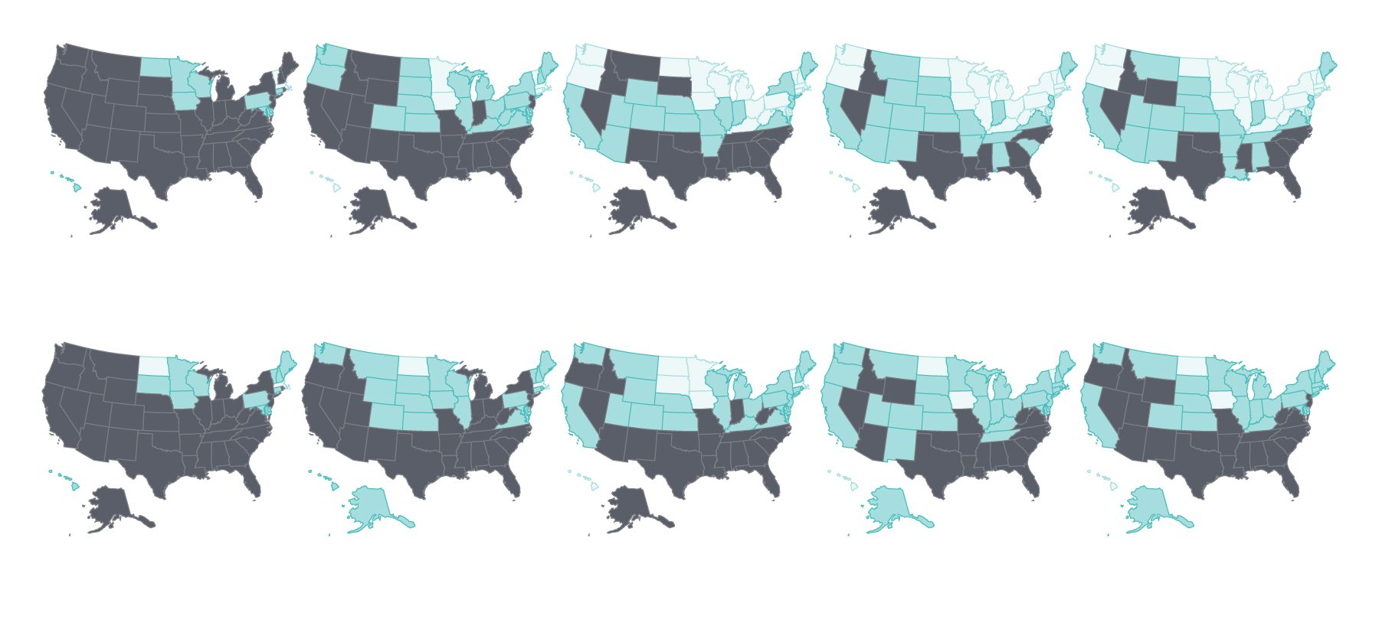
Cost barriers to receiving care fell as uninsured rates fell following ACA coverage expansions
Exhibit 11
Uninsured adults
Less than 10%
10%–14%
15% or more
Adults who went without care because of costs
2013
2014
2015
2016
2017
Notes: Adults who went without care is limited to persons age 18-64 in this exhibit, thou the Scorecard ranks states on a version of this measure that includes all adults age 18 and older.
Data: Uninsured (ages 19–64): U.S. Census Bureau, 2013–2017 One-Year American Community Surveys. Public Use Micro Sample (ACS PUMS); Cost barriers (ages 18–64): 2013–2017 Behavioral Risk Factor Surveillance System (BRFSS).
Notes:
Make this the first chart in this section

Slide 12
Five of the 17 states that have yet to expand Medicaid had the highest adult uninsured rates in 2017
Exhibit 12
Percent
Medicaid expansion states
as of January 1, 2017
24%
Non-Medicaid expansion states
as of January 1, 2017
4%
Note: ME and VA passed and implemented expansion after 1/1/2017. NE, UT, and ID passed ballot initiatives to expand Medicaid but have not yet implemented a full expansion.
Data: U.S. Census Bureau, 2017 One-Year American Community Surveys. Public Use Micro Sample (ACS PUMS).

Slide 13
The share of adults ages 18-64 who skipped needed care because of costs up in a dozen states, eroding earlier gains
Exhibit 13
Percent
2017
States with little or no change
States with an
Increase*
2016
Note: States are arranged in rank order based on their 2016 value. (*) rate increase refers to change between 2016 and 2017 of at least 2 percentage points. Adults who went without care is limited to persons age 18-64 in this exhibit, though the Scorecard ranks states on a version of this measure that includes all adults age 18 and older.
Data: 2016 and 2017 Behavioral Risk Factor Surveillance System (BRFSS).

Slide 14
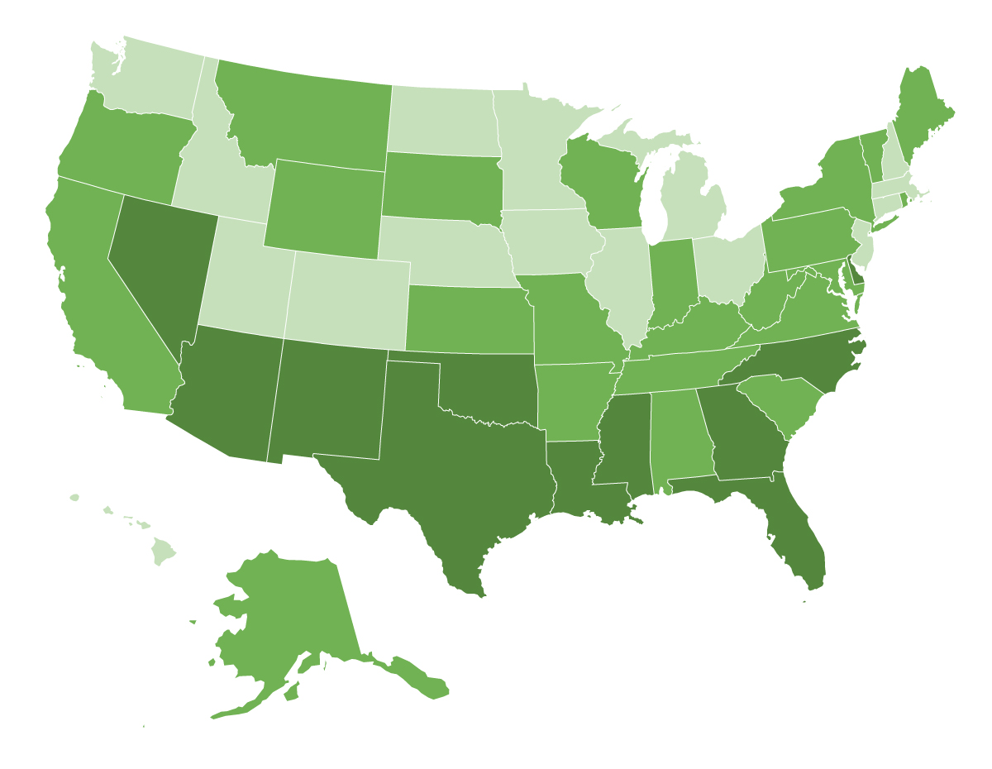
Average employee health insurance contributions were 8 percent of median income or more in 11 states, 2017
Exhibit 14
Average employee share of premium as percent of median state incomes
4.8%–5.9% (16 states + D.C.)
6.0%–7.7% (23 states)
8.0%–10.2% (11 states)
Source: Employee premium share: Medical Expenditure Panel Survey–Insurance Component (MEPS-IC, 2017); Median household income: Current Population Survey (2017-18).

Slide 15
Higher premiums for employer coverage is associated with higher per person spending, 2016
Exhibit 15
State values
U.S. Average
Average premiums for employer coverage
r = 0.74
Average per enrollee spending among individuals with employer coverage
Note: X- and Y-axes do not start at $0. Abbreviations left off some states clustered near the U.S. average for legibility
Data: Employer coverage per enrollee spending - 2016 Truven MarketScan Database, analysis by M.Chernew, Harvard Medical School. Medical Expenditure Panel Survey–Insurance Component (MEPS-IC, 2017)

Slide 16
Price increases drive total spending growth
Exhibit 16
Cumulative change in per person spending, utilization, average price, 2013-2017
Total Spending
Service Use
Price
+29%
+25%
+19%
+19%
+17%
+17%
+16%
+13%
+12%
+10%
+3%
+<1%
-<1%
-5%
Total Inpatient Outpatient Professional Services Rx Drugs
Note: The data on this chart come directly from the Healthcare Cost Institute (HCCI), and are not factored into the Scorecard rankings. The 2017 Health Care Cost and Utilization Report examines medical and prescription drug spending, utilization, and average prices, and is based on health care claims data from 2013 through 2017 for Americans under the age of 65 who were covered by employer-sponsored insurance (ESI). Utilization and average prices account for changes in the type or intensity of services used, with the exception of prescription drugs. Prescription drug spending is the amount paid on the pharmacy claim, which reflects discounts from the wholesale price, but not manufacturer rebates.
Source: Healthcare Cost Institute, 2017 Healthcare Cost and Utilization Report. Available here:
https://www.healthcostinstitute.org/images/pdfs/HCCI_2017_%20Health_%20Care_Cost_and_Utilization_Report_02.12.19.pdf

Slide 17
Cumulative growth in per-enrollee spending among adults with employer insurance out-paced per capita Medicare spending growth
Exhibit 17
Employer insurance
Medicare
Great Lakes
Mid-Atlantic
New England
Plains
Rocky Mountain
Southeast
Southwest
West
Data: Employer coverage - 2016 Truven MarketScan Database, analysis by M.Chernew, Harvard Medical School. Medicare, 2016 administrative claims via May 2018 CMS Geographic Variation Public Use File.

Slide 18
Summary and Implications
Exhibit 18
Improvement is possible, progress on many measures would benefit from state and federal partnerships
Expanding coverage and access to care
  Medicaid expansion is associated with lower uninsured rates
  Placing limits on Medicaid eligibility will further erode coverage;
  State and federal policies (e.g. reinsurance programs) can lower premiums in the individual market.
Mitigating spending growth
  State and federal value-based payment programs link provider payment to patient outcomes;
  State and federal efforts to set prices paid by private insurers closer to Medicare rates.
Addressing the opioid crisis
  Improving access to opioid overdose-reversal medications like naloxone
  Establishing guidelines and limits for opioid prescribing.

Slide 19
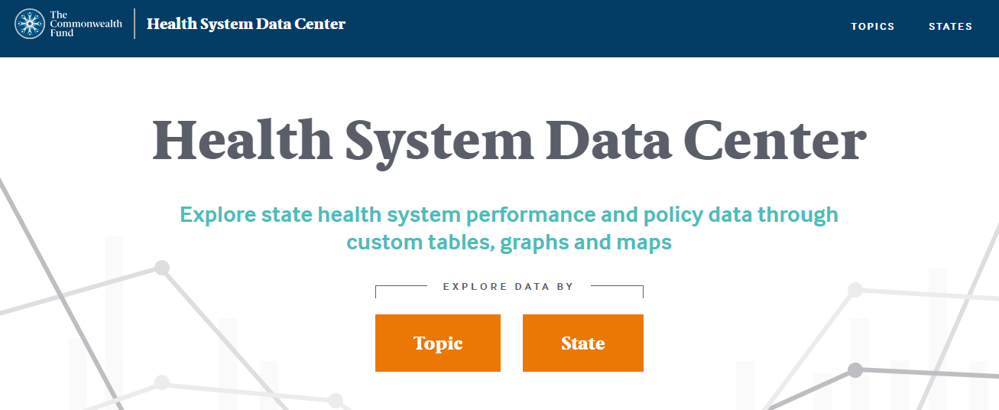
For More Information, Visit the Fund’s new Health System Data Center: http://datacenter.commonwealthfund.org/
Exhibit 19

Slide 20
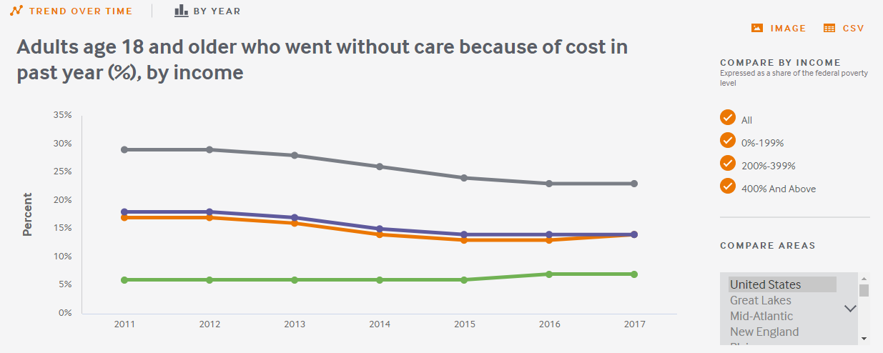
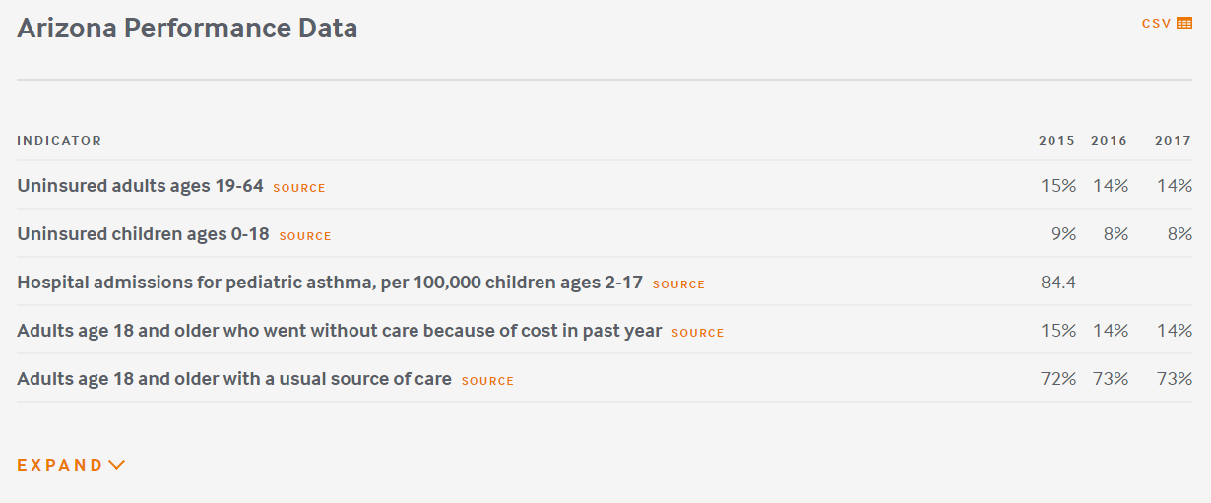
Exhibit 20
Interactive tools &
sub-population analysis
State-specific downloadable content

Slide 21
State Health System Scorecard Methods
Exhibit 21
Goal: to provide benchmarks and trends to inform national, state and local action to improve health care system performance
Health System Focus: Builds on previous Scorecards
  47 indicators organized into 4 dimensions: Access/affordability; Prevention/treatment; Avoidable hospital use and costs; and Healthy lives
  Disparity dimension assesses a subset of indicators by income within states
  National data sources including administrative claims, national surveys, and vital statistics available for states
2- to 3-year trend data available for 45 indicators
  Generally from 2013 to 2017, but varies by indicator
Scoring:
  Each indicator is ranked based on standardized (z- ) score
  Dimension rank is based on average of indicator standardized scores
  Overall rank based on average of five dimension standardized scores
Estimated gains are based on rates of performance in the top performing state

Slide 22
2019 Scorecard Indicators
Exhibit 22

