Slide 1



From Data to Decisions Nirav R. Shah, MD, MPH
APRIL 3, 2020 Senior Scholar, Stanford University

Slide 2


FOUNDERS
Max Henderson
Jonathan Kreiss-Tomkins
Igor Kofman
Zack Rosen

Slide 3
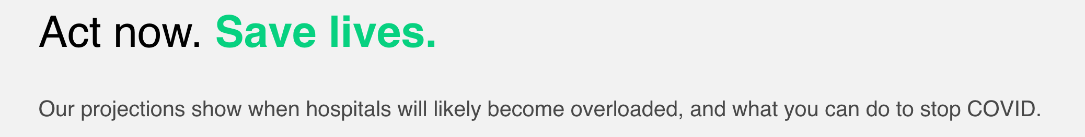
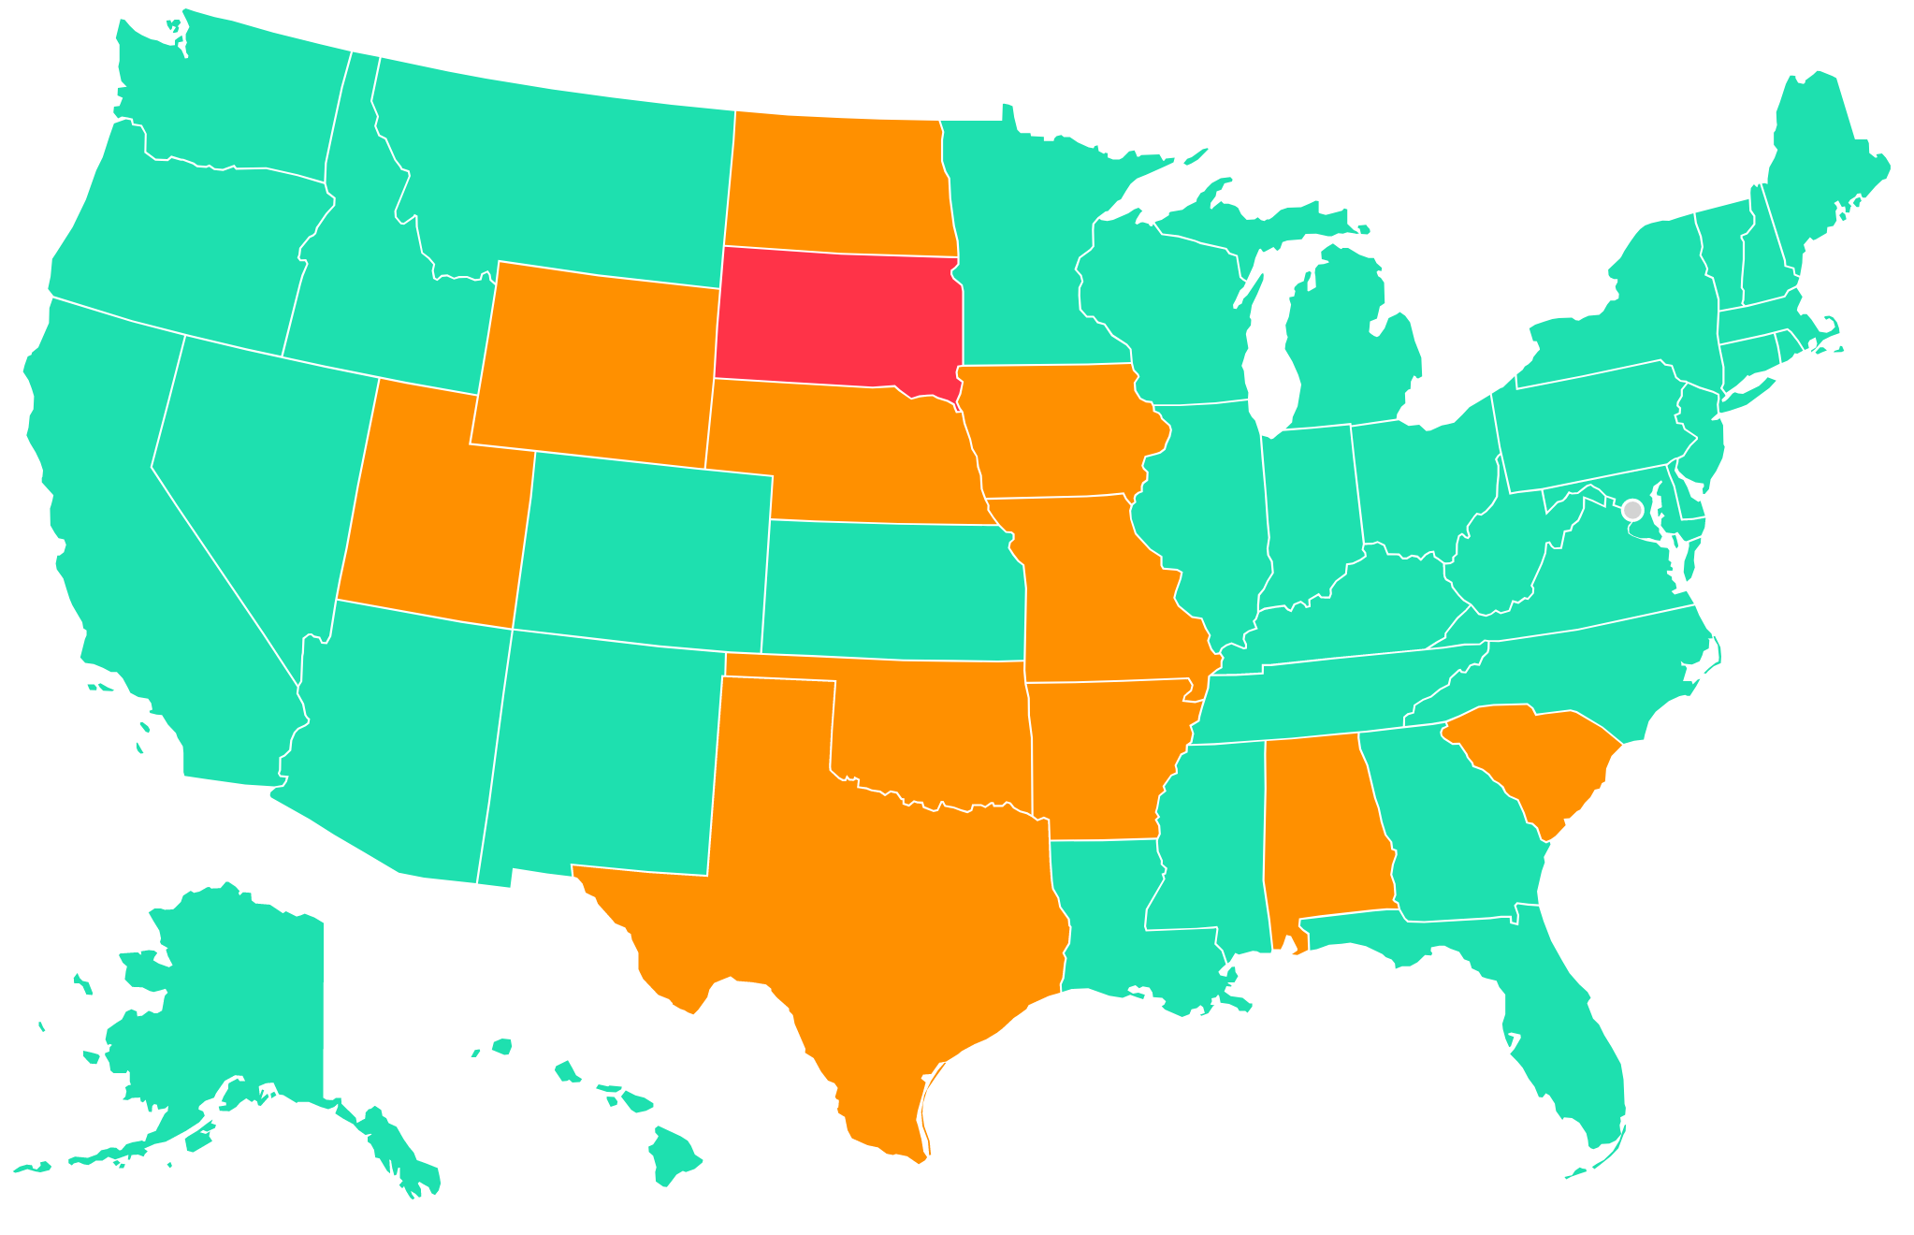

Slide 4

Get everyone to stay-at-home
(“flatten the curve”) by providing up-to-date information with best-available data
Launched 2 weeks ago (March 20)
Data for 2000+ counties included, updated daily
Full transparency on model, data sources, assumptions, etc.

Slide 5
7+ million page views in the first week
The Verge // The best graphs and data for tracking the coronavirus pandemic
Officials in MI, CO, AK, HI and cities across the US credit CovidActNow for the data supporting orders to “stay at home” or “shelter in place”

Slide 6


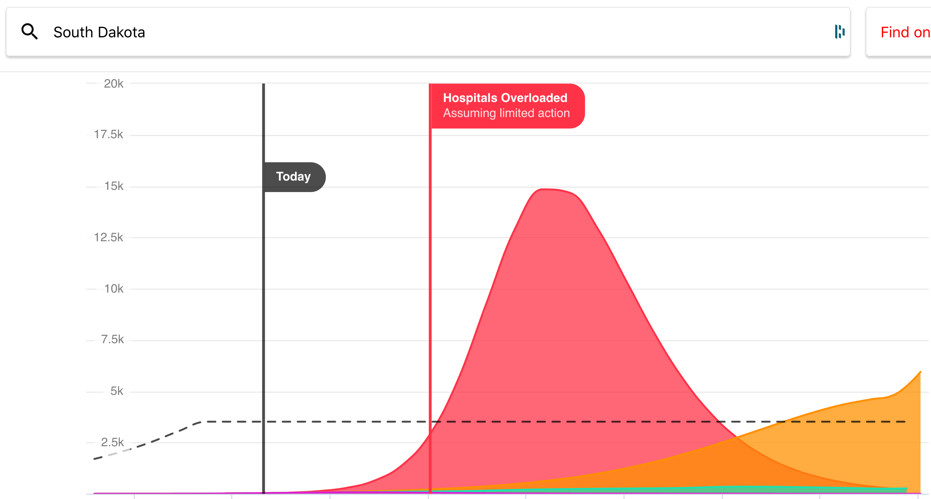

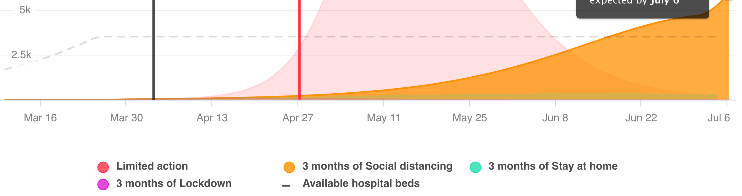

Slide 7

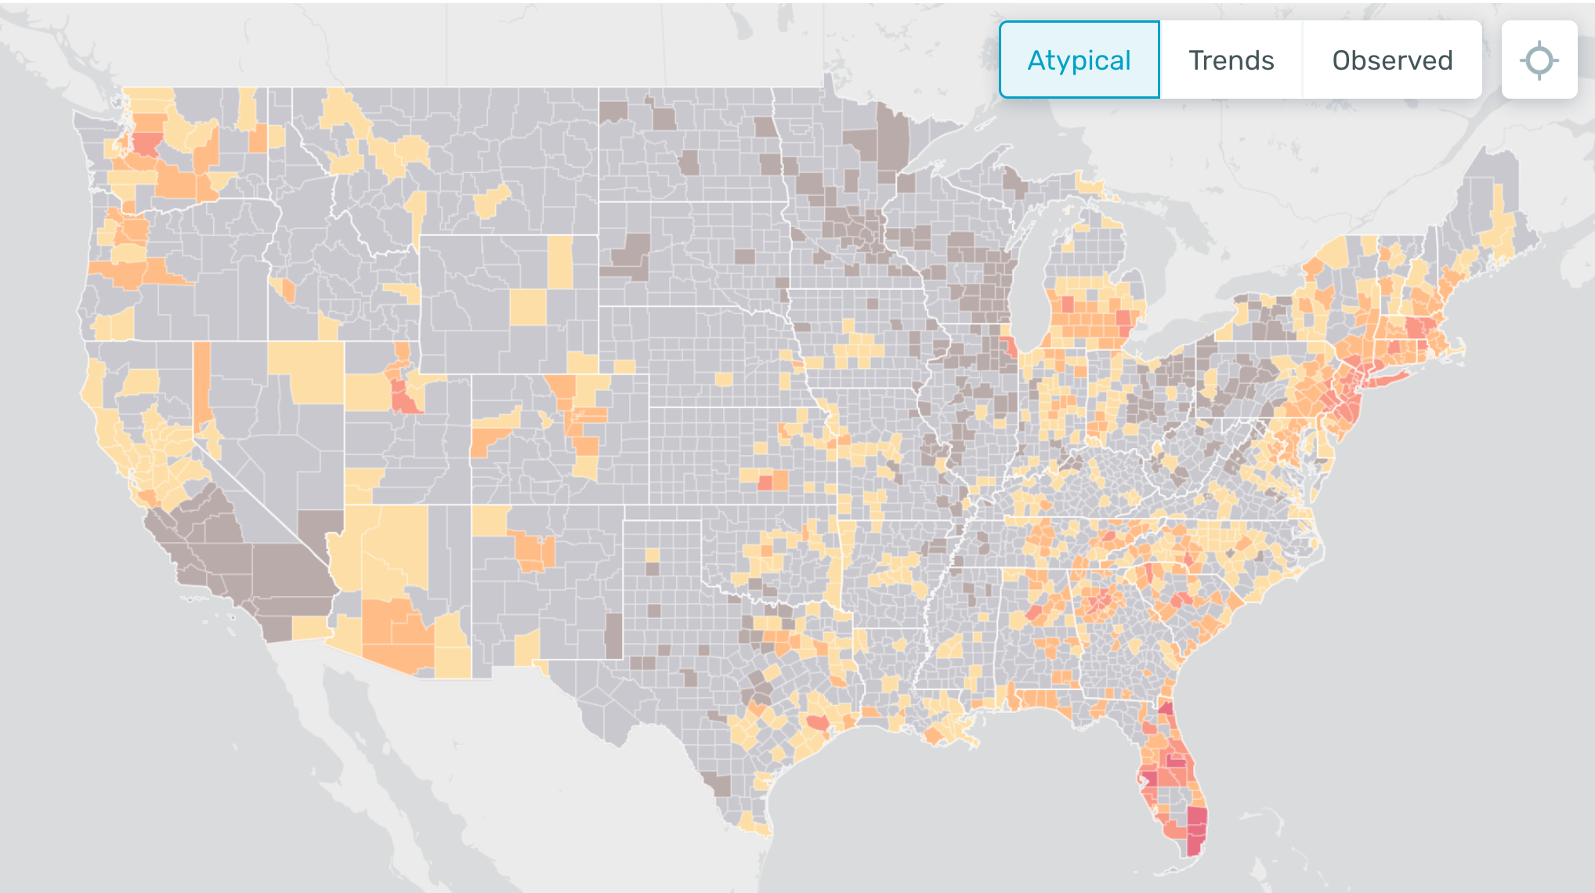
healthweather.us

Slide 8


Slide 9


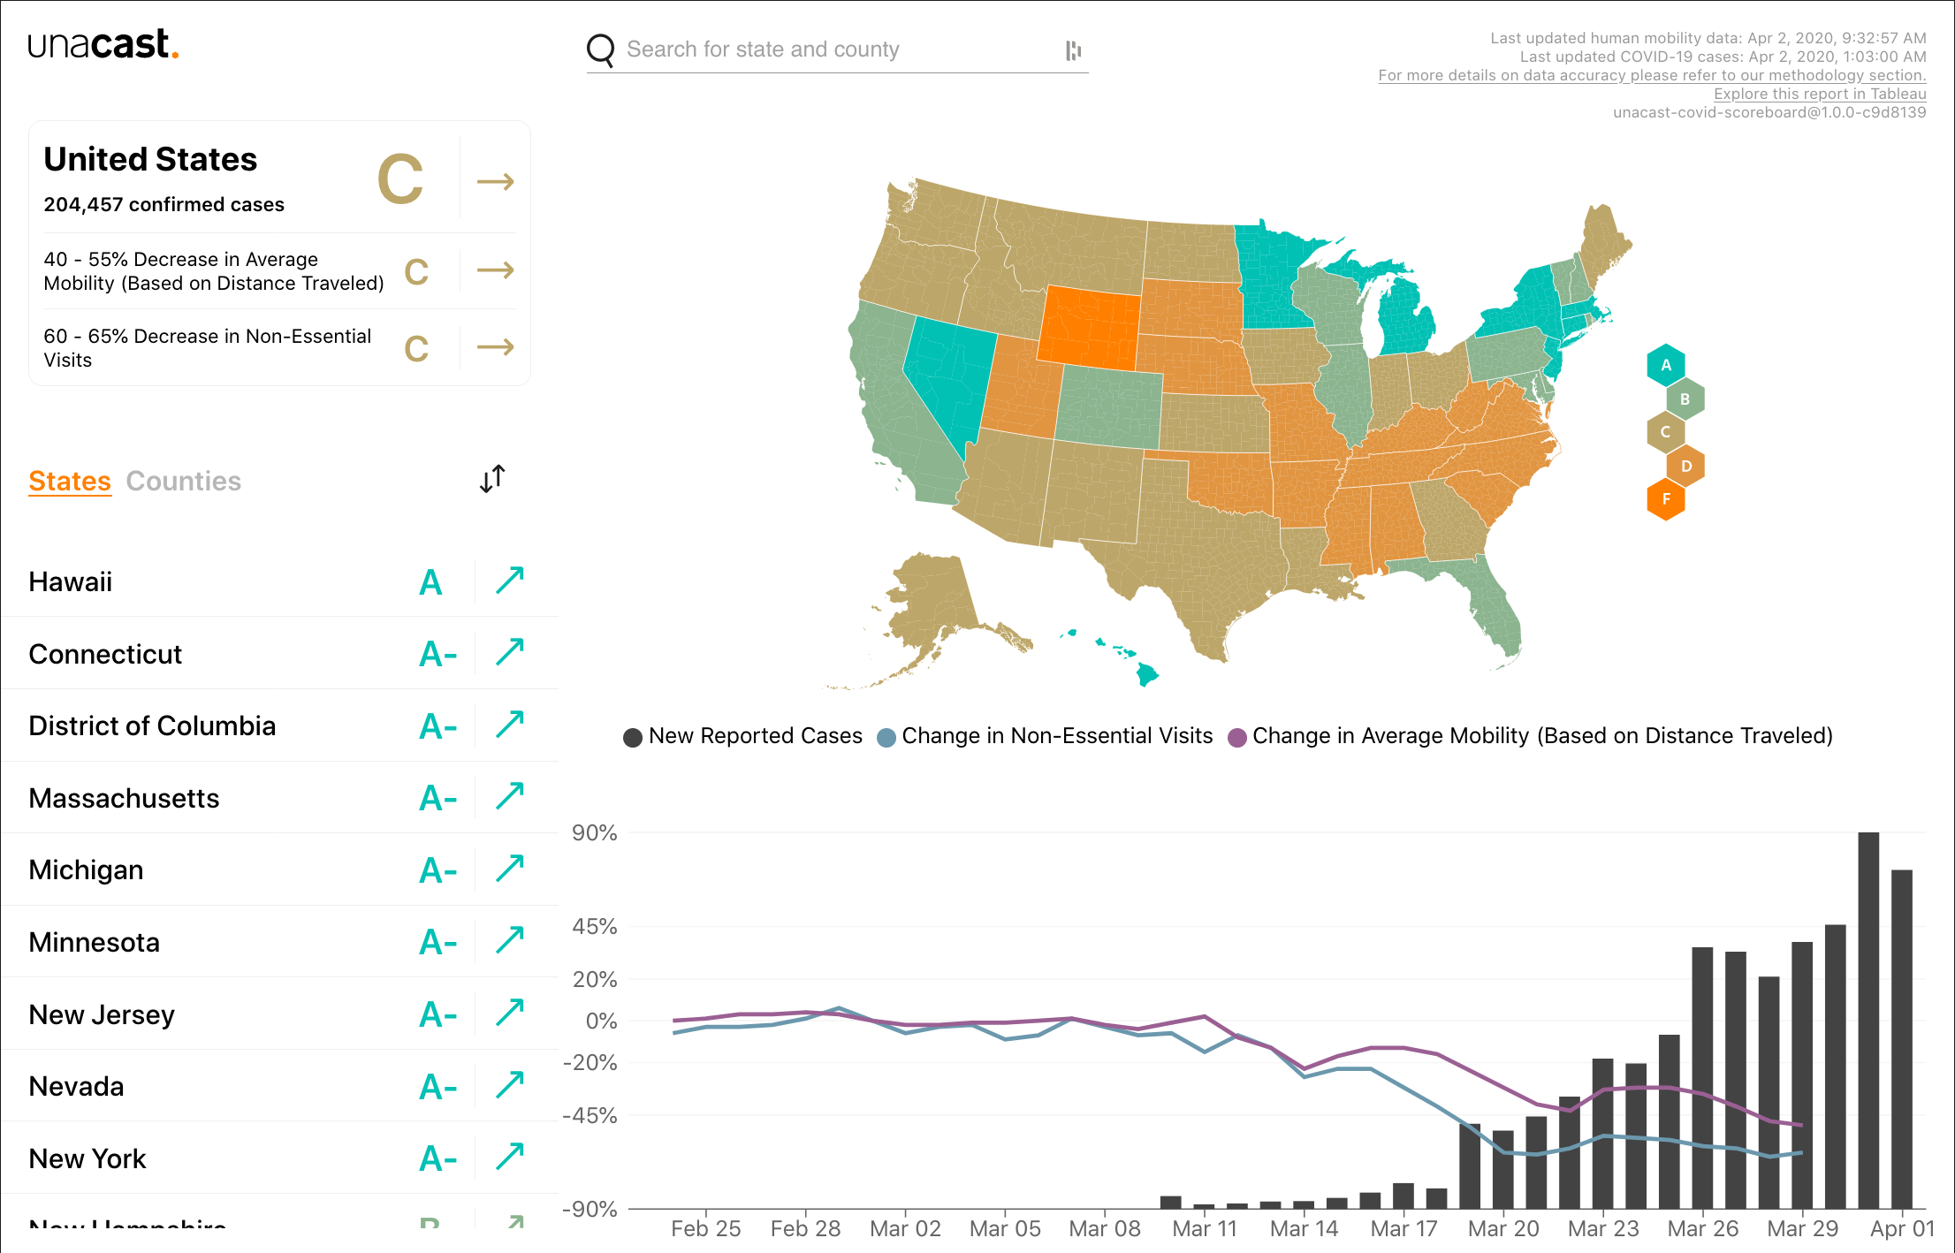


Slide 10

Thank you!
@niravrshah

Slide 11
How should you evaluate a model?
Reflects reality at a high level. Are the numbers order of magnitude correct? Moving in the right direction? Matching other countries that are ahead of us in the pandemic?
Robust. Does the model rely on singular, risky assumptions? What decisions does this lead us to? What would happen to our decision if this model were 10%, 50%, or 90% off?
Transparent. Can you review it? Is how it works easily explained/understood? Can you connect with the team and ask questions?
Clear about unknowns and limitations. Do the modelers openly admit what they don’t know? Do they clearly articulate what the model is and isn’t good for? Are the open about the fact that it will change?
Vetted. Have outside experts reviewed and endorsed?

