Slide 1

Results from the 2020 Scorecard on State Health System Performance
www.commonwealthfund.org
Media teleconference: September 10, 2020
Embargoed
until 12:01 am,
September 11, 2020

Slide 2
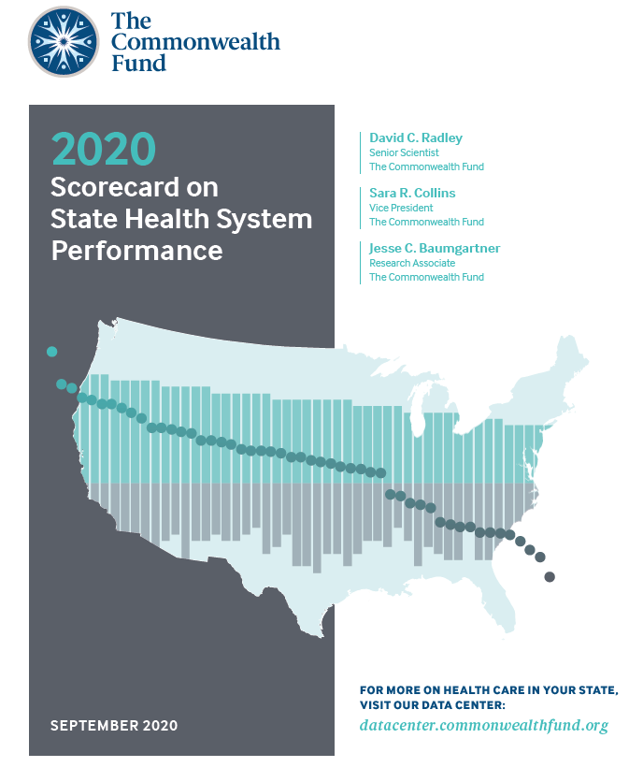
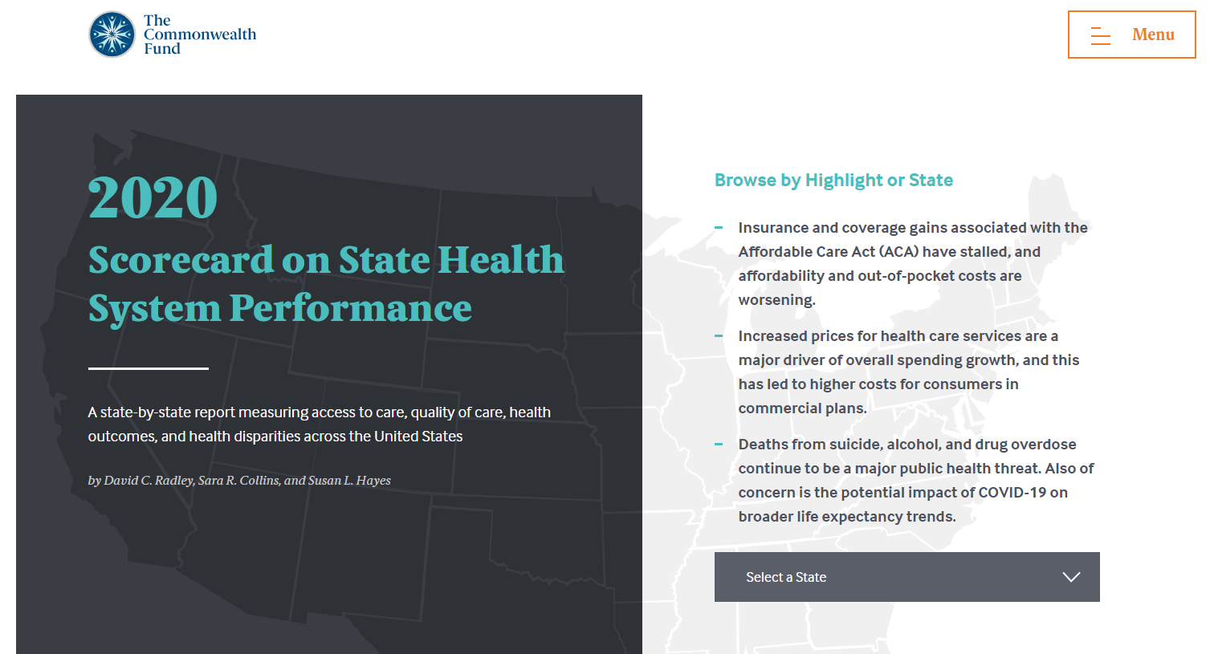
Results from the 2020 Scorecard on State Health System Performance
Exhibit 2
Online interactive report
Printable Version

Slide 3
The 2020 Scorecard & COVID-19
Exhibit 3
The 2020 Scorecard documents state-level variation in U.S. health care performance prior to COVID-19’s emergence.
The report draws on the most currently available, comprehensive, state-level data, which pre-date this rapidly evolving environment.
Throughout the report, and this presentation, we highlight the implications of the patterns seen in these data for the state of health care systems today.

Slide 4
Key Findings from the Scorecard
Exhibit 4
The novel coronavirus has exposed existing weaknesses and state variation highlighted by this year’s Scorecard on State Health System Performance
The pandemic and related economic crisis may also exacerbate state differences, leaving people in poorly performing states even further behind.
Premature deaths from treatable conditions and deaths from suicide, alcohol, and drug overdose continue to affect life expectancy.
  Mortality from treatable conditions were linked to large state differences in life expectancy;
  Wide disparities between Black and White individuals
Provider prices were a major driver of overall spending growth, and thus higher costs for people in commercial insurance plans.
  Prices for hospital inpatient care were at least 200% of Medicare rates in 22 states;
  Higher employer premiums were associated with higher prices
Coverage and access gains since the passage of the ACA have stalled
  22 states experienced small upticks in their adult uninsured rate between 2016 and 2018, and 15 states saw increases in reports of delaying care because of cost

Slide 5
Hawaii, Massachusetts, and Minnesota lead the nation
Exhibit 5
Better performance
U.S. average
Worse performance
States are arranged in rank order from left (best) to right (worst), based on their overall 2020 Scorecard rank.

Slide 6
Suicide and alcohol deaths rose modestly in 2018. Though drug overdoses dropped for the first time in decades, preliminary 2019 data shows that they have jumped back up
Exhibit 6
Cumulative increase
2005 – 2018
Age-adjusted deaths per 100,000
105%
Drug overdose
30%
Suicide
41%
Alcohol
Note: Preliminary 2019 drug overdose data from the CDC is not included in this exhibit.
Data: 2005–2018 National Vital Statistics System (NVSS), via CDC WONDER

Slide 7
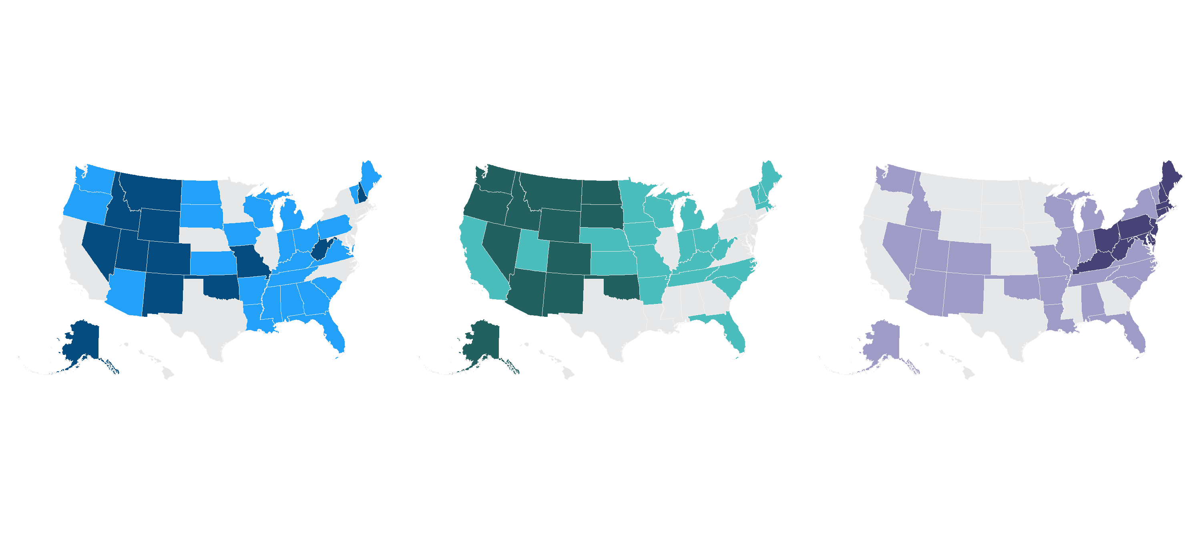
Deaths from suicide, alcohol, and drug overdose display significant regional variation
Exhibit 7
Suicide
Alcohol
Drug overdose
Age-adj. deaths per 100,000
Age-adj. deaths per 100,000
Age-adj. deaths per 100,000
7.5 – 13.7 (14 states)
5.7 – 7.8 (14 states)
6.9 – 14.3 (14 states)
13.8 – 19.3 (24 states)
8.6 – 13.0 (23 states)
14.6 – 27.5 (24 states)
19.4 – 25.2 (12 states)
13.6 – 32.7 (13 states)
27.9 – 51.5 (12 states)
Note: D.C. not counted in state tallies.
Data: 2018 National Vital Statistics System (NVSS), via CDC WONDER

Slide 8
Opioids contributed heavily to the overall rise in overdose deaths between 2009 and 2018, largely due to synthetic opioids
Exhibit 8
Share of Drug Overdose Deaths Due to Opioids
55%
71%
Age-adjusted deaths per 100,000
All Drug Overdose Deaths
Synthetic Opioid Overdose Deaths
All Opioid Overdose Deaths
Note: Data categories are overlaid, not stacked/aggregated; synthetic opioid deaths are from synthetic opioids other than methadone
Data: 2009–2018 National Vital Statistics System (NVSS), via CDC WONDER

Slide 9
Premature deaths from treatable conditions are closely linked to the wide variation in state life expectancy
Exhibit 9
Mortality amenable to health care (deaths per 100,000)
Life expectancy (years)
Data: Life Expectancy - United States Mortality Database. University of California, Berkeley (USA). Available at usa.mortality.org (data shown on 2020-05-11 12:22:03); Mortality Amenable to Healthcare - CDC, 2016 and 2017 National Vital Statistics System (NVSS), All-County Micro Data, Restricted Use Files.

Slide 10
In every state, Black people are more likely to die early from treatable conditions (2016–17)
Exhibit 10
Mortality amenable to health care: deaths per 100,000 population
Black
White
Notes: Data for Black individuals not available for Idaho, Montana, Vermont, or Wyoming. States arranged in rank order based on Black mortality rates.
Data: CDC, 2016 and 2017 National Vital Statistics System (NVSS), All-County Micro Data, Restricted Use Files.

Slide 11

Higher provider prices in commercial insurance have consequences for consumers
Exhibit 11
High provider prices
Higher private insurance premiums
Larger employee premium contributions and deductibles
Cost-related access problems for patients
Lower employee wages
Higher federal costs for marketplace subsidies

Slide 12
Price increases drive total spending growth
Exhibit 12
Cumulative change in per person spending, utilization, average price, 2014-2018
Total Spending
Service Use
Price
+26%
+21%
+21%
+18%
+17%
+15%
+16%
+14%
+11%
+5%
+11%
+4%
+3%, +3%
-2%
Total Inpatient Outpatient Professional Services Rx Drugs
Note: The data on this chart come directly from the Healthcare Cost Institute (HCCI), and are not factored into the Scorecard rankings. The 2018 Health Care Cost and Utilization Report examines medical and prescription drug spending, utilization, and average prices, and is based on health care claims data from 2014 through 2018 for Americans under the age of 65 who were covered by employer-sponsored insurance (ESI). Utilization and average prices account for changes in the type or intensity of services used, with the exception of prescription drugs. Prescription drug spending is the amount paid on the pharmacy claim, which reflects discounts from the wholesale price, but not manufacturer rebates.
Source: Healthcare Cost Institute, 2018 Healthcare Cost and Utilization Report. Available here:
https://healthcostinstitute.org/images/pdfs/HCCI_2018_Health_Care_Cost_and_Utilization_Report.pdf

Slide 13
Prices for hospital inpatient care paid by commercial insurers are higher than Medicare prices in every state
Exhibit 13
Commercial prices for inpatient care as a percentage of Medicare prices
200% of Medicare Rate
Note: Data not available for District of Columbia, Maryland, or South Carolina.
Data: 2017 IBM Watson Health MarketScan Database and Medicare’s Healthcare Provider Cost Reporting Information System; analysis by M.Chernew, Harvard Medical School, as reported in: “Wide State-Level Variation In Commercial Health Care Prices Suggests Uneven Impact Of Price Regulation”, Health Affairs, Vol. 39, No. 5; May 4, 2020

Slide 14
Higher premiums for employer coverage are associated with higher commercial prices for health care services
Exhibit 14
State values
State median
Average premiums for employer coverage
r = 0.59
Average commercial prices paid for healthcare services (employer coverage)
Note: X- and Y-axes do not start at $0. Abbreviations left off some states clustered near the U.S. average for legibility.
Data: Prices - IBM Watson Health MarketScan Database , analysis by M.Chernew, Harvard Medical School; Premiums - Medical Expenditure Panel Survey–Insurance Component (MEPS-IC, 2017)

Slide 15
Medicare spending on primary care is low throughout the U.S., but it varies by more than 50 percent across states
Exhibit 15
Percent of each state’s total Medicare spending on primary care
Data: Centers for Medicare and Medicaid Services, 2017 Limited Data Set (LDS) 5% sample. Analysis by Westat.

Slide 16
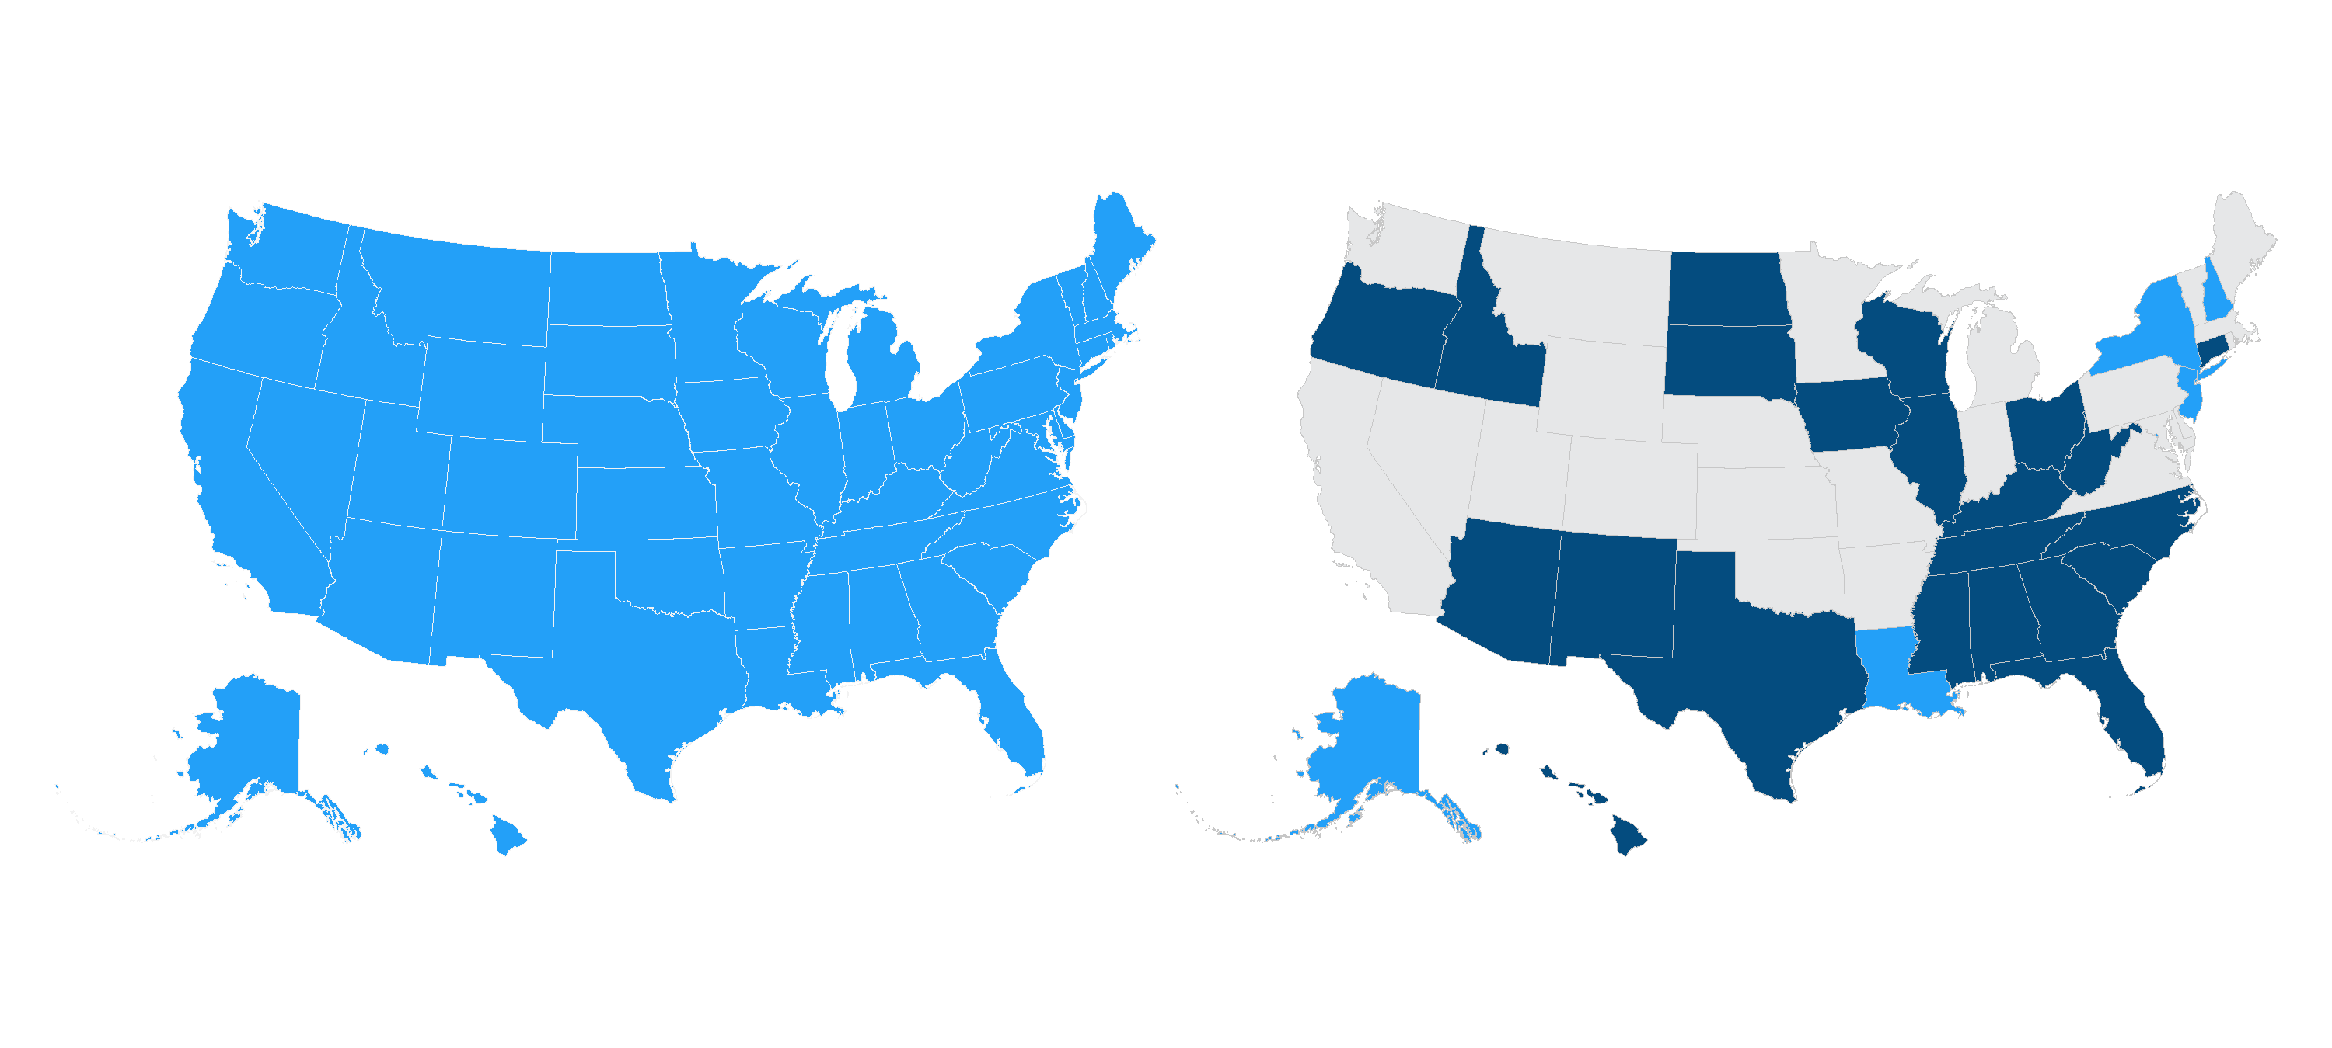
Gains in uninsured rates flattened, and even changed direction, after 2016
Exhibit 16
Average annual change
2014 to 2016
Average annual change
2016 to 2018
Improving: Uninsured rate went down by 2% or more per year on average (50 states)
Improving: Uninsured rate went down by 2% or more per year on average (5 states)
No change: Uninsured rate changed less than 2% per year on average (0 states)
No change: Uninsured rate changed less than 2% per year on average (23 states)
Worsening: Uninsured rate went up by 2% or more per year on average (0 states)
Worsening: Uninsured rate went up by 2% or more per year on average (22 states)
Notes: Adults ages 19–64. D.C. not included in legend counts
Data: U.S. Census Bureau, 2014–2018 1-Year American Community Surveys. Public Use Microdata Sample (ACS PUMS)

Slide 17
Four of the 12 states that have yet to expand Medicaid had among the highest adult uninsured rates in 2018
Exhibit 17
Percent
Medicaid expansion states
as of January 1, 2018
Non-Medicaid expansion states
as of January 1, 2018
Note: ME, VA, UT, ID passed and implemented Medicaid expansion after 1/1/2018. MO, NE and OK have passed but have not yet implemented. Nonelderly adults are between 19 and 64 years of age.
Data: U.S. Census Bureau, 2018 1-Year American Community Survey. Public Use Microdata Sample (ACS PUMS).

Slide 18
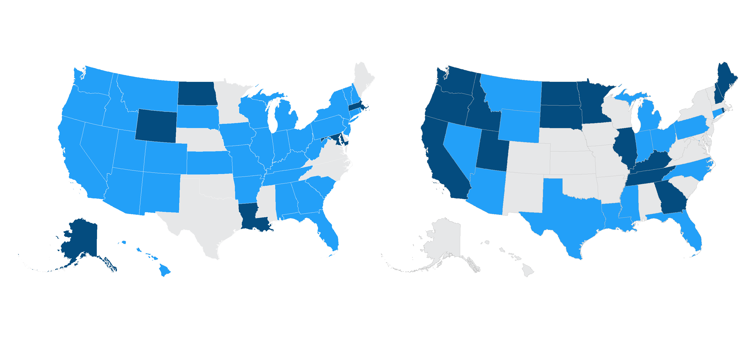
Adults in 15 states were more likely to avoid care because of cost concerns after 2016
Exhibit 18
Average annual change
2014 to 2016
Average annual change
2016 to 2018
Improving: Adults with cost barriers fell by 2% or more per year (35 states)
Improving: Adults with cost barriers fell by 2% or more per year (14 states)
No change: Less than 2% per year annual change (9 states)
No change: Less than 2% per year annual change (21 states)
Worsening: Adults with cost barriers rose by 2% or more per year (6 states)
Worsening: Adults with cost barriers rose by 2% or more per year (15 states)
Notes: Adults ages 18 and older. D.C. not included in legend counts
Data: 2014–2018 Behavioral Risk Factor Surveillance System (BRFSS).

Slide 19
In 17 states, there was at least a five-point disparity in the uninsured rate between white and both Black and Hispanic adults
Exhibit 19
Percent
White
Black
Hispanic
Notes: States arranged in order of the uninsured rate for white adults. Nonelderly adults are between 19 and 64 years of age. Alaska, Montana, Maine, North Dakota, Vermont and the District of Columbia do not have sufficient sample size for at least two of the races or ethnicities. Rhode Island, Hawaii, New Hampshire, New Mexico, Utah, South Dakota, West Virginia, Wyoming and Idaho do not have sufficient sample size for one of the races or ethnicities.
Data: U.S. Census Bureau, 2018 1-Year American Community Survey, Public Use Microdata Sample (ACS PUMS).

Slide 20
Implications of Study Findings For the Pandemic
Exhibit 20
The findings of the 2020 Scorecard show how state variation in health system performance leaves people with widely different risks of morbidity and mortality depending on where they live.
This means that the COVID-19 pandemic and the related economic crisis will affect people differently because of where they live.
These two crises may also exacerbate differences in state health system performance, leaving people in poorly performing states even further behind.
The study highlights 4 critical areas of performance which may leave people in poorly performing states particularly vulnerable, and which may be worsening:
        coverage and access,
        primary care investment,
        premature deaths from treatable conditions and deaths from suicide, alcohol, and drug overdose;
        racial inequity.

Slide 21
Implications of Study Findings For the Pandemic(cont.)
Exhibit 21
Coverage and access: People who are uninsured have poor access to health care needed to treat COVID-19 and otherwise stay healthy; job losses may lead to more uninsured.
  Uninsured rates ranged from a low of 4% in DC and MA to a high of 24% in TX.
Primary care is essential to chronic disease management and prevention but U.S. investment was low relative to OECD countries; the pandemic is further reducing use.
  The percentage of Medicare spending on primary care varied by more than 50% across states.
Premature deaths from treatable conditions and deaths from alcohol, suicide and drug overdose were fueling declining life expectancy; the pandemic and economic crisis are exacerbating these trends.
  The highest rates of premature deaths from treatable conditions were in MS, OK, AR, LA,TN.
  The highest rates of death from drug overdose were in 12 states in the Mid-Atlantic and Northeast.
Racial inequity: The health care system is highly unequal in its care of people of color, who have suffered disproportionately during the pandemic.
  Blacks died at 2X the rate of whites from treatable conditions; highest rates were in MS, AR, OK.

Slide 22
Looking forward
Exhibit 22
With the 2020 Presidential election less than two months away, federal and state governments face the daunting task of controlling the pandemic and improving health system performance.
State and federal partnerships will be critical for improvement.
Expanding coverage and access to care
  Expanding Medicaid in the 12 states that haven’t yet or providing a federal fallback option for those eligible;
  Enhancing and extending the ACA marketplace subsidies for premiums and cost-sharing;
  Allowing more people with employer plans to purchase subsidized coverage through the marketplaces.
Lowering spending growth
  State and federal efforts to set prices paid by private insurers closer to Medicare rates;
  State and federal value-based payment programs link provider payment to patient outcomes.
Addressing the opioid crisis and reducing preventable mortality
  Improving access to opioid overdose-reversal medications like naloxone;
  Increasing investment in primary care;
  Addressing structural racism in the health system.
Far more timely federal data collection.

Slide 23

For More Information, Visit the Fund’s new Health System Data Center: http://datacenter.commonwealthfund.org/
Exhibit 23

Slide 24
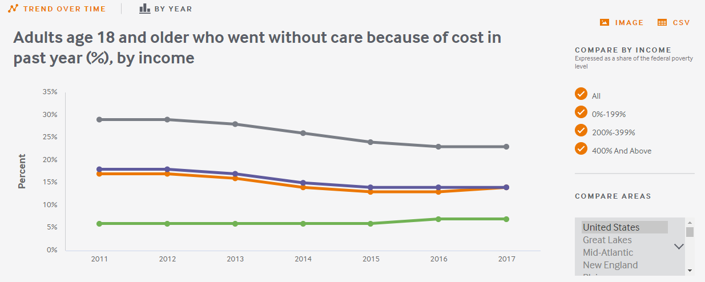
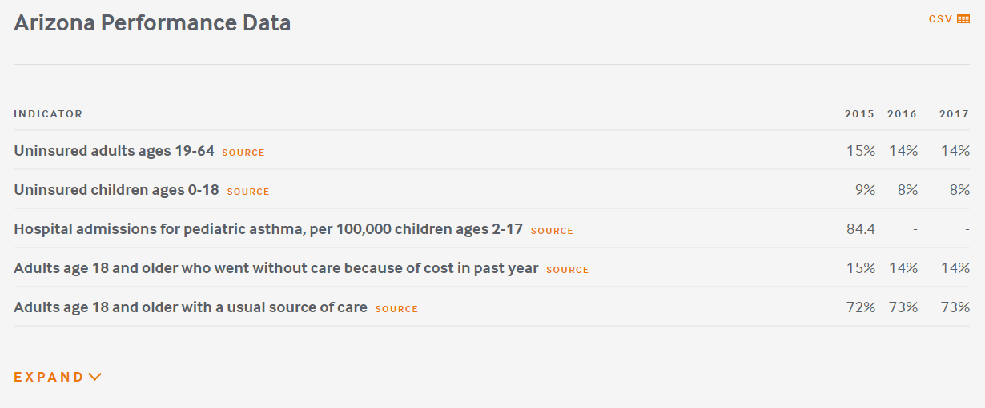
Exhibit 24
Interactive tools &
sub-population analysis
State-specific downloadable content

Slide 25
State Health System Scorecard Methods
Exhibit 25
Goal: to provide benchmarks and trends to inform national, state and local action to improve health care system performance
Health System Focus: Builds on previous Scorecards
  49 indicators organized into 4 dimensions: Access/affordability; Prevention/treatment; Avoidable hospital use and costs; and Healthy lives
  Income disparity dimension assesses a subset of indicators by income within states
  National data sources including administrative claims, national surveys, and vital statistics available for states
2- to 3-year trend data available for 43 indicators
  Generally from 2014 to 2018, but varies by indicator
Scoring:
  Each indicator is ranked based on standardized (z- ) score
  Dimension rank is based on average of indicator standardized scores
  Overall rank based on average of five dimension standardized scores
Estimated gains are based on rates of performance in the top performing state

Slide 26
2020 Scorecard Indicators
Exhibit 26

Slide 27
2020 Scorecard Indicators
Exhibit 27

