Slide 1
MEDICARE DATA HUB
COVID-19: Spending
Commonwealth Fund Analysis of CareJourney Claims Data for Traditional Medicare Beneficiaries

Slide 2
Overall, traditional Medicare spending was 7 percent less in 2020 compared to 2019.
COVID-19: SPENDING
$ billions
-7%
Note: Excludes November and December of both years. Similarly, overall spending in 2020 is 7% lower when only Parts A and B are included.
Data: Commonwealth Fund analysis of CareJourney traditional Medicare claims data.
Notes:
- Compared with spending between January and October of 2019, traditional Medicare spending was 7% lower during the same period in 2020.

Slide 3
Compared to 2019, traditional Medicare spending dropped dramatically between March and May of 2020, before returning to previous levels.
COVID-19: SPENDING
$ billions
Note: Excludes November and December of both years. Similarly, overall spending in 2020 is 7% lower when only Parts A and B are included.
Data: Commonwealth Fund analysis of CareJourney traditional Medicare claims data.
Notes:
- The largest decline in traditional Medicare spending occurred in April 2020, before rebounding in June.
- Spending between June and October 2020 did not rise higher than the prepandemic levels in January 2020.

Slide 4
Traditional Medicare spending decreased more for white beneficiaries and beneficiaries not also enrolled in Medicaid than for other beneficiaries from 2019 to 2020.
COVID-19: SPENDING
Net change in spending, 2019–20:
Not dually eligible: -7.1%
Dually eligible: -1.9%
Black: -1.4%
White: -3.3%
Other: -0.5%
Age <65: -4.5%
Ages 65-74: -0.7%
Ages 75-84: -2.6%
Age 85+: -4.5%
Note: Excludes November and December of both years. Spending is aggregate, not per capita.
Data: Commonwealth Fund analysis of CareJourney traditional Medicare claims data.
Notes:
- Traditional Medicare spending decreased across all demographics from 2019 to 2020.
- Compared to 2019, traditional Medicare spending in 2020 decreased more among beneficiaries under age 65 and over age 85, white beneficiaries, and beneficiaries not also enrolled in Medicaid.

Slide 5
Traditional Medicare spending decreased most for beneficiaries ages 65–74 between March and April 2020.
COVID-19: SPENDING
$ billions
Note: Excludes November and December. Spending is aggregate, not per capita.
Data: Commonwealth Fund analysis of CareJourney traditional Medicare claims data.
Notes:
- Traditional Medicare spending rebounded for beneficiaries ages 65-74 in June to levels above prepandemic spending for the remainder of the year.
- For the oldest and youngest traditional Medicare beneficiaries, spending declined only slightly during the early months of the pandemic.

Slide 6
Traditional Medicare spending for dually eligible beneficiaries remained steady throughout 2020, while spending for other beneficiaries plummeted from February to April before returning to prepandemic levels by summer.
COVID-19: SPENDING
$ billions
Note: Excludes November and December. Spending is aggregate, not per capita.
Data: Commonwealth Fund analysis of CareJourney traditional Medicare claims data.
Notes:
-Traditional Medicare spending for beneficiaries not dually eligible fell by more than 50 percent between February and April 2020. Spending than returned to prepandemic levels by the summer.

Slide 7
Inpatient, outpatient, and other Medicare Part B spending decreased in the early months of the pandemic.
COVID-19: SPENDING
$ billions
Note: Excludes November and December. Spending is aggregate, not per capita.
Data: Commonwealth Fund analysis of CareJourney traditional Medicare claims data.
Notes:
- Traditional Medicare spending on Part B, inpatient, and outpatient care decreased between March and April before rebounding to earlier levels.
- Traditional Medicare spending on Part D increased during the first month of the pandemic, then declined until May, when spending returned to prepandemic levels.

Slide 8
Traditional Medicare spending for skilled nursing and home health care decreased since the start of the pandemic.
COVID-19: SPENDING
$ billions
Note: Excludes November and December. Spending is aggregate, not per capita.
Data: Commonwealth Fund analysis of CareJourney traditional Medicare claims data.
Notes:
- Unlike spending on Part B, inpatient, and outpatient care, traditional Medicare spending for home health and skilled nursing facilities declined throughout the year.
- Traditional Medicare spending on hospice remained relatively steady throughout the pandemic.

Slide 9
Traditional Medicare spending declined for many chronic conditions early during the pandemic.
COVID-19: SPENDING
$ billions
Note: Excludes November and December. Spending is aggregate, not per capita.
Data: Commonwealth Fund analysis of CareJourney traditional Medicare claims data.
Notes:
- Spending in traditional Medicare declined among many chronic conditions during the first few months of the pandemic before rebounding in June 2020.
- Traditional Medicare spending decreased more substantially for hypertension, mental health, and diabetes during the early months of pandemic than for other chronic conditions.

Slide 10
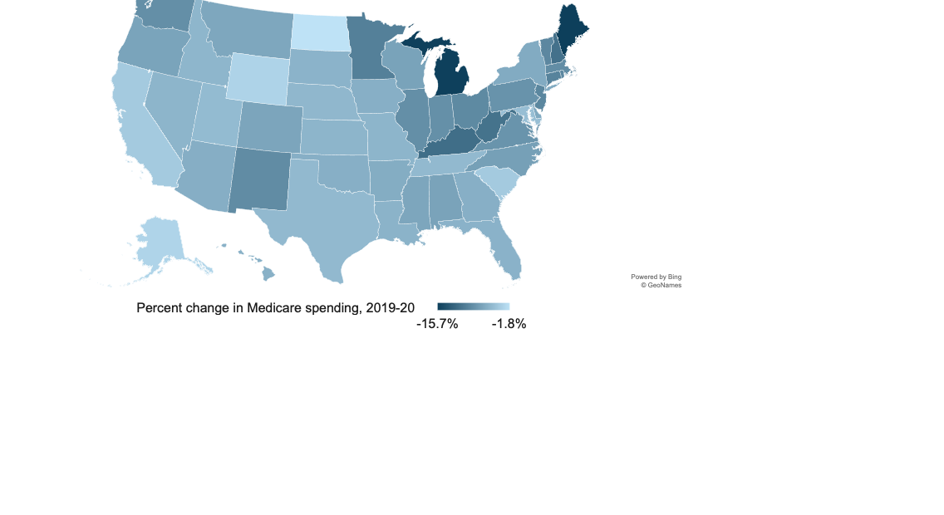
Declines in traditional Medicare spending varied across states between 2019 and 2020.
COVID-19: SPENDING
Note: Excludes November and December of both years.
Data: Commonwealth Fund analysis of CareJourney traditional Medicare claims data.
Notes:
- Declines in traditional Medicare spending between 2019 and 2020 differed across states, with the largest downturns in Maine and Michigan.

Slide 11
Among people in traditional Medicare diagnosed with COVID-19, average per capita spending was lower than for people with other common health conditions.
COVID-19: SPENDING
Notes: Excludes data from January and February 2020. COPD = chronic obstructive pulmonary disease.
CKD = chronic kidney disease.
Data: Commonwealth Fund analysis of CareJourney traditional Medicare claims data.

Slide 12
Among Medicare beneficiaries, COVID-19 had the lowest spending compared to other chronic conditions.
COVID-19: SPENDING
Notes: Excludes data from January and February 2020. COPD = chronic obstructive pulmonary disease. CKD = chronic kidney disease. Prevalence of health conditions was calculated by dividing the average number of beneficiaries in traditional Medicare with a chronic condition diagnoses between March and December 2020 by the average number of total beneficiaries in traditional Medicare from March to December 2020
Data: Commonwealth Fund analysis of CareJourney traditional Medicare claims data.

