Slide 1
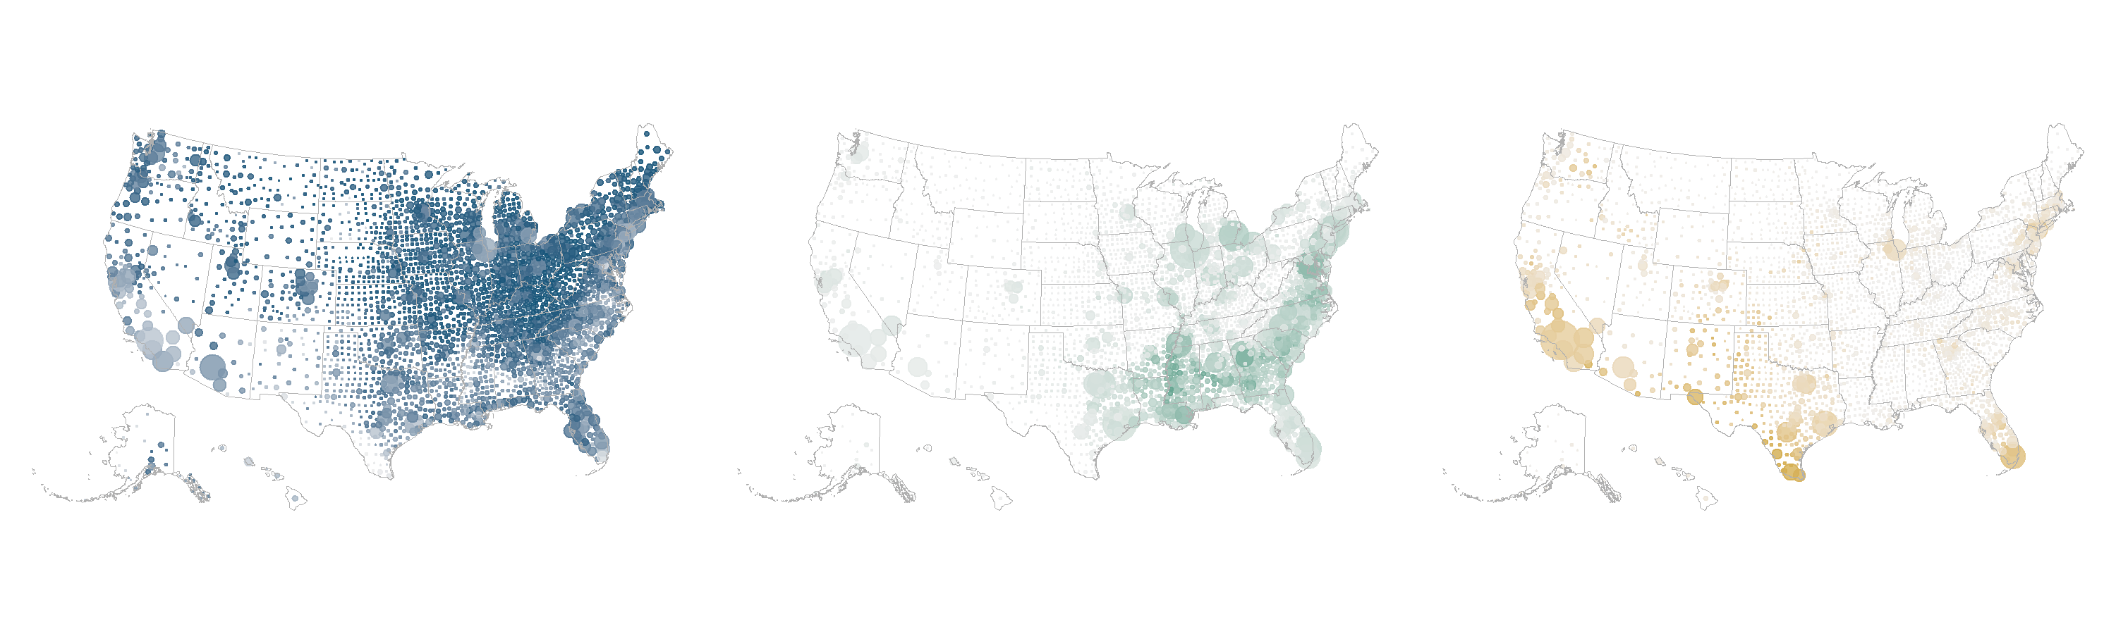
Where communities are located can have large health implications.
U.S. racial and ethnic demographics map
White, Non-Latinx/Hispanic
Black, Non-Latinx/Hispanic
Latinx/Hispanic
Note: Bubbles are sized relative to the county population count for each race/ethnicity group; color density is based on the share of the county population in each race/ethnicity group.
Data: National Center for Health Statistics. Vintage 2019 postcensal estimates of the resident population of the United States (April 1, 2010, July 1, 2010–July 1, 2019), by year, county, single-year of age (0, 1, 2, . . . 85 years and older), bridged race, Latinx/Hispanic origin, and sex. Prepared under a collaborative arrangement with the U.S. Census Bureau. Available from: https://www.cdc.gov/nchs/nvss/bridged_race/data_documentation.htm as of July 9, 2020, following release by the U.S. Census Bureau of the unbridged Vintage 2019 postcensal estimates by five-year age group on June 25, 2020.

Slide 2
Income inequities, which impact health and access to care, persisted over the past
15 years. Black and Latinx/Hispanic households live below the poverty level at around twice the rate of white households.
Median household income (2003–2019)
Poverty distribution (2019)
0%–99% FPL
100%–199%
FPL
200%–399%
FPL
400%+
FPL
Note: 100% of the federal poverty level (FPL) in 2019 was $12,490 for an individual and $25,750 for a family of four.
Data: Median household income — Current Population Survey, 2003–2019 Annual Social and Economic Supplements (2019 dollars); Poverty distribution — American Community Survey, Public Use Microdata Sample (ACS PUMS), 2019.

Slide 3
Reflecting the impact of racism on social and economic policies, Black and Latinx/
Hispanic household wealth is significantly lower than white household wealth across all education levels.
Median household wealth (in $ thousands), 2019
Data: Federal Reserve Board’s 2019 Survey of Consumer Finances; Chart reproduced from Ana Hernández Kent and Lowell R. Ricketts, “Wealth Gaps Between White, Black, and Hispanic Families in 2019,” Federal Reserve Bank of St. Louis, Jan. 5, 2021.

Slide 4
Coverage inequities significantly declined after key ACA provisions went into effect, but gains have stalled and disparities persist.
Percent of adults ages 19–64 who are uninsured, 2010–2019
Data: American Community Survey, Public Use Microdata Sample (ACS PUMS), 2010–2019.

Slide 5
Black and Latinx/Hispanic nonelderly adults are still uninsured at higher rates than white adults across all income levels, underscoring the need for additional reforms.
Percent of adults ages 19–64 who are uninsured, by income, 2010–2019
2010
2019
0%–199% FPL
200%–399% FPL
400%+ FPL
Note: FPL = federal poverty level.
Data: American Community Survey, Public Use Microdata Sample (ACS PUMS), 2010–2019.

Slide 6
Reflecting federal and state policies, children across all groups are more likely to be insured than adults, but Latinx/Hispanic children are still uninsured at twice the rate of white and Black children.
Percent of children and nonelderly adults who are uninsured, 2019
Children ages 0–18
Adults ages 19–64
Data: American Community Survey, Public Use Microdata Sample (ACS PUMS), 2019.

Slide 7
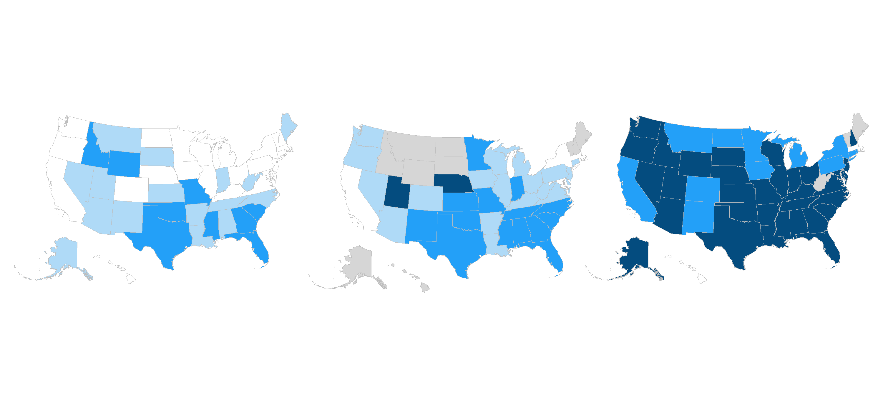
State-level coverage rates by race and ethnicity exhibit significant regional variation that is often tied to state policy decisions.
Percent of adults ages 19–64 who are uninsured, by state, 2019
White
Black
Latinx/Hispanic
Uninsured rate | Uninsured Rate | White | Black | Latinx/Hispanic
 | 1.7%–8.1% | 25 states + D.C. | 5 states + D.C. | 2 states + D.C.
 | 8.2%–13.1% | 16 states | 19 states | 0 states
 | 13.2%–21.7% | 9 states | 14 states | 12 states
 | 21.8%–50.7% | 0 states | 2 states | 33 states
 | Missing data | 0 states | 10 states | 3 states
Note: Map groupings are calculated by taking the 25th, 50th, and 75th percentiles across the full distribution of state uninsured rates for all three racial/ethnic groups.
Data: American Community Survey, Public Use Microdata Sample (ACS PUMS), 2019.

Slide 8
All groups experienced fewer financial barriers after the ACA coverage expansions, but Black and especially Latinx/Hispanic adults are still more likely than white adults to forgo needed care because of cost.
Percent of adults age 18 and older who went without care because of cost in the past year, 2011–2019
Data: Behavioral Risk Factor Surveillance System (BRFSS), 2011–2019.

Slide 9
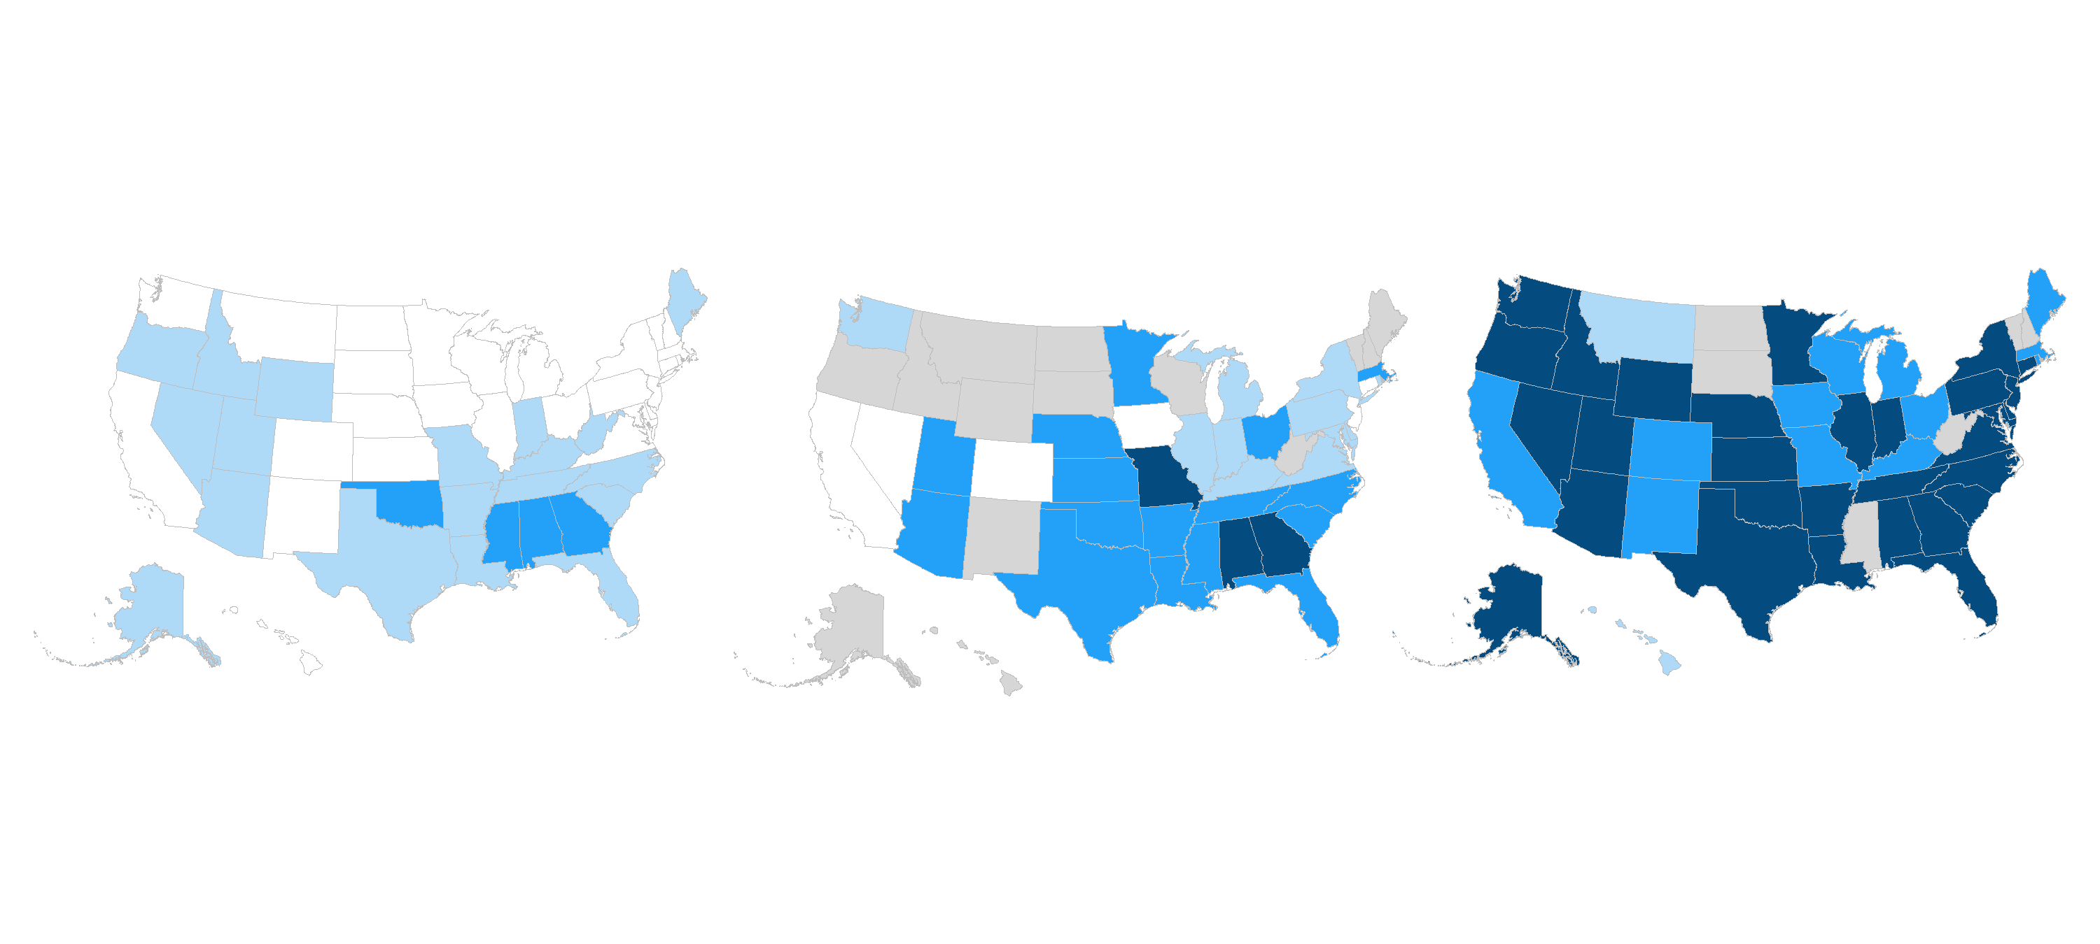
Financial barriers to health care vary widely across states but are particularly high for Black and Latinx/Hispanic adults in states that have not expanded Medicaid.
Percent of adults age 18 and older who went without care because of cost in the past year, by state, 2019
White
Black
Latinx/Hispanic
Share of adults who report cost-related access problems |  | White | Black | Latinx/Hispanic
 | 7.0%–11.1% | 27 states + D.C. | 6 states | 0 states
 | 11.2%–14.4% | 19 states | 11 states + D.C. | 2 states
 | 14.5%–19.1% | 4 states | 16 states | 12 states + D.C.
 | 19.3%–38.4% | 0 states | 3 states | 30 states
 | Missing data | 0 states | 14 states | 6 states
Note: Map groupings are calculated by taking the 25th, 50th, and 75th percentiles across the full distribution of state rates for all three racial/ethnic groups.
Data: Behavioral Risk Factor Surveillance System (BRFSS), 2019.

Slide 10
Black and Latinx/Hispanic adults are less likely to have a usual care provider, driven in part by coverage disparities and structural access barriers.
Percent of adults age 18 and older with a usual source of care, 2019
Data: Behavioral Risk Factor Surveillance System (BRFSS), 2019.

Slide 11
Breast cancer screening rates are high for all groups, but Black and Latinx/Hispanic adults are often diagnosed at more advanced stages.
Percent of adults age 18 and older with up-to-date cancer screenings, 2018
Breast cancer screening
Colon cancer screening
Note: Breast cancer screening is women ages 50 to 75 who received a mammogram in the past two years; colon cancer screening is adults ages 50 to 75 with a recent colon cancer screening test.
Data: Behavioral Risk Factor Surveillance System (BRFSS), 2018.

Slide 12
Higher child vaccination rates reflect public policy, though rates are still lower for both Black and Latinx/Hispanic children.
Percent of children ages 19–35 months who received all recommended doses of seven key vaccines, 2019
Note: Recommended vaccines are the 4:3:1:3:3:1:4 series, which includes ≥4 doses of DTaP/DT/DTP, ≥3 doses of poliovirus vaccine, ≥1 doses of measles-containing vaccine, full series of Hib (3 or 4 doses, depending on product type), ≥3 doses of HepB, ≥1 dose of varicella vaccine, and ≥4 doses of PCV.
Data: National Immunization Survey, 2019.

Slide 13
Adult flu vaccination rates are below the target for all groups, but especially among Black and Latinx/Hispanic adults who face more access barriers.
Percent of adults age 18 and older with a seasonal flu shot in the past year, 2019
Data: Behavioral Risk Factor Surveillance System (BRFSS), 2019.

Slide 14
Black and Latinx/Hispanic adults are less likely to receive dental care services, which insurance plans often do not cover.
Percent of adults age 18 and older with a dental visit in the past year, 2018
Data: Behavioral Risk Factor Surveillance System (BRFSS), 2018.

Slide 15
Black and Latinx/Hispanic adults with a mental health illness are less likely to receive mental health care.
Percent of adults age 18 and older with any mental illness who received mental health services in the past year, 2019
Data: Chart reproduced from National Institute of Mental Health, “Mental Illness,” NIMH, last updated Jan. 2021. See “Figure 2. Mental Health Services Received in Past Year Among U.S. Adults with Any Mental Illness (2019).” Data from SAMHSA, National Survey on Drug Use and Health (NSDUH), 2019.

Slide 16
Latinx/Hispanic and Black working-age adults are more likely to report being in fair or poor health.
Percent of adults ages 18–64 who report being in fair or poor health, 2019
Data: Behavioral Risk Factor Surveillance System (BRFSS), 2019.

Slide 17
All groups report elevated obesity. Black and Latinx/Hispanic adults, whose living environments can be impacted by policies like residential segregation, report higher rates in most states.
Percent of adults ages 18–64 who are obese, by state, 2019
White
Black
Latinx/Hispanic
Share of adults with BMI ≥ 30 |  | White | Black | Latinx/Hispanic
 | 9.3%–30.3% | 22 states + D.C. | 3 states | 9 states + D.C.
 | 30.4%–34.8% | 17 states | 4 states | 15 states
 | 35.0%–40.2% | 11 states | 9 states | 16 states
 | 41.0%–77.5% | 0 states | 27 states + D.C. | 8 states
 | Missing data | 0 states | 7 states | 2 states
Notes: Obesity is measured by adults with BMI ≥ 30. Map groupings are calculated by taking the 25th, 50th, and 75th percentiles across the full distribution of state rates for all three racial/ethnic groups.
Data: Behavioral Risk Factor Surveillance System (BRFSS), 2019.

Slide 18
Obesity is associated with additional health risks. Black and Latinx/Hispanic adults experience higher rates of diabetes than whites, and Black adults also report higher hypertension rates.
Age-adjusted prevalence of hypertension and diabetes among adults age 18 and older
Diabetes
Hypertension
Data: Diabetes — 2013–16 National Health and Nutrition Examination Survey (NHANES), as reported in 2020 National Diabetes Statistics Report (Centers for Disease Control and Prevention, Aug. 2020); Hypertension — 2017–18 NHANES, reproduced from Yechiam Ostchega et al., Hypertension Prevalence Among Adults Aged 18 and Over: United States, 2017–2018 (NCHS, Apr. 2020).

Slide 19
The gap in average life expectancy between Black and white adults has existed for generations, and COVID-19 erased recent progress.
Average life expectancy at birth (years), 1980–2020
Notes: 1980–2017 data come from: United States Life Tables, National Vital Statistics Reports 68, no. 7 (June 24, 2019). Black and white data points before 2006 include Latinx/Hispanic people; starting in 2006, they represent non-Latinx/Hispanic Black and non-Latinx/Hispanic white. 2020 projections (dashed lines) appear in Andrafsay and Goldman (see below), representing the Institute for Health Metrics and Evaluation (IHME) current/medium projection (Oct. 2020).
Chart reproduced from: Theresa Andrasfay and Noreen Goldman, “Reductions in 2020 U.S. Life Expectancy Due to COVID-19 and the Disproportionate Impact on the Black and Latino Populations,” PNAS 118, no. 5 (Feb. 2021): e2014746118.

Slide 20
Black adults across the U.S. die from treatable conditions at significantly higher rates than white and Latinx/Hispanic adults.
Mortality amenable to health care (deaths per 100,000 population), 2016 and 2017
White
Black
Latinx/Hispanic
Deaths per 100,000 population | Deaths per 100,000 population | White | Black | Latinx/Hispanic
 | 37.8–64.5 | 12 states + D.C. | 0 states | 35 states + D.C.
 | 64.9–101.9 | 32 states | 5 states | 11 states
 | 102.0–202.3 | 6 states | 41 states + D.C. | 0 states
 | Missing data | 0 states | 4 states | 4 states
Note: Measure includes deaths before age 75 from one of 33 preventable or treatable health conditions. Map groupings are calculated by taking the 33rd and 66th percentiles across the full distribution of state rates for all three racial/ethnic groups.
Data: National Vital Statistics System (NVSS) Mortality All-County Micro Data Files, 2016 and 2017.

Slide 21
Black individuals are more likely to die from breast and colon cancer, reflecting both later-stage diagnoses and differential treatment.
Age-adjusted breast and colorectal cancer deaths per 100,000 population, 2018
Breast cancer deaths
Colon cancer deaths
Note: Breast cancer deaths are among female population; colon cancer deaths are among full population.
Data: National Vital Statistics System (NVSS) Mortality Data Files, 2018.

Slide 22
Across all education levels, Black people suffer pregnancy-related deaths at two to four times the rate of white and Latinx/Hispanic people.
Pregnancy-related deaths per 100,000 live births in the U.S., by education level, 2007–2016
Data: Emily E. Petersen et al., “Racial/Ethnic Disparities in Pregnancy-Related Deaths — United States, 2007–2016,” Morbidity and Mortality Weekly Report (MMWR) 68, no. 35 (Sept. 6, 2019): 762–65.

Slide 23
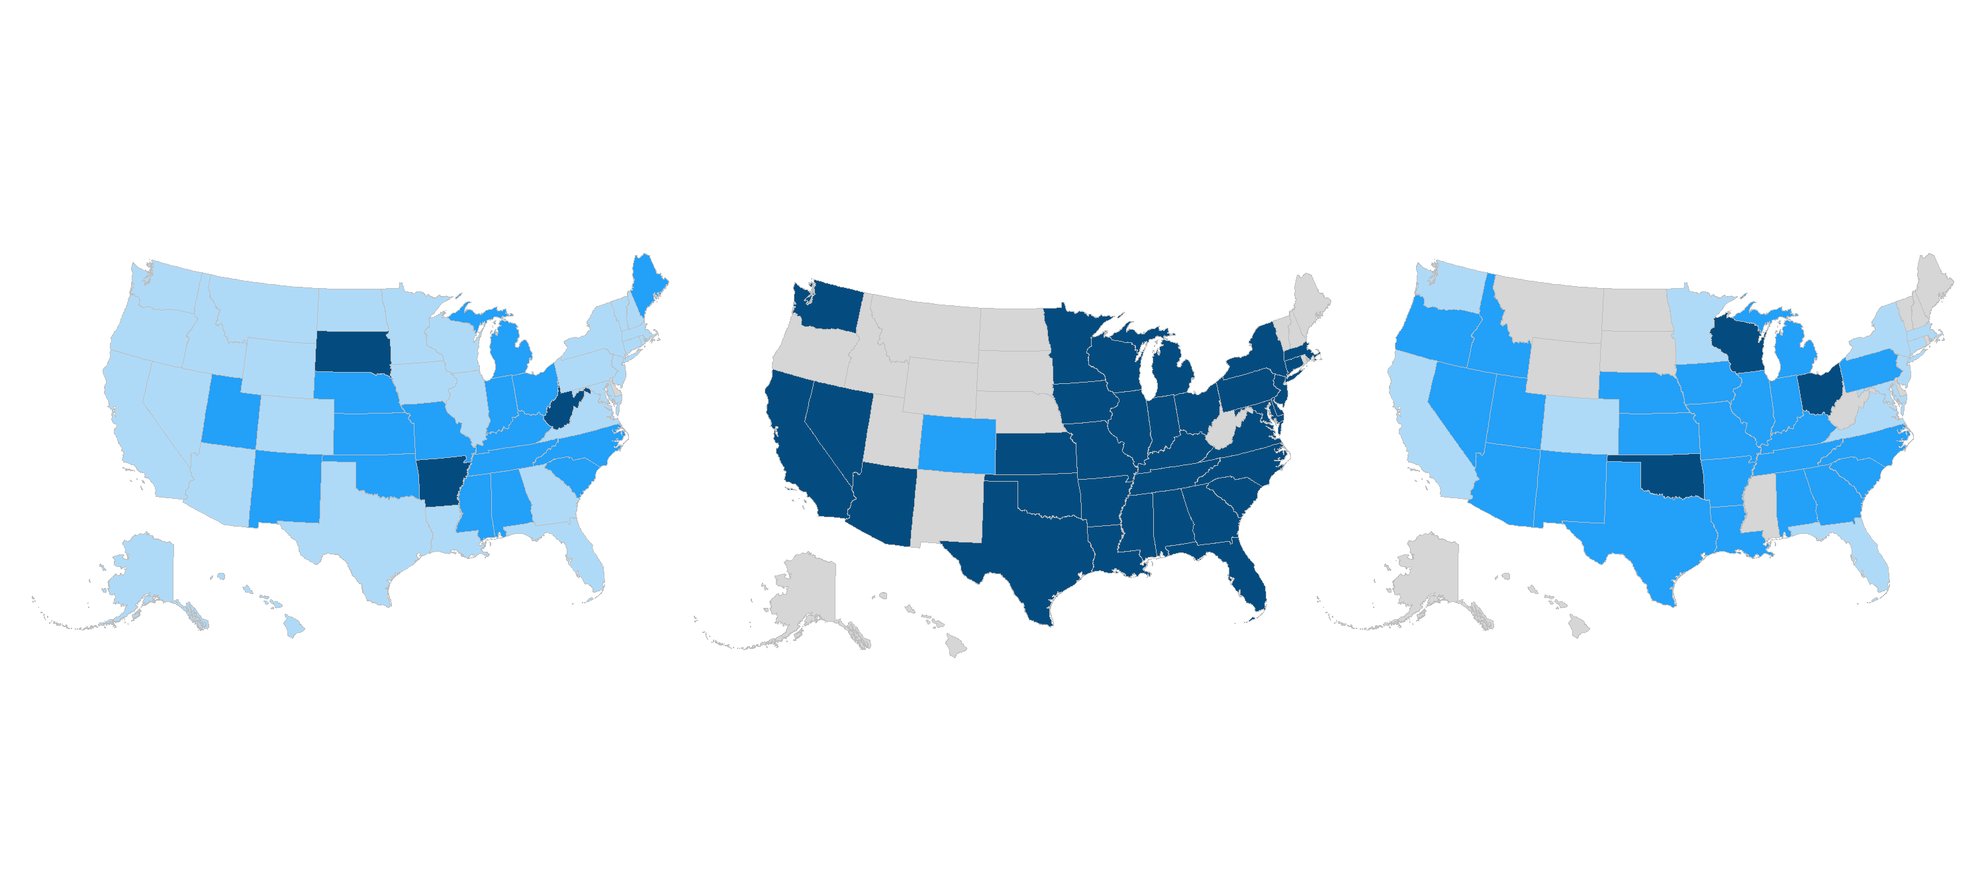
Infant mortality disparities exist in nearly every state; rates are particularly high in
Black communities.
Deaths in the first year of life per 1,000 live births, by state, 2017
White
Black
Latinx/Hispanic
Deaths in the first year of life per 1,000 live births | Deaths in the first year of life per 1,000 Live Births | White | Black | Latinx/Hispanic
 | 2.7–4.9 | 30 states | 0 states | 11 states
 | 5.0–6.8 | 16 states | 1 state | 23 states
 | 6.9–15.9 | 3 states | 33 states + D.C. | 3 states
 | Missing data | 1 state + D.C. | 16 states | 13 states + D.C.
Note: Map groupings are calculated by taking the 33rd and 66th percentiles across the full distribution of state rates for all three racial/ethnic groups.
Data: National Vital Statistics System (NVSS) Linked Birth and Infant Death Data, 2017.

