Slide 1
MEDICARE DATA HUB International Comparisons
October 2021

Slide 2
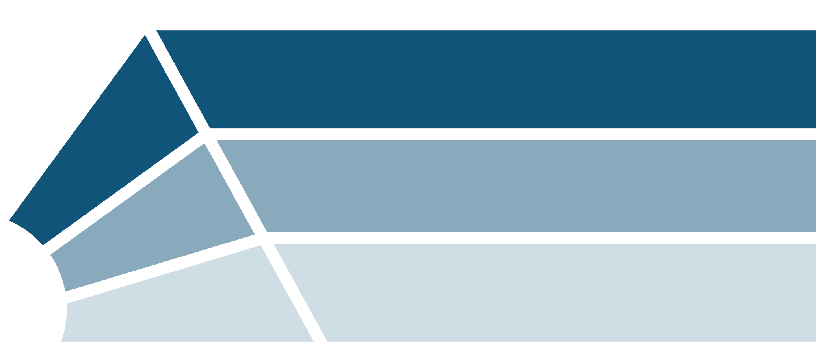
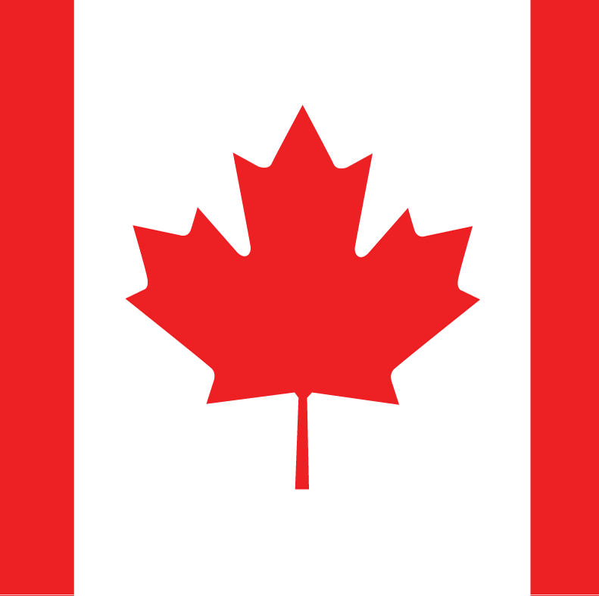
In the U.S. Medicare program, private plans offer primary, supplemental, and prescription drug–only coverage, similar to models of private plans in other countries.
INTERNATIONAL COMPARISONS
United States
Germany
Netherlands
Switzerland
Primary
United States
Australia
France
Netherlands
Supplemental
Coverage
Type
United States
Canada
Prescription Drug
Source: The Commonwealth Fund/London School of Economics 2020 International Profiles of Health Care Systems, June 2020.
Notes:
Private health insurance plans serve diverse roles in nations’ health care systems. In Germany, Netherlands, and Switzerland, private plans are the primary source of insurance and cover essential health benefits. In Australia, Netherlands, and France, people can purchase private plans that provide coverage supplemental to the primary insurance source for such things as adult dental or vision care, physical therapy, private hospital rooms, or greater choice of private providers. In Canada, people can purchase private plans that provide only outpatient prescription drug coverage.
In the United States, private health insurance plans play a pivotal role. Private plans provide primary coverage through Medicare Advantage plans, the Affordable Care Act (ACA) marketplaces, employer-sponsored plans, and some Medicaid managed care organizations. Examples of supplemental or wrap-around coverage provided by private plans include Medigap (for Medicare beneficiaries), critical illness insurance, and indemnity insurance plans. Medicare Part D stand-alone prescription drug plans (PDPs) are an example of private plans that offer only prescription drug coverage.
For more information, see https://www.commonwealthfund.org/international-health-policy-center/system-profiles.

Slide 3
A larger share of older adults in Switzerland, the United States, and Australia had high out-of-pocket health care costs compared to other high-income countries.
INTERNATIONAL COMPARISONS: AFFORDABILITY
Percent of adults age 65+ who reported out-of-pocket costs of more than USD 2,000 in the past year, by country
Note: Differences between US and all other surveyed countries except AUS were statistically significant at the p < 0.05 level.
Data: Commonwealth Fund 2021 International Health Policy Survey of Older Adults.

Slide 4
Americans age 65 and older were more likely to report postponing or forgoing health care because of the cost than older adults in other high-income countries.
INTERNATIONAL COMPARISONS: AFFORDABILITY
Percent of adults age 65+ who reported they skipped doctor visit or medical test/treatment in the past year because of the cost, by country
Did not consult/visit a doctor when had a medical problem because of the cost
Skipped a medical test or treatment because of the cost
Note: Differences in not consulting/visiting a doctor because of the cost between US and all other surveyed countries except AUS and NZ were statistically significant at the p < 0.05 level. Differences in skipping a medical test or treatment because of the cost between US and all other surveyed countries except AUS were statistically significant at the p < 0.05 level.
Data: Commonwealth Fund 2021 International Health Policy Survey of Older Adults.

Slide 5
Americans age 65 and older were more likely to report not filling a prescription or skipping a medication dose because of the cost than older adults in other high-income countries.
INTERNATIONAL COMPARISONS: AFFORDABILITY
Percent of adults age 65+ who reported they did not fill a prescription or skipped a dose of medication in the past year because of the cost, by country
Note: Differences between US and all other surveyed countries were statistically significant at the p < 0.05 level.
Data: Commonwealth Fund 2021 International Health Policy Survey of Older Adults.

Slide 6
About one of six older adults in the United States, Australia, Canada, and New Zealand reported skipping a dental visit because of the cost.
INTERNATIONAL COMPARISONS: AFFORDABILITY
Percent of adults age 65+ who reported they did not visit the dentist in the past year because of the cost, by country
Note: Differences between US and all other surveyed countries except AUS, CAN, and NZ were statistically significant at the p < 0.05 level.
Data: Commonwealth Fund 2021 International Health Policy Survey of Older Adults.

