Slide 1
MEDICARE DATA HUB
Enrollment and Beneficiary Characteristics
December 2021

Slide 2
More than one in ten Medicare beneficiaries were under age 65 in 2020
BENEFICIARY CHARACTERISTICS
Male
Female
Dual
Non-Dual
Under 65
65+
Rural
Urban
Data: Commonwealth Fund analysis of CareJourney traditional Medicare claims data

Slide 3
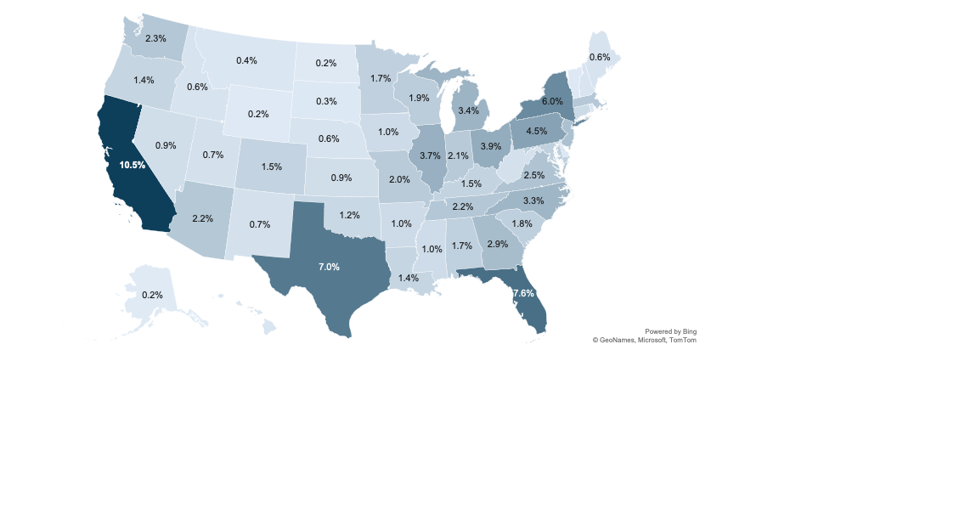
One out of every four Medicare beneficiaries lived in California, Florida, or Texas in 2020.
BENEFICIARY CHARACTERISTICS
Data: Commonwealth Fund analysis of CareJourney traditional Medicare claims data

Slide 4
Almost one in five Medicare beneficiaries spent 20 percent or more of their income on premiums and medical care, 2017
BENEFICIARY CHARACTERISTICS
Percent of federal poverty level, 2017
Note: FPL = federal poverty level.
Data: Authors’ analysis of the Medicare Current Beneficiary Survey 2017.
Source: Karen Davis and Amber Willink, COVID-19 and Affordability of Coverage and Care for Medicare Beneficiaries (Commonwealth Fund, Sept. 2020).

Slide 5
In 2020, more than a third of insured adults ages 60 to 64 paid $2,000 or more out of pocket for health care, compared to a fifth of people age 65 and older.
BENEFICIARY CHARACTERISTICS
Percentage of out-of-pocket costs for U.S. adults, by age
Note: The age 65+ group includes only respondents who reported Medicare coverage. The ages 60–64 group excludes those who did not report a source of insurance coverage and those who reported Medicare coverage.
*Indicates result is statistically different from the age 65+ group at the p < 0.05 level.
Data: Commonwealth Fund 2021 International Health Policy Survey of Older Adults.
Source: Gretchen Jacobson et al., “Older Adults on Medicare and Those Near Medicare Age Face Cost Barriers to Care,” To the Point (blog), Commonwealth Fund, Nov. 2, 2021. https://doi.org/10.26099/h3gy-2n66

Slide 6
Similar shares of insured adults ages 60 to 64 and those age 65 and older on Medicare reported postponing or forgoing health care because of cost.
BENEFICIARY CHARACTERISTICS
Percentage of older Americans who reported the following because of cost, by age:
Note: None of the differences are statistically significant at the p < 0.05 level. The age 65+ group includes only respondents who reported Medicare coverage. The ages 60–64 group excludes those who did not report a source of insurance coverage and those who reported Medicare coverage.
Data: Commonwealth Fund 2021 International Health Policy Survey of Older Adults.
Source: Gretchen Jacobson et al., “Older Adults on Medicare and Those Near Medicare Age Face Cost Barriers to Care,” To the Point (blog), Commonwealth Fund, Nov. 2, 2021. https://doi.org/10.26099/h3gy-2n66

