Slide 1
Virtual Symposium:
Health Care Transformation to Advance Black Maternal Health Equity
Host for the day:
Laurie C. Zephyrin MD, MPH, MBA
Senior Vice President, Advancing Health Equity
The Commonwealth Fund

Slide 2
Welcome
Objectives:
Focus on opportunities to improve Black maternal health using financing, health system transformation, and data use.
Describe emerging policy, program, and practice strategies that have the potential to advance equity.
Define and explore key concepts such as respectful care, structural racism, reproductive justice, and high value care.
Apply new knowledge generated by Commonwealth Fund grantees and other leaders.

Slide 3
Virtual Symposium: Health Care Transformation to Advance Black Maternal Health Equity
Speakers and moderators:
Congresswoman Robin Kelly, (D-IL-2)
PANEL ONE: Financing Health Care Transformation Innovation
  Moderator: Laurie Zephyrin, MD, MPH, MBA, The Commonwealth Fund
  Jamila Taylor, PhD, MPA, The Century Foundation
  Pooja Mehta, MD, Cityblock Health
  Aletha Akers, MD, MPH, Guttmacher Institute
PANEL TWO: Supporting High Quality, Equitable and Respectful Care
  Moderator: Dawn Godbolt, PhD, Maven Clinic
  Twylla Dillion, MBA, PhD, HealthConnect One
  P. Mimi Niles, PhD, MPH, CNM, Rory Meyers College of Nursing, New York University
  Brenda Gleason, MPH, M2 Health Care Consulting
PANEL THREE: Using Data to Drive Toward Equity
  Moderator: So O’Neil, Mathematica
  Rachel Hardeman, PhD, MPH, University of Minnesota School of Public Health
  Eona Young Harrison, PhD, Urban Institute
  Zsakeba Henderson, MD, FACOG. March of Dimes
  Aditi Mallick, MD, Center for Medicaid and CHIP Services, Centers for Medicare and Medicaid Services (CMCS-CMS)

Slide 4
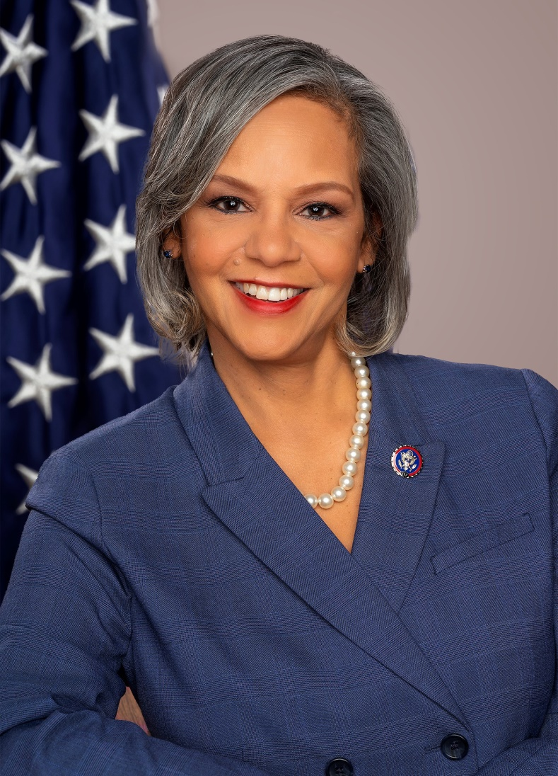
Congresswoman Robin Kelly (D-IL-2)
Vice Chair, House Energy and Commerce Committee
  Health Subcommittee
  Energy Subcommittee
  Consumer Protection and Commerce Subcommittees
Chair, Congressional Black Caucus Health Braintrust
Co-Chair, Congressional Caucus on Black Women and Girls
Member, Congressional Gun Violence Prevention Taskforce
Member, House Committee on Oversight and Reform
Co-Chair, House Democratic Policy Group

Slide 5
Opening Remarks
Laurie C. Zephyrin MD, MPH, MBA
Senior Vice President, Advancing Health Equity
The Commonwealth Fund

Slide 6



Commonwealth Fund Advancing Health Equity Program Goal
Overall Goal: eliminate unequal treatment, experience, and outcomes in health and health care for people of color by reducing systemic racism in health care policy and practice.
Dismantling Racism in Care Delivery
Using Policy
to Bring About Equitable Access
Changing Culture, Beliefs, and Attitudes

Slide 7
Strategies for Health Care Delivery System Change
Promote economic and educational opportunities and affordable health care access for the workforce
Identifying & correcting racially-biased health care processes
Reduce provider bias
Actively investing in and engaging with community partners
Communicate values including commitments to equity,
racial justice and inclusion
Increase knowledge about the impact of racism on health and health care, and have practical, actionable tools
Disaggregate data on outcomes, experience and quality
Improve training of professionals and staff
Diversify health care workforce at leadership levels

Slide 8
Strategies for Health Policy Change
Ensuring health care coverage
Analyze policies for health equity impact
Advance equity through workforce policy, licensure, and certification
Incorporate equity in
value-based care arrangements and managed care
Increase affordability and availability of health coverage
Address residential segregation impacts on hospital quality and hospital closures
Improve payment parity in Medicaid
Report disaggregated data on outcomes, experience and quality

Slide 9
Strategies for Changing Culture, Beliefs, and Attitudes
Efforts to track the history of racism in U.S. health care and health policy and the impact of racism and bias on health outcomes and patient experience.
Research to inform and frame messaging and narratives to address racism in health care.
Reporting and storytelling to address systemic racism in health system.
The development of metrics for assessing how racism manifests itself in health care.
The application of equity measurement and reporting systems for tracking progress in dismantling racism in health care.

Slide 10
Levers for Systems Change
Payment and policy reform ultimately drive change, but progresses at different speeds.
Delivery system change more challenging.
Community investment is a key lever for change.
Data are a tool for turning the gears to drive change.
Policy Reform (State and
Federal)
Delivery System Change
Community Investments

Slide 11

The landscape is shifting– a collision of crisis in COVID, economy, and reproductive policy change
Advancing Racial Equity and Reproductive Justice
Advancing Maternal Care
and Women’s Health
  Increased awareness of the structural causes of unequal treatment and outcomes
  Inequities underscored necessity of improving health equity and racial equity
  Importance of advancing diverse leadership
  New models of high value care emerging (midwifery, birthing centers, telehealth)
  Importance of community partners, integration of social needs, CHW/doula models
  An expanded role for Medicaid through covering uninsured and continuous eligibility protections

Slide 12
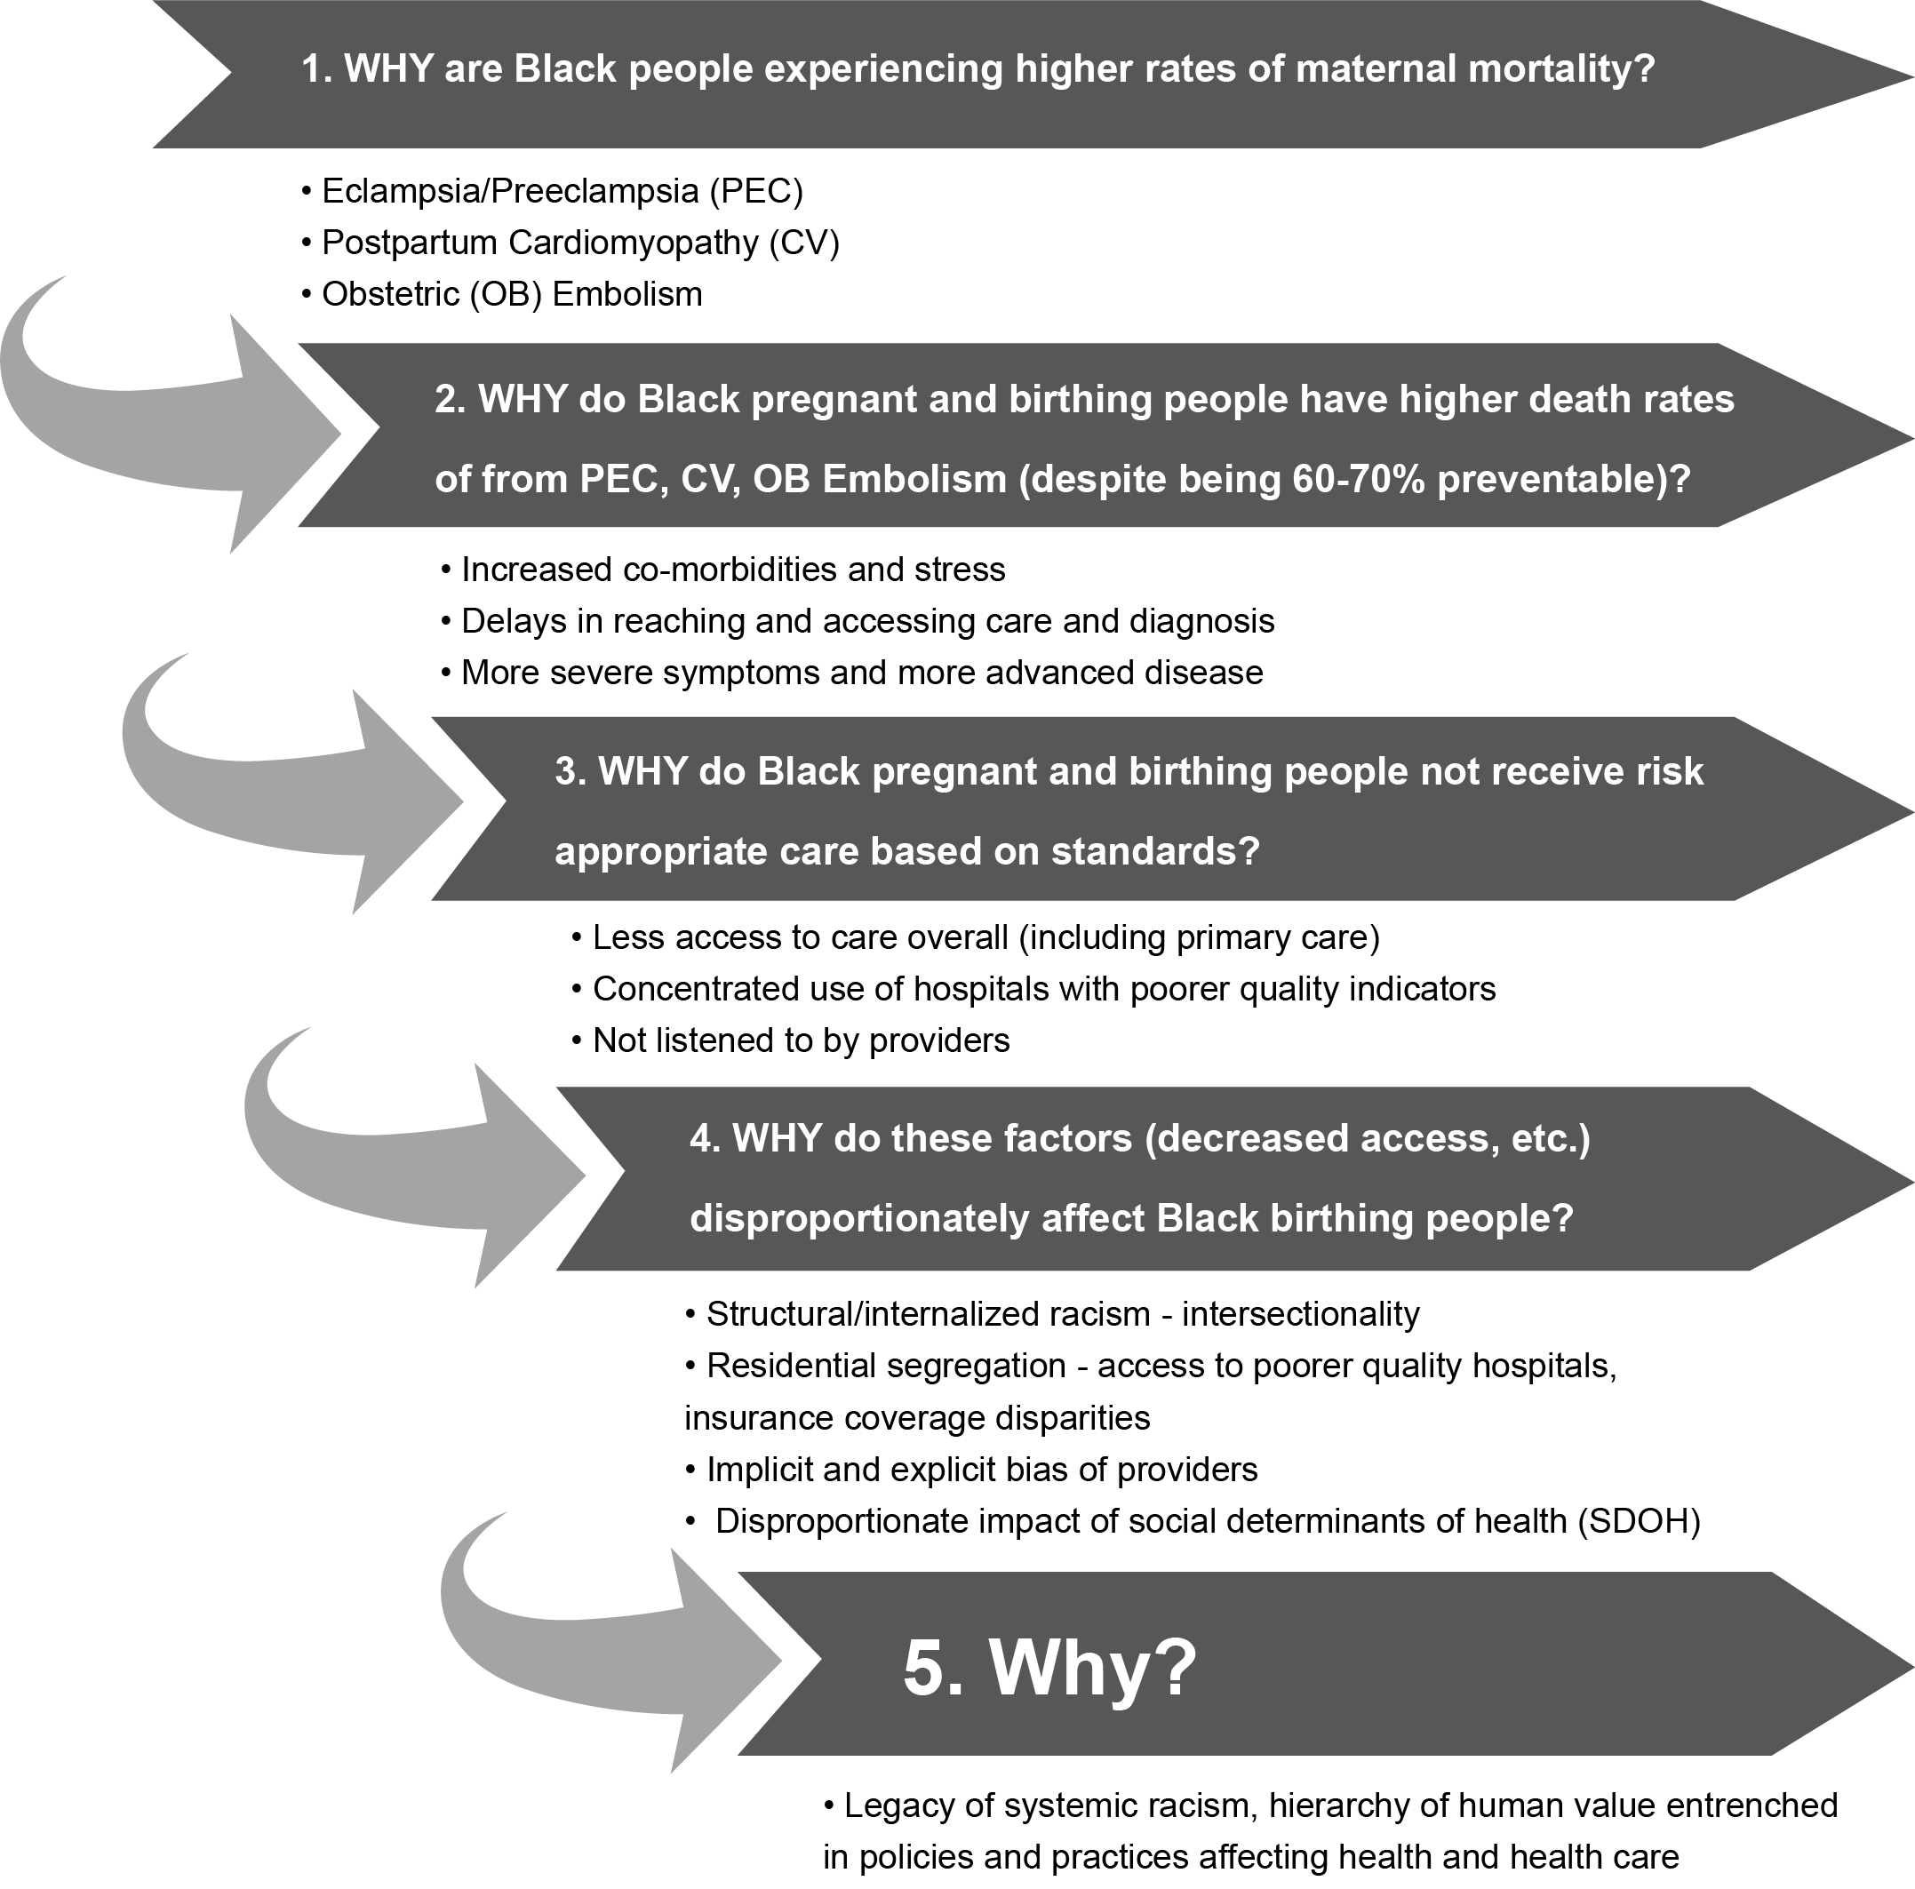
Looking at issues in new ways and asking deeper questions – using the five whys
Source: Zephyrin L. Changing the Narrative and Accelerating Action to Reduce Racial Inequities in Maternal Mortality. AJPH. 2021;111(9):1575-1577.

Slide 13
Resources on Maternal Health
Maternal Health issues page https://www.commonwealthfund.org/maternal-health
Maternal Mortality Primer https://www.commonwealthfund.org/publications/issue-brief-report/2020/dec/maternal-mortality-united-states-primer
Severe Maternal Morbidity Primer https://www.commonwealthfund.org/publications/issue-briefs/2021/oct/severe-maternal-morbidity-united-states-primer
Interactive map on what states are doing to improve maternal health https://www.commonwealthfund.org/blog/2022/loss-abortion-rights-will-send-shockwaves-through-us-health-care-system
Blog about impact of Dobbs decision by Laurie Zephyrin and David Blumenthal https://www.commonwealthfund.org/blog/2022/loss-abortion-rights-will-send-shockwaves-through-us-health-care-system
Blog about impact of Dobbs decision by Sara Rosenbaum et al. https://www.commonwealthfund.org/blog/2022/dobbs-immediate-aftermath-and-coming-legal-morass
New White House Blueprint for Addressing the Maternal Health Crisis
https://www.whitehouse.gov/wp-content/uploads/2022/06/Maternal-Health-Blueprint.pdf

