Slide 1
Prepandemic Hospital Discharge Distribution to Postacute Care (2017–2019)
EXHIBIT 1
Notes: Excludes cases that expired in hospital or discharged to hospice or other setting not listed. PAC = postacute care, HHA = home health agency, SNF = skilled nursing facility, IRF = inpatient rehabilitation facility, LTCH = long-term care hospital.
Data: KNG Health analysis of 2017–2020 Medicare claims data.

Slide 2
Trends in Transfer Rates to Postacute Care Settings Among Hospitalized Medicare Beneficiaries (2017–2020)
EXHIBIT 2
Notes: Excludes cases that expired in hospital or discharged to hospice or other setting not listed. HHA = home health agency, SNF = skilled nursing facility, IRF = inpatient rehabilitation facility,
LTCH = long-term care hospital.
Data: KNG Health analysis of 2017–2021 Medicare claims data.

Slide 3
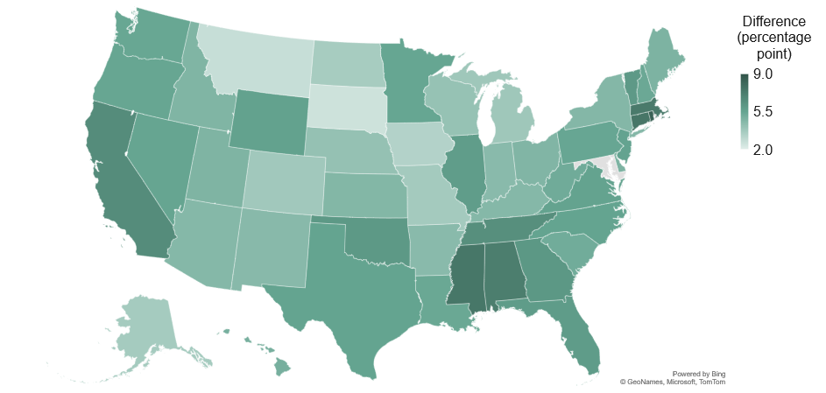
Changes in State-Level Rates of Hospital Discharge to HHAs Between the Prepandemic Period and During the Pandemic
EXHIBIT 3
Notes: Data for Maryland was excluded. We excluded cases that were not discharged to either home, home health, skilled nursing facility, inpatient rehabilitation facility, or long-term care hospital.
Data: KNG Health analysis of 2017–2021 Medicare claims data.

Slide 4
Percentage-Point Change (Risk-Adjusted) in the Likelihood of Discharge to HHA Associated with COVID-19 Pandemic
EXHIBIT 4
Notes: Percentage-point estimates reflect pandemic period change in likelihood in being discharged to HHA as compared with prepandemic period. HHA = home health agency.
Data: KNG Health analysis of 2017–2021 Medicare claims data.

