Slide 1
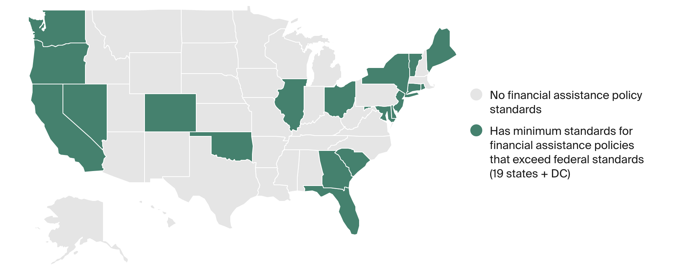
EXHIBIT 2
State Adoption of Financial Assistance Policy Standards
Notes: Coding on this map identifies states that require hospitals to maintain a financial assistance policy and set certain minimum standards for these policies. The state can require hospitals to have these policies in place as a condition of licensure, as a legal mandate subject to penalties, or as a condition of receiving state funding. States that have less prescriptive requirements for their hospitals (like states that put the onus of providing financial assistance on individual counties, or states that generally require provision of financial assistance without setting minimum standards) have been excluded.
The MN attorney general has an agreement in place with almost every hospital in the state requiring them to adhere to certain patient protections, but it does not require hospitals to provide charity care.
Data: Center on Health Insurance Reforms, Georgetown University Health Policy Institute; Commonwealth Fund analysis.
Notes:
1

Slide 2
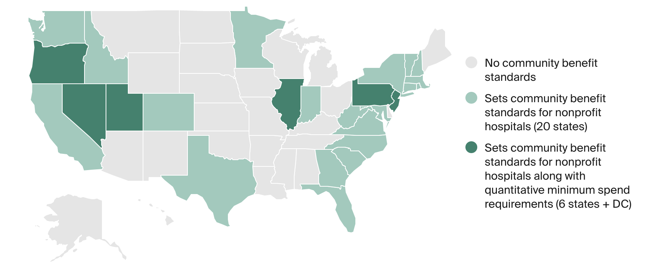
EXHIBIT 4
State Adoption of Community Benefit Standards
Notes: Coding on this map identifies states that require nonprofit hospitals to meet community benefit standards in exchange for an exemption from state taxes and states that also set certain minimum quantitative standards for how hospitals can fulfill their community benefit obligations.
ID, NV, and NH limit these requirements to hospitals of a certain size.
DC, MN, NV, RI, SC, and VA extend these requirements to for-profit hospitals as well.
TX requires nonprofit hospitals seeking certification as a "limited liability" entity to show that it spend 8% of its net patient revenue on charity care and provides 40% of the charity in its county.
GA state law requires destination cancer hospitals seeking a certificate of need to spend 3% of their adjusted gross income on indigent and charity care. While not in statute, the state might require this for all hospitals seeking a certificate of need, as a matter of practice.
Data: Center on Health Insurance Reforms, Georgetown University Health Policy Institute; Commonwealth Fund analysis.
Notes:
2

Slide 3
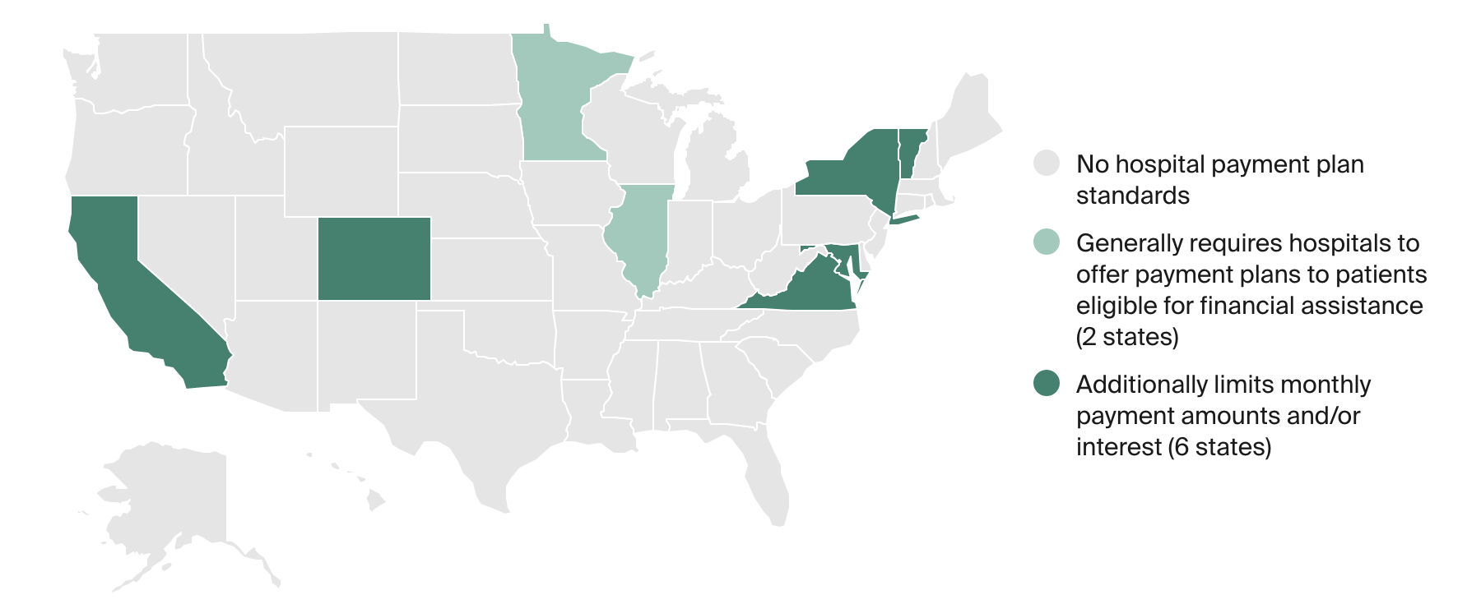
EXHIBIT 5
State Standards for Hospital Payment Plans
Notes: Coding on this map identifies states that require hospitals to offer payment plans and states that also set limits on monthly payment amounts and interest that can be charged on these payment plans.
MA only requires hospitals to provide payment plans to patients eligible for state-run Health Safety Net. For these patients, state limits monthly payment amounts only for debts under $1,000 and after a patient has paid an initial deposit of $500.
VA requires hospitals to allow uninsured patients eligible for financial assistance to pay in installments and caps the amount of interest that can be charged, but sets a vaguer standard for how much a hospital can require a patient to pay monthly (“based on ability to pay”).
Data: Center on Health Insurance Reforms, Georgetown University Health Policy Institute; Commonwealth Fund analysis.
Notes:
3

Slide 4
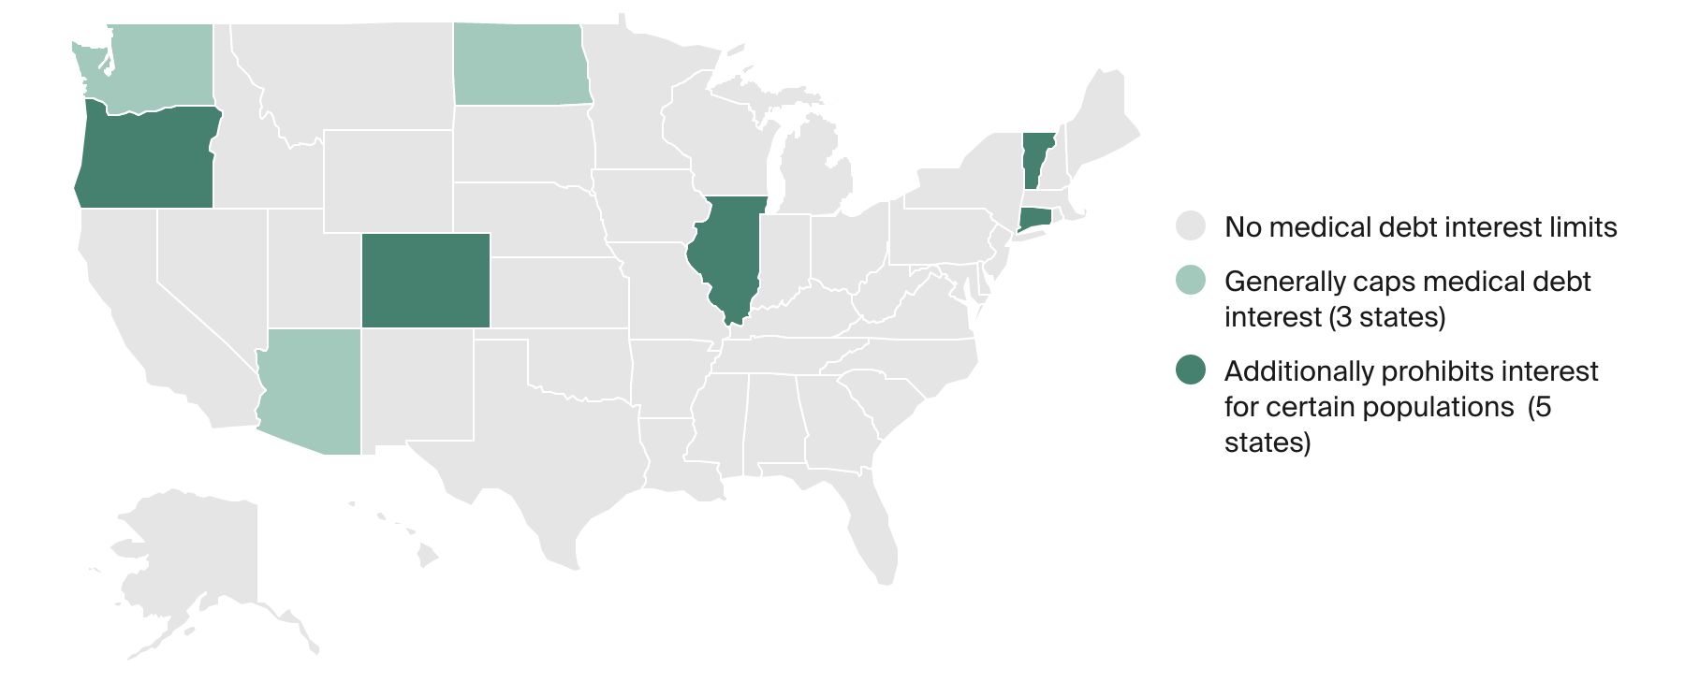
EXHIBIT 6
State Limits on Medical Debt Interest
Notes: Coding on this map identifies states that generally cap interest on medical debt, and those that also prohibit medical debt for certain low-income populations. All states have general usury laws that limit the amount of interest than can be charged on any oral or written agreement.
ME prohibits debt collectors from charging interest unless it is agreed upon in writing.
Data: Center on Health Insurance Reforms, Georgetown University Health Policy Institute; Commonwealth Fund analysis.
Notes:
4

Slide 5
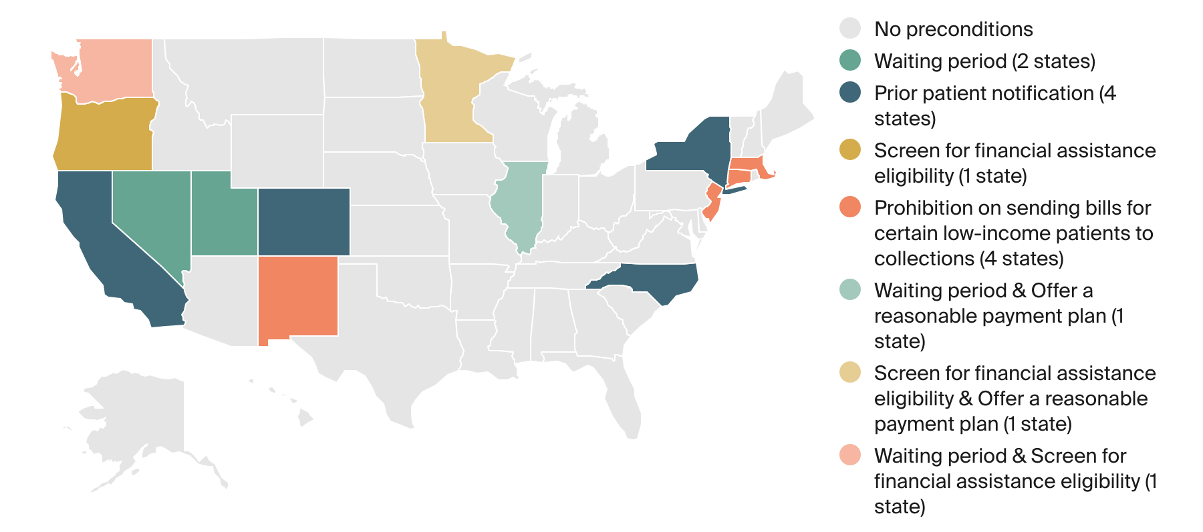
EXHIBIT 7
State Preconditions Before a Hospital Can Send a Bill to Collections
Note: Coding on this map identifies states that require hospitals to follow certain conditions before they can send a bill to collections.
Data: Center on Health Insurance Reforms, Georgetown University Health Policy Institute; Commonwealth Fund analysis.
Notes:
5

Slide 6
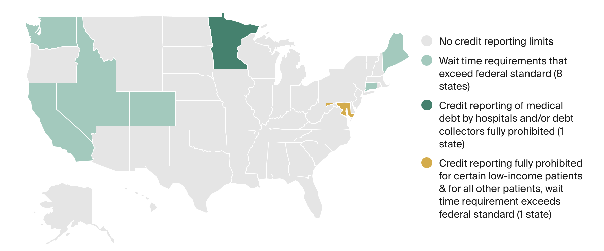
EXHIBIT 8
State Limits on Credit Reporting of Medical Debt
Notes: Coding on this map identifies states that limit reporting of medical debt to credit reporting agencies.
CO and ME directly regulate credit reporting agencies — CO prohibits them from reporting on medical debt under $726,200, and ME requires them to wait at least 180 days from the date of first delinquency before reporting the debt.
Data: Center on Health Insurance Reforms, Georgetown University Health Policy Institute; Commonwealth Fund analysis.
Notes:
6

Slide 7
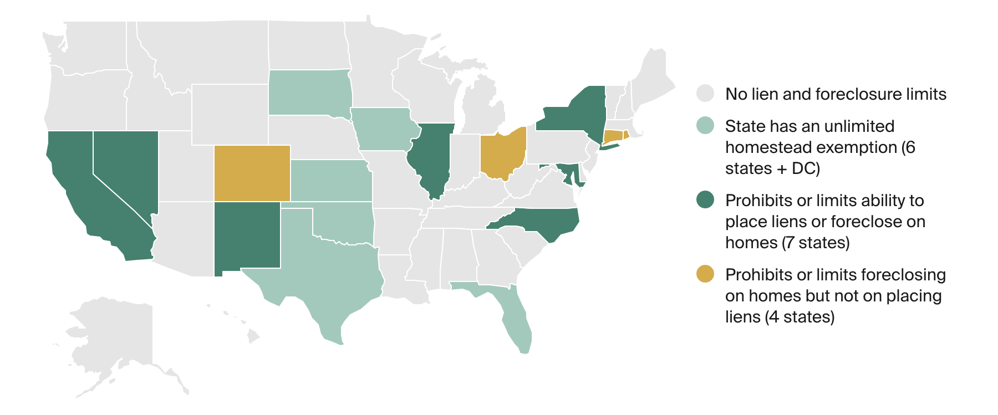
EXHIBIT 9
State Limits on Liens and Foreclosures to Collect on Medical Debt
Notes: Coding on this map identifies states that exceed federal protections against placing liens or foreclosing on homes to collect on medical debt.
LA offers an unlimited homestead exemption for certain uninsured, low-income patients with at least $10,000 in medical bills.
MD, NV, and NY protect all patients’ homes from liens and foreclosure.
CA, IL, and NM protect the homes of certain patients with demonstrated financial need.
NC fully prohibits liens on patients’ homes but only prohibits foreclosures for bills incurred by a minor until they become adults.
Data: Center on Health Insurance Reforms, Georgetown University Health Policy Institute; Commonwealth Fund analysis.
Notes:
7

Slide 8
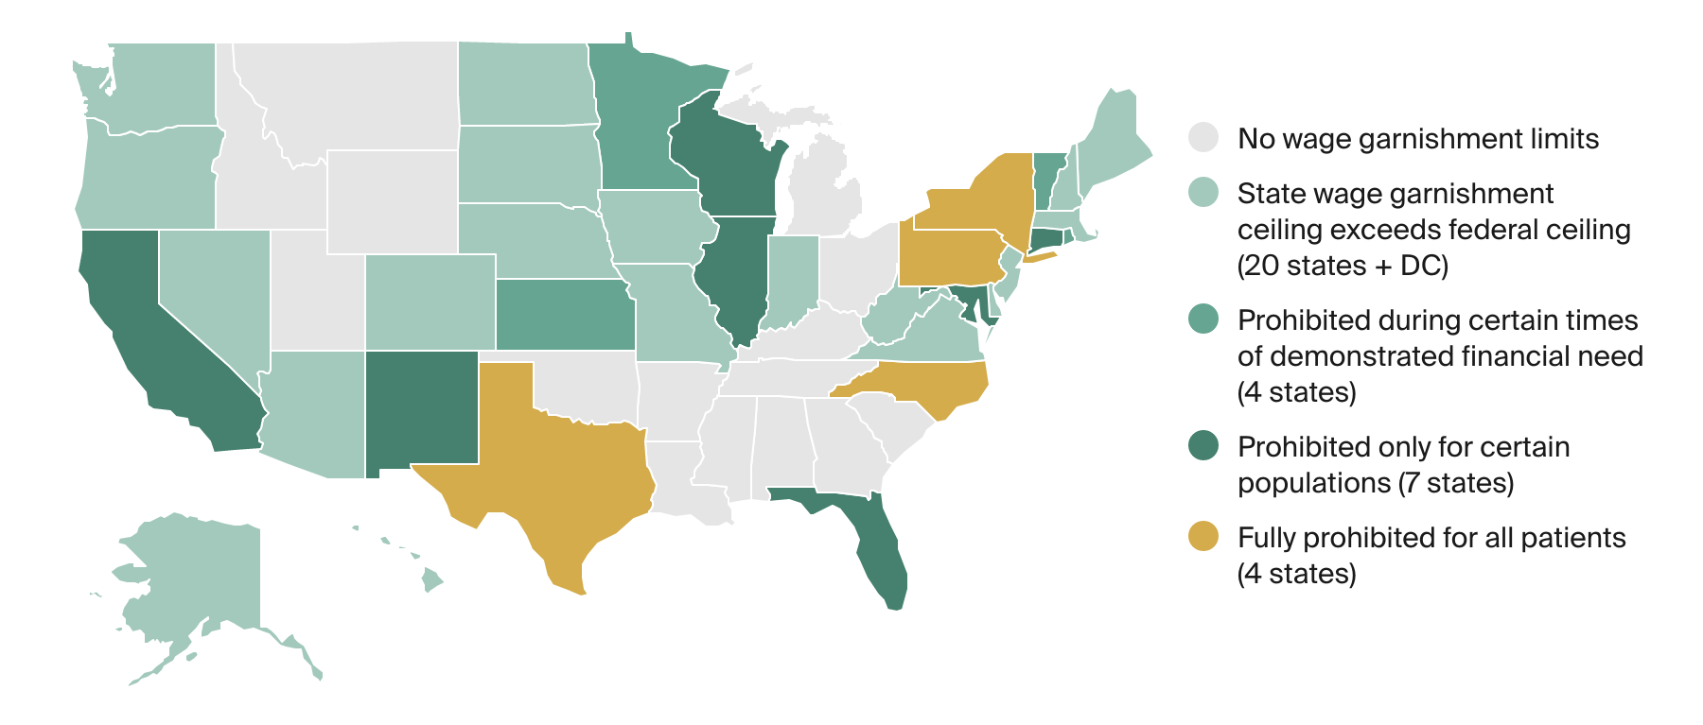
EXHIBIT 10
State Limits on Wage Garnishment to Collect on Medical Debt
Notes: Coding on this map identifies states that exceed federal protections against wage garnishment to collect on medical debt. Note that the states that prohibit wage garnishment at certain times or for some populations might otherwise have wage garnishment ceilings that exceed the federal ceiling, which will apply to all other patients.
Creditors in FL are not allowed to garnish a patient’s wages unless the patient agrees to it in writing, which has the potential to function as a prohibition as long as patients and consumers are made aware of their rights.
NH only allows garnishment of wages that have already been earned but not paid to the employee, which means that the creditor cannot acquire a standing writ to garnish the employee's wages and has to go to court every pay period to garnish wages. Given the expense involved, creditors do not use this process often.
Data: Center on Health Insurance Reforms, Georgetown University Health Policy Institute; Commonwealth Fund analysis.
Notes:
8

Slide 9
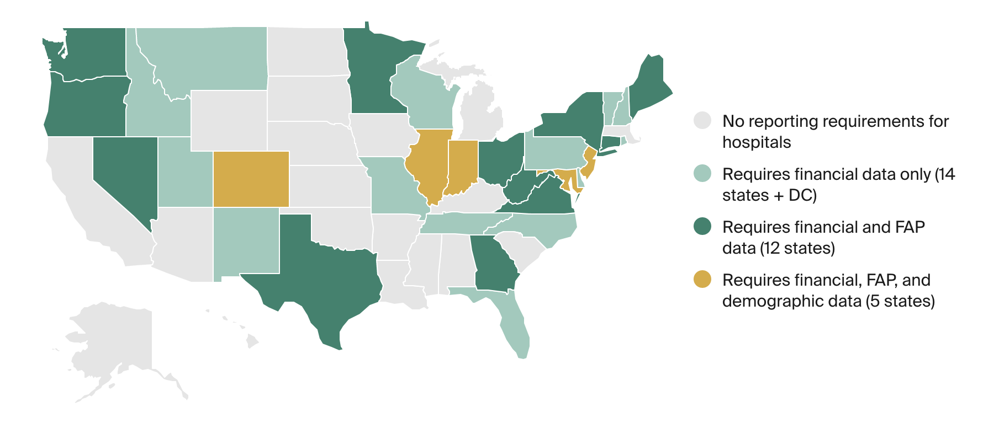
EXHIBIT 11
State Reporting Requirements for Hospitals on Data Related to Medical Debt Protections
Notes: Coding on this map identifies states that require hospitals to report certain data to help them conduct oversight of and enforce the various medical debt protections discussed in this report. States might have other reporting requirements for hospitals, but unless there was some indication in the law that the information was being used in the context of medical debt protections, it was not included in this exhibit. Some states might also impose additional reporting requirements through subregulatory guidance, and these documents were outside of the scope of research for this project. Financial data: total dollar amounts spent on financial assistance and/or bad debt. FAP (financial assistance policy) data: numbers of financial assistance applications received, numbers approved and denied, numbers appealed, etc. Demographic data: reporting of the above data by race, ethnicity, gender, preferred or primary language, etc.
WA requires its nonprofit hospitals to report their community benefit activities and provide information about participants by race, ethnicity, any disability, gender identity, preferred language, and zip code of primary residency.
Data: Center on Health Insurance Reforms, Georgetown University Health Policy Institute; Commonwealth Fund analysis.
Notes:
9

