Slide 1
Profound racial and ethnic disparities in health and health care exist across and within states.
EXHIBIT 1
Health system performance scores, by state and race/ethnicity
Higher health system performance
All-group median
Lower health system performance
Notes: Scores are based on the percentile distribution of each group’s final composite z-score across all indicators/dimensions; rank-ordered by highest state performance for AANHPI population. Gray dots represent the highest score achieved in each state by any of the five groups (if no gray dot is visible, the highlighted group has the top score). The 50th percentile represents the median health performance score among all the groups measured. Summary performance scores not available for all racial and ethnic groups in all states; missing dots for a particular group indicate that there are insufficient data for that state. AANHPI = Asian American, Native Hawaiian, and Pacific Islander.
Data: Commonwealth Fund 2024 Health System Performance Scores.

Slide 2
Profound racial and ethnic disparities in health and health care exist across and within states.
EXHIBIT 1
Health system performance scores, by state and race/ethnicity
Higher health system performance
All-group median
Lower health system performance
Notes: Scores are based on the percentile distribution of each group’s final composite z-score across all indicators/dimensions; rank-ordered by highest state performance for AIAN population. Gray dots represent the highest score achieved in each state by any of the five groups (if no gray dot is visible, the highlighted group has the top score). The 50th percentile represents the median health performance score among all the groups measured. Summary performance scores not available for all racial and ethnic groups in all states; missing dots for a particular group indicate that there are insufficient data for that state. AIAN = American Indian and Alaska Native.
Data: Commonwealth Fund 2024 Health System Performance Scores.

Slide 3
Profound racial and ethnic disparities in health and health care exist across and within states.
EXHIBIT 1
Health system performance scores, by state and race/ethnicity
Higher health system performance
All-group median
Lower health system performance
Notes: Scores are based on the percentile distribution of each group’s final composite z-score across all indicators/dimensions; rank-ordered by highest state performance for Black population. Gray dots represent the highest score achieved in each state by any of the five groups (if no gray dot is visible, the highlighted group has the top score). The 50th percentile represents the median health performance score among all the groups measured. Summary performance scores not available for all racial and ethnic groups in all states; missing dots for a particular group indicate that there are insufficient data for that state.
Data: Commonwealth Fund 2024 Health System Performance Scores.

Slide 4
Profound racial and ethnic disparities in health and health care exist across and within states.
EXHIBIT 1
Health system performance scores, by state and race/ethnicity
Higher health system performance
All-group median
Lower health system performance
Notes: Scores are based on the percentile distribution of each group’s final composite z-score across all indicators/dimensions; rank-ordered by highest state performance for Hispanic population. Gray dots represent the highest score achieved in each state by any of the five groups (if no gray dot is visible, the highlighted group has the top score). The 50th percentile represents the median health performance score among all the groups measured. Summary performance scores not available for all racial and ethnic groups in all states; missing dots for a particular group indicate that there are insufficient data for that state.
Data: Commonwealth Fund 2024 Health System Performance Scores.

Slide 5
Profound racial and ethnic disparities in health and health care exist across and within states.
EXHIBIT 1
Health system performance scores, by state and race/ethnicity
Higher health system performance
All-group median
Lower health system performance
Notes: Scores are based on the percentile distribution of each group’s final composite z-score across all indicators/dimensions; rank-ordered by highest state performance for white population. Gray dots represent the highest score achieved in each state by any of the five groups (if no gray dot is visible, the highlighted group has the top score). The 50th percentile represents the median health performance score among all the groups measured. Summary performance scores not available for all racial and ethnic groups in all states; missing dots for a particular group indicate that there are insufficient data for that state.
Data: Commonwealth Fund 2024 Health System Performance Scores.

Slide 6
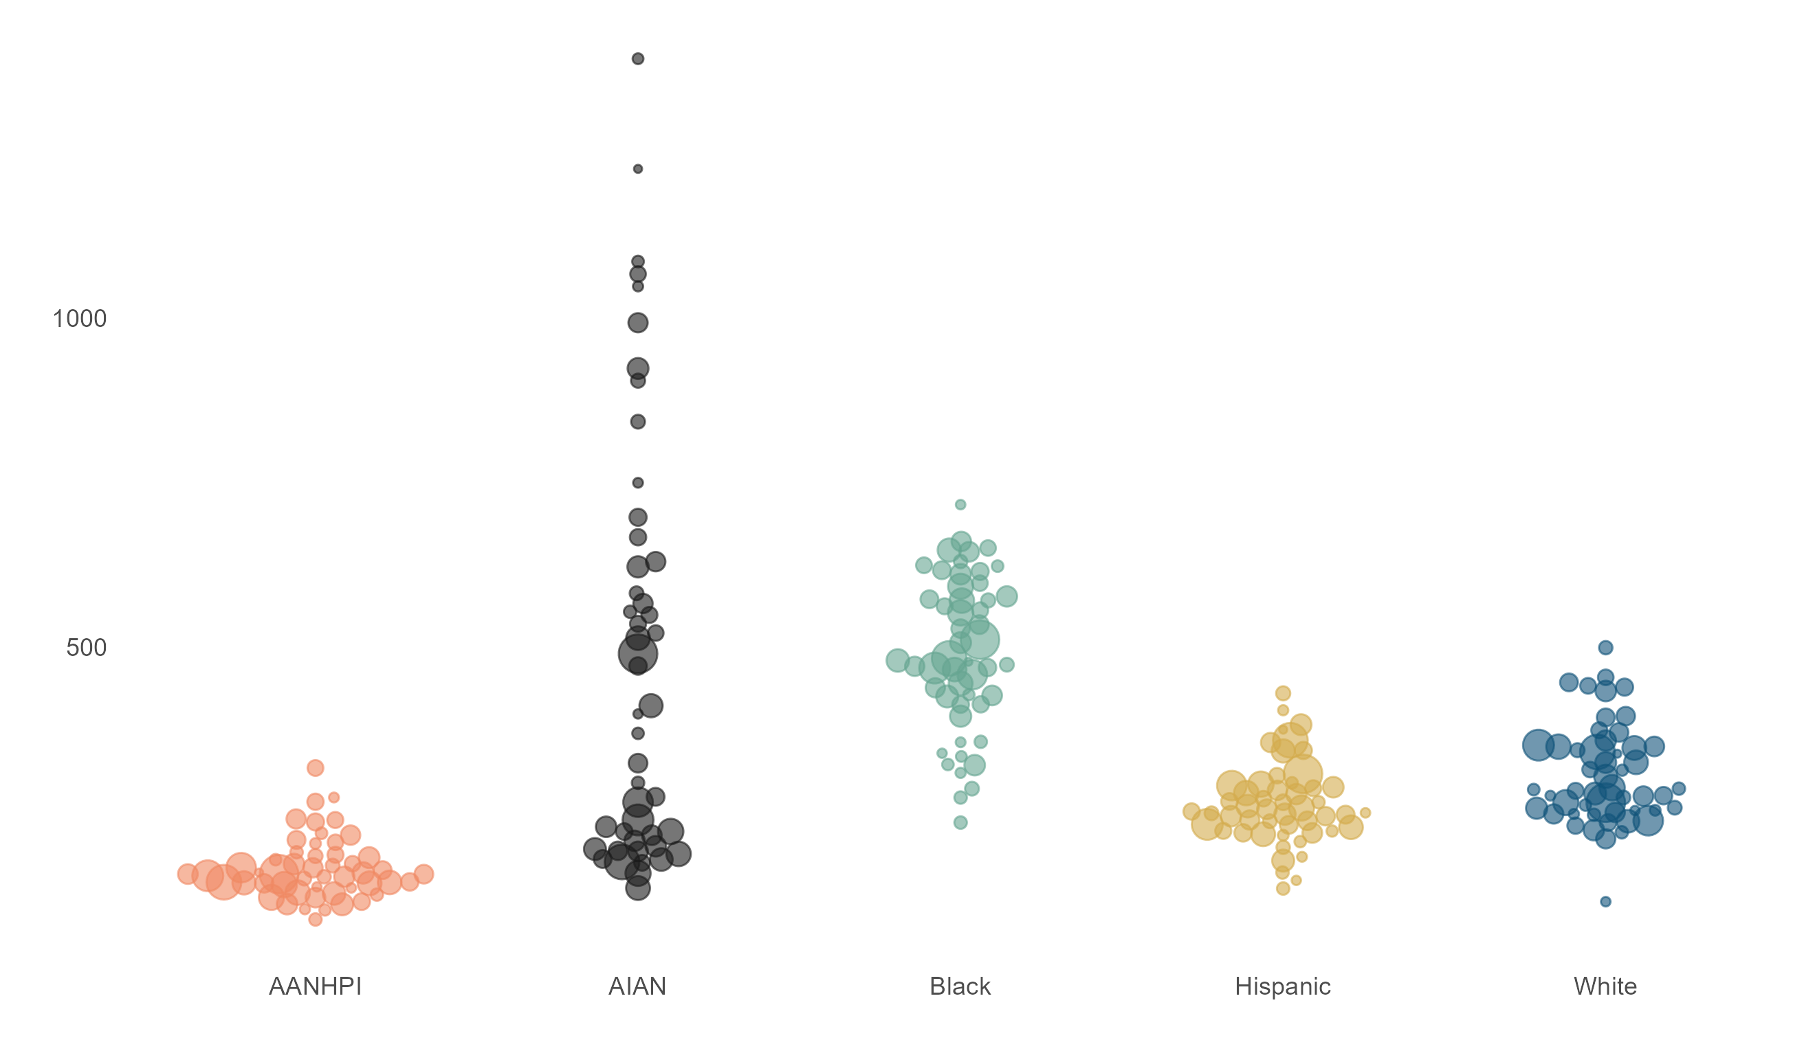
Premature deaths from avoidable causes vary across states and occur at a higher rate among AIAN and Black people compared to other racial and ethnic groups.
EXHIBIT 2
Deaths per 100,000 population, by state and race/ethnicity
Dots represent states and are scaled relative to the size of the total state population. Missing dots for a particular group indicate that there are insufficient data for that state. See online graphic for state detail.
South Dakota
1,394
District of Columbia
717
West Virginia
500
New Mexico
430
Arkansas
317
Hawaii
234
Georgia
134
Maine
134
District of Columbia
114
New Hampshire
87
Notes: AANHPI = Asian American, Native Hawaiian, and Pacific Islander. AIAN = American Indian and Alaska Native. Number of deaths before age 75 per 100,000 population that resulted from causes that can be mainly avoided through timely and effective prevention and treatment. Avoidable mortality rates presented in this exhibit reflect the combination of two variables used in this report: deaths from preventable causes and deaths from treatable causes. Refer to appendix B2 for state rates for each mortality type. Methodology developed by the Organisation for Economic Co-operation and Development (OECD) and Eurostat, as published in Avoidable Mortality: OECD/Eurostat Lists of Preventable and Treatable Causes of Death (January 2022 Version).
Data: Centers for Disease Control and Prevention, 2020 and 2021 National Vital Statistics System (NVSS), All-County Micro Data, Restricted Use Files.

Slide 7
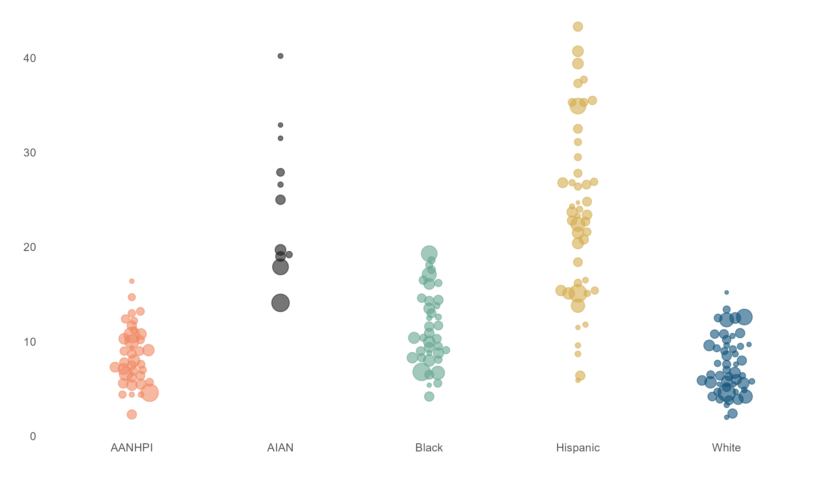
Although the ACA’s coverage expansion reduced inequities, state uninsured rates are generally higher and more variable for Black, Hispanic, and AIAN adults compared to AANHPI and white adults.
EXHIBIT 3
Percent of adults ages 19–64 who are uninsured, by state and race/ethnicity
Dots represent states and are scaled relative to the size of the total state population. Missing dots for a particular group indicate that there are insufficient data for that state. See online graphic for state detail.
Tennessee
43.3
South Dakota
40.2
Texas
19.3
Wyoming
15.2
Alaska
16.4
California
14.1
Massachusetts
4.2
District of Columbia
5.9
Massachusetts
2.3
District of Columbia
2.0
Notes: ACA = Affordable Care Act. AANHPI = Asian American, Native Hawaiian, and Pacific Islander. AIAN = American Indian and Alaska Native.
Data: American Community Survey Public Use Micro Sample (ACS-PUMS) 2021 1-year file.

Slide 8
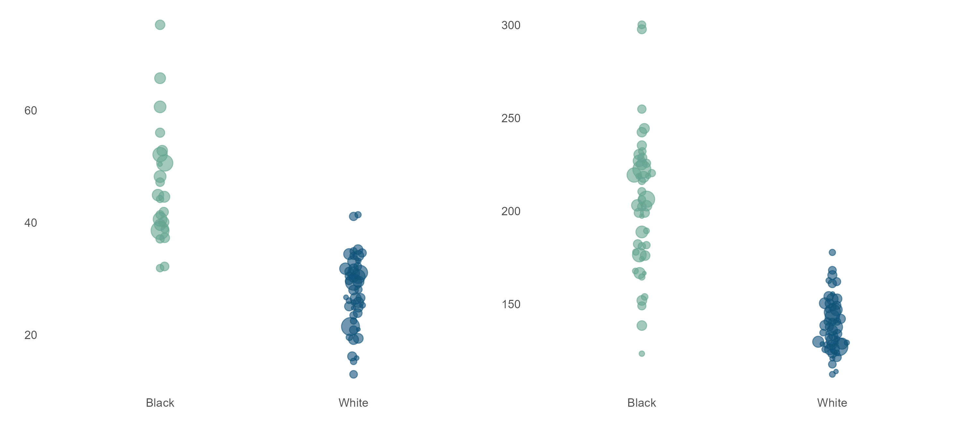
Black Medicare beneficiaries are more likely than white beneficiaries to be admitted to a hospital or to seek care in an emergency department for conditions that can typically be managed through good primary care.
EXHIBIT 4
Dots represent states and are scaled relative to the size of the total state population. Missing dots for a particular group indicate that there are insufficient data for that state. See online graphic for state detail.
Admissions for ambulatory care–sensitive conditions,
per 1,000 Medicare beneficiaries
Avoidable emergency department visits,
per 1,000 Medicare beneficiaries
Indiana
75.2
Connecticut
300.1
West Virginia
41.4
West Virginia
177.8
Nevada
31.9
Rhode Island
123.4
Utah
13.0
Hawaii
112.3
Note: Race data only available for Black and white populations; ethnicity is unknown.
Data: Centers for Medicare and Medicaid Services, 2021 Limited Data Set (LDS) 5% sample.

