Slide 1
Over half of U.S. adults report worrying about meeting their economic and social needs.
Percentage of U.S. adults who reported they always, usually, or sometimes worried or were stressed about having enough of the following in the past 12 months, by self-reported income
Notes: All U.S. adults age 18 and older: n=3.568; adults with income below the national average: n=1,547; adults with income at or above the national average: n=2,021. U.S. average household income was $62,000 at the time of the survey.
* Differences between income levels are statistically significant at the p<0.05 level.
Data: 2023 Commonwealth Fund International Health Policy Survey; U.S.-only data.

Slide 2
Most low-income adults were worried about their economic and social needs, regardless of their race, ethnicity, gender, or insurance status.
Percentage of U.S. adults whose self-reported income was below the national average and who reported they always, usually, or sometimes worried or were stressed about meeting their economic and social needs in the past 12 months
Notes: U.S. adults age 18 and older with income below the national household average of $62,000 at the time of the survey: n=1,547. “Economic and social needs” include having a stable job or source of income; having enough money to pay housing bills; having enough food to eat; and having a clean and safe place to sleep.
* Differences between categories are statistically significant at the p<0.05 level. For race and ethnicity, Non-Hispanic White was the comparator group.
Data: 2023 Commonwealth Fund International Health Policy Survey; U.S.-only data.

Slide 3
Nearly two-thirds of primary care physicians in the U.S. screen their patients for at least one social need.
Percentage of U.S. primary care physicians who report they or other personnel in their practice
usually or often screen patients for the following social needs
Notes: U.S. primary care physicians: n=1,059.
Data: 2022 Commonwealth Fund International Health Policy Survey of Primary Care Physicians; U.S.-only data.

Slide 4
Physicians in community health centers were more likely to screen patients for needs related to the drivers of health than those working in other settings.
Percentage of U.S. primary care physicians who report they or other personnel in their practice usually or often screen patients for any social needs, by practice characteristics
Notes: U.S. primary care physicians: n=1,059; U.S. primary care physicians working in community health centers: n=183; U.S. primary care physicians serving at least 50% Medicare patients: n= 198; U.S. primary care physicians serving at least 50% privately insured patients: n= 288; U.S. primary care physicians working in solo practices: n=210. “Social needs” include social isolation, domestic violence, transportation needs, food insecurity, housing problems, and financial security.
95% Confidence intervals are applied to point estimates to assess significant differences.
Data: 2022 Commonwealth Fund International Health Policy Survey of Primary Care Physicians; U.S.-only data.

Slide 5
Less than half of all physicians surveyed reported frequently coordinating their care with social services or community organizations.
Percentage of U.S. primary care physicians who report they or other health care professionals in their practice frequently coordinate care with social services or other community providers, by practice characteristics
Notes: U.S. primary care physicians: n=1,059; U.S. primary care physicians working in community health centers: n=183; U.S. primary care physicians serving at least 50% Medicare patients: n= 198; U.S. primary care physicians serving at least 50% privately insured patients: n= 288; U.S. primary care physicians working in solo practices: n=210.
95% Confidence intervals are applied to point estimates to assess significant differences.
Data: 2022 Commonwealth Fund International Health Policy Survey of Primary Care Physicians; U.S.-only data.

Slide 6
A quarter of physicians in community health centers reported that lacking information about community organizations was a challenge to coordinating care.
Percentage of U.S. primary care physicians who report the following were major challenges for themselves or other personnel
in their practice when coordinating their patient’s care with community or social services, by practice characteristics
Notes: U.S. primary care physicians: n=1,059; U.S. primary care physicians working in community health centers: n=183; U.S. primary care physicians working in solo practices: n=210.
95% Confidence intervals are applied to point estimates to assess significant differences.
Data: 2022 Commonwealth Fund International Health Policy Survey of Primary Care Physicians; U.S.-only data.

Slide 7
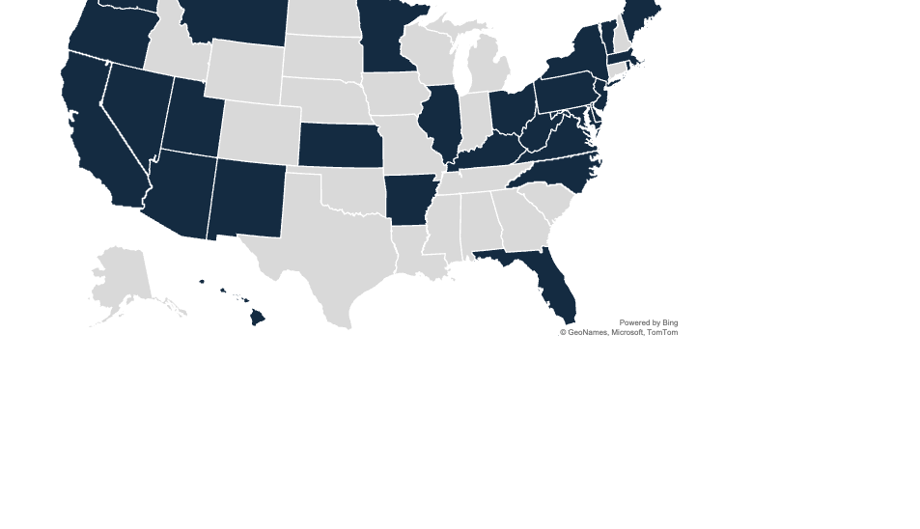
Many state Medicaid agencies provide nonclinical services to address unmet social and economic needs.
State Medicaid agencies with an approved or pending federal waiver or using another state authority to address beneficiaries’ needs related to the drivers of health
At least one program
No program
Notes: Federal waivers and state authority includes Section 1115 waiver, Section 1915 Home and Community-Based Services programs, In Lieu of Services, and community reinvestment opportunities for Medicaid managed care organizations.
Data: KFF, “Medicaid Waiver Tracker: Approved and Pending Section 1115 Waivers by State”; Aug. 11, 2023; and Center for Health Care Strategies, Financing Approaches to Address Social Determinants of Health via Medicaid Managed Care: A 12-State Review (CHCS, Feb. 2023).

