Slide 1
Despite a lower total premium, small-firm employees on average contribute more to family premiums and face higher deductibles than large-firm employees do.
Average annual family coverage total premium, employee contribution, and deductible, nationally, by size of firm, 2023
Data: Medical Expenditure Panel Survey Insurance Component (MEPS-IC), 2023.

Slide 2
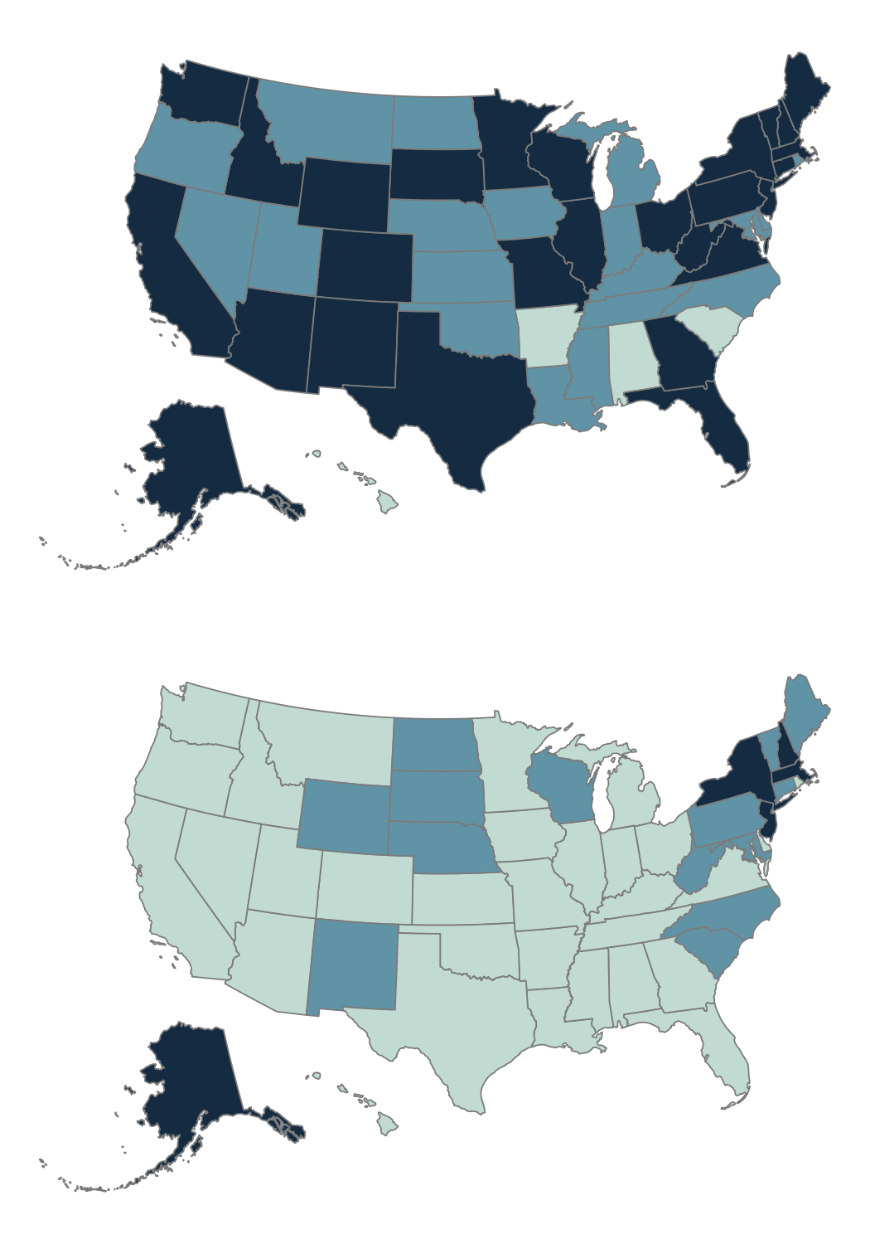
Across the U.S., total premiums for family coverage are generally lower for small firms than they are for large firms.
Total premium cost for family coverage, by state and size of firm, 2023
Large firm (50+ employees)
Total average premium cost, 2023
$20,795–$21,932 (4 states)
$22,288–$23,987 (19 states)
$24,015–$26,875 (27 states + D.C.)
Small firm (<50 employees)
Total average premium cost, 2023
$14,039–$21,910 (31 states + D.C.)
$22,083–$23,738 (14 states)
$24,083–$27,718 (5 states)
Data: Medical Expenditure Panel Survey Insurance Component (MEPS-IC), 2023.

Slide 3
Employee premium contributions for family coverage are higher at small firms than at large firms.
Average annual employee premium contribution (in $) for family coverage, nationally, by size of firm, 2014–2023
Data: Medical Expenditure Panel Survey Insurance Component (MEPS-IC), 2014–2023.

Slide 4
While small-firm employees once had lower premium contributions for single-coverage plans, they paid more than workers at large firms in 2023.
Average annual employee premium contribution (in $) for single coverage, nationally, by size of firm, 2014–2023
Data: Medical Expenditure Panel Survey Insurance Component (MEPS-IC), 2014–2023.

Slide 5
In 31 states, workers’ premium contributions for family coverage at small firms exceed those at large firms.
Average annual employee premium contribution (in $) for family coverage, by state and size of firm, 2023
Large-firm premium contributions exceed small-firm premium contributions
* Small-firm data missing for Alaska.
Note: Small-firm point estimates in Idaho for single coverage and Hawaii, Maryland, New Mexico, and Wyoming for family coverage have a relative standard error (RSE) greater than 30%, signaling high uncertainty and low statistical precision.
Data: Medical Expenditure Panel Survey Insurance Component (MEPS-IC), 2023.

Slide 6
In 27 states and the District of Columbia, workers at small firms pay more in premium contributions for single coverage than workers at large firms.
Average annual employee premium contribution (in $) for single coverage, by state and size of firm, 2023
Data: Medical Expenditure Panel Survey Insurance Component (MEPS-IC), 2023.

Slide 7
In most states, workers in small firms contribute a larger share of the premium for family coverage — in some cases exceeding 50 percent.
Average annual employee share of premiums (as %) for family coverage, by state and size of firm, 2023
Small-firm premium share exceeds large-firm premium share
Large-firm premium share exceeds small-firm premium share
* Small-firm data missing for family coverage in Alaska. ** Average share of premiums for single coverage is equal for small and large firms in Missouri in 2023.
Note: Small-firm point estimates in Hawaii and Utah for single coverage and Georgia, Hawaii, New Mexico, and Wyoming for family coverage have a relative standard error (RSE) greater than 30%, signaling high uncertainty and low statistical precision.
Data: Medical Expenditure Panel Survey Insurance Component (MEPS-IC), 2023.

Slide 8
In more than half the states, small-firm employees contribute a larger share of the premium for single coverage.
Average annual employee share of premiums (as %) for single coverage, by state and size of firm, 2023
Small-firm premium share exceeds large-firm premium share
* Average premium shares are equal for small and large firms in Missouri in 2023.
Data: Medical Expenditure Panel Survey Insurance Component (MEPS-IC), 2023.

Slide 9
The average deductible for family coverage is higher for workers at small firms than it is for those at large firms.
Average annual employee deductible (in $) for family coverage, nationally, by size of firm, 2014–2023
Data: Medical Expenditure Panel Survey Insurance Component (MEPS-IC), 2014–2023.

Slide 10
Employees in small firms face higher deductibles for single-coverage than those in large firms.
Average annual employee deductible (in $) for single coverage, nationally, by size of firm, 2014–2023
Data: Medical Expenditure Panel Survey Insurance Component (MEPS-IC), 2014–2023.

Slide 11
In nearly all states, employee deductibles for family coverage are higher in small firms than in large firms.
Average annual employee deductible (in $) for family coverage, by state and size of firm, 2023
Small-firm deductibles exceed large-firm deductibles
Large-firm deductibles exceed small-firm deductibles
* Small-firm data missing for Hawaii.
Data: Medical Expenditure Panel Survey Insurance Component (MEPS-IC), 2023.

Slide 12
In nearly every state, employee deductibles for single coverage in small firms exceed those in large firms.
Average annual employee deductible (in $) for single coverage, by state and size of firm, 2023
Small-firm deductibles exceed large-firm deductibles
Large-firm deductibles exceed small-firm deductibles
* Average deductibles are equal for small and large firms in Nevada in 2023.
Data: Medical Expenditure Panel Survey Insurance Component (MEPS-IC), 2023.

