Slide 1
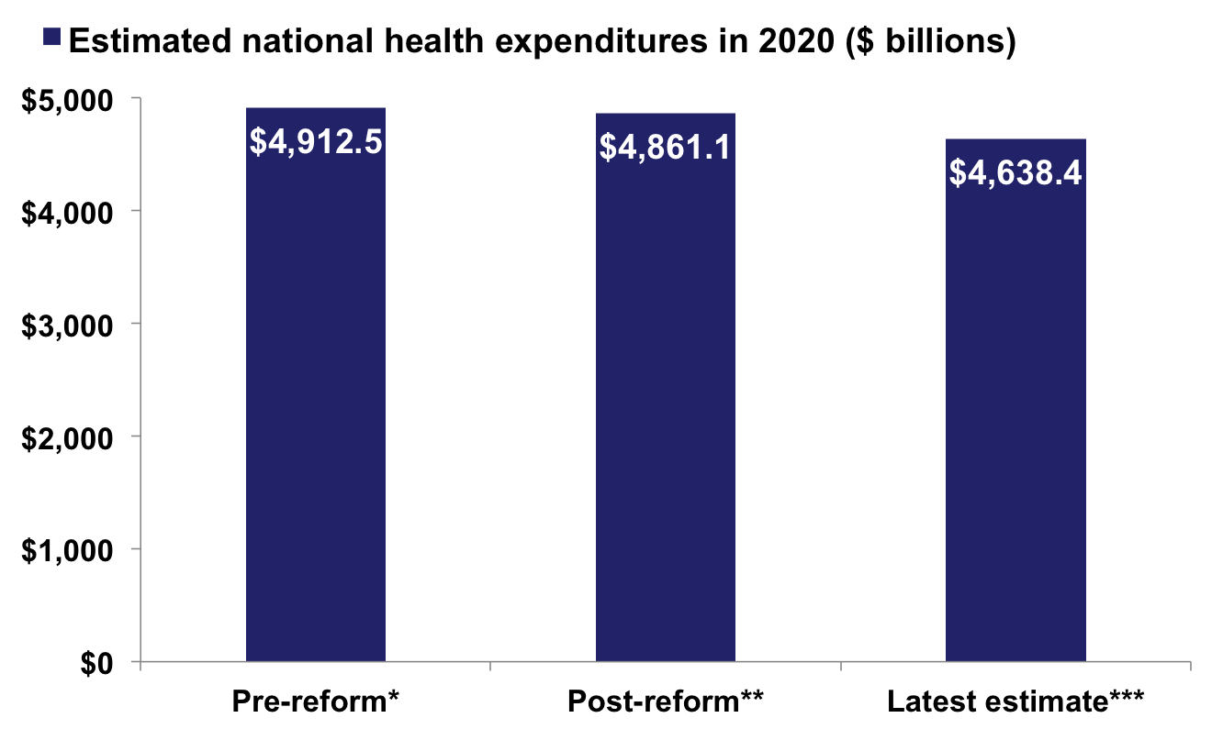
Projected Health Spending in 2020 $275 Billion Lower Than Pre-Reform Predictions Cumulative Reduction of $1.7 Trillion over 2011–2020
−5.6%
21.1% of GDP
19.9% of GDP
19.8% of GDP
Notes: * CMS projection as of February 2009 assuming no reform; ** CMS projection as of September 2010 after enactment of reform; *** CMS projection as of July 2011 after enactment of reform.
Source: CMS spending projections from 2009, 2010, and 2011; Commonwealth Fund estimates extrapolating trends in last one to two years, assuming continuation of compounded annual growth rate.

