Slide 1
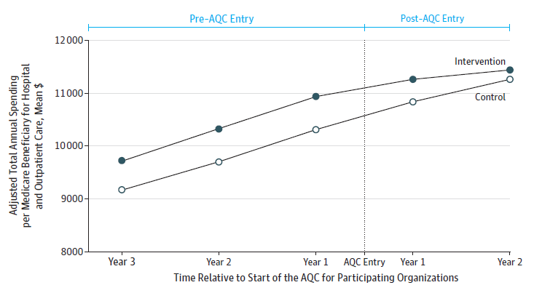
Spillover Across Payers
Medicare spending for providers participating in Blue Cross Blue Shield of Massachusetts Alternative Quality Contract
Source: J. Michael McWilliams, Bruce E. Landon, and Michael E. Chernew, “Changes in Health Care Spending and Quality for Medicare Beneficiaries Associated with a Commercial ACO Contract,” Journal of the American Medical Association, Aug. 28, 2013 310(8):829–36.

