Slide 1
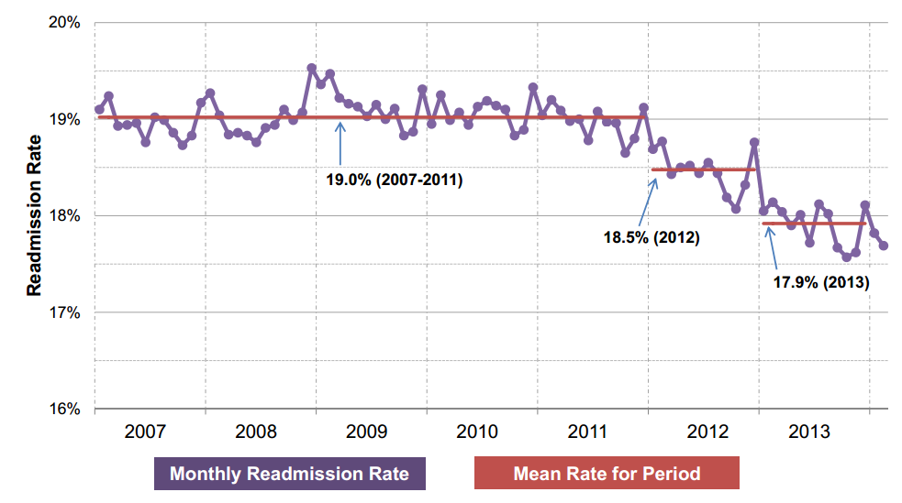
30-Day, All-Condition Medicare Readmission Rates
ACA passed
Penalties start
Source: Niall Brennan, Centers for Medicare and Medicare Services, “Findings from Recent CMS Research on Medicare,” Presentation at AcademyHealth Annual Research Meeting session on The Centers for Medicare and Medicaid Services Data and Information Products, June 9, 2014. Available at http://www.academyhealth.org/files/2014/monday/brennan.pdf

