Slide 1
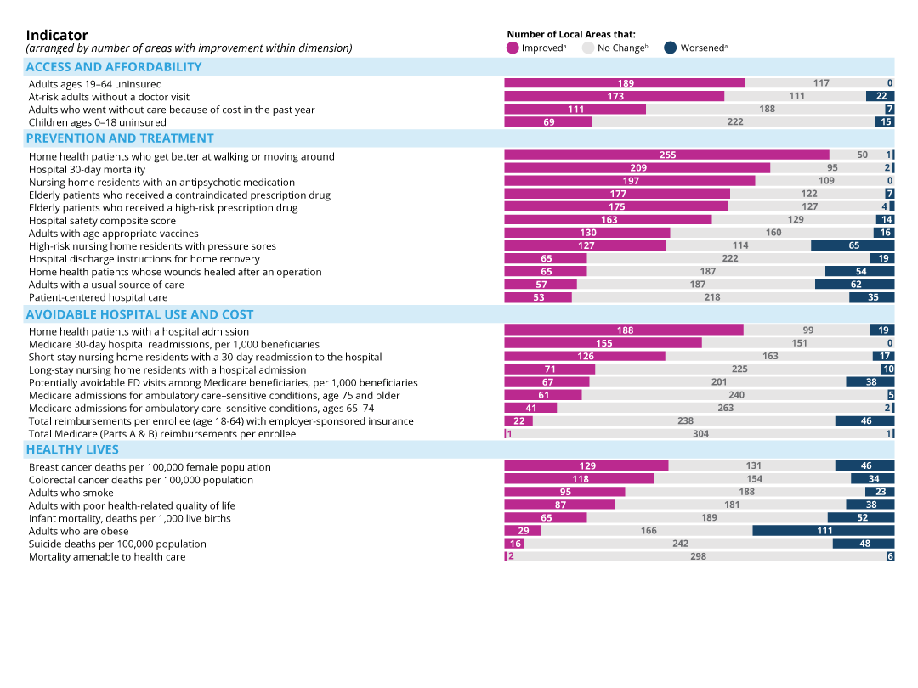
Overall Improvement by Indicator
Notes: Only Scorecard indicators with trends are shown. Trend data generally reflect the three-year period ending in 2014 or 2015—refer to Appendix for additional detail. ª Improvement or worsening refers to a change between the baseline and current time periods of at least 0.5 standard deviations. ^{b} Includes the number of local areas with little or no change or without sufficient data for this subpopulation to assess change over time.
Source: Commonwealth Fund Scorecard on Local Health System Performance, 2016 Edition.

