Slide 1
The Mount Sinai Health System Experience

Slide 2
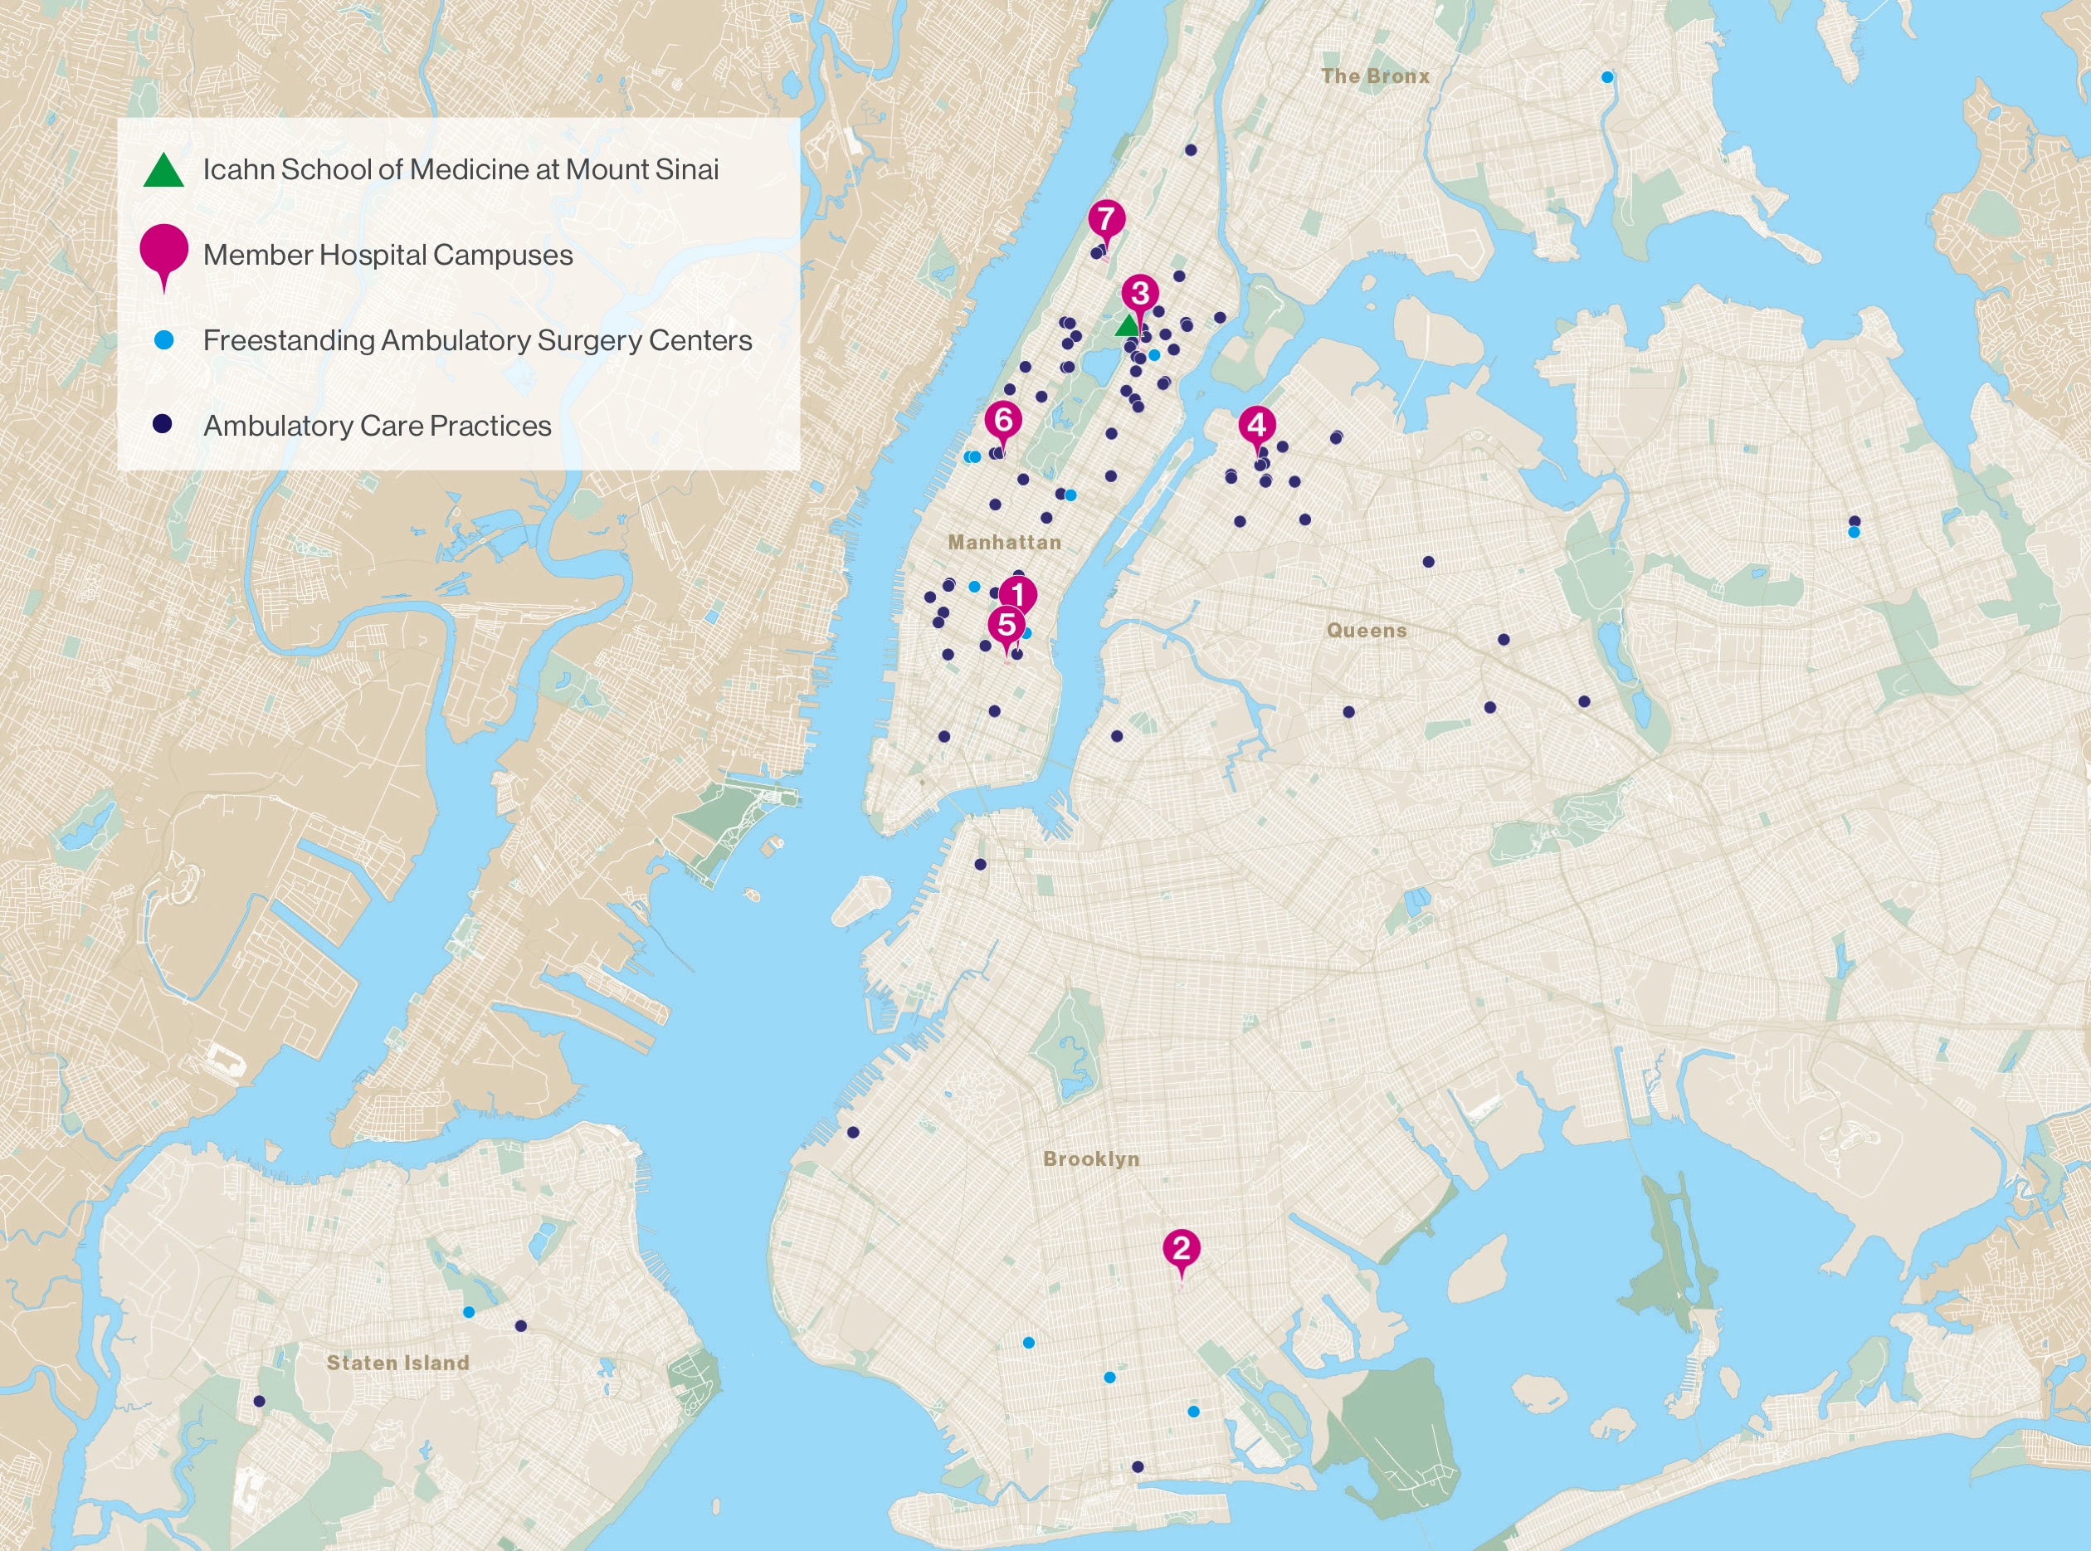

Slide 3
What is PACT?
The Preventable Admissions Care Team is…
An intensive, short-term transitional care program for patients at high risk for a 30-day readmission
Mission:
Identify and address underlying areas of psychosocial strain increasing readmission risk;
Ensure a connection to a medical home (for primary & specialty care);
Improve patients’ health outcomes
Eligibility:
Medicare FFS (Part A + B) OR Healthfirst insurance
Patients are prioritized based on risk for 30-day readmission derived from an algorithm developed by MSH’s Department of Population Health Science and Policy
Outcomes:
40% reduction in admissions and a 40% reduction in ED visits across 7829 patients from various patient cohorts since the pilot ended
Declines in utilization are also observed at 60 & 90 days post-discharge
Achievements:
Contract extension and approval to expand Healthfirst PACT and C-PACT to an additional 4 hospital campuses (10/1/14) and increase in target enrollment to approximately 14,000 patients

Slide 4
Program Overview
Emphasis is on engagement at hospital bedside to identify for each patient the areas of psychosocial strain that compound readmission risk
28-day post discharge intervention is titrated to address each psychosocial driver; delivered through phone calls, accompaniments and home visits when necessary
No exclusions for: homeless; non-English speaking; substance abuse; mental illness; dialysis; dementia
Integration & coordination w/other care coordination initiatives at MSHS

Slide 5
PACT Assessment & Intervention
What circumstances increase the risk for readmission?
What are the psychosocial factors at the root?
In what areas is the patient open to receiving support?
What resources exist or can be established to foster long-term sustainability?

Slide 6
Examples of PACT
PACT work requires strong engagement, assessment & advocacy skills; creativity, collaboration & perseverance - “Anything & Everything”
Standardized approach that is individualized for each patient VERY HIGH; HIGH; MODERATE
  Joe: 76; male; venous stasis ulcers of lower extremity, weakness, coronary heart disease, and “social problem”
    Six month-Pre-PACT utilization: 1 MSH admission in 6 months prior + 3 ED visits/week, multiple weeks
    30-day Readmission Risk: HIGH
    PACT Intervention Type: HIGH
    Areas of psychosocial strain addressed: Housing; Primary Care; Formal Supports; Insurance
    Six month-Post-PACT utilization: None
  Mark: 65; male; emphysema, heart failure, diabetes; anxiety
    Six month- Pre-PACT utilization: 3 MSH admissions in 30 days for shortness of breath
    30-day Readmission Risk: HIGH
    PACT Intervention Type: MODERATE
    Areas of psychosocial strain addressed: Formal Supports; Mental Health
    Six month-Post-PACT utilization: None

