Slide 1

DC Health Link SHOP
Mila Kofman, JD
Executive Director
DC Health Benefit Exchange Authority

Slide 2
267 Small Group Plans:
Aetna
Carefirst BlueCross BlueShield
Kaiser Permanente
United HealthCare

Slide 3
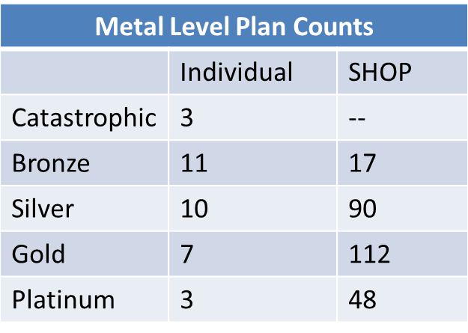
Products for Individuals/Small Business
Prices & Medal Levels
Carrier Plan Counts
 | Individual | SHOP
Aetna | 9 | 14
CareFirst | 15 | 54
Kaiser | 10 | 22
United | -- | 177

Slide 4
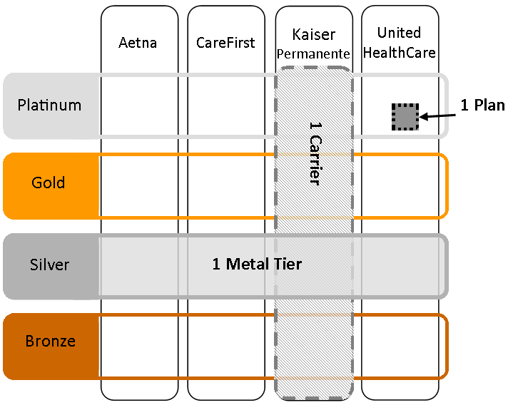
Employer’s Options
Employer chooses how many plans to offer to employees:
All Plans - 1 Metal Level
All Plans from 1 Carrier
1 Plan from 1 Carrier

Slide 5
Employer’s Choice (first 180 employers)
1 Plan 1 Carrier | 55
All Plans 1 Carrier | 71
1 Metal Level all Carriers | 54

Slide 6
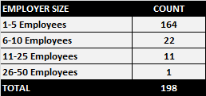
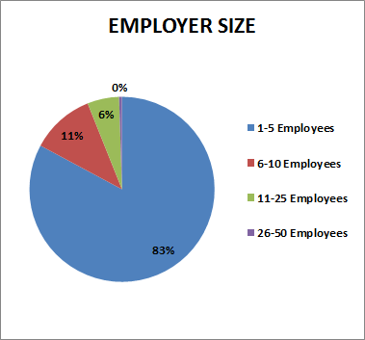
* Does not include Congressional employers.

Slide 7
DC ENROLLMENT – UPDATE WITH CURRENT DATA
October 1, 2013 to April 30, 2014, 44,833 people have enrolled through DC Health Link in private health plans or Medicaid:
  11,106 people enrolled in private health plans through the DC Health Link individual and family marketplace;
  20,497 people gained Medicaid coverage through DC Health Link; and
  13,230 people enrolled through the DC Health Link small business marketplace (includes Congressional enrollment)

Slide 8
SHOP COVERED LIVES - METAL LEVEL
(not including Congress) May 11th data

Slide 9
SHOP (not including Congress) – AGE
May 11th data

Slide 10
Thank you!
To learn more:
Visit us at www.dchealthlink.com
Like us on Facebook:DC Health Benefit Exchange
Follow us on twitter @dchbx

