Slide 1
Get Covered Illinois: A Partnership Marketplace

Slide 2
Marketplace Enrollment Update
61,111 Illinois residents selected a plan using the federal Marketplace
73% of Marketplace consumers were eligible for financial assistance
52% purchased a silver plan
54% of customers are women
23% in the 18-34 year old age group

Slide 3
Medicaid Enrollment Update
Illinois is a Medicaid expansion state
State of Illinois supported Cook County’s early expansion 1115 waiver (CountyCare) in 2012
To date 136,000 individuals enrolled in Medicaid through ABE, CountyCare and SNAP express enrollment
Applications representing 101,000 individuals at the FFM to be transferred to Illinois

Slide 4
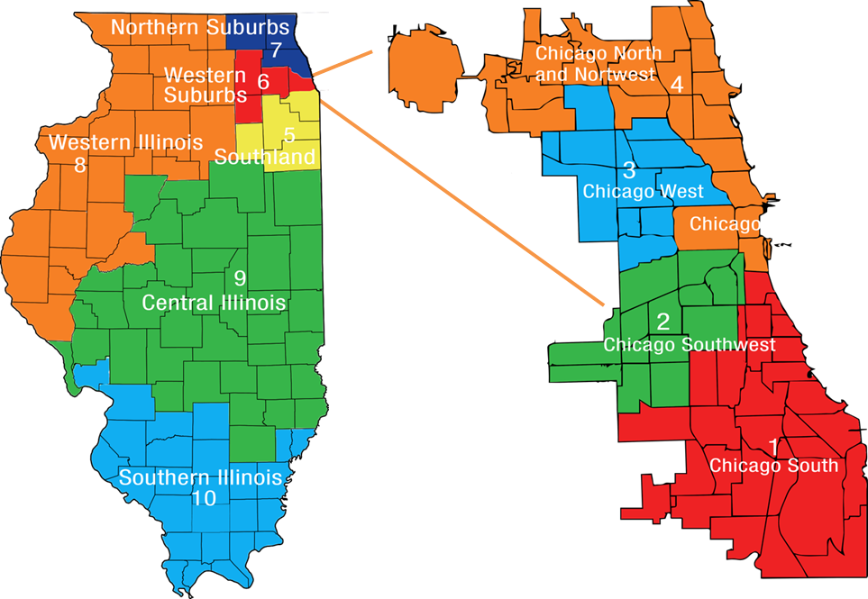
Marketplace Field Operations
State Regional Outreach Coordinators
44 Lead Grantee Organizations
1,059 Navigators/In-Person Counselors
634 Certified Application Counselors
Navigators reflect demographics of Illinois’ uninsured

Slide 5
Training
Three day, state based training developed with UIC to supplement federal training
More than 30 in-person trainings, including pre-assessment and post-assessment exams
Over 98% pass rate
18% increase between pre-assessment scores and post-assessment scores
Average pre-assessment score was 71.6% (below passing threshold)
Average post-assessment score was 90.2% (above passing threshold)

Slide 6
Other Consumer Assistance
Getcoveredillinois.gov Website:
Includes easy to use screening tool to get consumers in the right place
858,718 unique website visits since Oct. 1
More than 370,000 screening tool users
Exit tracking: 81,000 to Healthcare.gov and 56,000 ABE exits (Medicaid)
Get Covered Illinois Help Desk
Hours: 8-8 every day
Many Medicaid questions

