Slide 1
Implementing the ACA: State Action To Establish SHOP Marketplaces
Kevin Lucia and Sarah Dash
May 29, 2014

Slide 2
Design Decisions in State-Based Marketplaces
?
Sustainable Marketplace
Competitive Marketplace
Meaningful Consumer Choice
Options for Small Businesses
Maximizing Enrollment

Slide 3
States Electing to Operate SHOP Marketplaces
17 states* plus DC elected to establish and operate a SHOP Marketplace in 2014
California | Mississippi
Colorado | Nevada
Connecticut | New Mexico
District of Columbia | New York
Hawaii | Oregon
Kentucky | Rhode Island
Maryland | Utah
Massachusetts | Vermont
Minnesota | Washington
* Idaho is a “supported SBM” for individual and SHOP in 2014; not included in count.

Slide 4
SHOP Design Considerations: The Value Proposition
Predictable eligibility and participation requirements
Competition as a price driver
Employee choice with predictable budgeting
Convenient shopping experience
What Small Employers Want : 56% of small employers prefer “offering workers a choice of plans, with the employer paying a fixed amount, and the employee paying any extra cost for choosing a more expensive plan”… than in “offering workers one plan with less administrative work for your firm” (Gabel et al., Health Affairs, 2013)
But…
Does IT work? Is too much choice confusing?
Will the price be right?

Slide 5
Key Findings: SHOP Marketplace Design Decisions
Many states moved ahead of federal requirements in key design areas, especially employee choice, and attracted competitive selection of plans in most states.
States sought mechanisms to allow predictable contributions regardless of employee’s age or plan choice, but technically challenging and approaches may evolve; Information technology is in varying stages of functionality across states.
Most states maintained status quo in other areas: all kept definition of “small employer” at 50 or fewer FTEs; very few merging individual and small group markets.

Slide 6
Key Findings: Predictability
States sought to reduce disruption to existing small-group market.
All states elected to open SHOP to 50 or fewer employees, in line with historical definition of small-group market
Few states (MA, VT, DC*) merged individual and small-group markets
VT and DC creating a single marketplace for all small-group coverage
Many states established minimum participation requirements, which ACA specifies must be uniform across small-group market
Helps employers who were shut out of market because they could not get enough employees to participate to meet insurers’ minimum participation requirements
ACA creates a one-month enrollment period for small businesses that are not able to meet minimum participation or contribution levels.
*DC has a “modified merged market”

Slide 7
Key Findings: Competition
SHOPs attracted a wide range of insurers and plans
Participating insurers ranged from one (WA) to 10 (MA and NY)
Number of plans ranged from 5 (WA) to over 250 (DC)
At least one of three largest insurers participated in every state but Washington
All three participated in MA, MD, and DC
Two of three participated in CA, CO, CT, HI, KY, MN, NM, RI, UT, VT
One of three participated in NV, NY, OR
Importantly, there was choice of plans and insurers in nearly every county in nearly every state

Slide 8
Key Findings: Employee Choice
ACA requires SHOPs to offer employee choice starting in 2015 (recent regs allow additional one-year delay)
Basic employee choice requirement: employer chooses a metal tier, employees choose a plan from different insurers (“horizontal choice”)
States can provide additional options: multiple metal tiers/insurers, up to “full employee choice”
Sixteen states plus DC planned to offer employee choice in 2014
Washington wanted to, but only attracted one carrier
Seven states (HI, MN, NY, OR, RI, UT, VT) allowed “full employee choice”—employees can choose any plan on SHOP

Slide 9
Key Findings: Employer Contribution under Employee Choice
14 states allowed employers to provide a fixed contribution towards coverage regardless of the plan selected by the employee; employee pays more for a more expensive plan.
Example: Employer selects a “reference plan” and a contribution level, translating to a dollar amount; employee applies that dollar amount to the coverage of their choice.
Generally, states struggled to adopt premium allocation models that would mitigate the effect of age rating.
Contributions may vary by employee age in nine states plus DC
Example: Employee pays difference between age-rated (“list-bill”) premium for the plan he selects and the amount employer contributes towards the reference plan.

Slide 10
Key Findings: Creating an Easier Shopping Experience
First things first: if the IT doesn’t work or is clunky, it will overshadow other consumer-friendly features.
But… states incorporated online tools to help employers shop and compare:
12 states plus DC (and FF-SHOP) allowed anonymous browsing of plan options
10 states plus DC offered a small business tax credit calculator
10 states plus DC created a portal for agents and brokers to manage small business accounts.
Eighty percent of offering firms use brokers.
(Gabel et al, Health Affairs, 2013)

Slide 11
SHOP: Considerations for Success
Getting off the ground
Fully functioning, user-friendly IT incorporating key features (employee choice, agent/broker portals)
Selling the value proposition to small businesses
Competing with non-SHOP options: early renewals/transitional policy, self-insurance, private exchanges, option to *not* offer coverage
Building the book of business
Will take time
Will depend on agents and brokers selling the product—need to make it easy for them too!

Slide 12
Managing Expectations: SHOP is Part of a Bigger Picture
Market Reforms
Essential Health Benefits (EHB)
Rating rules
Pre-ex
MLR (80/20 rule)
Small Business Tax Credits
SHOP
“The Outside Market”
Better/more coverage options?
Early renewals
Self-insurance
Option not to cover

Slide 13
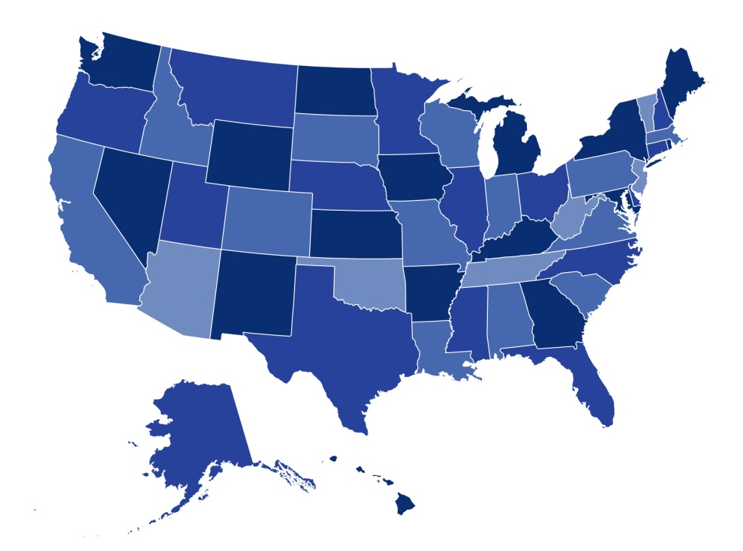
Thank you!
Contact:
Kevin Lucia, MHP, JD
kwl@georgetown.edu
Sarah J. Dash, MPH
sd850@georgetown.edu

