Slide 1
2016 Commonwealth Fund International Health Policy Survey of Adults in Eleven Countries
May 18th, 2017

Slide 2
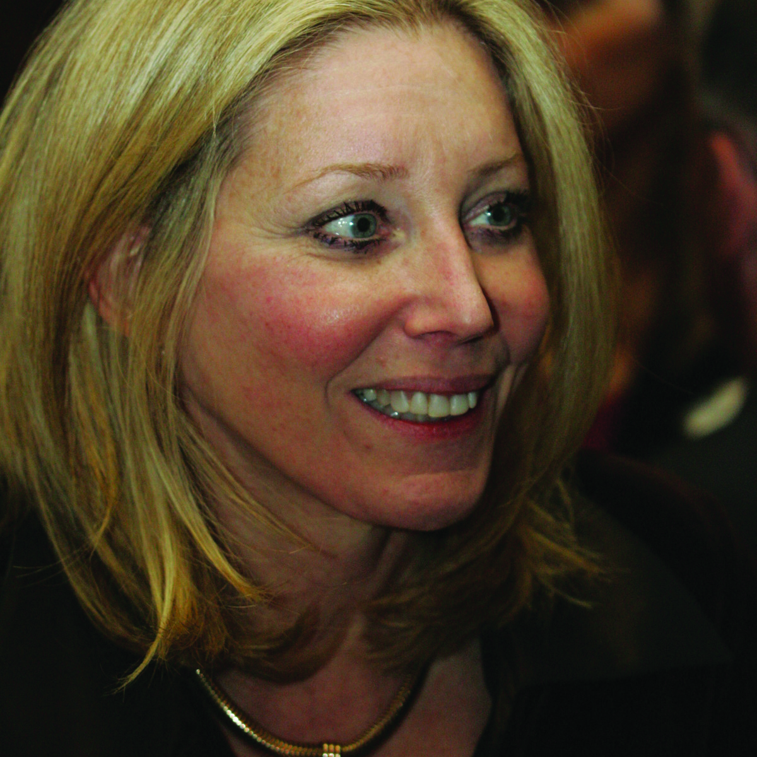
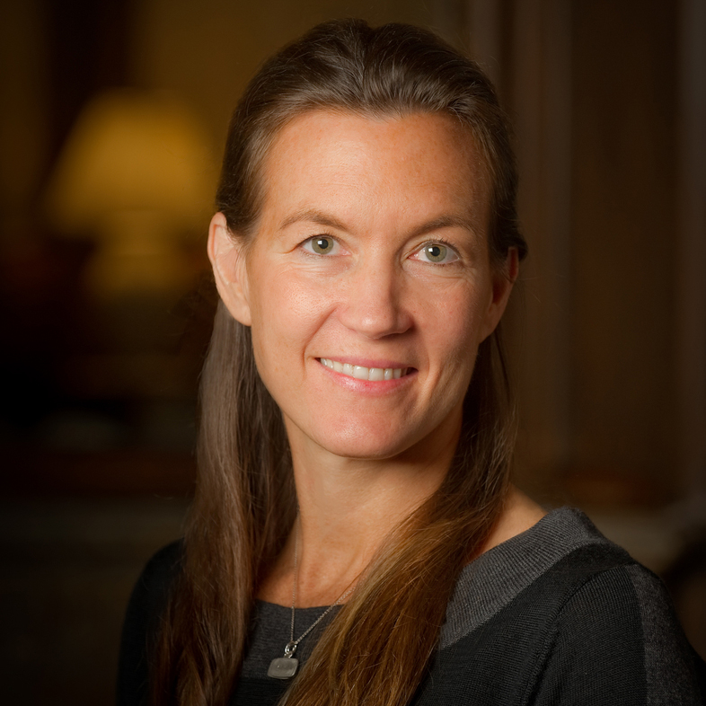
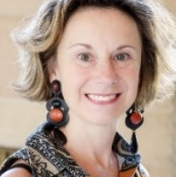
Today’s Webinar Presenters
Robin Osborn, M.B.A.
Vice President and Director
International Health Policy and Practice Innovations
The Commonwealth Fund
(Moderator)
Michelle Doty, Ph.D., M.P.H.
Vice President, Survey Research and Evaluation
The Commonwealth Fund
Philip J. van der Wees, PT, Ph.D.
Senior Researcher, Radboud University Medical Center, Scientific Center for Quality of Healthcare
Isabelle Durand-Zaleski, MD, Ph.D.
Professor of Medicine, Researcher in Clinical Public Health, Hôpital Henri Mondor
2016 International Health Policy Survey Webinar | May 18, 2017

Slide 3
2016 International Health Policy Survey Webinar | May 18, 2017

Slide 4
Country Partners and Co-funders
Australia: New South Wales Bureau of Health Information and Victoria Department of Health and Human Services
Canada: Canadian Institute for Health Information, Canadian Institutes of Health Research, Health Quality Ontario, and Commissaire à la Santé et au Bien-être du Québec
France: Haute Autorité de Santé and Caisse Nationale d’Assurance Maladie des Travailleurs Salariés
Germany: Federal Ministry of Health and Federal Institute for Quality Assurance and Transparency in Health Care (IQTIG)
Netherlands: Ministry of Health, Welfare, and Sport and the Scientific Institute for Quality of Healthcare at Radboud University Nijmegen Medical Centre
Norway: Norwegian Knowledge Centre for the Health Services
Sweden: Ministry of Health and Social Affairs and the Swedish Agency for Health and Care Services Analysis
Switzerland: Federal Office of Public Health
United Kingdom: The Health Foundation
2016 International Health Policy Survey Webinar | May 18, 2017

Slide 5
2016 Commonwealth Fund International Health Policy Survey of Adults in 11 Countries
Topics:
Population health
Cost and access
Care coordination
Health promotion
Income disparities
2016 International Health Policy Survey Webinar | May 18, 2017

Slide 6
Agenda
12:00-12:15 Introduction
Robin Osborn, Vice President and Director,
International Health Policy and Practice Innovations, The Commonwealth Fund
12:15-12:35 Survey Presentation
Michelle Doty, Senior Vice President for Policy and Research,
The Commonwealth Fund
12:35-12:55 Country Perspectives
Philip J. van der Wees, Senior Researcher, Radboud University Medical Center
Scientific Center for Quality of Healthcare (IQ healthcare)
Isabelle Durand-Zaleski, Professor of Medicine
Researcher in Clinical Public Health, Hôpital Henri Mondor
12:55-1:15 Question and Answer
2016 International Health Policy Survey Webinar | May 18, 2017

Slide 7
Question and Answer
To access the 2016 International Health Policy Survey of Adults in 11 Countries:
http://www.commonwealthfund.org/publications/in-the-literature/2016/nov/2016-international-health-policy-survey-of-adults
Please visit our international health policy website:
http://international.commonwealthfund.org/
2016 International Health Policy Survey Webinar | May 18, 2017

Slide 8
For further information please contact:
Robin Osborn,
Vice President and Director, International Health Policy and Practice Innovations, The Commonwealth Fund
ro@cmwf.org
2016 International Health Policy Survey Webinar | May 18, 2017

