Slide 1
Driving Innovation in Health Care Delivery Through Medicaid Managed Care
Thursday, March 8, 2018
2:00 p.m. EST

Slide 2



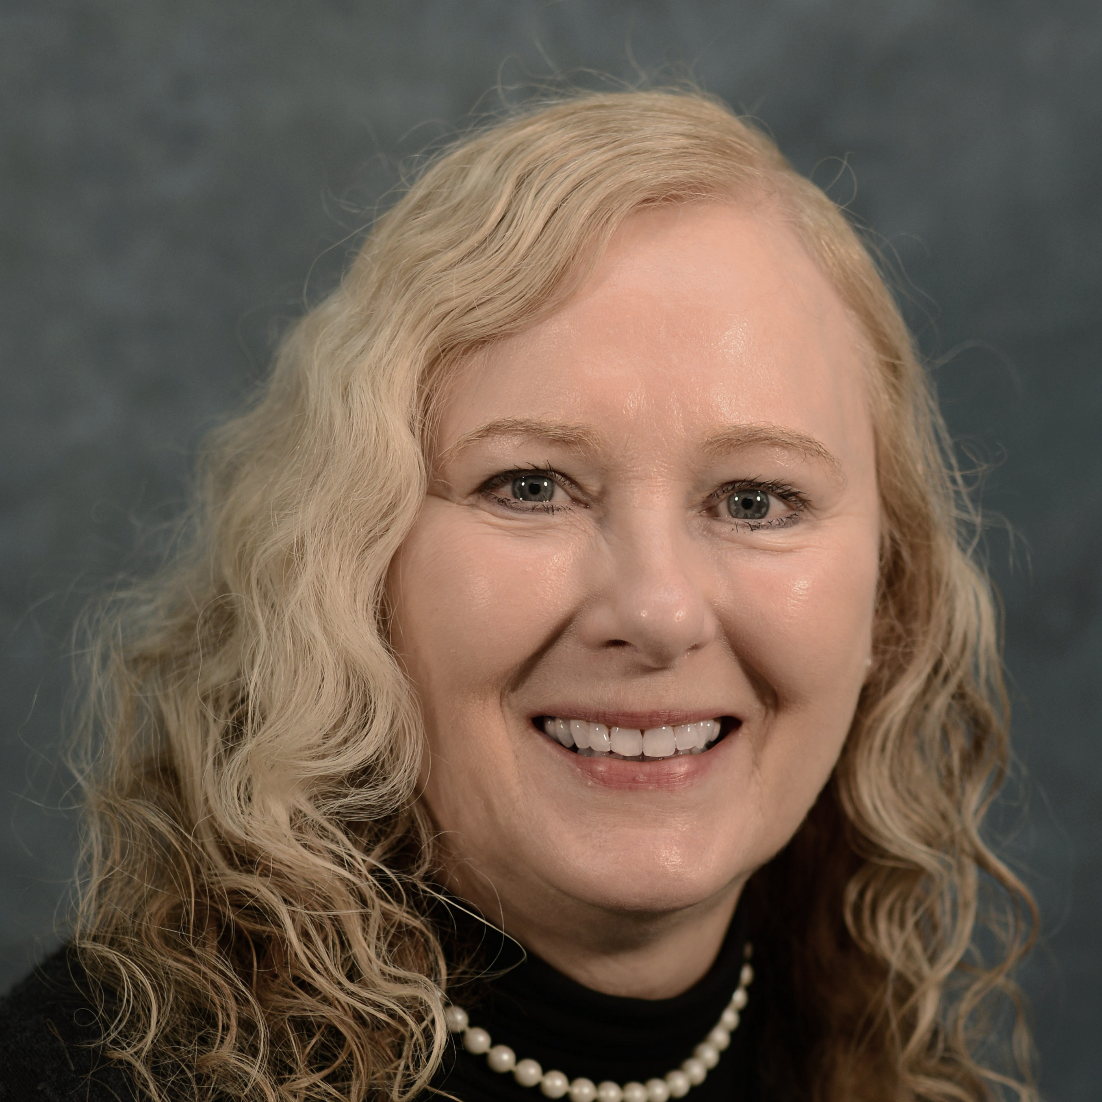
AGENDA
Introduction
Pamela Riley, M.D., M.P.H, Vice President, Delivery System Reform, The Commonwealth Fund
Medicaid Payment and Delivery Reform: Lessons from Managed Care Initiatives in 10 Medicaid Expansion States
Sara Rosenbaum, Harold and Jane Hirsh Professor of Health Law and Policy, Milken Institute School of Public Health, George Washington University
Paying for Value in Medicaid: Using Regulatory Flexibility
Leonardo Cuello, Director, Health Policy, National Health Law Program
Reactor
MaryAnne Lindeblad, State Medicaid Director, Washington State Medicaid Authority
Questions

Slide 3
QUESTIONS?
Resources available at www.commonwealthfund.org:
S. Rosenbaum, R. Gunsalus, M. Velasquez et al., Medicaid Payment and Delivery Reform: Insights from Managed Care Plan Leaders in Medicaid Expansion States, The Commonwealth Fund, March 2018.
S. Rosenbaum, S. Schmucker, S. Rothenberg et al., Medicaid Payment and Delivery System Reform: Early Insights from 10 Medicaid Expansion States, The Commonwealth Fund, October 2017.
S. Rosenbaum, R. Gunsalus, J. Z. Beckerman et al., “How 10 States Are Reforming Medicaid Payment and Delivery,” To the Point, The Commonwealth Fund, Oct. 25, 2017.
E. Edwards, Assessing Changes to Medicaid Managed Care Regulations: Facilitating Integration of Physical and Behavioral Health Care The Commonwealth Fund, October 2017.
D. Machledt, Addressing the Social Determinants of Health Through Medicaid Managed Care, The Commonwealth Fund, November 2017.

