Slide 1
Medicaid Payment and Delivery Reform: Lessons from Managed Care Initiatives in 10 Medicaid Expansion States
Sara Rosenbaum, JD
March 8, 2017

Slide 2
Background
With total Medicaid enrollment approaching 75 million, high interest in delivery and payment reform
Managed care serves as the principal means for health care organization, delivery, and payment within the Medicaid program, increasingly across all beneficiary populations
2016 Medicaid managed care rules increase the national spotlight on managed care as the mechanism for organizing, delivering and paying for health care, as well as using health care as an entry point into broader efforts to address underlying social determinants of health

Slide 3
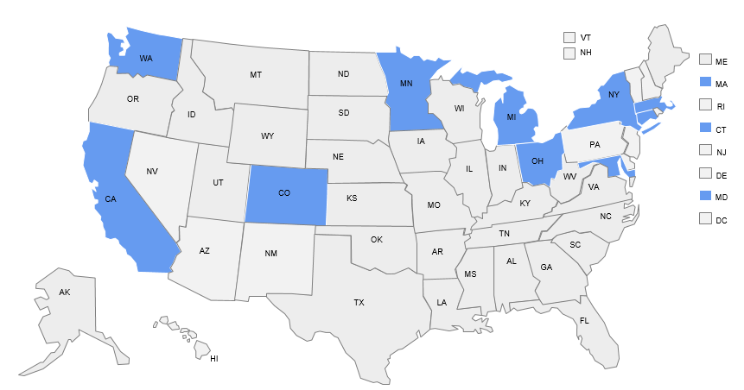
Purpose of the Combined Studies
To examine Medicaid managed care evolution in 10 ACA Medicaid expansion states with extensive experience in managed care purchasing.
Conducted in 2017
Study states represent:
43% of the total Medicaid population
63% of the Medicaid expansion population
42% of all risk-based managed care enrollment
Analysis of written policy documents (e.g., contract, regulations) coupled with in-depth interviews with state Medicaid officials and leadership in 17 separate managed care organizations.
Notes:
States: we undertook a study of ten states– California, Colorado, Connecticut, Maryland, Massachusetts, Michigan, Minnesota, New York, Ohio, and Washington State-- that implemented the Medicaid expansion and have long-standing experience with managed care for traditional beneficiaries.
MCOs: We focused on MCOs serving adult beneficiaries and families whose members are eligible due to low income; we did not include plans designed for beneficiaries with serious disabilities. We interviewed CEOs and financial and operational managers from 17 MCOs to determine whether common issues are emerging. Because participants were offered anonymity in order to speak candidly, we do not report the results by state or plan.

Slide 4
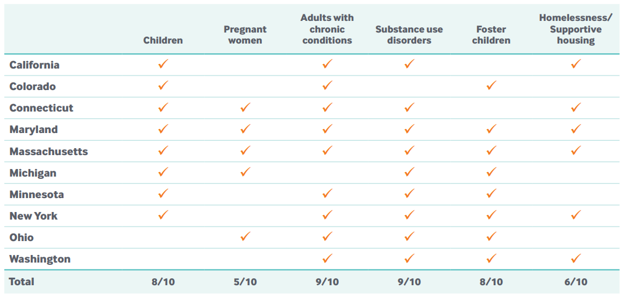
State policies focus on populations needing care management and integrated health and social service delivery
Notes:
Targeted initiatives: States focus on these areas of interest in various ways. For instance, some states are working to improve integration of physical and behavioral health care, while others focus on ensuring that networks include needed providers in strategic locations, like school-based health centers, child and adolescent health centers, and behavioral health homes for children and adults with serious and chronic mental conditions. Other states emphasize specific network competencies such as care management for women with high-risk pregnancies or for people experiencing homelessness.

Slide 5
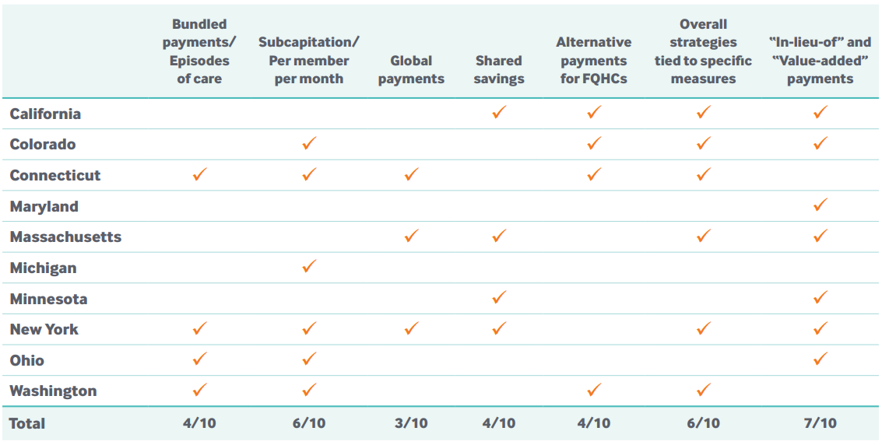
States are testing innovative payment approaches
Notes:
These models are designed to transition away from a payment system based on volume and toward outcome-based performance.

Slide 6
Medicaid MCOs are serving high-need, high-cost populations

Slide 7
Medicaid MCOs seek to integrate health care and services addressing social determinants

Slide 8
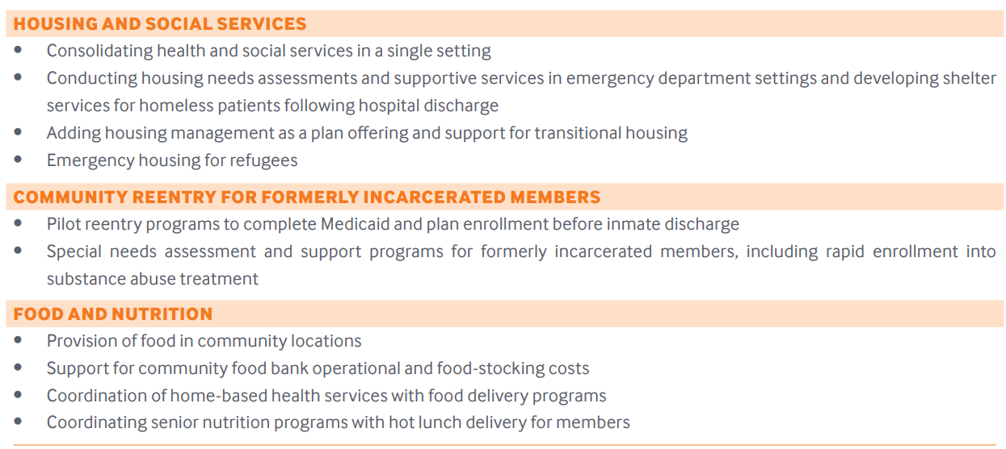
Medicaid MCOs are using interventions to address social determinants of health

Slide 9
Medicaid MCOs are also testing value-based payment strategies that link payment with performance
Notes:
Leaders said that implementing payment reforms is easier in local health care markets where providers have become accustomed to alternative payment models such as payment bundles and partial capitation, in which providers share the risk of losses as well as the opportunity for gains. Leaders stated that tolerance for risk comes with experience and sophisticated budgetary management capabilities. As a result, they noted that progress in payment innovation will be sensitive to provider experience and type of service involved.
No in lieu of, yet: The 2016 Medicaid managed care rule permits states to use their managed care contracts to substitute certain services for those normally covered under their state plan, such as home visits for new mothers rather than in-office mother and infant care. This flexibility to provide other types of care “in lieu of” normally covered services has been a focus of interest. Although no MCOs had yet developed such “in lieu of” agreements with their states, leaders expressed interest in doing so.

Slide 10
Common Challenges
Uncertain Medicaid environment
Achieving stable coverage
Getting the capitation rate right
Achieving payment reform
Testing new approaches to coverage

