Slide 1


How to Improve Care for Patients with Complex Needs in the Framework of the Swiss Health Care System?
Commonwealth Fund International Survey Webinar January 11, 2012
Thomas Zeltner
Professor of Public Health, University of Bern, Switzerland.
Former Secretary of Health of Switzerland (1991-2009)

Slide 2
The Regulated Market Model of Switzerland
Citizen,
Customer
Patient
Government
Regulator
Health
Insurance
Company
Health Service
Provider
Notes:
Switzerland has many similarities with the US: One of reasons: Switzerland has copy pasted the US Constitution (except for the strong position of the President): Central Government (rather weak), 26 Cantons. 3 Language/cultural regions (German (65%), French (20%) and Italian (6.5%); Rumansh (0.5%)). Non Swiss Residents ~ 20%.
But Switzerland is, of course, much smaller than the US.
But there are also many similarities in the health care system: Like the US Switzerland has no National Health System like eg. Great Britain. Ambulatory care is mostly in the hands of for profit operating doctors in private practices. Even though group practices or HMO like organizations gain ground in Switzerland, they make up only about 15% of ambulatory care. Hospital care as well as institutions for long term care are run by non for profit and for profit organizations.
Up to the major health care reform in 1996 the health insurance market looked quite like the one in the Us today. There was no mandatory insurance scheme. Health insurances were for profit and not for profit. They were free to accept or to refuse applicants and the premium was calculated taking into account preexisting conditions, gender and age. Chronically ill, women and elderly persons therefore paid much higher premiums. And as in the US some employers would pay for the health insurance plan.
3 major differences exist however:
Switzerland never had and does not have structures like Medicare or Medicaid.
-Switzerland has no deficit in the health system or accumulated debts.
-the Swiss system provides a very large degree of financial protection against medical cost of illness and maternity.

Slide 3
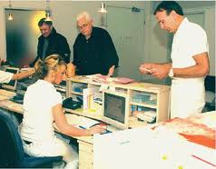


Specific Aspects of the Swiss Health Care Systems
< 1/3 mile
< 3 miles

Slide 4
Specific Aspects of the Swiss Health Care Systems
GPs and Specialists are allowed to
(and are reimbursed by the social health insurance)
Run their own laboratories
Dispense medications (in part of the country)
Offer methods of “complementary medicine”
Offer X-ray examinations

Slide 5
Specific Aspects of the Swiss Health Care Systems
Number of Hospitals in Switzerland (7.8 Mio Citizens):
General Hospitals 119
Specialized Clinics 178
TOTAL 297

Slide 6
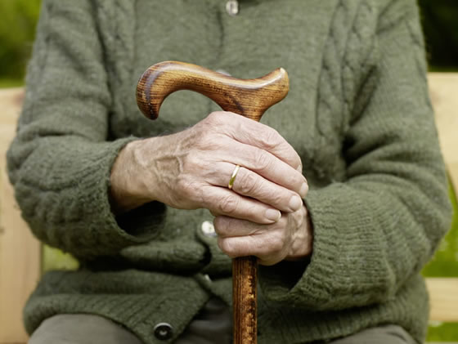
Challenges for the Future

Slide 7
Challenges for the Future:
Density of General Practitioners

Slide 8
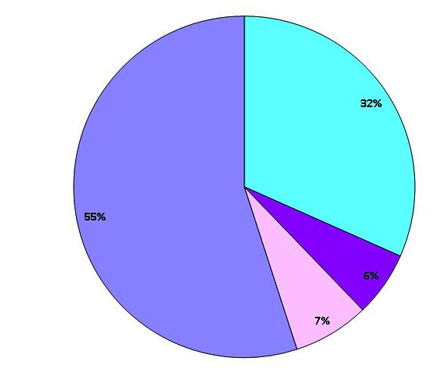
Challenges for the Future:
Health Insurance Plans in Switzerland (2010)
“Regular Insurance
Plans”
Gate Keeper Models
(without Capitation)
Managed Care Models
with Capitation
Models with Telemedicine

Slide 9
Challenges for the Future:

Slide 10
Challenges for the Future:
Total expenditures on health as percent of GDP

Slide 11
Next Reforms of the Swiss Health Care System:
Strengthening the Position of General Practitioners (2009)
Integrated Care shall become “Regular Model of Care” (2012)
Strengthening Health Promotion/Disease Prevention (2012)
Introducing Disease Management Programs (2014)

