Slide 1
Rising to the Challenge:
Results from a Scorecard on Local Health System Performance, 2012
David Radley and Cathy Schoen
On behalf of the Commonwealth Fund Commission on a High Performance Health System
www.commonwealthfund.org
March 13, 2012
Embargoed: Not for release before 12:01 ET Wednesday, March 14, 2012

Slide 2
2012 Local Scorecard: Key Findings
Where you live Matters
  Wide variation across 306 local areas on access, care, outcomes, and costs
  Two to three-fold variations on many key indicators
  Often wide variation between communities in the same state
  Leaders offer benchmarks and targets to improve
Strong geographic patterns
  Leading areas often in the Northeast and Upper Mid-West
  Regional patterns vary by dimension
Dimensions of health system performance are interrelated
  Access, care and healthy lives correlated across communities
  Prevention and treatment related to avoidable costs
Opportunities for all communities to improve
  No local area consistently leads all key indicators
  Potential gains in health, care experiences and lower costs with strategic local action, supported by national reforms

Slide 3
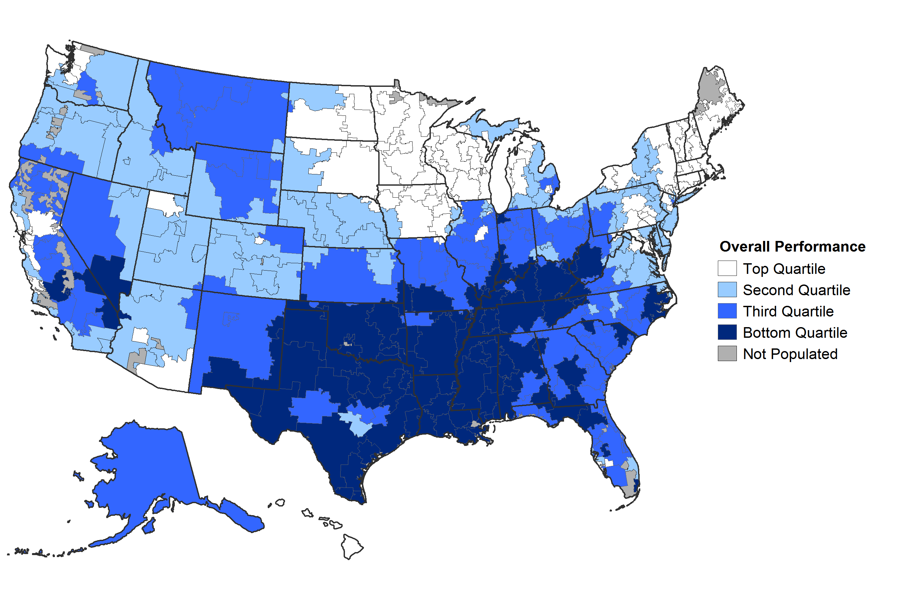
Overall Health System Performance
SOURCE: Commonwealth Fund Local Scorecard on Health System Performance, 2012

Slide 4
2012 Local Scorecard Summary of Health System Performance
Top
Performing HRRs
Bottom
Performing HRRs
SOURCE: Commonwealth Fund Local Scorecard on Health System Performance, 2012

Slide 5
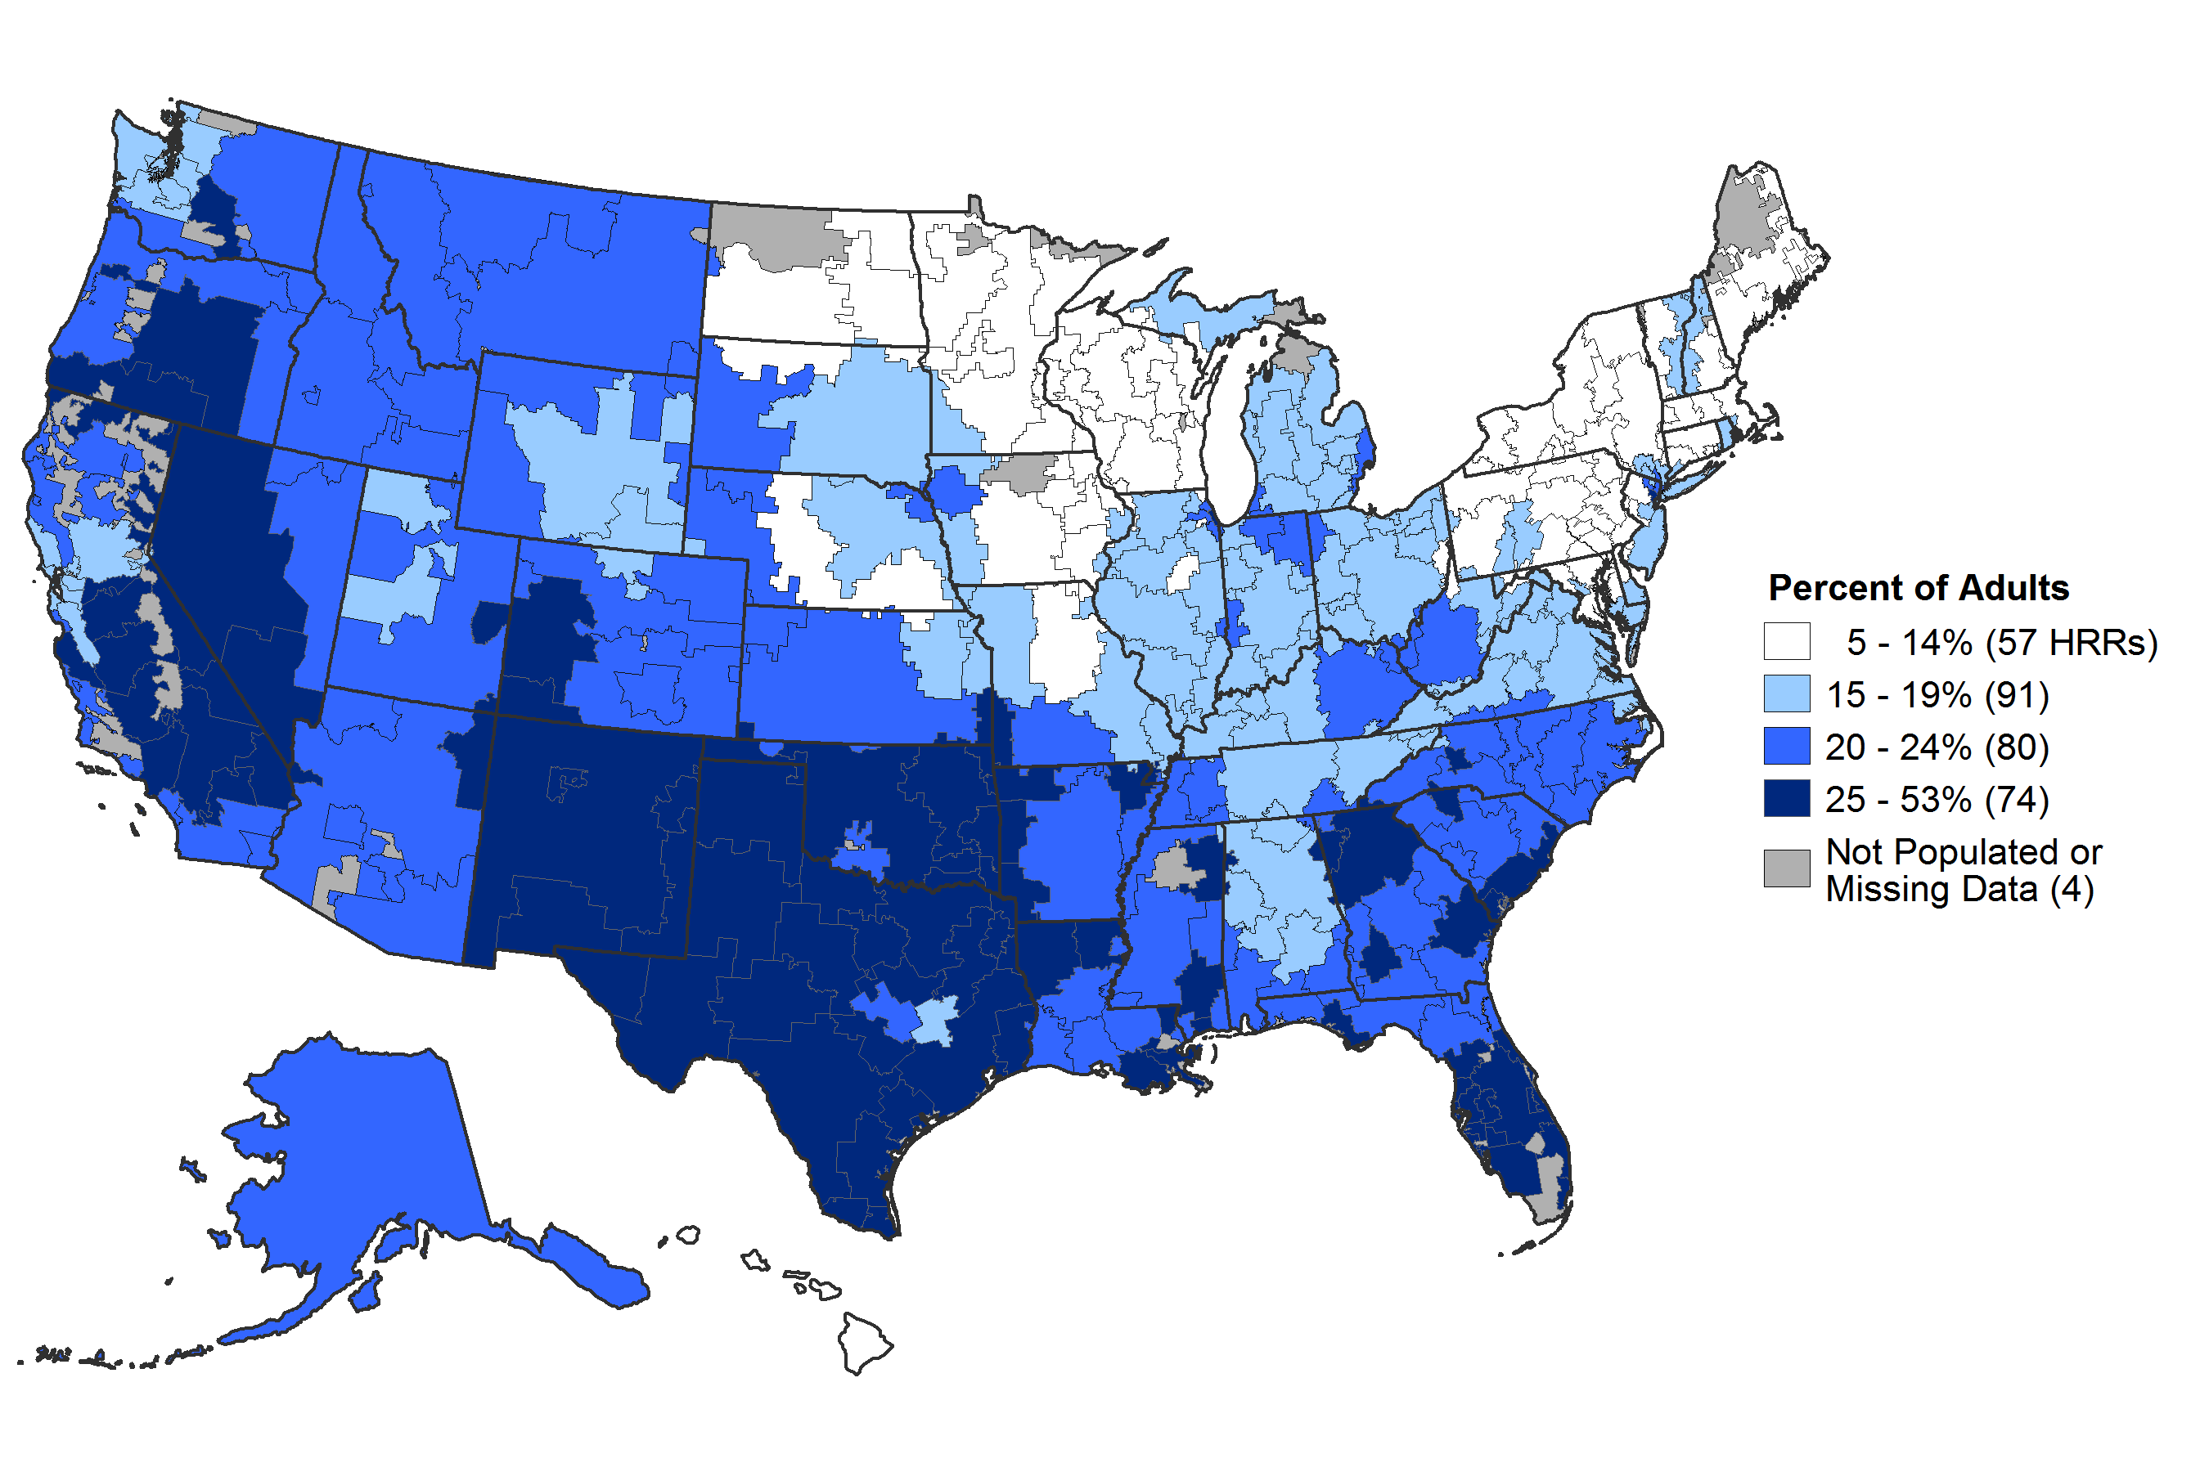
Percent of Adults Ages 18-64 Uninsured, 2009-2010
Access
HRR = hospital referral region
DATA: U.S. Census Bureau, 2009-10 American Community Survey
SOURCE: Commonwealth Fund Local Scorecard on Health System Performance, 2012

Slide 6
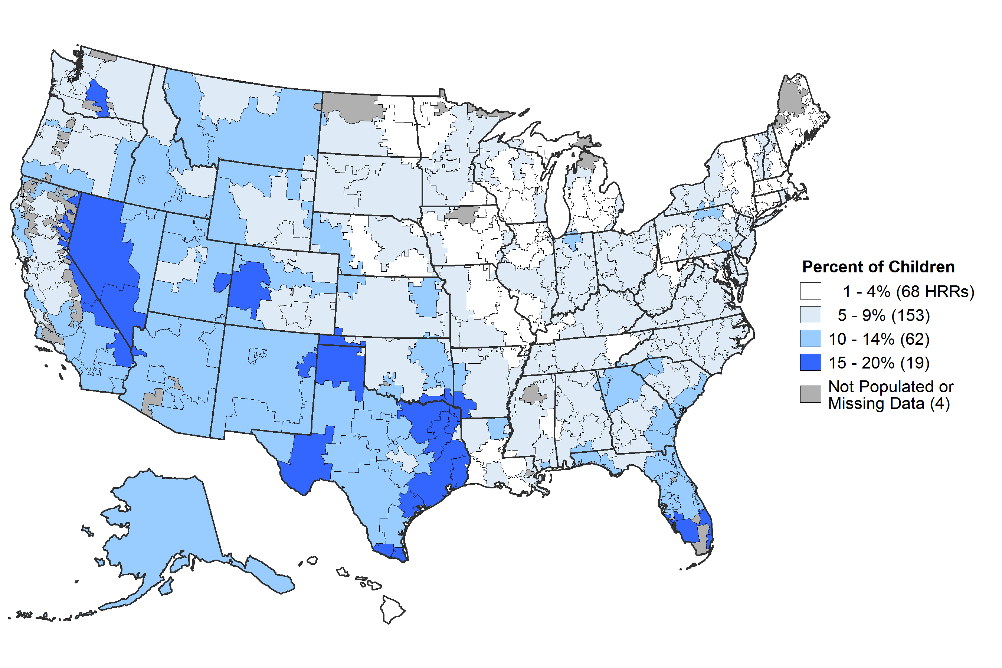
Percent of Children Ages 0-17 Uninsured, 2009-2010
Access
HRR = hospital referral region
DATA: U.S. Census Bureau, 2009-10 American Community Survey
SOURCE: Commonwealth Fund Local Scorecard on Health System Performance, 2012

Slide 7
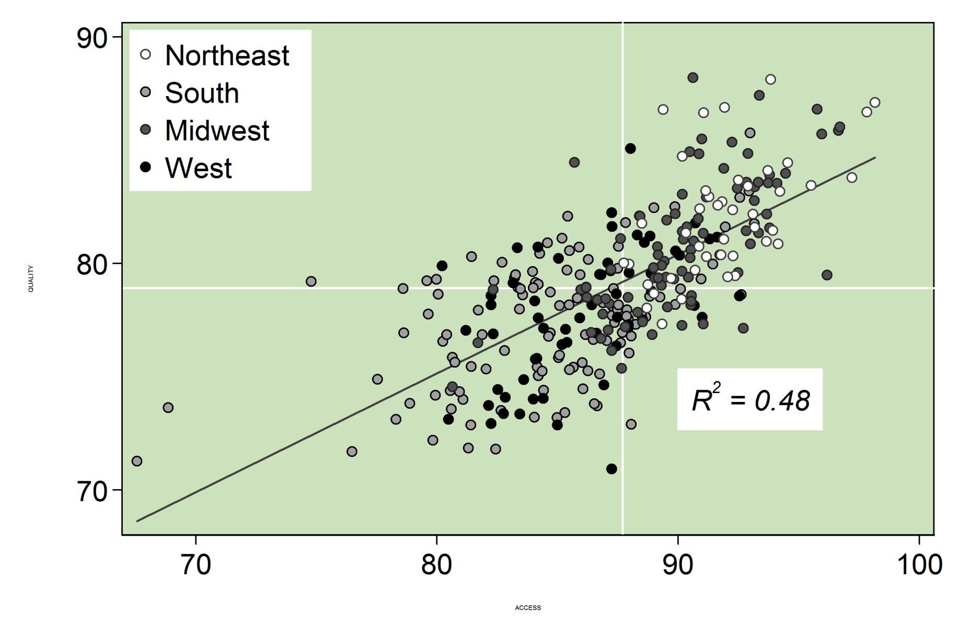
Better Access is Associated with Better
Prevention & Treatment
Access
7
Prevention and Treatment Score
Access Score
SOURCE: Commonwealth Fund Local Scorecard on Health System Performance, 2012

Slide 8
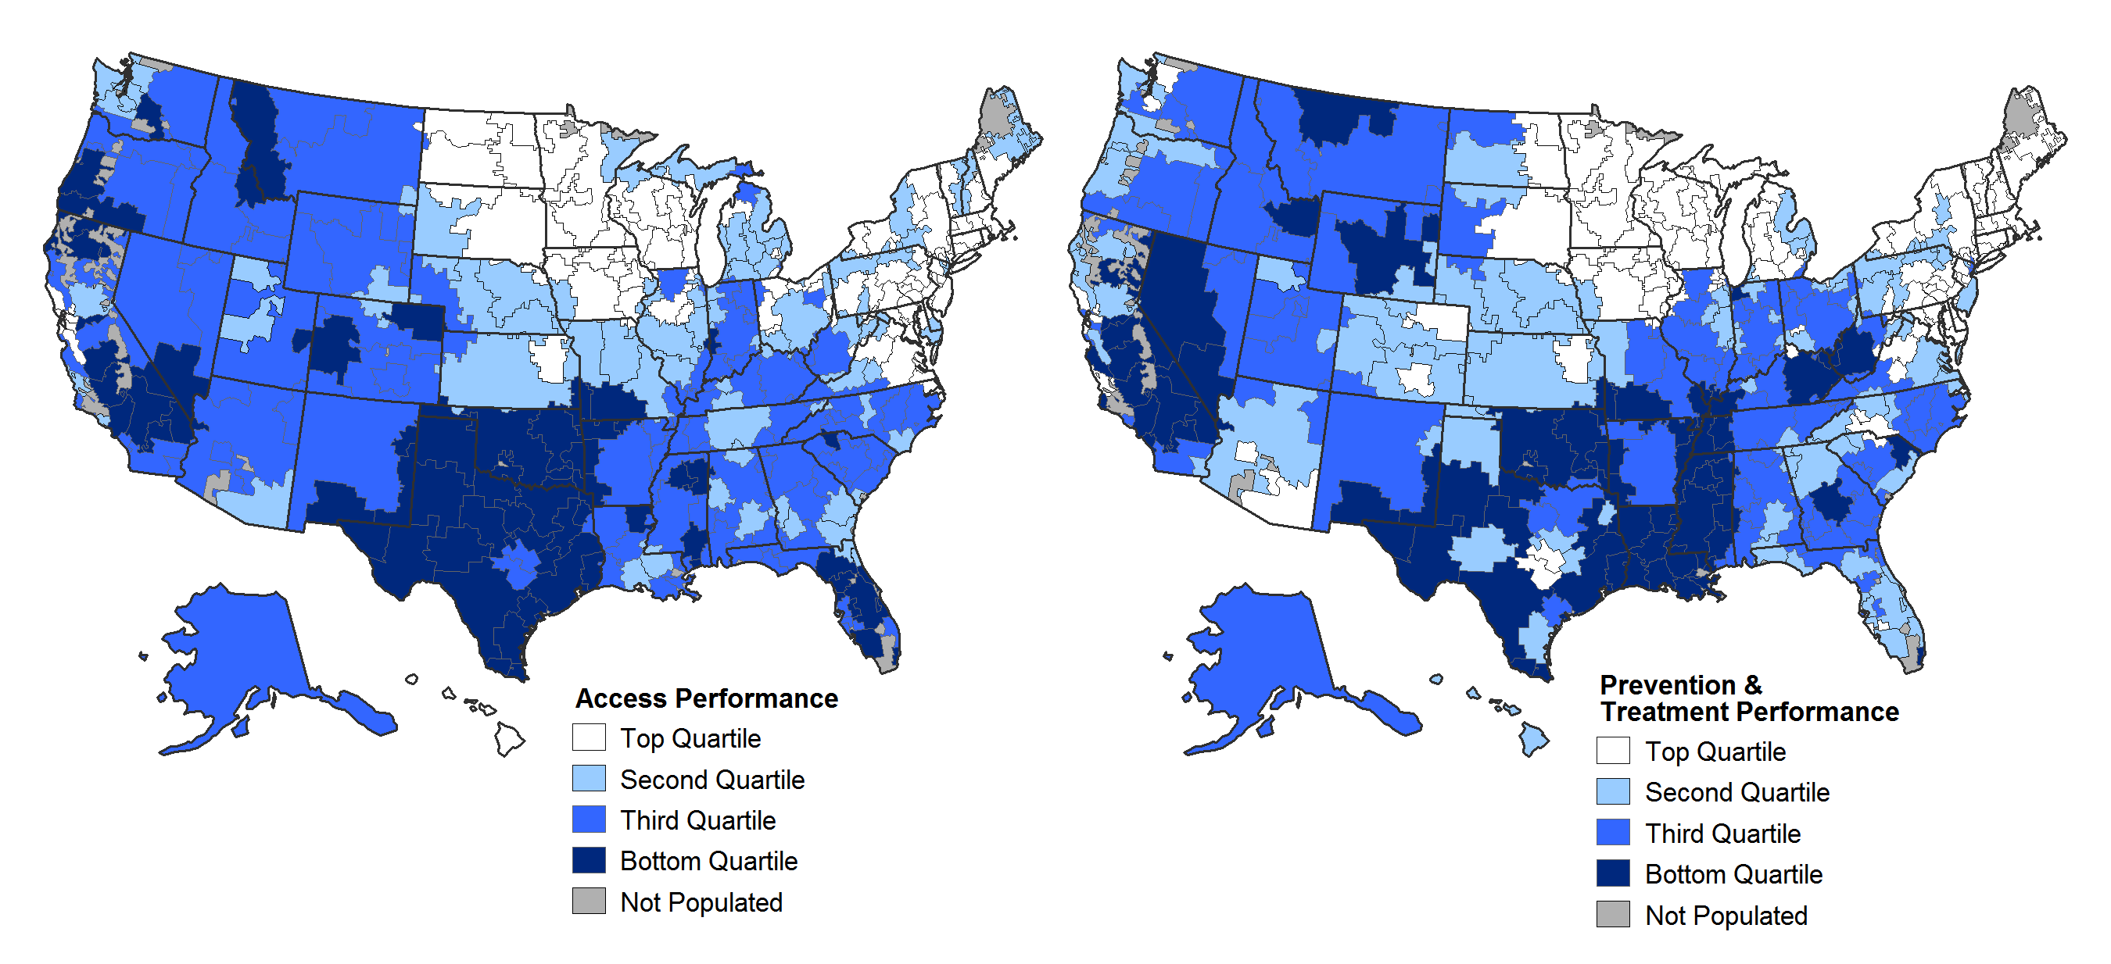
Better Access is Associated with Better
Prevention & Treatment
Access
Overall Performance on Access
Overall Performance on Prevention & Treatment
SOURCE: Commonwealth Fund Local Scorecard on Health System Performance, 2012

Slide 9
Performance Varies Among Top-Ranked Local Areas in Prevention & Treatment
Prevention & Treatment
SOURCE: Commonwealth Fund Local Scorecard on Health System Performance, 2012

Slide 10
Usual Source of Care and Preventive Care
Prevention & Treatment
Percent
HRR = hospital referral region
DATA: Adults with usual source of care—2009-10 BRFSS; Adults received preventive care—2008 & 2010 BRFSS; Adult diabetic recommended care—2008-10 BRFSS
SOURCE: Commonwealth Fund Local Scorecard on Health System Performance, 2012

Slide 11
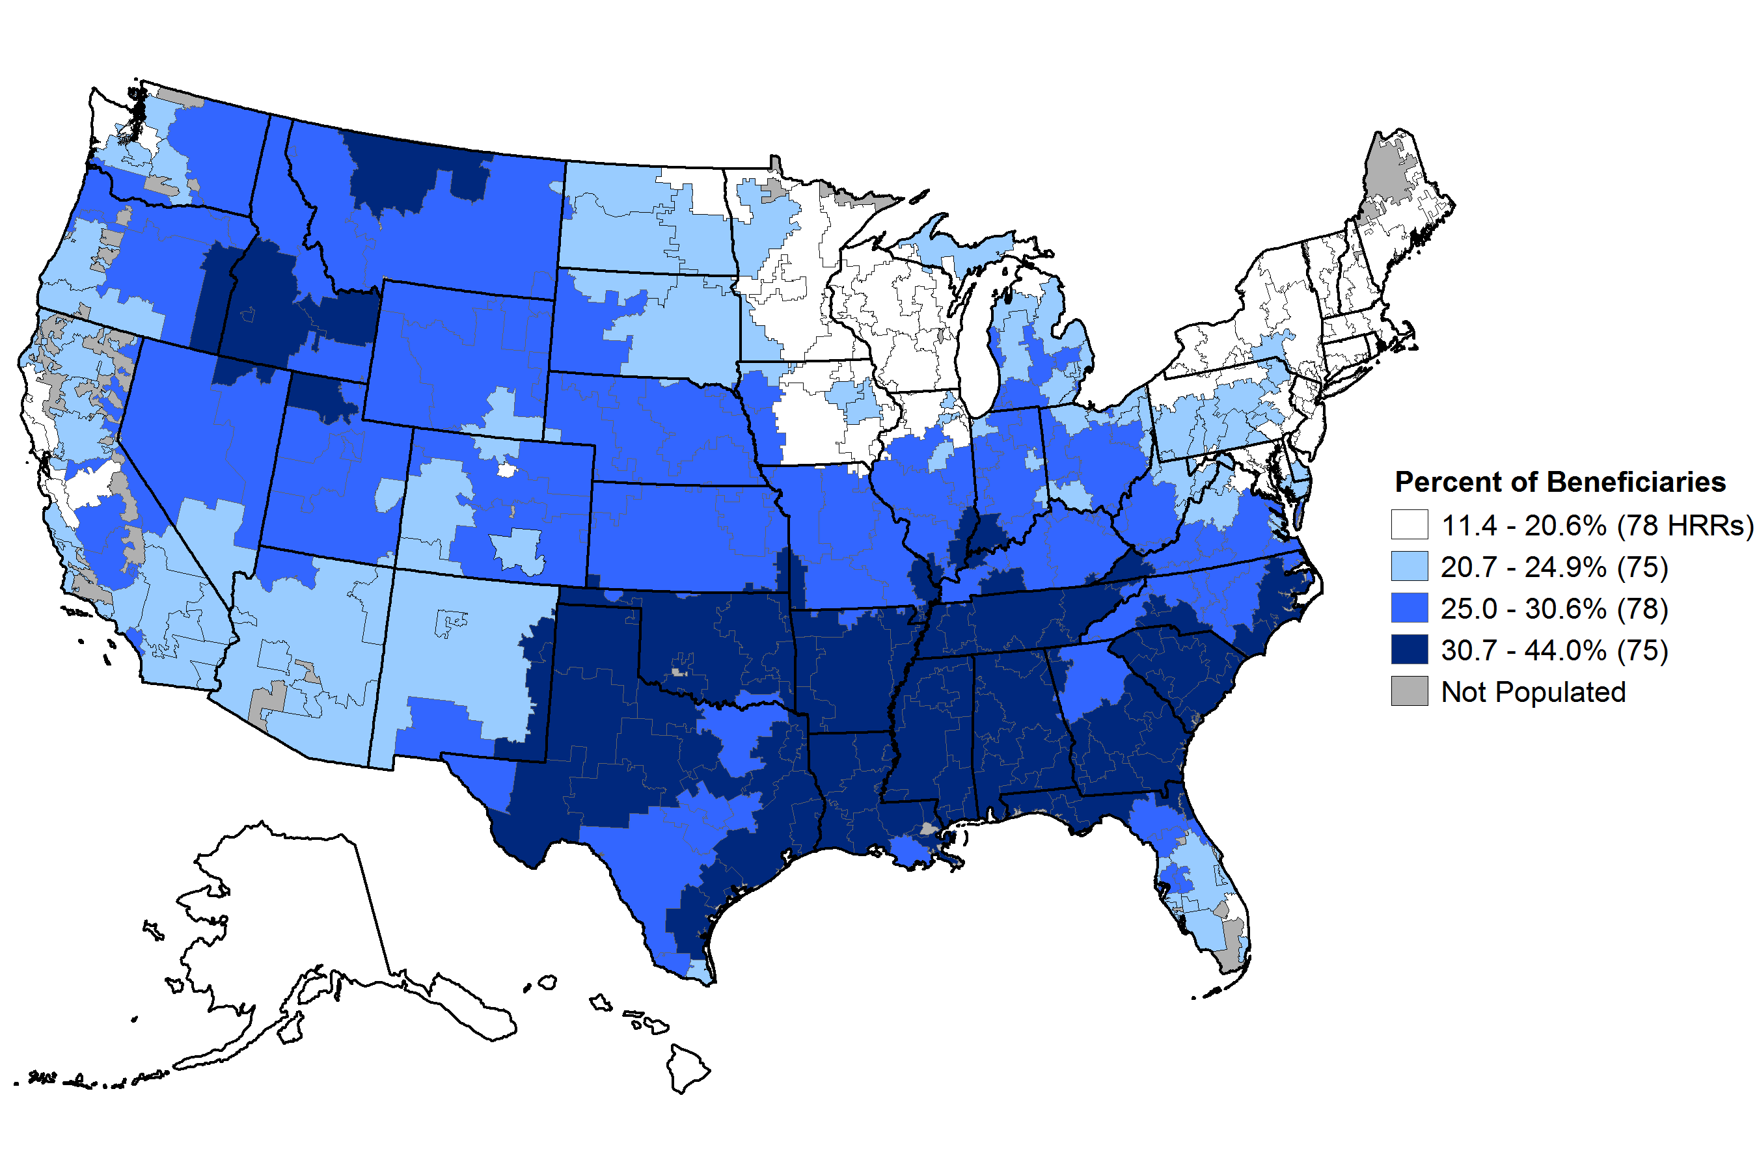
Prescription of Potentially Unsafe Medications, Medicare Beneficiaries 2007
Prevention & Treatment
HRR = hospital referral region
DATA: 2007 Medicare Part D 5% Data. Beneficiaries who received at least one drug that should be avoided for the elderly.
SOURCE: Commonwealth Fund Local Scorecard on Health System Performance, 2012

Slide 12
Hospital Clinical Care and Responsiveness to Patients
Prevention & Treatment
Percent
HRR = hospital referral region
DATA: 2010 CMS Hospital Compare
SOURCE: Commonwealth Fund Local Scorecard on Health System Performance, 2012

Slide 13
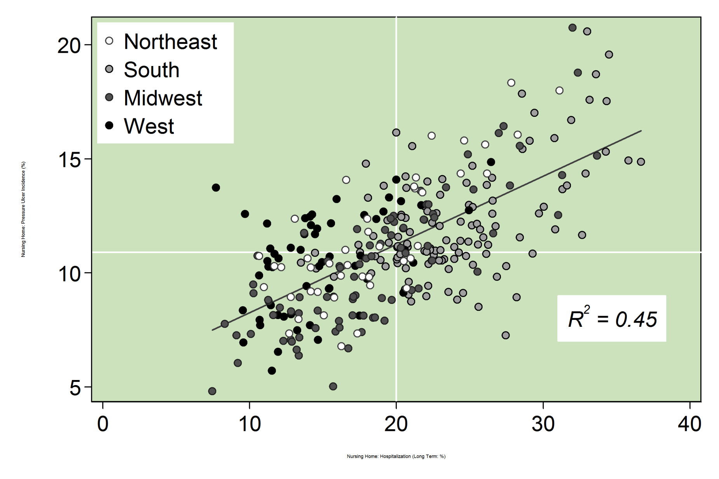
Nursing Home Pressure Sores and Admission to Hospital from Nursing Homes
Prevention & Treatment
High-risk nursing home residents with pressure sores (%)
Long-stay nursing home residents with a hospital admission (%)
HRR = hospital referral region
DATA: Residents with pressure sores—2008-09 MDS; Residents with hospital admission—2008 MEDPAR, MDS
SOURCE: Commonwealth Fund Local Scorecard on Health System Performance, 2012

Slide 14
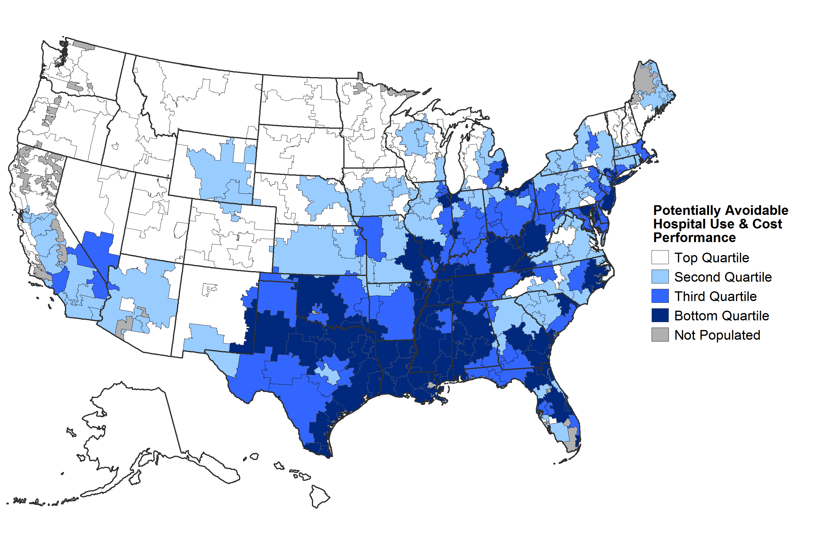
Overall Performance on Potentially Avoidable Hospital Use & Cost
Potentially Avoidable Hospital Use & Cost
SOURCE: Commonwealth Fund Local Scorecard on Health System Performance, 2012

Slide 15
Potentially Avoidable Hospital Admissions
Potentially Avoidable Hospital Use & Cost
Percent
HRR = hospital referral region
DATA: Readmissions within 30 days of discharge—2008 Medicare claims as reported by IOM; long-stay nursing home residents hospitalized—2008 MEDPAR, MDS; Home health care patients with hospital admission—2010-11 OASIS as reported by CMS Home Health Compare.
SOURCE: Commonwealth Fund Local Scorecard on Health System Performance, 2012

Slide 16
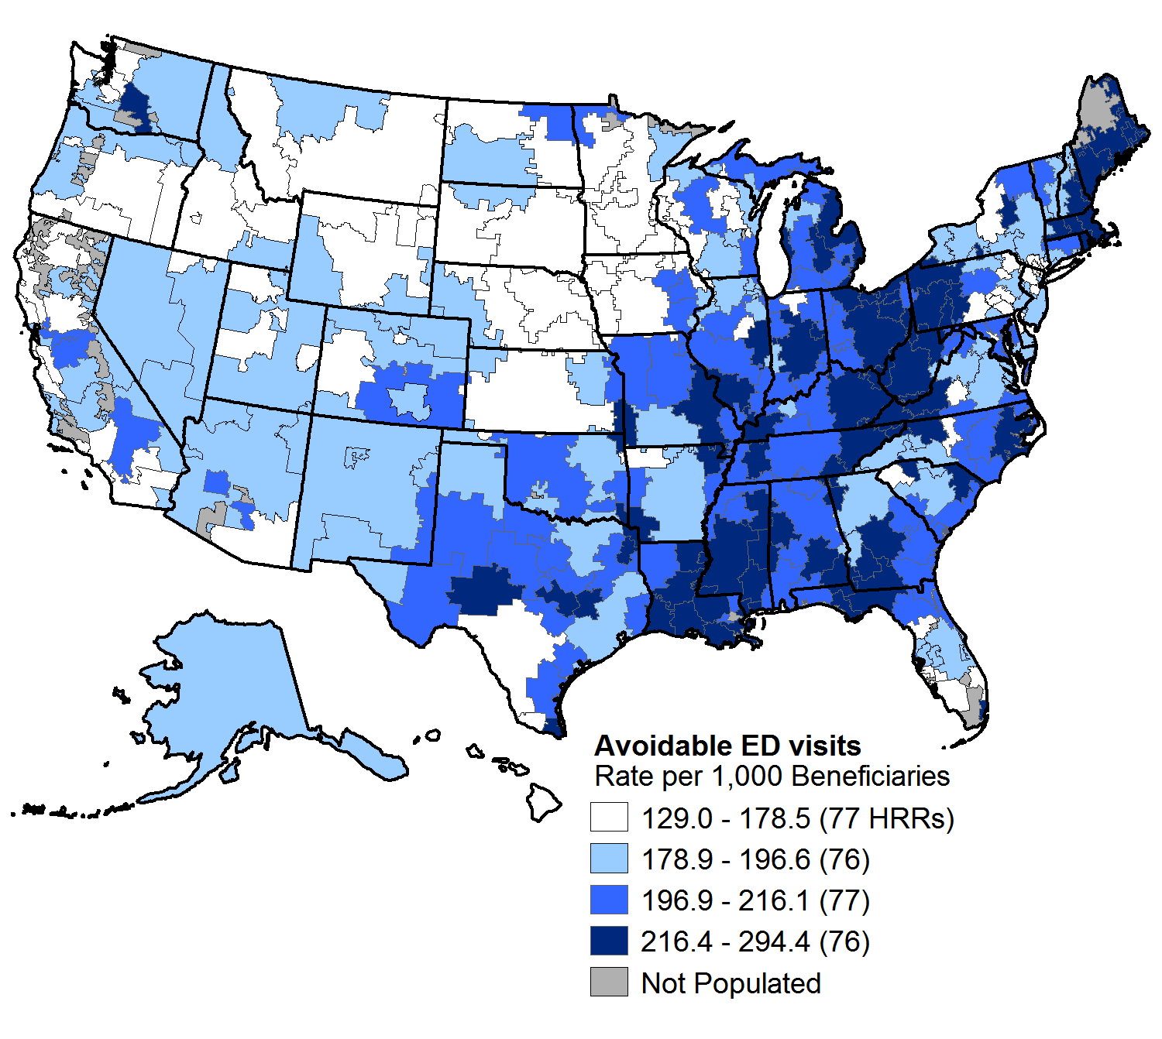
Potentially Avoidable Emergency Department (ED) Use Among Medicare Beneficiaries
Potentially Avoidable Hospital Use & Cost
All ED Visits
Potentially Avoidable ED Visits
HRR = hospital referral region
DATA: 2009 5% Medicare SAF
NOTE: Potentially avoidable emergency department (ED) visits are considered either non-emergent, where treatment was not required within 12 hours, or emergent but primary care treatable, where care was needed within 12 hours, but the service provided in the ED could have been provided in a primary care setting.
SOURCE: Commonwealth Fund Local Scorecard on Health System Performance, 2012

Slide 17
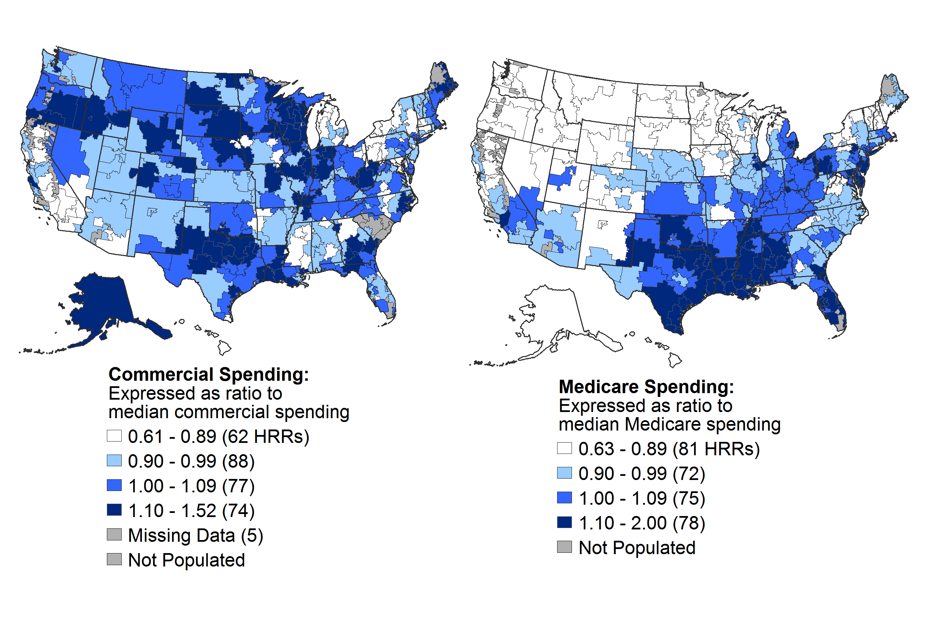
Commercially Insured and Medicare Spending per Enrollee, Relative to U.S. Median Spending for each population
Potentially Avoidable Hospital Use & Cost
HRR = hospital referral region
DATA: Commercial – 2009 Thomson Reuters MarketScan Database, analysis by M.Chernew, Harvard Medical School. Medicare – 2008 Medicare claims as reported by IOM . Ratio lower than 1.0 indicate percent lower than average; ratio higher than 1.0 indicate percent higher than average. Median spending determined separately for the commercially insured and Medicare populations
SOURCE: Commonwealth Fund Local Scorecard on Health System Performance, 2012

Slide 18
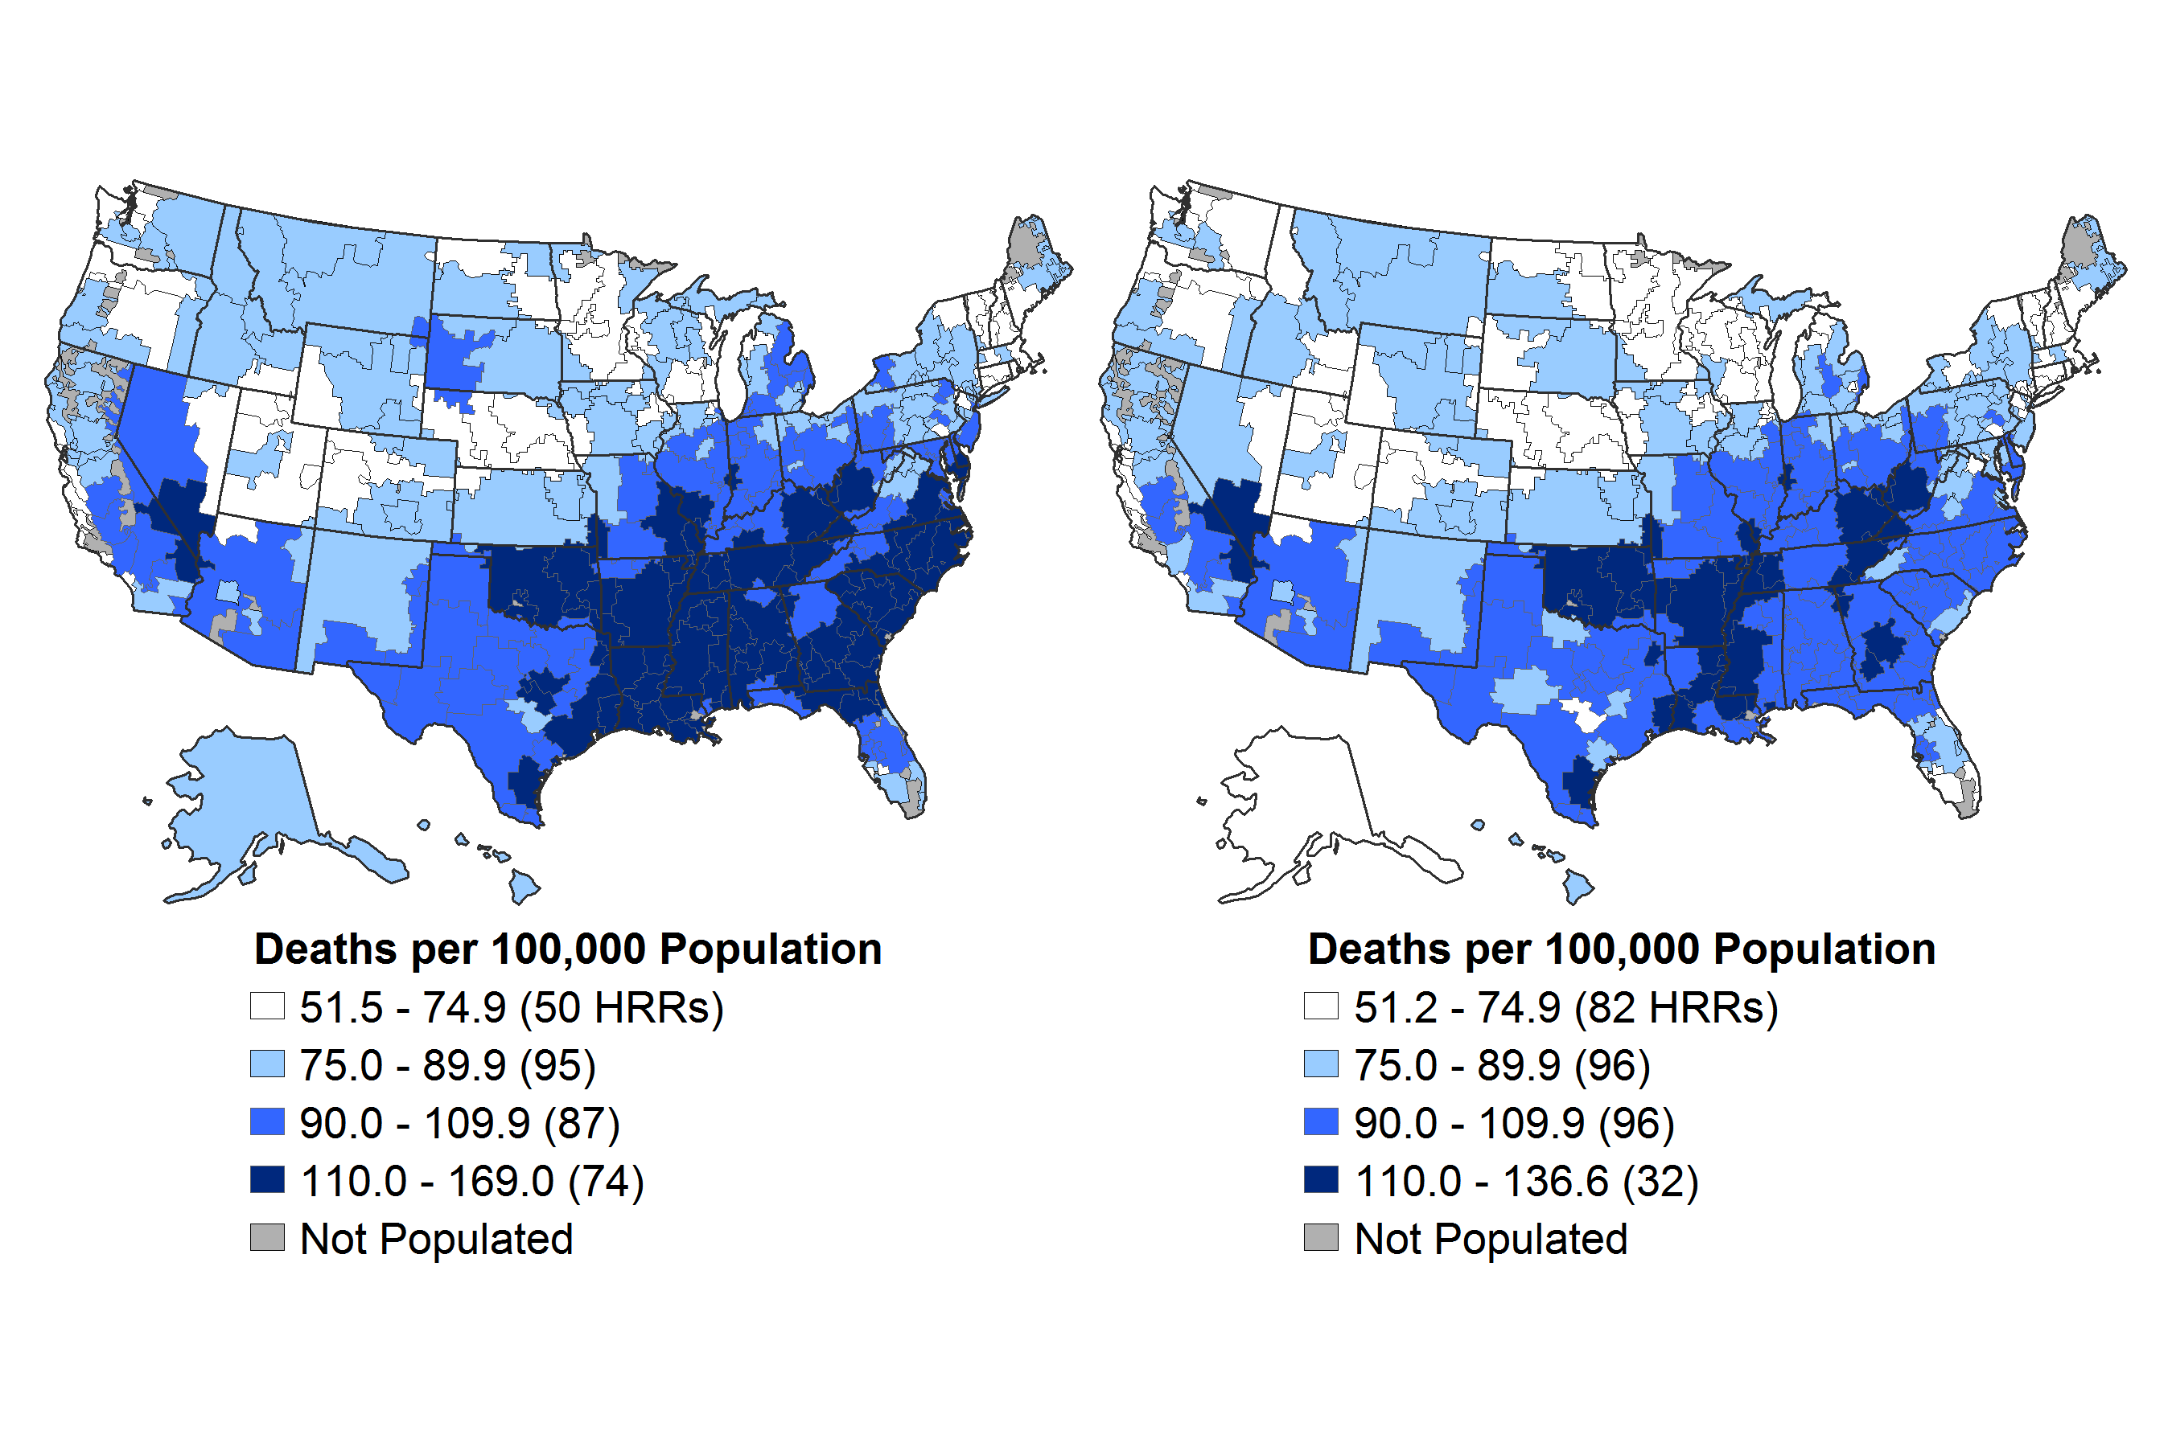
Mortality Potentially Preventable by Health Care
Deaths per 100,000 Population, 2005‒2007
Healthy Lives
All Races
White Race
HRR = hospital referral region
DATA: 2005-07 Vital statistics. Age-standardized death rates before age 75 for causes potentially preventable with timely effective care, including ischemic heart disease, diabetes, stroke, bacterial infections and screenable cancers.
SOURCE: Commonwealth Fund Local Scorecard on Health System Performance, 2012

Slide 19
Healthy Lives Indicators
Healthy Lives
Percent
HRR = hospital referral region
DATA: 2009-10 BRFSS
SOURCE: Commonwealth Fund Local Scorecard on Health System Performance, 2012

Slide 20
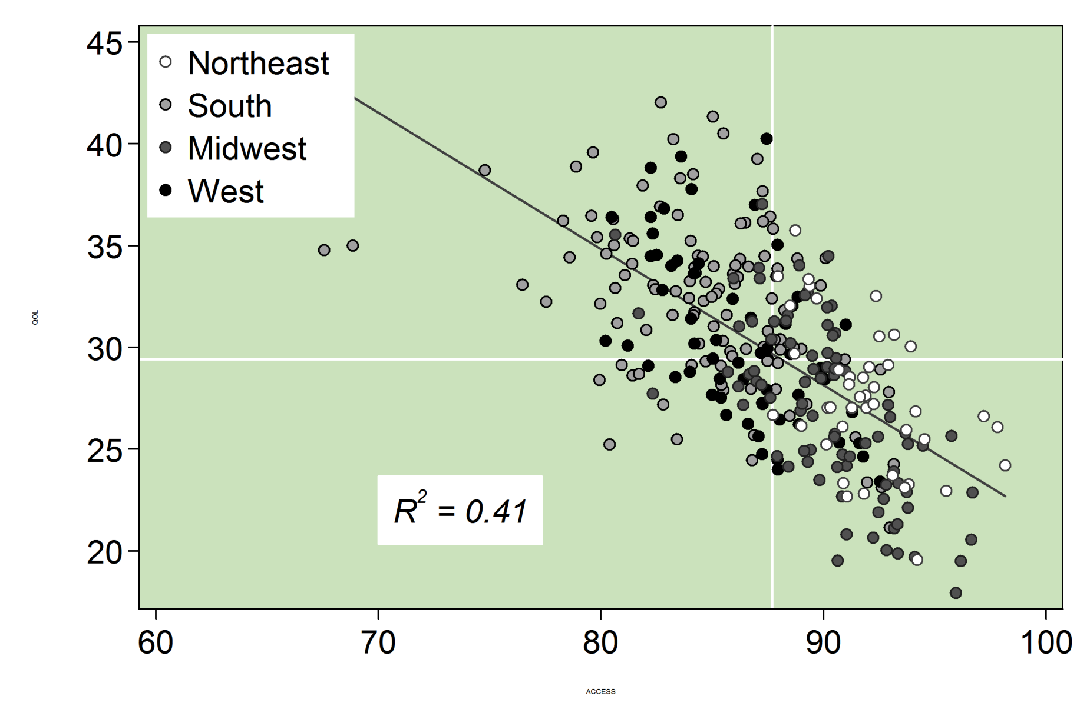
Better Access is Associated with fewer Adults Reporting Poor Health or Health-Related Limitations
Healthy Lives
People who report fair/poor health health-related activity limitations (%)
Access Score
HRR = hospital referral region
DATA: Adults Reporting Poor Health or Health-Related Limitations 2009-10 BRFSS
SOURCE: Commonwealth Fund Local Scorecard on Health System Performance, 2012

Slide 21
Poverty and Health System Performance
  High-poverty rates associated with worse access, lower rates of preventive care and poor health
    Better access should improve care, lives and health system performance for communities
Income not always predictive of performance
  Some low-income communities perform better than expected
  Some high-income communities perform worse than expected on care, costs and healthy lives
Link between income weakest for two dimensions:
  Prevention and Treatment
  Potentially Avoidable Hospital Use & Cost

Slide 22
National Gains if All Local Areas Achieved Top Rates of Performance
More people insured and with a primary care source:
  30 million more adults and children insured
  25 million more adults with a usual source of primary care
More receive recommended preventive care:
  9.4 million adults age 50+ would receive evidence-based preventive care, including cancer screenings and immunizations.
Less avoidable hospital use:
  1.4 million fewer Medicare hospital admissions and readmissions per year; potential savings of over $8 billion a year
Safer use of prescriptions drugs:
  1.3 million fewer Medicare beneficiaries would receive a potentially unsafe or inappropriate prescription

Slide 23
Summary and Implications
  Substantial opportunity to improve
    66 million people live in lowest performing areas; 156 million live in areas that perform below average
    Scorecard offers starting point to compare and inform strategic action to improve
    Within state variation points to potential of targeted action
  Affordable Care Act provides new resources and tools to support states and communities
    Access is foundation for care and healthier lives
    Preventive care, payment and information resources
    Opportunity to innovate; New State Authority
  Rising to the Challenge
    Cost pressures ever more urgent to take action to improve
    Local providers and community leaders have potential to improve care, health and costs performance

Slide 24
Rising to the Challenge: Results from a Scorecard on Local Health System Performance, 2012
Co-Authors
  David Radley, Sabrina K.H. How, Ashley-Kay Fryer, Douglas McCarthy, and Cathy Schoen
Released: March 13, 2012
http://www.commonwealthfund.org/Maps-and-Data/State-Data-Center/Local-Scorecard.aspx
  Profiles for all Local Areas
  Maps for each of 43 indicators
  Interactive benchmarking tools

Slide 25
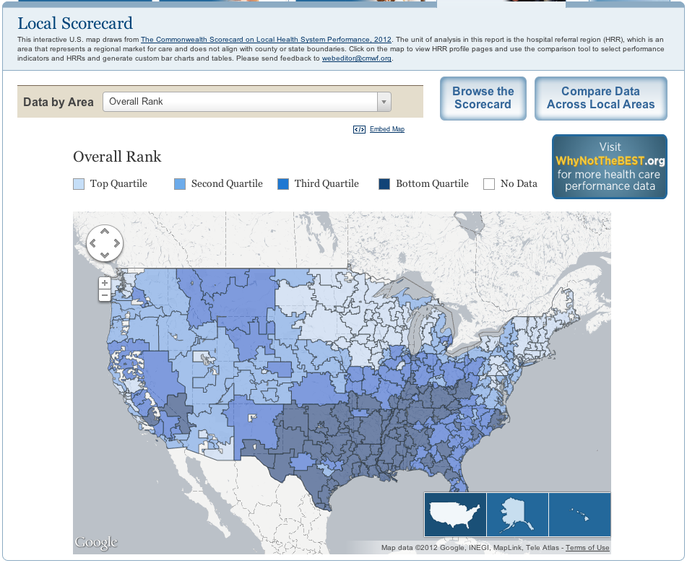
For More Information Visit the Fund’s
Web site at www.commonwealthfund.org

Slide 26
Local Health System Scorecard Methods
Goal: to stimulate discussion and collaboration and inform national, state and local action
Framework modeled on National and State Scorecards
  4 dimensions: access; prevention and treatment; avoidable hospital use and costs; and healthy lives
  43 indicators; national data generally 2008-2010
National data sources that use same definition and year for each indicator in all 306 local areas
  Local areas defined by referral patterns (Hospital Referral Region) rather than city or county political boundaries
Scoring
  Each indicator scored as ratio to the top 1%ile
  Dimensions Rank = average of indicator scores, then ranked
  Overall Rank = average of 4 dimension ranks

