Slide 1
How High Is America’s Health Care Cost Burden? Findings from the Commonwealth Fund Health Care Affordability Tracking Survey, July-August 2015
Sara R. Collins, Ph.D.
Vice President, Health Care Coverage and Access
The Commonwealth Fund
Media Teleconference
November 19, 2015

Slide 2
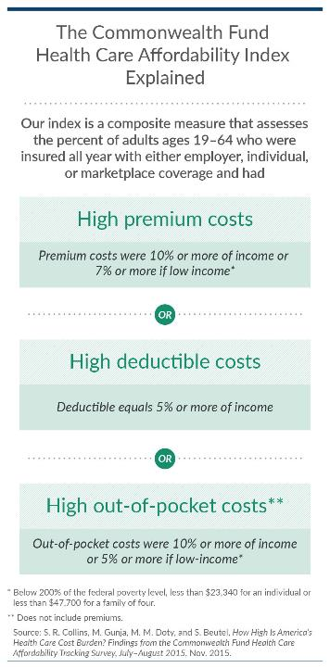
Exhibit 1.

Slide 3
Exhibit 2. Summary of Major Findings
The Commonwealth Fund Health Care Affordability Index indicates that one-quarter of privately insured, working-age adults had health insurance or health care costs that were unaffordable.
This estimate, which largely reflects the experience of adults in employer plans, is statistically unchanged from 2014.
There was an income divide in affordability: much larger shares of adults with low and moderate incomes had unaffordable costs compared to those with higher incomes.
When questioned about their own views of affordability, 25% of adults said it was difficult to afford their premiums, 43% said it was difficult to afford their deductibles.
People’s concerns about their ability to afford health care costs are leading many to delay needed health care or not fill prescriptions.
Many people appear to be confused about what is covered by their health plans; this confusion is affecting their medical decisions.

Slide 4
Exhibit 3. Health Care Affordability Index Explained
Percent of privately insured adults ages 19-64 who were insured all year*
*Private insurance includes adults with either employer, individual, or marketplace coverage
**Less than 200% of the Federal Poverty Level
Source: The Commonwealth Fund Health Care Affordability Tracking Survey, September-October 2014 and July-August 2015.

Slide 5
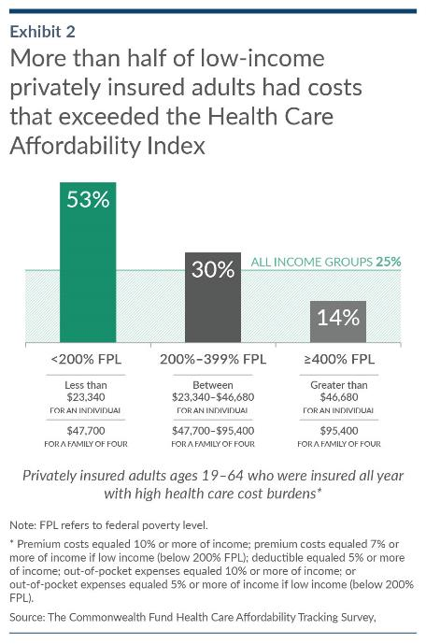
Exhibit 4.

Slide 6
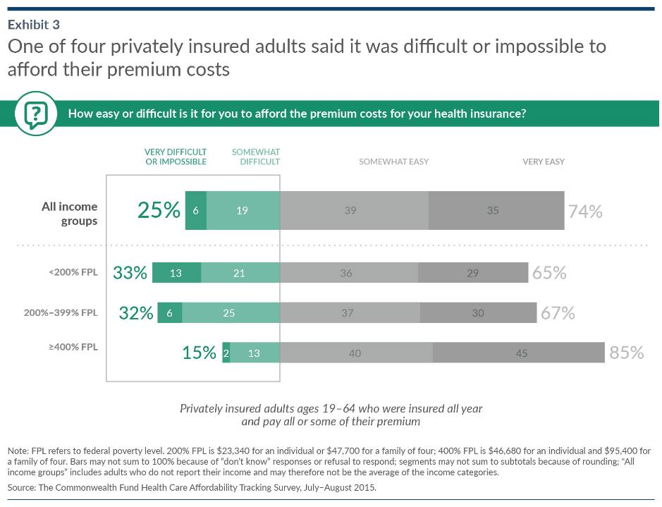
Exhibit 5.

Slide 7
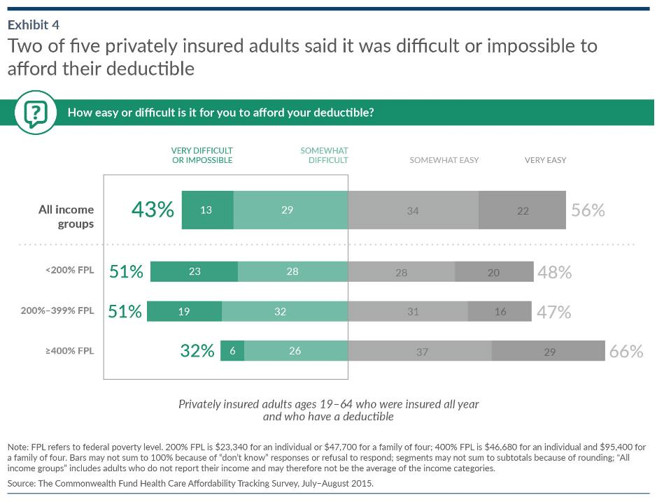
Exhibit 6.

Slide 8
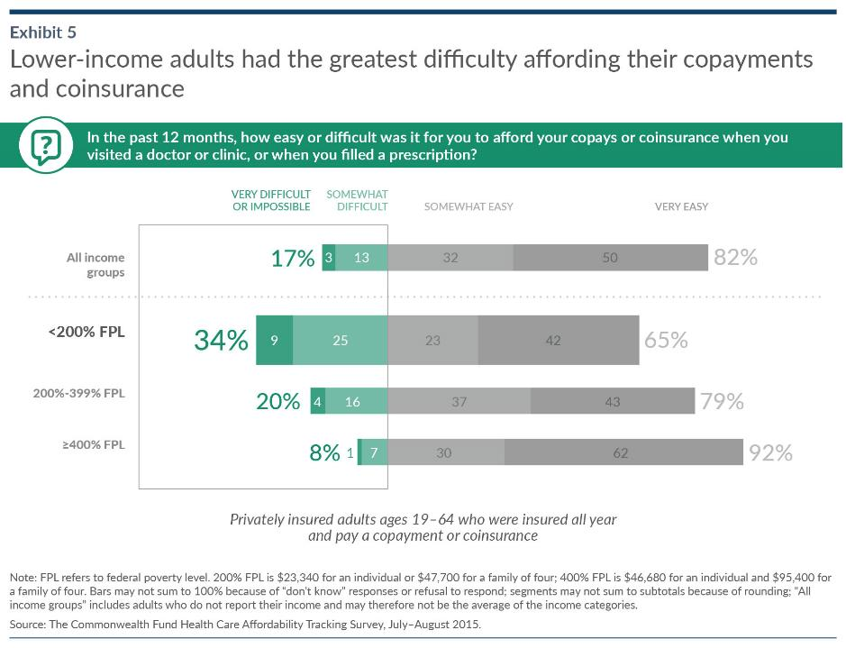
Exhibit 7.

Slide 9
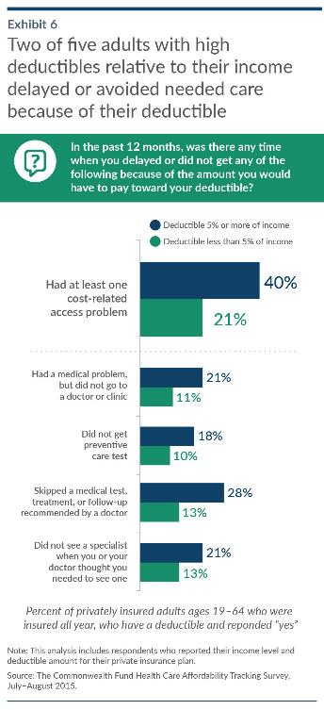
Exhibit 8.

Slide 10
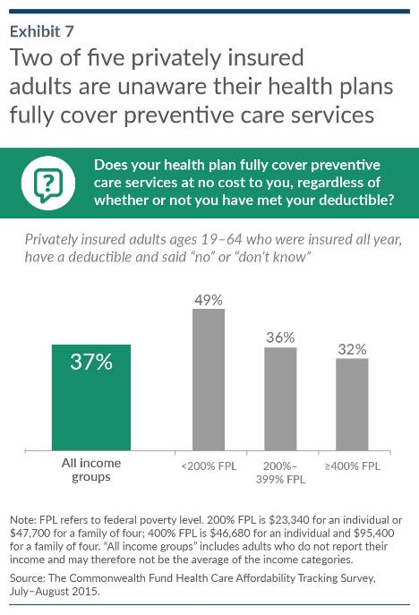
Exhibit 9.

Slide 11
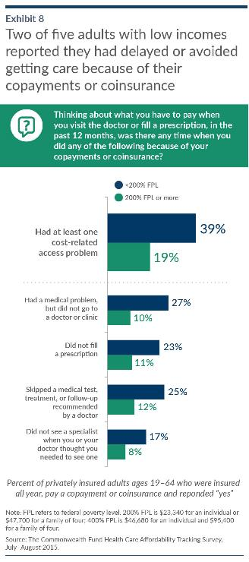
Exhibit 10.

Slide 12
Exhibit 11. Conclusions
The Commonwealth Fund Health Care Affordability Index indicates that one-quarter of working age adults with private health insurance had premiums, deductibles, or out-of-pocket costs that were unaffordable in 2014 and 2015.
A larger share of adults viewed key components of the index—premiums and deductibles—as more difficult to afford than the index would suggest.
Consumers’ perceptions of cost and their understanding of their health plans is affecting their health care decisions.
Nearly two of five adults didn’t know that preventive care services were free and excluded from their deductibles, and 18 percent said they had delayed getting a preventive care test because of their deductible.
Policies to simplify plan design and mitigate cost-burdens for low and moderate income families may be needed.

Slide 13
Exhibit 12. Survey Methodology
Conducted by SSRS from July 15 to August 9, 2015, as part of their weekly nationally representative Omnibus survey. This is the second wave of the survey. The first wave was conducted from September 10 to October 5, 2014.
15-minute telephone interviews in English and Spanish, among a random, nationally representative sample of 2,762 adults ages 19 to 64, living in the United States; 1,060 interviews were on landlines and 1,702 on cellular phones.
The data are weighted to adjust for the fact that not all survey respondents were selected with the same probabilities, the overlapping landline and cellular phone samples, and disproportionate nonresponse that might bias results.
Data are weighted to the U.S. 19-to-64 adult population by age, gender, race, region, marital status, education, and population density, based on the U.S. Census Bureau’s 2014 March Supplement to the Current Population Survey and household telephone use using the CDC’s National Health Interview Survey. The resulting weighted sample is representative of the approximately 190.7 million U.S. adults ages 19 to 64.
Overall margin of sampling error of +/-2.1 percentage points at the 95 percent confidence level.
Landline portion of the survey achieved a 10 percent response rate; cellular phone sample achieved a 5.5 percent response rate; overall response rate was 6.9 percent.

