Slide 1
Aiming Higher: Results from a Scorecard on State Health System Performance, 2017 edition
www.commonwealthfund.org
Media teleconference: March 15, 2017
Embargoed
until 12:01 am,
Thursday,
March 16

Slide 2
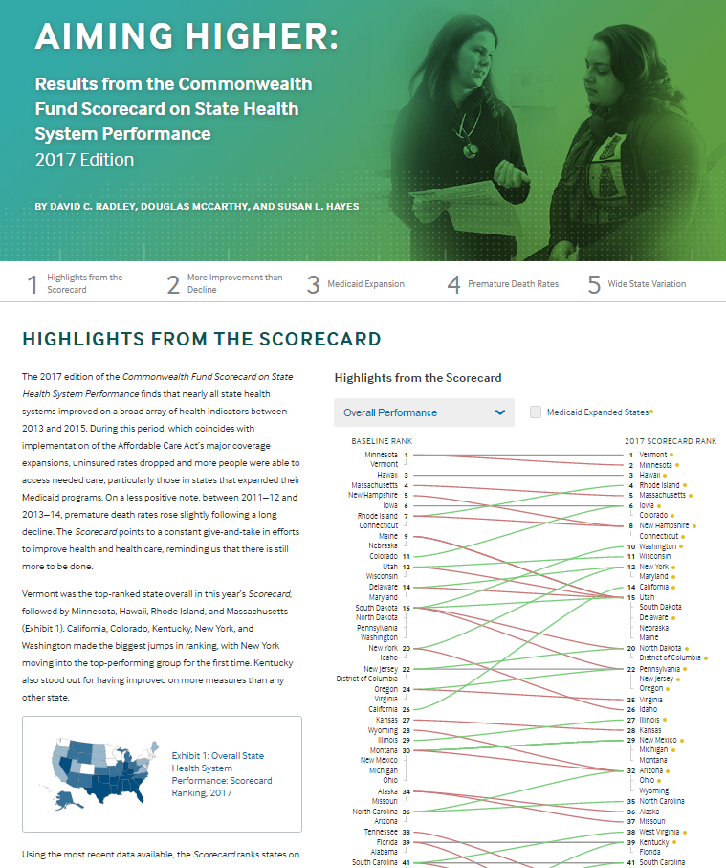

Aiming Higher: Results from a Scorecard on State Health System Performance, 2017 edition
Online interactive report
Printable version

Slide 3
Key Findings from the Scorecard
Widespread improvements in access to care, driven by reductions in uninsured rates following Affordable Care Act health insurance coverage expansions
States that expanded Medicaid saw the greatest gains in access to care
Almost all states improved on more performance indicators than they worsened
Premature death rates crept up in almost two-thirds of states
Wide variations persist: 3-fold difference, on average, between top- and bottom-performing states.
Top quartile (13 states)
Second quartile (11 states + D.C.)
Third quartile (13 states)
Bottom quartile (13 states)

Slide 4
Leading states offer targets to aim higher
Top Quartile
Second Quartile
Third Quartile
Bottom Quartile
Prevention & Treatment
Prevention & Treatment
Access & Affordability
Avoidable Hospital Use
Change in Overall Rank
Access & Affordability
Avoidable Hospital Use
Change in Overall Rank
Healthy Lives
Healthy Lives
Equity
Equity
States highlighted in green expanded their Medicaid programs under the Affordable Care Act as of Jan. 1 2015.

Slide 5
More improvement than decline
More indicators improved than worsened in almost all states
Kentucky and Oklahoma improved on the greatest number of indicators
All states improved on at least six indicators, but also worsened on at least one
Chart Notes: States highlighted in green expanded their Medicaid programs under the Affordable Care Act as of Jan. 1 2015. Based on trends for 39 of 44 total indicators; trend data are not available for all indicators. Improvement or worsening refers to a change between the baseline and current time periods of at least 0.5 standard deviations.

Slide 6
Widespread Gains in Access to Health Care, 2013-2015
Number of states that:
Improved
Had little or no change
Worsened
Adults
ages 19-64 uninsured
Children
ages 0-18 uninsured
Adults who went without care because of costs in the past year
Adults with
a usual source of care
At-risk adults with a routine doctor visit in past two years
Notes: For this exhibit, we count the District of Columbia as a state. “Improved” or “worsened” refers to a change between 2013 and 2015 of at least 0.5 standard deviations. “Little or no change” includes states with changes of less than 0.5 standard deviations as well as states with no change or without sufficient data to assess change. “Adults with a usual source of care” is an indicator in the Scorecard’s Prevention and Treatment dimension; it is included here because having a regular health care provider is associated with better access to care.
Data: Uninsured: U.S. Census Bureau, 2013 and 2015 1-Year American Community Surveys. Public Use Micro Sample (ACS PUMS). Cost Barriers, Doctor Visit, and Usual Source of Care: 2013 and 2015 Behavioral Risk Factor Surveillance System (BRFSS).

Slide 7
States that Expanded Medicaid Saw Greatest Reductions in Rates of Uninsured Working-Age Adults
percent
States that expanded Medicaid
as of January 1, 2015
States that had not expanded Medicaid as of January 1, 2015
2013
2015
Notes: States are arranged in rank order based on their uninsured rate in 2013. Alaska, Indiana, Louisiana, and Montana expanded their Medicaid programs after Jan. 1, 2015.
Data: U.S. Census Bureau, 2013 and 2015 One-Year American Community Surveys. Public Use Micro Sample (ACS PUMS).

Slide 8
States That Expanded Medicaid Experienced Greater Improvement in Health Care Access Among Low-Income Populations, 2013 to 2015
Average percentage-point change, 2013 to 2015
Uninsured adults
Adults who went without care because of costs
Adults without a regular
health care providerª
Medicaid-expansion states
(as of Jan. 1, 2015)
Nonexpansion states
Notes: Alaska, Indiana, Louisiana, and Montana expanded their Medicaid programs after Jan. 1, 2015. ªAdults with a usual source of care is reported elsewhere in the Scorecard, such that a higher value is favorable; for this exhibit, the share of “adults without a regular health care provider” is reported. Low income refers to household income <200% of the federal poverty level.
Data: Uninsured (ages 19-64): U.S. Census Bureau, 2013 and 2015 One-Year American Community Surveys. Public Use Micro Sample (ACS PUMS). Cost Barriers and Usual Source of Care (ages 18 and older): 2013 and 2015 Behavioral Risk Factor Surveillance System (BRFSS).

Slide 9
States with Highest Hospital Readmission Rates in 2012 Saw Large Improvements By 2014
Rate of 30-day hospital readmissions per 1,000 Medicare beneficiaries
2012
2014
U.S. average, 2012
34 per 1,000
U.S. average, 2014
27 per 1,000
Notes: States are arranged in order (lowest to highest) of their readmission rate in 2012.
*Denotes states with at least -0.5 standard deviation change (at least 5 fewer readmissions per 1,000) between 2012 and 2014.
Data: Medicare claims via Feb. 2016 CMS Geographic Variation Public Use File.

Slide 10
Widespread Patient Safety Gains in Doctors’ Offices and Hospitals
Number of states that:
Improved
Had little or no change
Worsened
Elderly Medicare beneficiaries who received a
high-risk prescription drug, 2012 to 2014
Central line-associated bloodstream infections (CLABSI), standardized infection ratio, 2013 to 2014
Notes: For this exhibit we count the District of Columbia as a state. “Improved” or “worsened” refers to a change between the baseline and current time periods of at least 0.5 standard deviations. “Little or no change” includes states with changes of less than 0.5 standard deviations as well as states with no change or without sufficient data to assess change.
Data: High-Risk Prescription Drug Use: 2012 and 2014 Medicare Part D 5% Sample. Analysis by Y. Zhang, University of Pittsburgh. CLABSI: Centers for Disease Control and Prevention, 2013 and 2014 National and State Healthcare-Associated Infections Progress Report.

Slide 11
After a Decade of Decline, Premature Death Rates from Treatable Conditions Flattened Between 2011/12 – 2013/14
Mortality amenable to health care: deaths per 100,000 population
Cumulative decline:
2004–2014
−5.8%
−5.1%
−3.7%
−8.1%
−1.3%
Black −22%
−5.3%
Annual % Change
−4.7%
−3.1%
−5.2%
−5.4%
0.2%
Total −17%
−4.4%
−2.9%
−3.7%
0.8%
White −15%
Data: 2003–2014 National Vital Statistics System (NVSS) Mortality All-County Micro Data Files.

Slide 12
African Americans More Likely than Whites to Die Early from Treatable Conditions in Every State, 2013–14
Mortality amenable to health care: deaths per 100,000 population
White
Black
U.S. average,
all races=
84.1 per 100,000
Notes: Data for black race not available for Idaho, Montana, New Hampshire, North Dakota, South Dakota, Vermont, or Wyoming. Data for Hispanic ethnicity not available for Maine, Montana, New Hampshire, North Dakota, South Dakota, Vermont, or West Virginia. States arranged in rank order based on black mortality.
Data: 2013 and 2014 National Vital Statistics System (NVSS) Mortality All-County Micro Data Files.

Slide 13
National Gains If All States Achieved Top Rates* of Performance
20 million | more adults and children insured, beyond those who already gained coverage through the ACA
14 million | fewer adults skipping care because of its cost
26 million | more adults with a usual source of care
12 million | more adults receiving recommended cancer screenings
513,000 | more young children receiving all recommended vaccines
1 million | fewer Medicare beneficiaries receiving a high-risk prescription drug
124,000 | fewer hospital readmissions among Medicare beneficiaries ages 65 and older
1.4 million | fewer emergency room visits for nonemergency care or conditions treatable with primary care
90,000 | fewer deaths before age 75 from treatable diseases
Note: *Performance benchmarks set at the level achieved by the top-performing state with available data for this indicator.

Slide 14
Summary and Implications
State gains brought about by Affordable Care Act (ACA) coverage expansions highlight the federal government’s role in helping to support State health system improvement
Five states that rose the most in overall rankings (Calif, Colo., Ky., N.Y., Wash.) each embraced the ACA by expanding Medicaid and implementing their own state-based insurance exchanges
Widespread state gains in access to care may be threatened by proposed repeal and replacement of the ACA
Wide range in performance among states and disparities in performance for vulnerable populations offer many opportunities for improvement: lower-ranked states have the most to gain
Every state has the opportunity to teach and learn

Slide 15
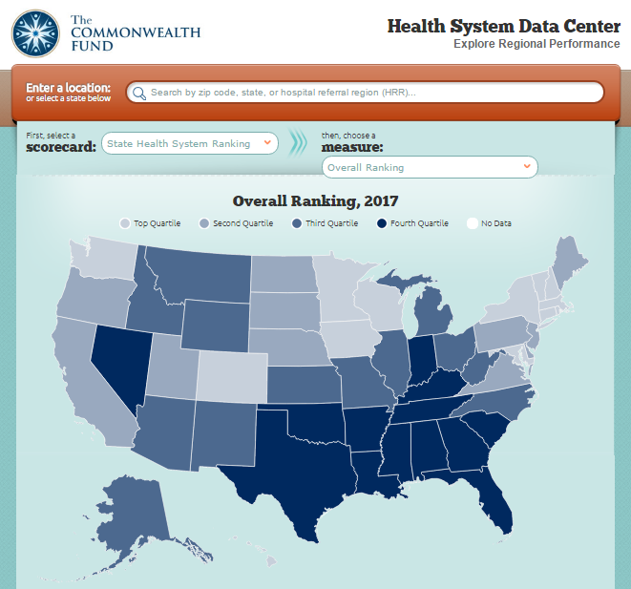
For More Information, Visit the Fund’s Health System Data Center: http://datacenter.commonwealthfund.org/

Slide 16
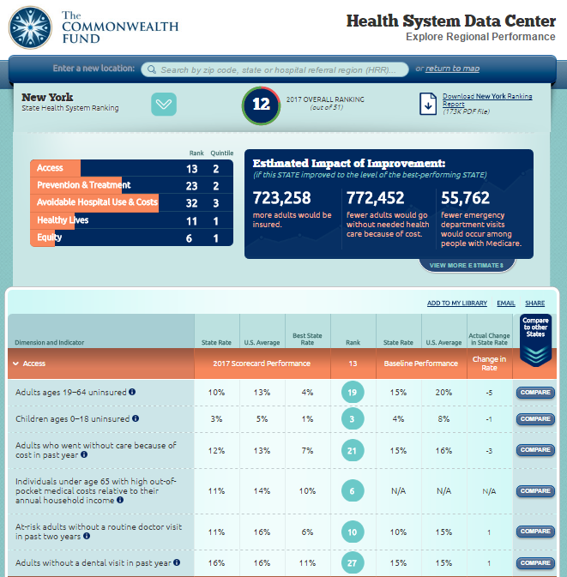
http://datacenter.commonwealthfund.org
Downloadable Profile
Standard Benchmarking tools
Customizable Benchmarking tools and comparisons

Slide 17
State Health System Scorecard Methods
Goal: to provide benchmarks and trends to inform national, state and local action to improve health care system performance
Health System Focus: Builds on previous Scorecards
  44 indicators organized into 4 dimensions
  Access/affordability; Prevention/treatment; Avoidable hospital use and costs; and Healthy lives
  Equity dimension assesses a subset of indicators by income and race/ethnicity within states
  National data sources including administrative claims, national surveys, and vital statistics available for states
1- to 2-year trend data available for 39 indicators
  Generally from 2013 to 2015, but varies by indicator
Scoring:
  Each indicator is ranked
  Dimension rank is based on average of indicator ranks
  Overall rank based on average of five dimension ranks
Estimated gains are based on rates of performance in the top performing state

