Slide 1
At lower incomes, enrollees have lower out-of-pocket limits and deductibles
Exhibit 1
Median out-of-pocket (OOP) limits and median deductible in states that use HealthCare.gov
Without cost-sharing reductions
With cost-sharing reductions
Out-of-pocket limit
Deductible
Annual income
Notes: Second-lowest-cost silver plans for 2016; 40-year-old male nonsmoker; largest city in state. The median includes 36 states that use the HealthCare.gov platform, excluding Alaska and Hawaii for the $17,000 category; 37 states that use the HealthCare.gov platform for the $20,000 category; and the 38 states that use the HealthCare.gov platform for the $25,000 and $35,000 categories.
Data: HealthCare.gov. Source: S. R. Collins, M. Gunja, and S. Beutel, How Will the Affordable Care Act’s Cost-Sharing Reductions Affect Consumers’ Out-of-Pocket Costs in 2016? The Commonwealth Fund, March 2016.

Slide 2
There is wide variation in deductibles across markets for silver plans
Exhibit 2
Highest, median, and lowest in-network deductible amounts in states that use HealthCare.gov
Without cost-sharing reductions*
With cost-sharing reductions
Highest
Median
Lowest
Annual income
Notes: Second-lowest-cost silver plans for 2016; 40-year-old male nonsmoker; largest city in state. The highest, median, and lowest amounts include 36 states that use the HealthCare.gov platform, excluding Alaska and Hawaii for the $17,000 category; 37 states that use the HealthCare.gov platform for the $20,000 category; and the 38 states that use the HealthCare.gov platform for the $25,000 and $35,000 categories.
* Minimum values are not displayed because the benchmark plan for Texas has a zero dollar deductible across all income levels.
Data: HealthCare.gov. Source: S. R. Collins, M. Gunja, and S. Beutel, How Will the Affordable Care Act’s Cost-Sharing Reductions Affect Consumers’ Out-of-Pocket Costs in 2016? The Commonwealth Fund, March 2016.

Slide 3
There is wide variation in out-of-pocket limits across markets for silver plans
Exhibit 3
Highest, median, and lowest out-of-pocket limits in states that use HealthCare.gov
Without cost-sharing reductions
With cost-sharing reductions
Highest
Median
Lowest
Annual income
Notes: Second-lowest-cost silver plans for 2016; 40-year-old male nonsmoker; largest city in state; The highest, median, and lowest amounts include 36 states that use the HealthCare.gov platform, excluding Alaska and Hawaii for the $17,000 category; 37 states that use the HealthCare.gov platform for the $20,000 category; and the 38 states that use the HealthCare.gov platform for the $25,000 and $35,000 categories.
Data: HealthCare.gov. Source: S. R. Collins, M. Gunja, and S. Beutel, How Will the Affordable Care Act’s Cost-Sharing Reductions Affect Consumers’ Out-of-Pocket Costs in 2016? The Commonwealth Fund, March 2016.

Slide 4
Cost-sharing reductions lower peoples’ projected out-of-pocket costs, especially for those who use health care the most
Exhibit 4
Median projected out-of-pocket costs
Without cost-sharing reductions
With cost-sharing reductions
“High” health care users
“Medium” health care users
“Low” health care users
Annual income
Notes: Second-lowest-cost silver plans for 2016; 40-year-old male nonsmoker; largest city in state. The median includes 36 states that use the HealthCare.gov platform, excluding Alaska and Hawaii for the $17,000 category; 37 states that use the HealthCare.gov platform for the $20,000 category; and the 38 states that use the HealthCare.gov platform for the $25,000 and $35,000 categories. OOP costs is either the difference between total expected costs and the annual premium cost to the enrollee, or the plan's out-of-pocket limit, whichever is lower.
Data: HealthCare.gov. Source: S. R. Collins, M. Gunja, and S. Beutel, How Will the Affordable Care Act’s Cost-Sharing Reductions Affect Consumers’ Out-of-Pocket Costs in 2016? The Commonwealth Fund, March 2016.

Slide 5
Variation in projected out-of-pocket costs across markets among “low” users of health care, for enrollees with incomes of $17,000
Exhibit 5a
Annual out-of-pocket costs
$0-$25
$26-$51
$52-$76
$77-$102
$103-$121
Notes: Second-lowest-cost silver plans for 2016; 40-year-old male nonsmoker; largest city in state. The amounts include 36 states that use the HealthCare.gov platform, excluding Alaska and Hawaii. OOP costs is either the difference between total expected costs and the annual premium cost to the enrollee, or the plan's out-of-pocket limit.
Data: HealthCare.gov. Source: S. R. Collins, M. Gunja, and S. Beutel, How Will the Affordable Care Act’s Cost-Sharing Reductions Affect Consumers’ Out-of-Pocket Costs in 2016? The Commonwealth Fund, March 2016.

Slide 6
Variation in projected out-of-pocket costs across markets among “medium” users of health care, for enrollees with incomes of $17,000
Exhibit 5b
Annual out-of-pocket costs
$0-$110
$111-$221
$222-$331
$332-$441
$442-$550
Notes: Second-lowest-cost silver plans for 2016; 40-year-old male nonsmoker; largest city in state. The amounts include 36 states that use the HealthCare.gov platform, excluding Alaska and Hawaii. OOP costs is either the difference between total expected costs and the annual premium cost to the enrollee, or the plan's out-of-pocket limit.
Data: HealthCare.gov. Source: S. R. Collins, M. Gunja, and S. Beutel, How Will the Affordable Care Act’s Cost-Sharing Reductions Affect Consumers’ Out-of-Pocket Costs in 2016? The Commonwealth Fund, March 2016.

Slide 7
Variation in projected out-of-pocket costs across markets among “high” users of health care, for enrollees with incomes of $17,000
Exhibit 5c
Annual out-of-pocket costs
$0-$450
$451-$901
$902-$1352
$1353-$1803
$1804-$2250
Notes: Second-lowest-cost silver plans for 2016; 40-year-old male nonsmoker; largest city in state. The amounts include 36 states that use the HealthCare.gov platform, excluding Alaska and Hawaii. OOP costs is either the difference between total expected costs and the annual premium cost to the enrollee, or the plan's out-of-pocket limit.
Data: HealthCare.gov. Source: S. R. Collins, M. Gunja, and S. Beutel, How Will the Affordable Care Act’s Cost-Sharing Reductions Affect Consumers’ Out-of-Pocket Costs in 2016? The Commonwealth Fund, March 2016.

Slide 8
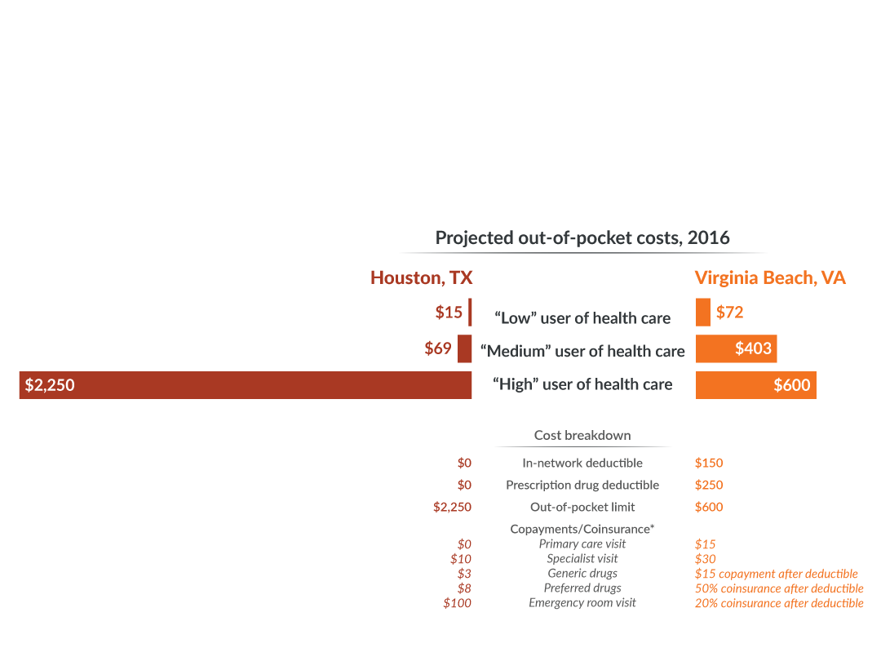
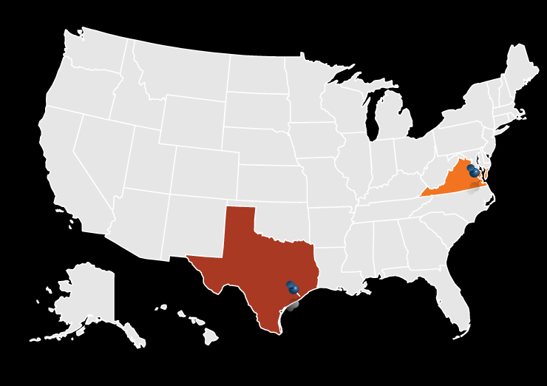
Silver plans in Houston, Texas, and Virginia Beach, Virginia, for enrollees with incomes of $17,000
Exhibit 6
Notes: Second-lowest-cost silver plans for 2016; 40-year-old male nonsmoker with an annual income of $17,000; largest city in state. OOP costs is either the difference between total expected costs and the annual premium cost to the enrollee, or the plan's out-of-pocket limit, whichever is lower.
* Copayments/Coinsurance are compared for only 5 of the services displayed on HealthCare.gov.
Data: HealthCare.gov. Source: S. R. Collins, M. Gunja, and S. Beutel, How Will the Affordable Care Act’s Cost-Sharing Reductions Affect Consumers’ Out-of-Pocket Costs in 2016? The Commonwealth Fund, March 2016.

Slide 9
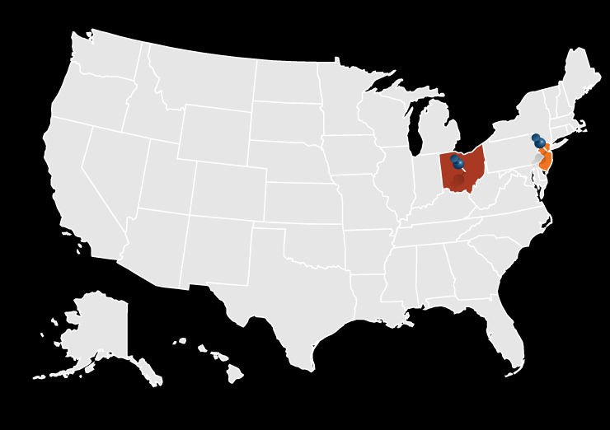
Silver plans in Columbus, Ohio, and Newark, New Jersey, for enrollees with incomes of $17,000
Exhibit 7
Notes: Second-lowest-cost silver plans for 2016; 40-year-old male nonsmoker with an annual income of $17,000; largest city in state. OOP costs is either the difference between total expected costs and the annual premium cost to the enrollee, or the plan's out-of-pocket limit, whichever is lower.
* Copayments/Coinsurance are compared for only 5 of the services displayed on HealthCare.gov.
Data: HealthCare.gov. Source: S. R. Collins, M. Gunja, and S. Beutel, How Will the Affordable Care Act’s Cost-Sharing Reductions Affect Consumers’ Out-of-Pocket Costs in 2016? The Commonwealth Fund, March 2016.

