Slide 1
Change in Probability That Out-of-Pocket Spending Equals or Exceeds Thresholds as Marketplace Enrollment Increases
Exhibit 3
As enrollment increases from 0% to 2.6% of population, adjusted for changing population characteristics
Pre-ACA, $500 threshold
Post-ACA, $500 threshold
Pre-ACA, $2,000 threshold
Post-ACA, $2,000 threshold
Pre-ACA, $5,000 threshold
Post-ACA, $5,000 threshold
Percent
Notes: Average marketplace enrollment in June 2014 was 2.6 percent of the adult population. Regression models adjust for marketplace enrollment rate (the number of individuals enrolled divided by the total adult population), state Medicaid expansion status (year interacted with whether a state had expanded Medicaid), and year, and control for age, work status, gender, education level, marital status, and state dummies.
Data: Current Population Surveys, 2010–2014, and Charles Gaba, 2016.
Source: S. Glied, C. Solís-Román, and S. Parikh, How the ACA’s Health Insurance Expansions Have Affected Out-of-Pocket Cost-Sharing and Spending on Premiums, The Commonwealth Fund, September 2016.

Slide 2
Change in Probability That Combined Out-of-Pocket and Premium Spending Equals or Exceeds Thresholds as Marketplace Enrollment Increases
Exhibit 4
As enrollment increases from 0% to 2.6% of population, adjusted for changing population characteristics
Pre-ACA, $500 threshold
Post-ACA, $500 threshold
Pre-ACA, $2,000 threshold
Post-ACA, $2,000 threshold
Pre-ACA, $5,000 threshold
Post-ACA, $5,000 threshold
Percent
Notes: Average marketplace enrollment in June 2014 was 2.6 percent of the adult population. Regression models adjust for marketplace enrollment rate (the number of individuals enrolled divided by the total adult population), state Medicaid expansion status (year interacted with whether a state had expanded Medicaid), and year, and control for age, work status, gender, education level, marital status, and state dummies.
Data: Current Population Surveys, 2010–2014, and Charles Gaba, 2016.
Source: S. Glied, C. Solís-Román, and S. Parikh, How the ACA’s Health Insurance Expansions Have Affected Out-of-Pocket Cost-Sharing and Spending on Premiums, The Commonwealth Fund, September 2016.

Slide 3
Effects of Economic, Health System, and Nonmarketplace Enrollment Changes on Probability That Combined Out-of-Pocket and Premium Spending Equals or Exceeds Thresholds Between 2013 and 2014
Exhibit 5
Pre-ACA, $500 threshold
Post-ACA, $500 threshold
Pre-ACA, $2,000 threshold
Post-ACA, $2,000 threshold
Pre-ACA, $5,000 threshold
Post-ACA, $5,000 threshold
Percent
Notes: Average marketplace enrollment in June 2014 was 2.6 percent of the adult population. Regression models adjust for marketplace enrollment rate (the number of individuals enrolled divided by the total adult population), state Medicaid expansion status (year interacted with whether a state had expanded Medicaid), and year, and control for age, work status, gender, education level, marital status, and state dummies. Estimates based on 2014 year dummy (compared to 2013).
Data: Current Population Surveys, 2010–2014, and Charles Gaba, 2016.
Source: S. Glied, C. Solís-Román, and S. Parikh, How the ACA’s Health Insurance Expansions Have Affected Out-of-Pocket Cost-Sharing and Spending on Premiums, The Commonwealth Fund, September 2016.

Slide 4
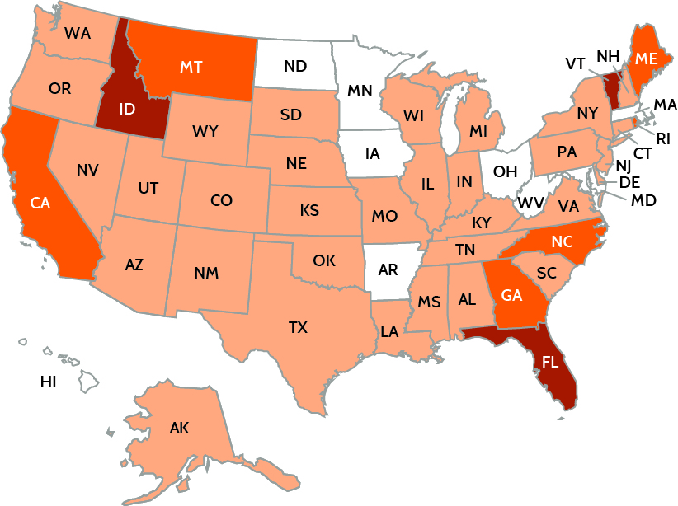
Reduction in Probability That Out-of-Pocket Health Spending Equals or Exceeds $2,000 as Marketplace Enrollment Rate Increases
Exhibit 6
As enrollment rate increases from zero to state rate in 2014, adjusted for changing population characteristics
Percentage-point reduction
1.50%+
1.00%–1.49%
0.50%–0.99%
<0.50%
Note: Coefficients on marketplace enrollment rates from regressions are multiplied by each state's average marketplace enrollment rate (2.6% is the national average) to provide adjusted reduction in probability of spending at or above threshold.
Data: Current Population Survey, 2014, and Charles Gaba, 2016.
Source: S. Glied, C. Solís-Román, and S. Parikh, How the ACA’s Health Insurance Expansions Have Affected Out-of-Pocket Cost-Sharing and Spending on Premiums, The Commonwealth Fund, September 2016.

